Slide 1

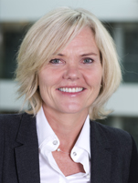
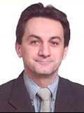
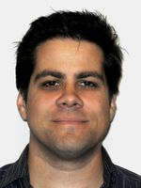
Seminar on WIPO Services and Initiatives
Porto, Portugal
May 08, 2014

Slide 2


Speaker: Mr. Victor Vazquez Lopez, Section for Coordination of Developed Countries, Department for Transition and Developed Countries (TDC), WIPO

Slide 3
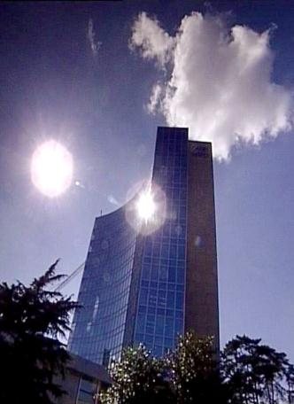
BASICS FACTS ABOUT WIPO
WIPO’s MISSION: To promote the protection of IP rights worldwide and extend the benefits of the international IP system to all member states.
MEMBER STATES: 186
OBSERVERS : + 390
STAFF : 950 FROM 101 COUNTRIES
ADMINISTERED TREATIES : 26
MAIN ORGANS/BODIES : GA, CC, WIPO CONFERENCE

Slide 4
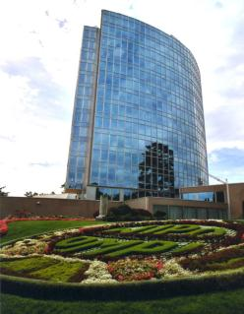
MILESTONES: 1883 - 2013
2013
MARRAKESH TREATY
2012
2006
BEIJING TREATY
2000
STLT
1996
PATENT LAW TREATY
INTERNET TREATIES
1989
MADRID PROTOCOL
1970
PCT ESTABLISHED
1967
1960
WIPO CONVENTION
1925
BIRPI MOVES TO GENEVA
1893
HAGUE AGREEMENT
1891
BIRPI
1886
1883
MADRID AGREEMENT
BERNE CONVENTION
PARIS CONVENTION

Slide 5
INTELLECTUAL PROPERTY : OUTREACH
PUBLIC SECTOR & POLICY MAKERS
BUILDING AWARENESS
INTELLECTUAL PROPERTY OFFICES
GENERAL PUBLIC & CIVIL SOCIETY

Slide 6

WIPO’s MAIN ACTIVITIES
Economic Development
Norm Setting
Global Infrastructure
Services to Industry

Slide 7
WIPO … PROVIDER OF PREMIER GLOBAL IP SERVICES
Core income generating business areas:
  Patent Cooperation Treaty (Patents)
  Madrid System (Trademarks)
  Hague System (Industrial Designs)
  Lisbon System (Geographical Indications)
  WIPO Arbitration and Mediation Center
AIM : to be the first choice for users by continuing to offer cost-effective and value-added services
Notes:
Patent law differs from country to country. It can be a costly, complex and lengthy process to obtain patent protection in multiple countries. WIPO’s global protection services offer a swift, reliable cost-effective and user-friendly option. Principle objective of PCT is operational excellence and provision of high quality services to benefit users of patent system, patent administrations and general public by streamlining the filing and processing of patent applications in multiple countries (through reduced duplication of work of national filing and processing) to make the grant of patents more economical (ie less diversion of public resources for patent admin.)
Emphasis on ensuing PCT beneficiaries receive adequate knowledge of system and that the system responds satisfactorily to their needs.
TRADEMARKS: In constantly changing business environment, TMs, etc. are important tools for promotion of domestic commerce and int’l. trade which, in turn, contribute to sustainable national economic growth. Indispensable in designing marketing strategies to identify and promote goods in market place and distinguish these goods from those of competitors. To be effective, need adequate legal protection at national & int’l. levels. WIPO’s registration systems facilitate the acquisition and maintenance of these IPRs in different countries
A company in Morocco requesting TMP in 12 countries - application in 3 classes would pay over 6.5 times more if it didn't use MS but opted to apply to each national office separately -Madrid = 2,162 CHF; vs. 14,245 CHF using national route). Renewal of same app. = 5+ times cheaper and cost of registering a change in ownership is 20+ times cheaper, costing 177 Swiss francs as opposed to 3,697 Swiss francs under the national route.
Patent law differs from country to country. It can be a costly, complex and lengthy process to obtain patent protection in multiple countries. WIPO’s global protection services offer a swift, reliable cost-effective and user-friendly option. Principle objective of PCT is operational excellence and provision of high quality services to benefit users of patent system, patent administrations and general public by streamlining the filing and processing of patent applications in multiple countries (through reduced duplication of work of national filing and processing) to make the grant of patents more economical (i.e. less diversion of public resources for patent admin.)
Emphasis on ensuing PCT beneficiaries receive adequate knowledge of system and that the system responds satisfactorily to their needs.
TRADEMARKS: In constantly changing business environment, TMs, etc. are important tools for promotion of domestic commerce and int’l. trade which, in turn, contribute to sustainable national economic growth. Indispensable in designing marketing strategies to identify and promote goods in market place and distinguish these goods from those of competitors. To be effective, need adequate legal protection at national & int’l. levels. WIPO’s registration systems facilitate the acquisition and maintenance of these IPRs in different countries
A company in Morocco requesting TMP in 12 countries - application in 3 classes would pay over 6.5 times more if it didn't use MS but opted to apply to each national office separately -Madrid = 2,162 CHF; vs. 14,245 CHF using national route). Renewal of same app. = 5+ times cheaper and cost of registering a change in ownership is 20+ times cheaper, costing 177 Swiss francs as opposed to 3,697 Swiss francs under the national route.

Slide 8
WIPO’s MAIN SOURCES OF REVENUE

Slide 9
GLOBAL IP INFRASTRUCTURE
WIPO is coordinating with stakeholders to develop tools, services, platforms, standards, etc. that enable IP institutions to work :
  EFFICIENTLY
  PROVIDE BETTER
  HIGH QUALITY SERVICES
Notes:
“Just as participation in the physical economy requires access to roads, bridges, and vehicles to transport goods, similar infrastructure is needed in the virtual and knowledge economy. However, here the highway is the Internet and other networks, bridges are interoperable data standards, and vehicles are computers and databases.”
WIPO DIRECTOR GENERAL, FRANCIS GURRY

Slide 10
GLOBAL IP INFRASTRUCTURE
WIPO coordinates with stakeholders to develop tools, services, platforms, standards, that enhance the performance of IP institutions
INFRASTRUCTURE INCLUDES :
Databases (PATENTSCOPE, Global Brand DB, Global Design DB (coming soon))
Common platform for e-data exchange among IPOs (WIPO CASE for Global Patent Dossier, the Digital Access Service).
Tools (international classifications in Patents, TMs, Design)
Standards & technical agreements
Assistance & Services for IPOs technical infrastructure (IPAS software)

Slide 11
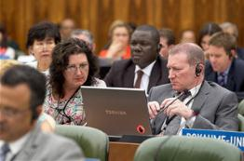

NORM SETTING
AIM → Progressive development of international IP law for an IP system that is:
  balanced/responsive to emerging needs
  effective in encouraging innovation/creativity
  sufficiently flexible to accommodate national policy objectives
Topical issues reviewed/discussed in Standing Committees

Slide 12


NORM SETTING
WIPO treaties are often closely connected to infrastructure and services:
  Treaties that provide legal support to international infrastructure and services: PCT, Madrid.
  Business simplification treaties, which simplify the operation of national infrastructure and services: Singapore Treaty on the Law of Marks (2006), Patent Law Treaty ( 2000)

Slide 13
STANDING COMMITTEES
PATENTS (SCP)
COPYRIGHT & RELATED RIGHTS (SCCR)
TRADEMARKS, DESIGNS & GEOGRAPHICAL INDICATIONS (SCT)
AIM :
      Build consensus on topical issues
      Take into account interests of all stakeholders for a balanced, reliable, efficient, user-friendly, cost-effective system.
      N.B. Enforcement issues are discussed within the Advisory Committee on Enforcement (ACE)
Notes:
WIPO’s work in this area is designed to reduce complexity, cost and time involved in obtaining patent protection in multiple countries and to address workload crisis facing many office because of rising number of patent applications, changing nature of applications (biotech) and duplication of work. Various activities support this endeavor, namely:
- Substantive and procedural harmonization of patent law.
- Development and adoption of reforms of PCT System.
PCT Reform: began in Oct. 2000. General objectives to simplify the system, streamline procedures, reduce costs for applicants, maintains quality of services to facilitate greater use, ensure system works to advantage of all offices irrespective of size.

Slide 14
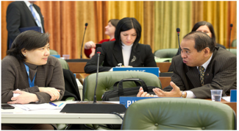
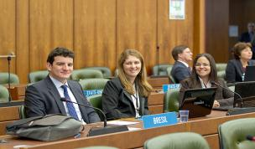
THE STANDING COMMITTEE ON LAW OF PATENTS
Member States’ Committee (IGOs and NGOs: observers)
Established in 1998
Forum to discuss issues, facilitate coordination and provide guidance concerning the progressive international development of patent law
Forum that deals with a cluster of issues rather than each issue in isolation
Since 2008, discussions on various issues identified by Member States

Slide 15
THE STANDING COMMITTEE ON LAW OF PATENTS
PART II
Twentieth Session of the SCP took place from January 27 to 31, 2014
Quality of patents: The Committee shared a general understanding that the proposal submitted with respect to the quality of patents did not lead to harmonization of substantive patent law and to automatic acceptance of work sharing products
    A study will be prepared on inventive step containing the definition of the person skilled in the art, methodologies employed for evaluating an inventive step and the level of the inventive step
    A study on sufficiency on of disclosure containing the enabling disclosure requirement, support requirement and written description requirement
Notes:
private and/or non-commercial use; experimental
use and/or scientific research; preparation of medicines; prior use; use of
articles on foreign vessels, aircrafts and land vehicles. The document should
also cover practical challenges encountered by Member States in
implementing them.

Slide 16
THE STANDING COMMITTEE ON LAW OF PATENTS
PART III
The Secretariat will prepare a document on how exceptions and limitations are implemented in Member States, without evaluating the effectiveness of those exceptions and limitations
The Secretariat will collect more practical examples and experiences on patent-related and impediments to transfer of technology from members and observers of the Committee
The Twenty-First session would be held from November 3 to 7, 2014

Slide 17
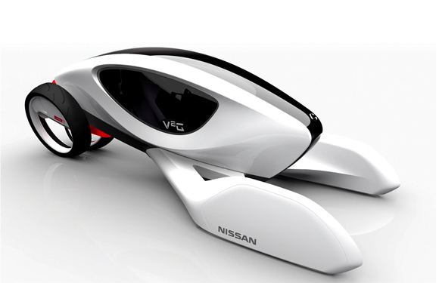
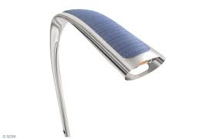
NORM SETTING :
INDUSTRIAL DESIGNS
THE STANDING COMMITTEE ON THE LAW OF TRADEMARKS, INDUSTRIAL DESIGNS AND GEOGRAPHICAL INDICATIONS (SCT)
  The SCT has substantially advanced work on the draft of a design law treaty
  The idea would be to have a design law treaty similar to the Patent Law Treaty and the Singapore Treaty
  A business simplification treaty will simplify and standardize the registration and ancillary procedures applied to industrial designs in different countries

Slide 18
LATEST SCT SESSION (MARCH 2014)
During the last session and with regard to technical assistance and capacity building, all delegations stated that progress was made.
  Technical assistance and capacity building to help implementing the new treaty:
    For number of delegations technical assistance provisions have to be in the form of an article
    Other delegations either stated that they were flexible or that they would consider this option
  Convening a diplomatic conference for the adoption of a Design Law Treaty
    Some delegations expressed the view that an agreement upon the existence of the article regarding technical assistance and capacity building had to be reached prior convening a diplomatic conference
    Other delegations stated that the treaty is mature enough to convene the Diplomatic Conference.
The extraordinary session of the GA in May 2014 will decide whether to convene a Diplomatic Conference.

Slide 19
BEYOND THE SCT
Beyond SCT: Lisbon Union Assembly in September 2013 decided on the convening of a Diplomatic Conference for the adoption of a Revised Lisbon Agreement on Appellations of Origin and Geographical Indications in 2015.

Slide 20
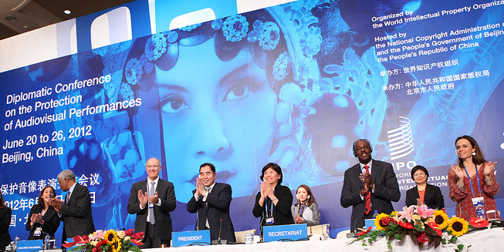
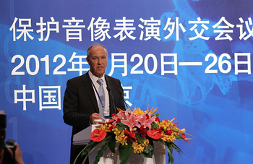
BEIJING TREATY ON AUDIOVISUAL
PERFORMANCES JUNE, 26 2012

Slide 21


BEIJING TREATY
The treaty on audiovisual performances was adopted on June 2012. The treaty will enter into force with 30 ratifications.
This treaty will strengthen the position of performers, giving them moral and economic rights for the international use of their performances.
Countries becoming party will pay for the use of foreign audiovisual performances. Some or all of this money will be going to performers.
« The conclusion of the Beijing Treaty is an important milestone toward closing the gap in the international rights system for audiovisual performers » WIPO Director General, Francis Gurry

Slide 22
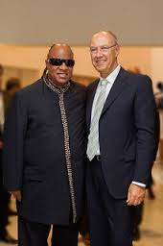
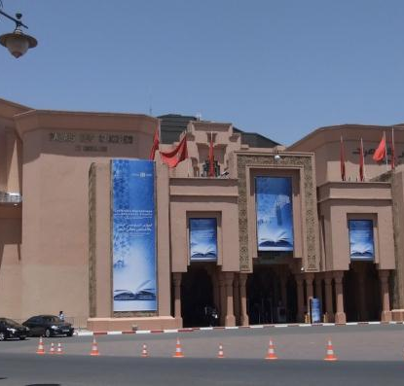
MARRAKESH TREATY TO FACILITATE ACCESS TO PUBLISHED WORKS FOR PERSONS WHO ARE BLIND,
VISUALLY IMPAIRED OR OTHERWISE PRINT DISABLED

Slide 23

MARRAKESH TREATY
The Diplomatic Conference took place in Marrakesh from June 18 to 28, 2013 (600 negotiators from WIPO’s 186 member states)
There are more than 285 million blind and VIP- 90 % living in developing countries.
Only 5 % of the books published are available in braille or other accessible formats.
Requires contracting parties to adopt limitations for the benefit the people who are blind, visually impaired, and print disabled.
It also provides for the exchange of accessible format works across borders.

Slide 24

MAJOR ECONOMIC STUDIES ON IP
A NEW WIPO UNIT – THE ECONOMICS AND STATISTICS DIVISION- REFLECTS THE GROWING CONSENSUS ON THE IMPORTANCE OF THE ECONOMIC DIMENSION OF IP.
THE DIVISION APPLIES STATISTIC AND ECONOMIC ANALYSIS TO THE USE OF WIPO SERVICES.
THIS NEW STRUCTURE ALSO IMPROVES WIPO ECONOMIC INSIGHT ON IP DEVELOPMENT.

Slide 25
STRATEGIC REALIGNMENT WITHIN WIPO
Economics and Statistics Division
WIPO Chief Economist
IP Statistics
Section
Data Development
Section
Economics
Section

Slide 26
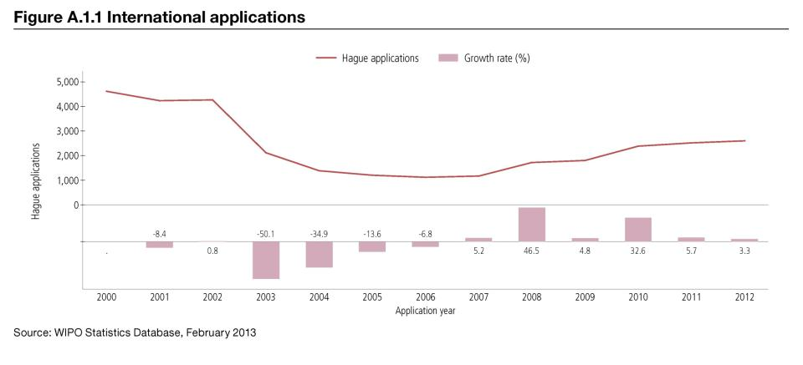
TREND IN HAGUE FILINGS (DESIGNS)

Slide 27
DEMAND FOR IP RIGHTS HAS GROWN
Source: WIPO Statistics Database, October 2011

Slide 28
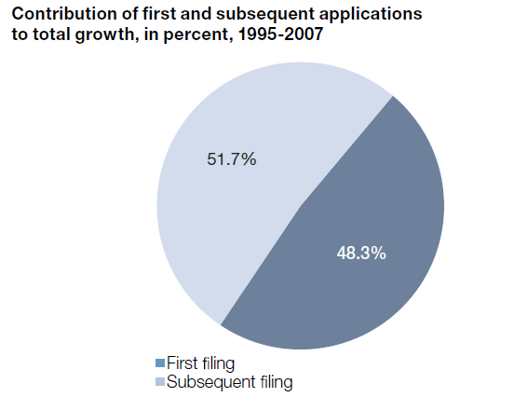
MORE INVENTIONS AND GREATER INTERNATIONALIZATION
Source: WIPO (2011)

Slide 29
STUDIES AND REPORTS
World Intellectual Property Indicators (WIPI): This is our flagship IP statistics publication. It provides an overview of latest trend in IP filings and registrations covering more than 100 offices : http://www.wipo.int/ipstats/en/wipi/index.html
The PCT Yearly Review provides an overview of the performance and development of the PCT system. It includes a comprehensive set of statistics for the latest available year See: http://www.wipo.int/ipstats/en/statistics/pct/
Madrid Yearly Review: http://www.wipo.int/ipstats/en/
Hague Yearly Review: http://www.wipo.int/ipstats/en/
The WIPO IP Facts and Figures provides an overview of intellectual property (IP) activity based on the latest available year of statistics. It serves as a quick reference guide for statistics: http://www.wipo.int/ipstats/en/
WIPO IP Statistics Data Center is an on-line service enabling access to WIPO’s statistical data. Users can select from a wide range of indicators and view or download data according to their needs: http://ipstatsdb.wipo.org/ipstatv2/ipstats/patentsSearch

Slide 30

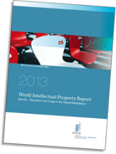
STUDIES AND REPORTS
II
New report « Brands – Reputation and Image in the Global Marketplace»
The report looks at how branding behavior and trademark use have evolved in recent history, how they differ across countries, what is behind markets for brands, what lessons economic research holds for trademark policy and how branding strategies influence companies’ innovation activities
For further information and the full report :
http://www.wipo.int/econ_stat/en/economics/wipr

Slide 31
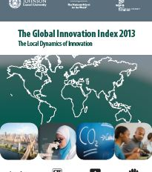
THE GLOBAL INNOVATION INDEX 2013
Annual publication that provides the latest trends in innovation activities across the world. It is co-published by INSEAD, Cornell Univ. and WIPO http://www.wipo.int/econ_stat/en/economics/gii/index.html
Its results are useful:
  To benchmark countries against their peers
  To study countries profiles over time
  Identify countries strengths and weaknesses

Slide 32
THE GLOBAL INNOVATION INDEX 2013
The framework is revised and adjusted every year in a transparent exercise
This year, out of 84 indicators, 64 are identical to GII 2012, and a total of 20 indicators were modified
10 indicators were deleted/replaced
10 indicators underwent changes such as the computation methodology at the source, change of scaling factor, change of classification etc.
The year per year comparison has to be carefully taken into consideration

Slide 33
GLOBAL INNOVATION INDEX FRAMEWORK
OUTPUT SUB INDEX
INPUT SUB INDEX
SCIENTIFIC OUTPUT
CREATIVE OUTPUT
HUMAN CAPITAL AND RESEARCH
INFRASTRUCTURE
MARKET SOPHISTICATION
BUSINESS SOPHISTICATION

Slide 34
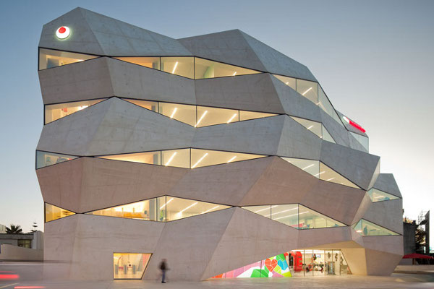
PORTUGAL PROFILE
VODAPHONE HEADQUARTERS BY BARBOSA GUIMARÃES, PORTO, PORTUGAL

Slide 35

THE GLOBAL INNOVATION INDEX
RANKING 2012
RANKING 2013
1. SWITZERLAND
2. SWEDEN
3. SINGAPORE
34. PORTUGAL
1. SWITZERLAND
2. SWEDEN
3. UNITED KINGDOM
35. PORTUGAL

Slide 36

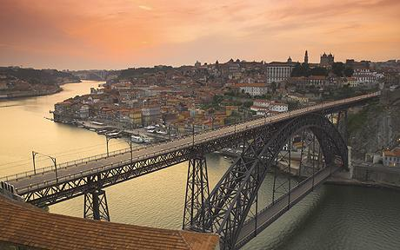
PORTUGAL STRENGTHS
  Portugal’s strengths are drawn mostly from Human Capital & Research :
      Portugal is ranked 22nd in Human Capital & Research
        Portugal is ranked 19th within Education:
          Current expenditure on education, % GNI
          Public expenditure/pupil, % GDP/cap (ranked 11th)
          School life expectancy, years
          PISA scales in reading, maths & science
          Pupil-teacher ratio, secondary (ranked 4th)

Slide 37
SOME DEFINITIONS
Current expenditure on education, % GNI: Current operating expenditures in education, including wages and salaries and excluding capital investments in buildings and equipment, as a percentage of gross national income (GNI)
Public expenditure/pupil, % GDP/cap : Public expenditure includes government spending on educational institutions (both public and private), education administration, and subsidies for private entities
School life expectancy, years: Total number of years of schooling that a child of a certain age can expect to receive in the future

Slide 38
PORTUGAL STRENGTHS
  Portugal’s strengths are also drawn from Market Sophistication
    Portugal is ranked 25th with regard to the Market Sophistication indices
      Portugal is 13th with regard to Credit indices:
            Ease of getting credit
            Domestic credit to private sector, % GDP (ranked 8th)
            Microfinance gross loans, % GDP

Slide 39
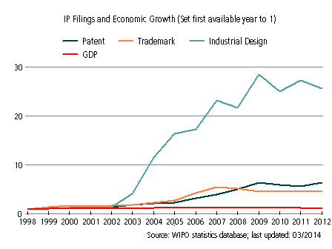
PORTUGAL’S EVOLUTION WITH RESPECT TO IP FILINGS AND
ECONOMIC GROWTH FROM 1998 TO 2012
The graphic shows a recent peak (2002) in industrial design’s filling, which is still strongly growing today. This is a sign of the strength of industrial designs in Portugal.
The patents and trademarks filings are also present. This steady growth is a sign of Portugal’s reliance on IP for economic development.
Notes:
GDP : GROSS DOMESTIC PRODUCT

Slide 40
PATENT APPLICATION BY TOP FIELDS OF TECHNOLOGY (1998-2012)

Slide 41
INTERNATIONAL APPLICATIONS VIA WIPO ADMINISTERED TREATIES

Slide 42
THANK YOU!
****************
Mr. Victor Vazquez Lopez
Head
Section for the Coordination of Developed Countries (SCDC)
Department for Transition and Developed Countries(TDC)
World Intellectual Property Organization (WIPO)
Email: Victor.Vazquez-lopez@wipo.int
Notes:
Welcome ….
Today, we are going to explain to you, in very general terms,
what this Organization does and why?

Slide 43
PATENT COOPERATION TREATY (PCT)
INTRODUCTION AND FUTURE DEVELOPMENTS
Speaker: Mr. Claus Matthes, Director, PCT Business Development Division, WIPO

Slide 44
USING THE TRADITIONAL PATENT SYSTEM TO SEEK MULTINATIONAL PATENT PROTECTION
(months)
0
12
File
applications
abroad
File
application
locally
Local patent application followed within 12 months by multiple foreign applications claiming priority under Paris Convention:
  - multiple formality requirements
  - multiple searches
  - multiple publications
  - multiple examinations and prosecutions of applications
  - translations and national fees required at 12 months
Some rationalization because of regional arrangements:
  ARIPO, EAPO, EPO, OAPI

Slide 45
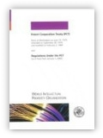
THE PCT ─ 1970
Basic idea: simplify the procedure for obtaining patent protection in many countries, making it more efficient and economical for:
  users of the patent system: makes available a filing tool for applicants for foreign patent filings; and
  patent offices: makes available a tool for effective processing of patent applications by offices of PCT Member States willing to exploit work done by others

Slide 46
PCT BASICS
Filing Tool for applicants:
  Only one application filed, containing, by default, the designation of all States (for every kind of protection available) and usual priority claim(s)
  Has the effect of a regular national filing (including establishment of a priority date) in each designated State: the international filing date is the filing date in each designated State
  Filed in one language
  Filed with one Office
  One set of formality requirements
  Delays national processing until 30 months from priority date
  International reports improve basis for
  decision making

Slide 47
PCT BASICS
Work sharing tool for Offices:
  Central formality checking
  Central international publication
  International search report (ISR)
  International Preliminary Reports on Patentability (preliminary, non-binding opinion on novelty, inventive step (non-obviousness) and industrial applicability
    Chapter I
    Chapter II

Slide 48
TRADITIONAL PATENT SYSTEM
VS. PCT SYSTEM
Fees for:
--translations
--Office fees
--local agents
File
applications
abroad
(months)
0
12
Traditional
Fees for:
--translations
--Office fees
--local agents
File local
application
Enter
national
phase
(months)
International
publication
PCT
0
12
16
18
22
28
30
File local
application
File PCT
application
International
search report & written opinion
(optional)
File
demand for
International
preliminary
examination
(optional)
International
preliminary report on patentability

Slide 49
THE PCT SYSTEM
Enter
national
phase
International
publication
(months)
0
12
16
18
22
28
30
File local
application
File PCT
application
International
search report & written opinion
(optional)
File
demand for
International
preliminary
examination
(optional)
International
preliminary report on patentability
Typically a national patent application in the home country of the applicant

Slide 50
THE PCT SYSTEM
Enter
national
phase
International
publication
(months)
0
12
16
18
22
28
30
File local
application
File PCT
application
International
search report & written opinion
(optional)
File
demand for
International
preliminary
examination
(optional)
International
preliminary report on patentability
Typically filed in same national patent office--one set of fees, one language, one set of formality requirements--and legal effect in all PCT States

Slide 51
THE PCT SYSTEM
Enter
national
phase
International
publication
(months)
0
12
16
18
22
28
30
File local
application
File PCT
application
International
search report & written opinion
(optional)
File
demand for
International
preliminary
examination
(optional)
International
preliminary report on patentability
Report on state of the art (prior art documents and their relevance) + initial patentability opinion

Slide 52
PCT INTERNATIONAL SEARCHING AUTHORITIES
The ISAs are the following 19 offices:
  Australia
  Austria
  Brazil
  Canada
  China
  Chile (not yet operating)
  Egypt
  Finland
  India
  Israel
  Japan
  Republic of Korea
  Russian Federation
  Spain
  Sweden
  Ukraine (not yet operating)
  United States of America
  European Patent Office
  Nordic Patent Institute

Slide 53
PRIOR ART FOR INTERNATIONAL SEARCH
Prior art:
  everything which has been made available to the public,
  anywhere in the world,
  by means of written disclosure,
  which is capable of being of assistance in determining that the claimed invention is or is not new and that it does or does not involve an inventive step,
  provided the making available to the public occurred prior to the international filing date.
PCT Minimum Documentation (Rule 34)

Slide 54
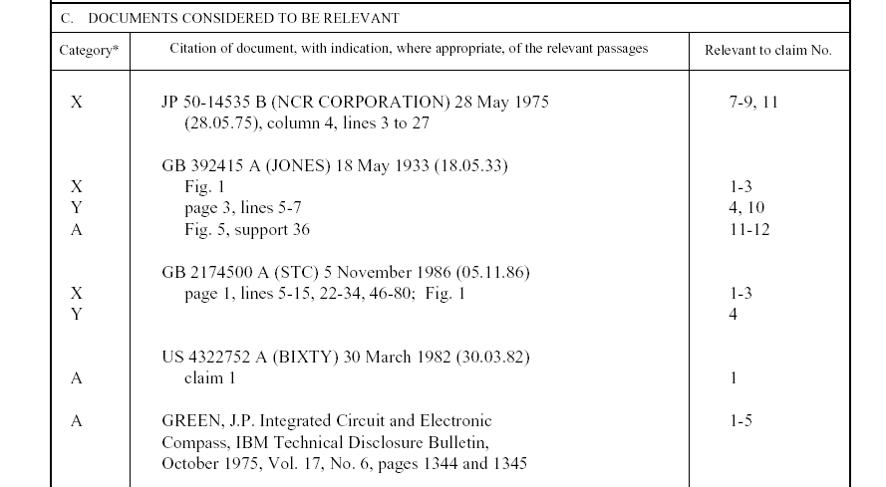
EXAMPLE: PCT INTERNATIONAL SEARCH REPORT
Symbols indicating
which aspect of patentability
the document cited is
relevant to (for example, novelty, inventive step, etc.)
The claim numbers
in your application to
which the document is
relevant
Documents relevant to whether or not your invention may be patentable

Slide 55
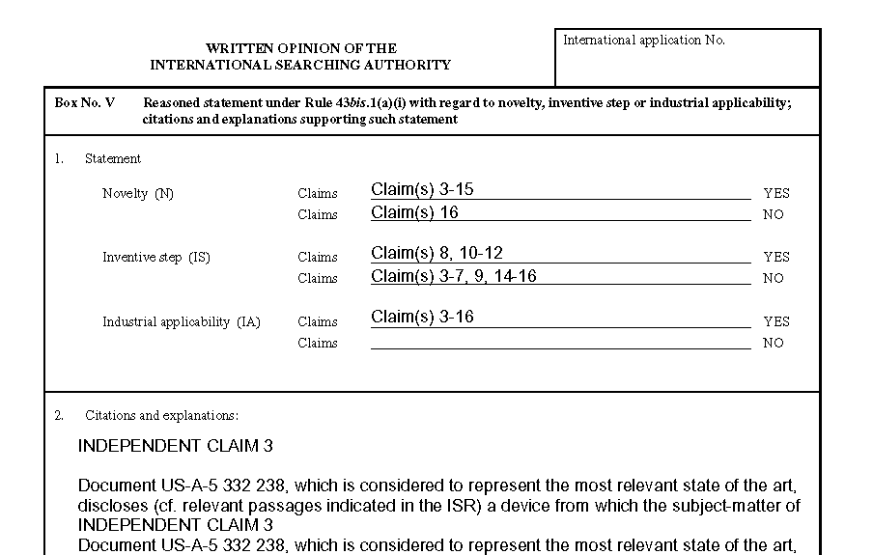
EXAMPLE: PCT WRITTEN OPINION OF THE INTERNATIONAL SEARCHING AUTHORITY
Reasoning supporting the assessment
Patentability assessment
of claims

Slide 56
THE PCT SYSTEM
Disclosing to world content of application in standardized way
Enter
national
phase
International
publication
(months)
0
12
16
18
22
28
30
File local
application
File PCT
application
International
search report & written opinion
(optional)
File
demand for
International
preliminary
examination
(optional)
International
preliminary report on patentability

Slide 57
THE PCT SYSTEM
Enter
national
phase
International
publication
(months)
0
12
16
18
22
28
30
File local
application
File PCT
application
International
search report & written opinion
(optional)
File
demand for
International
preliminary
examination
(optional)
International
preliminary report on patentability
Request an additional patentability analysis on basis of amended application

Slide 58
THE PCT SYSTEM
Enter
national
phase
International
publication
(months)
0
12
16
18
22
28
30
File local
application
File PCT
application
International
search report & written opinion
(optional)
File
demand for
International
preliminary
examination
(optional)
International
preliminary report on patentability
Additional patentability analysis, designed to assist in national phase decision-making

Slide 59
THE PCT SYSTEM
Express intention and take steps to pursue to grant in various states
Enter
national
phase
International
publication
(months)
0
12
16
18
22
28
30
File local
application
File PCT
application
International
search report & written opinion
(optional)
File
demand for
International
preliminary
examination
(optional)
International
preliminary report on patentability

Slide 60
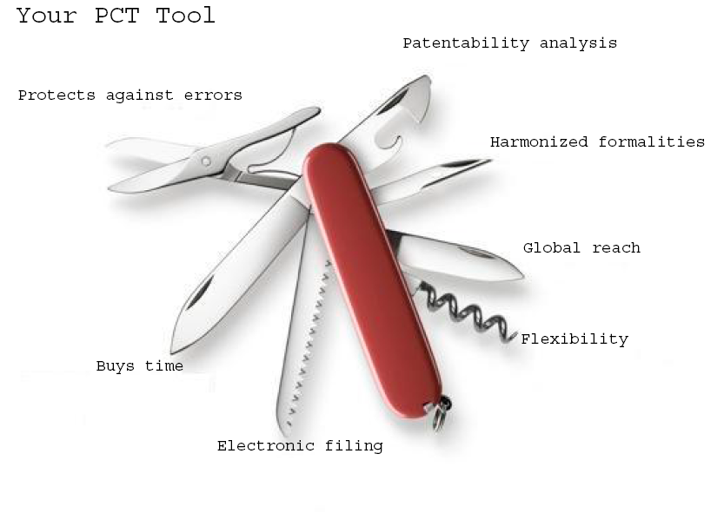
THE PCT

Slide 61
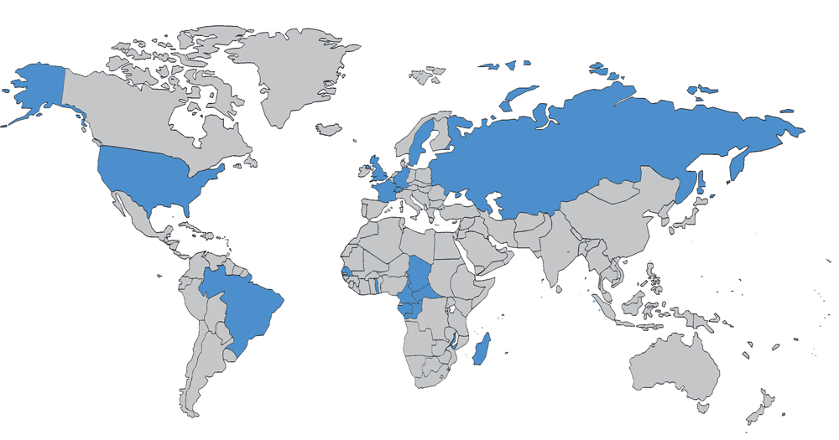
THE PCT IN 1978

Slide 62
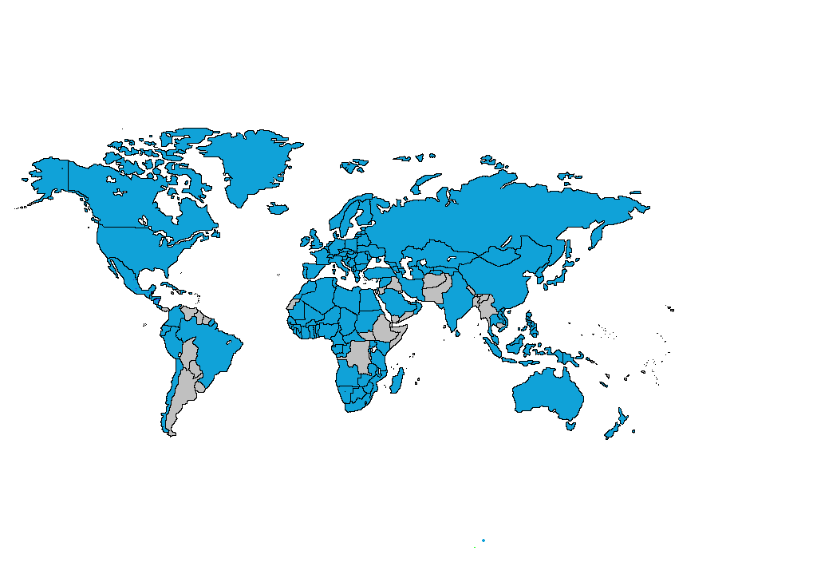
PCT COVERAGE TODAY

Slide 63

148 PCT STATES
=PCT
Albania
Algeria
Angola
Antigua and Barbuda
Armenia
Australia
Austria
Azerbaijan
Bahrain
Barbados
Belarus
Belgium
Belize
Benin
Bosnia and Herzegovina
Botswana
Brazil
Brunei Darussalam
Bulgaria
Burkina Faso
Cameroon
Canada
Central African Republic
Chad
Chile
China
Colombia
Comoros
Congo
Costa Rica
Côte d'Ivoire
Croatia
Cuba
Cyprus
Czech Republic
Democratic People's
Republic of Korea
Denmark
Dominica
Dominican Republic
Ecuador
Egypt
El Salvador
Equatorial Guinea
Estonia
Finland
France,
Gabon
Gambia
Georgia
Germany
Ghana
Greece
Grenada
Guatemala
Guinea
Malawi
Malaysia
Mali
Malta
Mauritania
Mexico
Monaco
Mongolia
Montenegro
Morocco
Mozambique
Namibia
Netherlands
New Zealand
Nicaragua
Niger
Nigeria
Norway
Oman
Panama
Papua New Guinea
Peru
Philippines
Poland
Portugal
Qatar
Republic of Korea
Republic of Moldova
Romania
Rwanda
Russian Federation
Saint Lucia
Saint Vincent and
the Grenadines
San Marino
Sao Tomé e Principe
Saudi Arabia (3 Aug. 2013)
Senegal
Serbia
Seychelles
Sierra Leone
Singapore
Slovakia
Slovenia
South Africa
Spain
Sri Lanka
Sudan
Swaziland
Guinea-Bissau
Honduras
Hungary
Iceland
India
Indonesia
Iran (Islamic Republic of)
(4 Oct. 2013)
Ireland
Israel
Italy
Japan
Kazakhstan
Kenya
Kyrgyzstan
Lao People’s Dem Rep.
Latvia
Lesotho
Liberia
Libyan Arab Jamahiriya
Liechtenstein
Lithuania
Luxembourg
Madagascar
St. Kitts and Nevis
Sweden
Switzerland
Syrian Arab Republic
Tajikistan
Thailand
The former Yugoslav
Republic of Macedonia
Togo
Trinidad and Tobago
Tunisia
Turkey
Turkmenistan
Uganda
Ukraine
United Arab Emirates
United Kingdom
  United Republic of Tanzania
  United States of America
Uzbekistan
Viet Nam
Zambia
Zimbabwe
Notes:
63

Slide 64
COUNTRIES NOT YET IN PCT
Afghanistan
Andorra
Argentina
Bahamas
Bangladesh
Bhutan
Bolivia
Burundi
Cambodia
Cape Verde
Democratic Republic of Congo
Djibouti
Eritrea
Ethiopia
Fiji
Guyana
Haiti
Iraq
Jamaica
Jordan
Kiribati
Kuwait
Lebanon
Maldives
Marshall Islands
Mauritius
Micronesia
Myanmar
Nauru
Nepal
Pakistan
Palau
Paraguay
Samoa
Solomon Islands
Somalia
South Sudan
Suriname
Timor-Leste
Tonga
Tuvalu
Uruguay
Vanuatu
Venezuela
Yemen
(45)

Slide 65
PCT APPLICATIONS
2013: 205,300 PCT applications (+5.1%)

Slide 66
TRENDS IN PCT FILING

Slide 67
INTERNATIONAL APPLICATIONS RECEIVED
IN 2013 BY COUNTRY OF ORIGIN
CN: +15.6%
US: +10.8%
SE: +10.4%

Slide 68
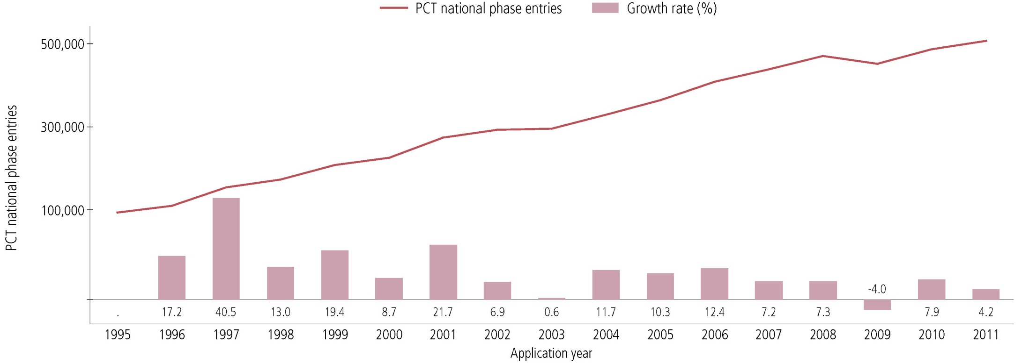
PCT NATIONAL PHASE ENTRIES—TOTAL
507,400 national phase entries estimated in 2011 (+ 4.2%)
431,800 (about 85%) of NPEs are from non-resident applicants, making PCT NPEs responsible for 54.9% of all non-resident patent applications filed worldwide in 2011

Slide 69
PCT NATIONAL PHASE ENTRIES 2011—BY TARGET DO (1)
USPTO most preferred DO for National Phase Entries; had highest growth among the IP5 Offices (+7.3%)
Brazil (+12.6%) and India (+9.8%) had highest growth rates among top 10 Offices

Slide 70
PCT NATIONAL PHASE ENTRIES 2011—
BY TARGET DO (2)

Slide 71
TOP PCT APPLICANTS 2013
Panasonic—JP (2881)
ZTE—CN (2309)
Huawei—CN (2094)
Qualcomm—US (2036)
Intel—US (1852)
Sharp—JP (1840)
Bosch—DE (1786)
Toyota—JP (1696)
Ericsson—SE (1467)
Philips—NL (1423)
Siemens—DE (1323)
Mitsubishi Electric—JP (1312)
Samsung Electronics—KR (1193)
NEC—JP (1190)
LG Electronics—KR (1170)
Fujifilm Corporation (1008)
Shenzhen China Star Optoelectronics—CN (916)
Sony—JP (915)
Hitachi—JP (841)
Nokia—FI (807)
() of published
PCT applications

Slide 72
TOP UNIVERSITY PCT APPLICANTS 2013
University of California (US)
MIT (US)
Columbia University (US)
University of Texas (US)
Harvard University (US)
Johns Hopkins (US)
Korea Advanced Institute of Science and Technology (KR)
Leland Stanford University (US)
Cornell University (US)
Cal Tech (US)
University of Florida (US)
Postech Foundation (KR)
Seoul National University (KR)
Peking University (CN)
Nanyang Technical University (CN)
University of Tokyo (JP)
Isis Innovation Limited (GB)
University of Pennsylvania (US)
University of Michigan (US)
National University of Singapore (SG)

Slide 73
THE PCT ─ 1970 TO TODAY
*

Slide 74
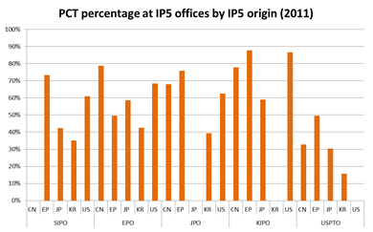
THE PCT ─ 1970 TO TODAY

Slide 75
CERTAIN PCT ADVANTAGES
The PCT, as the cornerstone of the international patent system, provides a worldwide system for simplified filing and processing of patent applications, which:
  1. postpones the major costs associated with internationalizing a patent application
  2. provides a strong basis for patenting decisions
  3. harmonizes formal requirements
  4. protects applicant from certain inadvertent errors
  5. evolves to meet user needs
  6. is used by the world’s major corporations, universities and research institutions when they seek international patent protection

Slide 76
PCT CHALLENGES
Improving the quality of PCT international phase work products
Building trust between patent offices, so that duplicative international phase and national phase processing can be reduced
Language issues
  33% of applications filed in Chinese, Japanese and Korean
Helping developing countries benefit from the PCT
  15 countries responsible for 92.1% of IAs published in 2011
Making PCT accessible to applicants of all types from all Contracting States (for example, SMEs)
Helping PCT users stay abreast of new developments and strategies

Slide 77
THE PCT─ 1970 TO TODAY
PCT extremely successful as filing tool
Harmonization of formal and procedural requirements (beyond PCT: national laws; Patent Law Treaty (PLT))
However: PCT not as effective as work sharing tool in practice for addressing national quality of examination and (for some Offices) backlogs
Expectation was: “flying start” for offices, work should be “rather in the nature of completing, checking and criticizing than starting from scratch in complete isolation”
Reality is: many Offices do start “from scratch”
  Perhaps not in complete isolation, but …

Slide 78
PCT ROADMAP
Needed: change in approach of offices vis-à-vis the PCT system, including a review of national procedures and practices and of what kind of incentives are set to use the system in a way which is beneficial to all

Slide 79
PCT ROADMAP
Improve quality and consistency of international reports:
  The better the quality of the tools (reports), the better for all Contracting States: tools allow them to deal more effectively with requirements of their national laws
  The smaller the national examining capacity, the bigger the importance of quality tools

Slide 80
PCT ROADMAP
Improve quality and consistency of international reports:
  Develop quality metrics for measuring usefulness
  Explore collaborative search and examination
  Third party observations system
  Set up quality feedback system for offices
  Improve explanations of relevance of cited documents
  Extend opportunity for dialogue with examiner during international preliminary examination

Slide 81
PCT ROADMAP
Improve timeliness of actions in international phase
Create incentives for applicants to use system efficiently
  encourage high quality applications and early correction of defects and filing of amendments
Improve training for Offices, better coordination
  notably for examiners in developing country Offices
Improve access to effective search systems
  affordable access to online search systems
Improve access to national search and examination reports

Slide 82
ePCT
WIPO online service that provides secure electronic access to/interaction with IB’s PCT application files by applicants/agents and Offices
8500 users in over 100 countries, 30+ Offices
Positive feedback from users:
  applicant features generally reckoned best in class
  unique notifications feature already saved applicants
  Office features found easy to use
More information: https://pct.wipo.int/ePCT
ePCT-Filing: web-based electronic filing of new PCT applications
  Currently available live for filings with RO/IB, RO/AT & RO/SE; awaiting other ROs

Slide 83
ePCT: FURTHER IMPROVEMENTS
Aiming for fully hosted RO service by end 2014
Multilingual interface (eventually 10 languages)
Extension of ePCT to interested Offices in their various capacities (RO, ISA, SISA, IPEA, DO, EO)
Goal to offer centralized real-time credit card transactions for all fee types and all authorities
National phase entry function could be added to ePCT
  Applicant would select from among participating DOs, upload any necessary documents and add any bibliographic data not already available to IB
  Local counsel could be fully involved, as needed

Slide 84
Indication of availability for license
PCT applicants can indicate in relation to their published applications that the invention is available for license
  Request to IB, within 30 months from the priority date, free of charge
Licensing indications made publicly available after international publication of the application on PATENTSCOPE
International applications containing such licensing indication requests can be searched in PATENTSCOPE
Most use thus far from universities/research institutions

Slide 85
PCT TRAINING OPTIONS
New: 29 video segments on WIPO’s YouTube channel and WIPO’s PCT page about individual PCT topics
PCT Distance learning course content available in the 10 PCT publication languages
PCT Webinars
  providing free updates on developments in PCT procedures, and PCT strategies—previous webinars are archived and freely available
  upon request also for companies or law firms, for example, for focused training on how to use ePCT
In-person PCT Seminars and training sessions

Slide 86
PCT RESOURCES/INFORMATION
For further information about the PCT, see
Website: http://www.wipo.int/pct/en/
For general questions about the PCT, contact the PCT Information Service at:
      Telephone: (+41-22) 338 83 38
      Facsimile: (+41-22) 338 83 39
      E-mail: pct.infoline@wipo.int

Slide 87
Thank You!
****************
Mr. Claus Matthes
Director
Patent Cooperation Treaty (PCT) Business Development Division
World Intellectual Property Organization (WIPO)
T + 41 22 338 98 09
Email: claus.matthes@wipo.int
Website: www.wipo.int

Slide 88
THE MADRID SYSTEM
THE HAGUE SYSTEM & THE LISBON SYSTEM
Speaker: Mrs. Asta Valdimarsdottir, Director, Operations Division, Madrid Registry, Brands and Designs Sector, WIPO

Slide 89


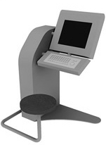

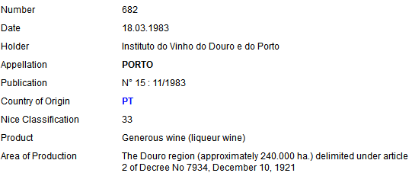


Trademarks
IRN 1159604
Designs
DM/081 852
Appellations of Origin
The International System of Appellations of Origin

Slide 90












NO INTERNATIONAL PROCEDURE
NATIONAL OFFICES
APPLICANT

Slide 91





















INTERNATIONAL PROCEDURE
INTERNATIONAL PROCEDURE
MADRID
NATIONAL OFFICE
WIPO
WIPO
MAINTENANCE
Basic
HAGUE
NATIONAL OFFICE
WIPO
Basic
WIPO
MAINTENANCE
USER
LISBON
WIPO
LISBON
REGISTRY
GOVERNMENT
ALL MEMBERS
Protected AO

Slide 92
THE MADRID SYSTEM

Slide 93
TRADEMARKS
"A brand incarnates an enterprise's reputation and image and so is one of an enterprise's most valuable assets” (Director General, Francis Gurry)
Trademarks are the most widely used form of registered intellectual property (IP) throughout the world
Trademark demand quadrupled between 1985 and 2011, from just under 1 million applications per year in 1985 to 4.2 million by 2011

Slide 94
THE MADRID SYSTEM - FACTS AND FIGURES
Worldwide trademark filings + 9.3% from 2008 - 2013
Madrid filings
  + 4.1% in 2012
  + 6.4% in 2013
  + 7.4% this year
578.320 international registrations in force
5.61 million designations in force
191.759 holders of international registrations

Slide 95
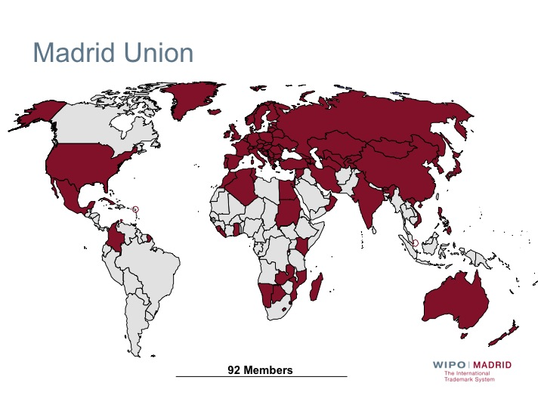

Slide 96
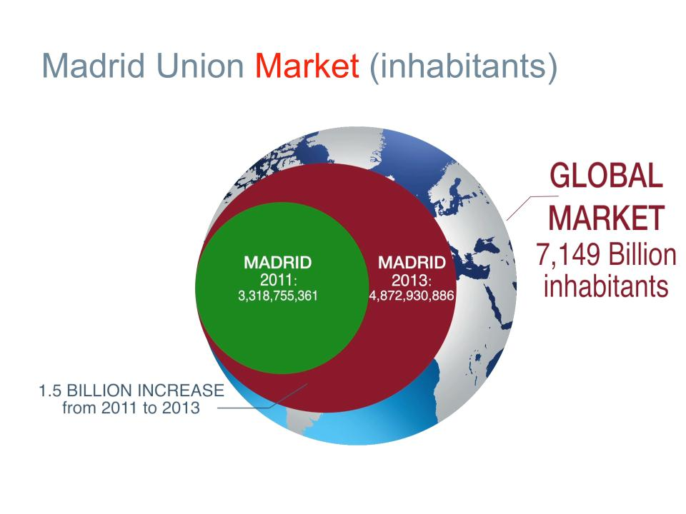
Madrid Union Market (inhabitants)

Slide 97
ACCESSIONS
2012: Colombia, Mexico, New Zealand and Philippines
2013: India, Rwanda and Tunisia (October 16, 2013)
Future accessions?
  Latin American countries
  ASEAN countries by 2015
  Caribbean countries
  African countries

Slide 98
TOP FILING STATES – 2013
States/regional entities | Change from 2012
European Union | 15.3%
United States of America | 4.8%
Germany | 6.1%
France | 0.7%
Switzerland | 10.7%
Italy | -1.2%
China | 10.9%
Japan | -9.3%
Benelux | 0.1%
United Kingdom | 17.2%

Slide 99
TOP DESIGNATIONS – 2013
States/regional entities | Change from 2012
China | 18.1%
Russian Federation | 24.4%
European Union | 23.7%
United States of America | 23.2%
Japan | 25.5%
Switzerland | 9.3%
Australia | 32.6%
Republic of Korea | 30.4%
Turkey | 10.9%
Ukraine | 11.6%

Slide 100
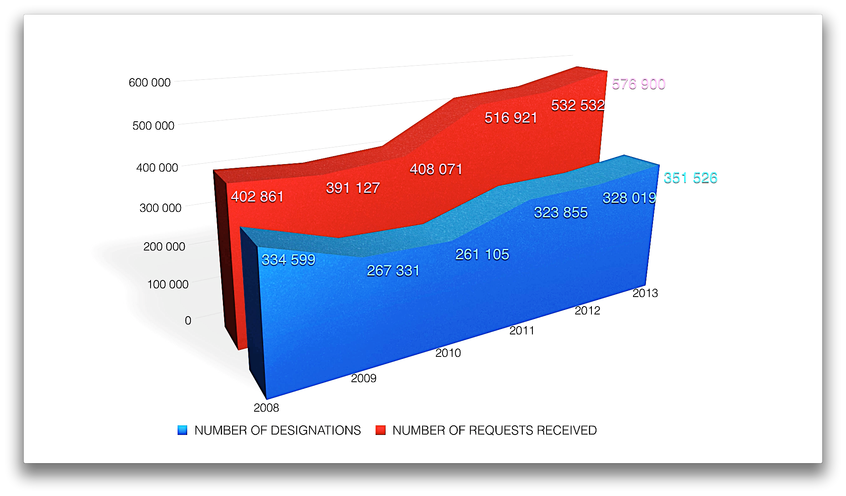

Slide 101
EXAMPLE OF THE LIFE CYCLE OF AN INTERNATIONAL REGISTRATION
International Registration, designating US, CN and KR
Statement of Grant of Protection from US and CN
Subsequent Designation for AU and NZ
Renewal
Amending of the licenses for the US
Change in the address of the holder
Licenses for US
Appointment of a representative
Limitation of the list of G&S for KR
Renewal
Change in Ownership
Provisional Refusal from KR
Final decision grating protection from KR
Request of an Extract
8686: is it possible to amend a license and how to do it?
Statement of grant of protection from AU and NZ
Registration date
10 years
10 years
The Madrid customer service and the Madrid teams are always available by phone or e-mail

Slide 102
MADRID SYSTEM – I
A registration system for 92 Contracting Parties
One application – one language – one set of fees
Three main stages
  Basic application/basic registration > International application
  Formal examination by WIPO
  Substantive examination by the Offices of the designated Contracting Parties

Slide 103
MADRID SYSTEM – II
One registration covering multiple territories
Manage a portfolio of trademarks via a single centralized system
Renew in all designated Contracting Parties with one request
Expand protection to new Contracting Parties

Slide 104
MADRID SYSTEM – III
All transactions are done with the appropriate form.
  19 forms for applying for a registration and managing the registration
  available in the three working languages (E/F/S)
  can be sent to the IB by e-mail to interg.mail@wipo.int
  some forms are already available through e-filing:
    E-subsequent designation
    E-renewal

Slide 105
MADRID SYSTEM – IV
Fees can easily be paid by:
  Credit card using E-payment / E-subsequent designation / E-renewal
  WIPO current account
  Bank transfer
More information about the payment of fees is available at: http://www.wipo.int/about-wipo/en/finance/madrid.html
One can calculate the cost of an application, subsequent designation or a renewal at: http://www.wipo.int/madrid/en/fees/calculator.jsp

Slide 106
THE NATIONAL ROUTE VS. THE MADRID ROUTE
Filing in several Offices
Many application forms
Several languages
Several currencies
Several registrations
Several renewals
Several modifications
Foreign attorney needed from filing
Filing in one Office
One application form
One language (E/F/S)
One currency (CHF)
One international registration
One renewal
One modification
Foreign attorney first needed in case of refusal
Notes:
106

Slide 107
GENERAL PROFILE 2013
44,414 International Registrations
Average Number of Designations | 6.9
Average Number of Classes | 2.5
Average Fee | CHF 2,926
All Fees | 70% < 3,000 CHF
Notes:
107

Slide 108
INTERNATIONAL APPLICATIONS AND REGISTRATIONS FROM PORTUGAL

Slide 109
DESIGNATIONS IN INTERNATIONAL REGISTRATIONS AND SUBSEQUENT DESIGNATIONS – DCP: PORTUGAL

Slide 110
DESIGNATIONS IN INTERNATIONAL REGISTRATIONS AND SUBSEQUENT DESIGNATIONS DCP: PORTUGAL
Total number of designations: 1,872

Slide 111
ONLINE INFORMATION SERVICES
Legal texts, Guide and Information Notices
WIPO Gazette of International Marks
ROMARIN: Online search database
E-Forms: e-renewal and e-subsequent designations
Fee Calculator: Costing service
Dynamic Madrid Statistics
free access at http://www.wipo.int/madrid/en/
Notes:
111

Slide 112
ONLINE TOOLS
MGS (Madrid Goods and Services Manager): To use correct specifications of goods and services
MRS (Madrid Real-Time Status): To check the status of an international application/registration
MPM (Madrid Portfolio Manager): To enable holders and representatives to view and modify their portfolio
MEA (Madrid Electronic Alert): To enable users to submit a list of IRs to monitor and to be informed by email when any of them change
Accessible from http://www.wipo.int/madrid/en/services/

Slide 113
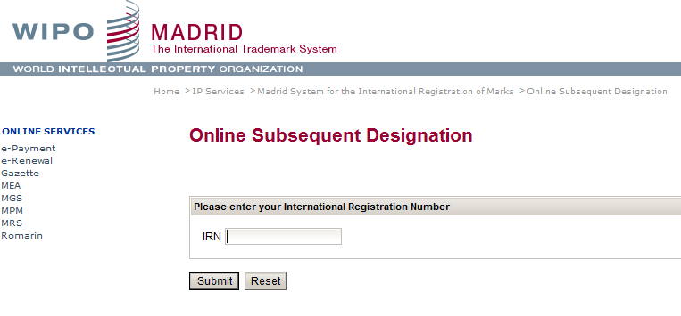
E - SUBSEQUENT DESIGNATION

Slide 114
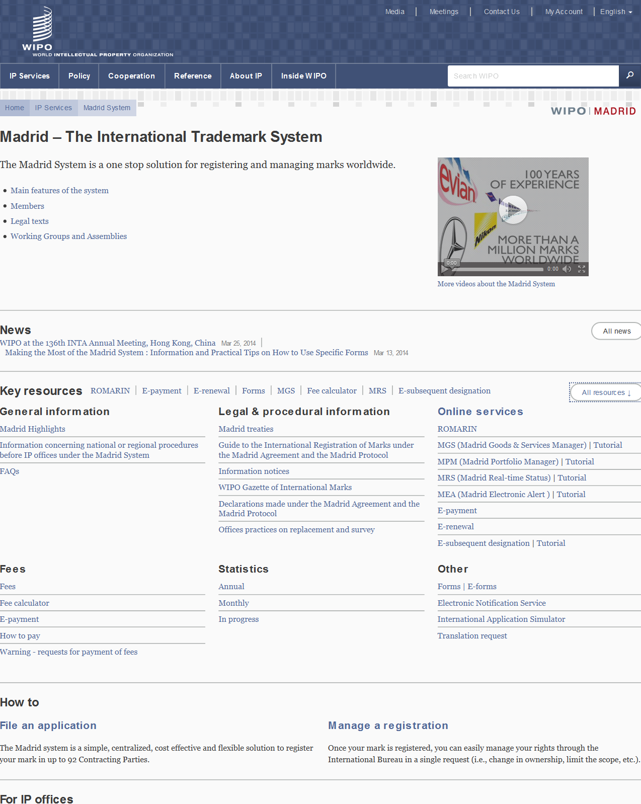
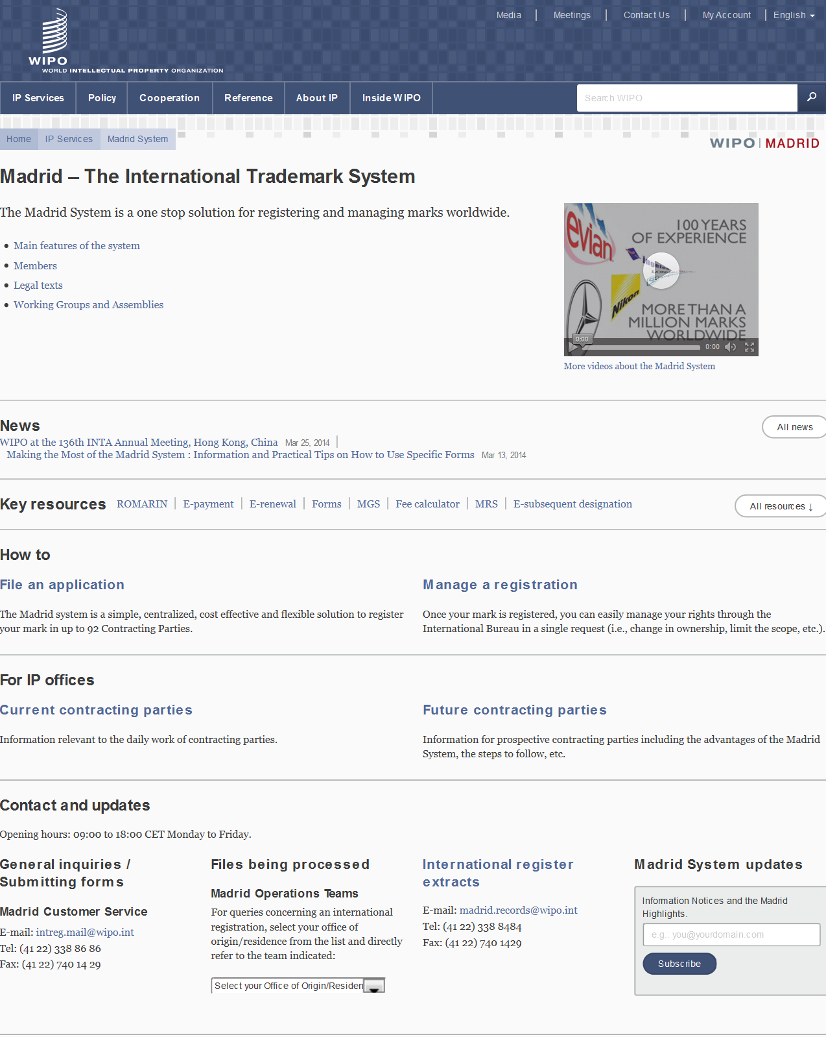

Slide 115
THE HAGUE SYSTEM

Slide 116
HAGUE UNION
47 Geneva Act (1999) (including EU and OAPI)
15 Hague Act (1960)
62 Contracting Parties

Slide 117
ACCESSIONS
2010: Germany, Norway, Azerbaijan
2011: Finland, Monaco, Rwanda
2012: Montenegro, Tajikistan, Tunisia
Future accessions?
  China, Japan and USA
  Russian Federation and Belarus
  ASEAN countries by 2015
  Barbados and Trinidad & Tobago
  Madagascar and Morocco
Notes:
117

Slide 118
FORESEEN EXPANSION OF THE HAGUE SYSTEM
Coming Soon!

Slide 119
THE USE OF THE HAGUE SYSTEM IN 2012
2,604 international applications filed (12,454 designs)
2,440 international registrations recorded (11,971 designs)
Largest filers: Swatch AG, Daimler AG, Koninklijke Philips Electronics
Approximately 26,284 international registrations in force, containing 110,158 designs
  Equivalent to over 131,420 designations in force
  Involving 8,029 holders
Notes:
119

Slide 120
TOP FILING CONTRACTING PARTIES
Contracting Party of entitlement
1. European Union (5168 designs, 41.5%)
2. Switzerland (2855 designs, 22.9%)
3. Germany (1630 designs, 13.1%)
4. France (1265 designs, 10.2%)
5. Turkey (278 designs, 2.2%)
6. Norway (186 designs, 1.5%)
7. Spain (101 designs, 0.8%)
8. Poland (86 designs, 0.7%)
9. Croatia (76 designs, 0.6%)
10. Liechtenstein (73 designs, 0.6%)

Slide 121
MOST DESIGNATED CONTRACTING PARTIES
Number of designs recorded:
1. European Union (8961 designs, 74.9%)
2. Switzerland (8802 designs, 73.5%)
3. Turkey (5110 designs, 42.7%)
4. Ukraine (2853 designs, 23.8%)
5. Singapore (2531 designs, 21.1%)
6. Norway (2389 designs, 20%)
7. Croatia (2376 designs, 19.8%)
8. Morocco (1853 designs, 15.5%)
9. Liechtenstein (1499 designs, 12.5%)
10. Serbia (1494 designs, 12.5%)

Slide 122
KEY PRINCIPLES OF THE HAGUE SYSTEM (1)
Entitlement:
In order to use the Hague system, you need a connection with a Contracting Party (CP), such as establishment, domicile, nationality or habitual residence
One file > many territories:
File a single international application for a single international registration (IR) in which one or more Contracting Parties (CP) are designated (“self-designation“ is possible)
Renewal:
Duration: 5 years renewable. 15 years for the 1999 Act or possibly longer if allowed by a designated CP

Slide 123
KEY PRINCIPLES OF THE HAGUE SYSTEM (2)
Possible deferment of up to 30 months:
Counted from date of filing or priority date
Fixed Time Limit for Refusal:
Any refusal must be notified to the International Bureau within 6 or 12 months from the publication of the international registration on the WIPO website, otherwise the design will be deemed protected
“Bundle of Rights”:
If no refusal is issued, the resulting IR has the effect of a grant of protection in each designated CP

Slide 124
THE REGISTRATION PROCEDURE
Only formal examination in the International Bureau
  Recording in the International Register
  Publication in the International Designs Bulletin
  Notification to designated CPs through the publication
Substantive examination by the designated Contracting Parties only
Refusal must be received by the International Bureau within a set time limit after publication: 6 or 12 months

Slide 125
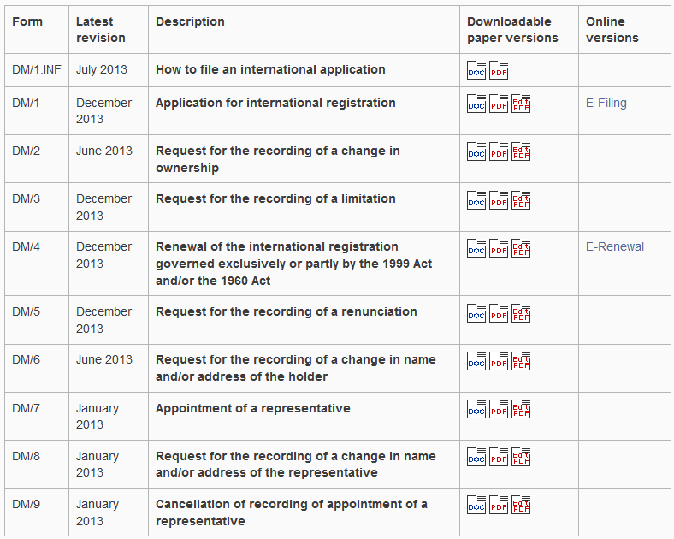
E-FILING/FORMS (http://www.wipo.int/hague/en/forms/)

Slide 126
THE NATIONAL ROUTE VS. THE HAGUE ROUTE
Several Offices for filing
Several application forms
Several languages
Several currencies
Several registrations
Several renewals
Several modifications
Foreign attorney needed from filing
One Office for filing
One application form
One language (E/F/S)
One currency (CHF)
One international registration
One renewal
One modification
Foreign attorney first needed in case of refusal
Notes:
126
126

Slide 127
DESIGNS PER INTERNATIONAL REGISTRATION 2013
International Registrations | 1065 | 452 | 572 | 353 | 210 | 59 | 23
% | 39.0% | 16.5% | 20.9% | 12.9% | 7.7% | 2.2% | 0.8%
Notes:
Most applications – contain only one design

Slide 128
AMOUNT OF FEES PAID PER INTERNATIONAL
REGISTRATION 2013
IR | 1380 | 798 | 295 | 169 | 92
% | 50.5% | 29.2% | 10.8% | 6.2% | 3.4%
Notes:
Most of the applicatant pay less than 1000 chf

Slide 129
DESIGNATIONS IN INTERNATIONAL REGISTRATION 2013
IR | 437 | 721 | 844 | 396 | 200 | 127 | 9
% | 16.0% | 26.4% | 30.9% | 14.5% | 7.3% | 4.6% | 0.3%

Slide 130
ONLINE SERVICES / TOOLS
http://www.wipo.int/hague/en/
  E-Filing Portfolio Manager
  E-Renewal
  E-Payment
  Hague Express Database
  Fee calculator

Slide 131
LATEST DEVELOPMENTS
Weekly publication cycle since January 2012
Enhancement of the E-filing interface
  A WIPO User account
  Facilitated downloading of reproductions
  Automatic check and transformation of images
  Integrated fee calculator
  Payment of fees by credit card

Slide 132
THE LISBON SYSTEM
Notes:
132

Slide 133
THE LISBON SYSTEM
An international system that facilitates the protection of a special category of geographical indications, i.e. “appellations of origin”, in countries other than the country of origin
Protection of national economic interests, in many countries, for goods bearing an appellation of origin

Slide 134
LISBON UNION: 28 MEMBER STATES
  Africa (6)
  Algeria
  Burkina Faso
  Congo
  Gabon
  Togo
  Tunisia
  Asia (3)
  Iran (Islamic Rep. of)
  Israel
  Korea (DPR of)
  Europe (13)
  Bosnia and Herzegovina
  Bulgaria
  Czech Rep.
  France
  Georgia
  Hungary
  Italy
  Moldova
  Montenegro
  Portugal
  Serbia
  Slovakia
  The FYR of Macedonia
  America (6)
  Costa Rica
  Cuba
  Haiti
  Mexico
  Nicaragua
  Peru
Countries in red are post TRIPS accessions
Notes:
134

Slide 135
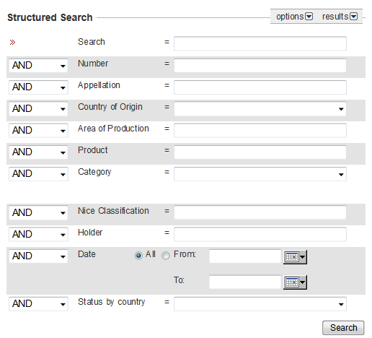
SEARCH APPELLATIONS OF ORIGIN
LISBON EXPRESS
Available at: http://www.wipo.int/ipdl/en/search/lisbon/search-struct.jsp

Slide 136
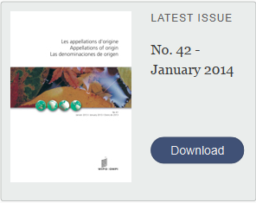
THE BULLETIN “APPELLATIONS OF ORIGIN”
The official publication of the Lisbon system for the publication of recordings in the International Register and information concerning changes in the legal framework.
Available at: http://www.wipo.int/lisbon/en/bulletin/

Slide 137
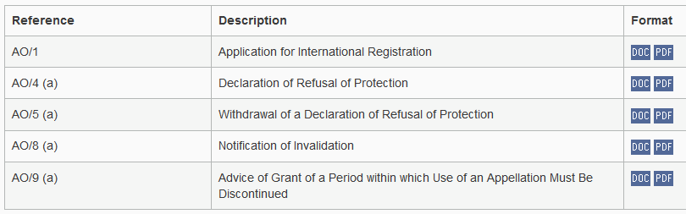
FORMS TO APPLY FOR AN INTERNATIONAL REGISTRATION OF APPELLATION OF ORIGIN
(http://www.wipo.int/lisbon/en/forms/)

Slide 138
ON-GOING MULTILATERAL NEGOTIATIONS
WTO:
  establish a GI registry
  wine and spirits only or not ?
WIPO:
    working group to review Lisbon

Slide 139
LISBON UNION ASSEMBLY (SEPTEMBER 2009)
Mandated the Working Group on the Development of the Lisbon System to
  look for improvements of the Lisbon system
  so that it might attract a wider membership
  while preserving the principles and objectives of the Lisbon Agreement

Slide 140
TWO-FOLD MANDATE (LISBON UNION ASSEMBLY 2012)
Revision of the Lisbon Agreement
  Refinement and Modernization of the Legal Framework
  Accession Possibility for Intergovernmental Organizations (e.g., EU, OAPI)
2. Specifying its applicability to AOs and GIs

Slide 141
DRAFT REVISED LISBON AGREEMENT
MAIN PROVISIONS
Definitions for GIs and AOs
Procedures for international applications, refusals, invalidations, modifications, etc.
Scope of protection
How to deal with prior rights and prior use
Option for registration of trans-border GIs and AOs
Option for direct filings by beneficiaries
Accession criteria for Intergovernmental Organizations (e.g., EU, OAPI)

Slide 142
PROSPECTS
Results 8th Session of the WG: December 2 to 6, 2013
(http://www.wipo.int/meetings/en/details.jsp?meeting_id=31204)
    9th Session: June 23 to 27, 2014
    10th Session: October 27 to 31, 2014, together with the Preparatory Committee
Diplomatic Conference: Summer of 2015

Slide 143
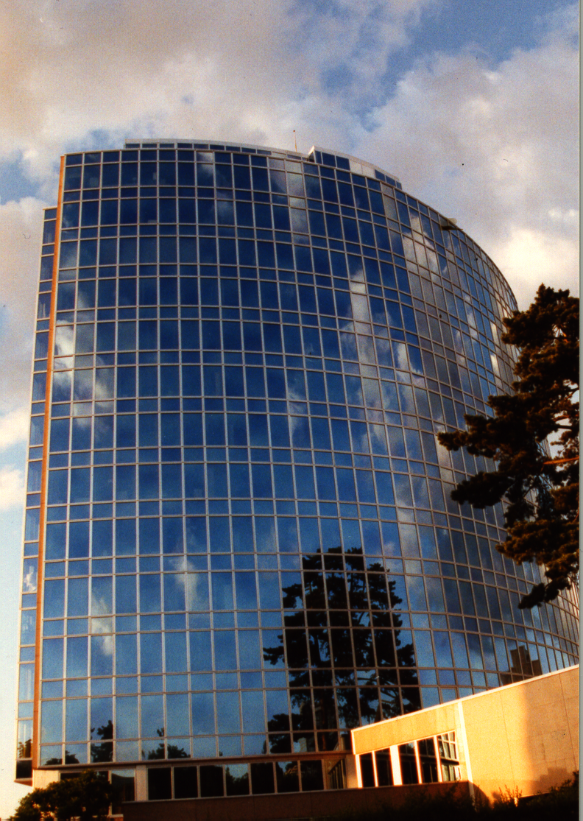
Thank you
for your attention
****************
Mrs. Asta Valdimarsdottir
Director
Operations Division
Madrid Registry, Brands and Designs Sector
World Intellectual Property Organization (WIPO)
Email: Asta.valdimarsdottir@wipo.int

Slide 144
ALTERNATIVE DISPUTE RESOLUTION- WIPO ARBITRATION AND MEDIATION CENTER
Speaker : Víctor Vázquez, Head, Section for Coordination of Developed Countries, Department for Transition and Developed Countries (TDC), WIPO

Slide 145
ALTERNATIVE DISPUTE RESOLUTION
Procedure for settling disputes by means other than litigation (e.g. Arbitration, mediation or expert determination)
The WIPO Arbitration and Mediation center was established in 1994
Headquarters in Geneva with an office in Singapore

Slide 146
MEDIATION, ARBITRATION, EXPERT DETERMINATION
Mediation: an informal consensual procedure in which a neutral intermediary the mediator, assists the parties in reaching a settlement of their dispute, based on the parties’ respective interests. The mediator cannot impose a decision. The settlement agreement has the force of a contract. Mediation leaves open all other dispute resolution options.
Arbitration: A consensual procedure in which the parties submit their dispute to one or more chosen arbitrators, for a binding and final decision (award) based on the parties’ respective rights and obligations and enforceable as an award under arbitral law. Arbitration constitutes a private alternative to court litigation.
Expert Determination: A consensual procedure in which the parties submit a specific matter (e.g. technical question) to one or more experts who make a determination on the matter, which can be binding unless the parties have agreed otherwise

Slide 147
WHY ADR FOR IP DISPUTES?
Internationalization of creation/use of IP: cross-border solutions
Technical and specialized nature of IP: specific expertise of the neutral
Short product and market cycles: time-efficient procedures
Confidential nature of IP: confidential procedures
Collaborative nature of IP creation and commercialization: procedures that preserve relations
Comprehensive solution to a plurality of disputes

Slide 148
WIPO ARBITRATION AND MEDIATION CENTER
ADR of IP Disputes requires a specialized, neutral and cost efficient provider
  WIPO panel members experienced in IP and technology - able to deliver informed results efficiently
  Very competitive WIPO fee structure
  Status as international agency
Services include mediation, (expedited) arbitration, expert determination
  Parties can shape the process with the help of WIPO Rules, contract clauses
  Active case management: time and cost
  WIPO ECAF (online case management)
  Procedural guidance, training programs

Slide 149

WIPO ADR OPTIONS
Party Agreement
WIPO Contract Clause/ Submission Agreement
First Step
(Negotiation)
Mediation
Procedure
Expert Determination
Expedited Arbitration
Arbitration
Outcome
Determination
Settlement
Award

Slide 150
WIPO SURVEY: INTERNATIONAL DIMENSION OF TECHNOLOGY DISPUTES
91% of respondents conclude agreements with parties from other jurisdictions
+75% of respondents conclude agreements relating to technology protected by patents in several countries
Notes:
Question 9, 10
91% conclude agreements with parties from other jurisdictions
75% conclude agreements relating to technology protected by patents in several countries
Interventions commenting from your own experience on slides 1 to 15: particularly regarding types of technology agreements leading to disputes and international vs. domestic agreements

Slide 151
HOW ARE TECHNOLOGY DISPUTES RESOLVED ?

Slide 152
RELATIVE TIME & COST OF TECHNOLOGY DISPUTE RESOLUTION

Slide 153
AREAS OF WIPO CASES
IP disputes and commercial disputes
Contractual: patent licenses, software/IT, research and development agreements, patent pools, distribution agreements, joint ventures, copyright collecting societies, trademark coexistence agreements, settlement agreements
Non-contractual (infringement of IP rights)
Domestic and international disputes

Slide 154
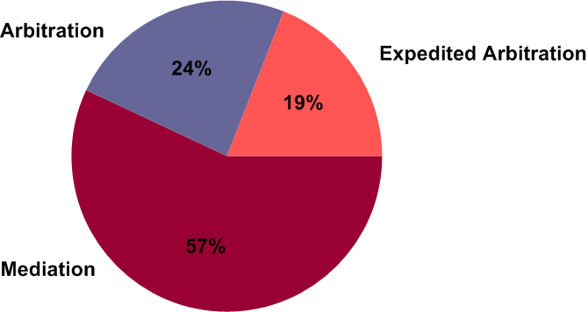
WIPO CASES: TYPES OF PROCEDURE

Slide 155
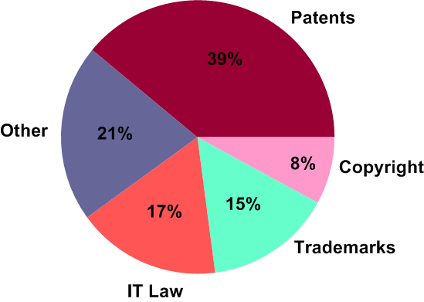
WIPO CASES: SUBJECT MATTER

Slide 156
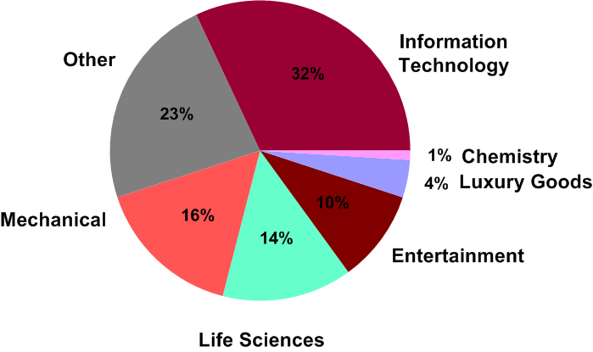
WIPO CASES: BUSINESS AREAS

Slide 157
DURATION OF MEDIATION AND ARBITRATION
MEDIATION
  Average duration: 8 months (46% of respondents: 1-6 months)
  WIPO cases: 5 months
ARBITRATION
  6-12 months typically (61% of Respondents)
EXPEDITED ARBITRATION
  9 months on average
  WIPO cases: expedited arbitration 7 months
Source: WIPO Arbitration and Mediation Center, International Survey on Dispute Resolution in Technology Transactions, 2013
Notes:
Häufigkeit Schiedsgerichtsverfahren in Vertragsklauseln:
11% Umfrageteilnehmer: Schiedsgerichtsverfahren für mind. 30% der vertraglichen Streitigkeiten und 10% der nichtvertraglichen Streitigkeiten
Negativ
Präzedenzfall nötig
???: “Mediation ist ein Zeichen von Schwäche” / “Wir haben versucht zu verhandeln, daher wird ein Mediator nichts Weiteres beitragen”

Slide 158
COSTS OF MEDIATION AND ARBITRATION
MEDIATION
  Costs below USD 100,000 (91% of Respondents)
  WIPO cases: average USD 21,000
ARBITRATION
  Average costs: USD 400,000 – USD 425,000
EXPEDITED ARBITRATION
  typically not more than USD 50,000
WIPO CASES: AVERAGE COSTS 165,000
Source: WIPO Arbitration and Mediation Center, International Survey on Dispute Resolution in Technology Transactions, 2013
Notes:
Häufigkeit Mediationsklauseln:
11% Umfrageteilnehmer: Mediation für mind. 30% der vertraglichen Streitigkeiten und 14% der nichtvertraglichen Streitigkeiten
Negativ
Präzedenzfall nötig
???: “Mediation ist ein Zeichen von Schwäche” / “Wir haben versucht zu verhandeln, daher wird ein Mediator nichts Weiteres beitragen”

Slide 159
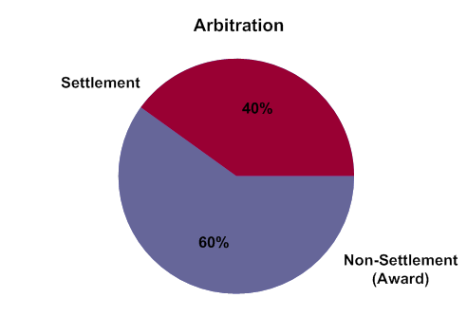
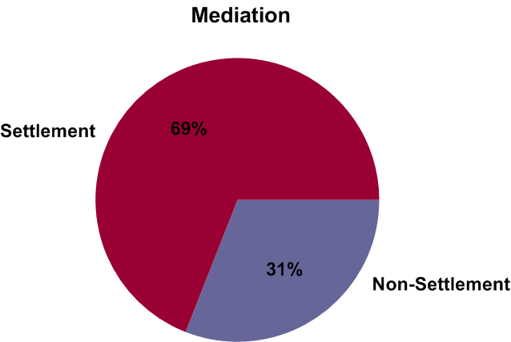
SETTLEMENT IN WIPO-ADMINISTERED CASES

Slide 160
One Exchange of Pleadings
Shorter Time Limits
Sole Arbitrator
Shorter Hearings
Fixed Fees
Notes:
Voluntary process agreed by the parties
Binding procedure
Guaranty of due process
Cost-effectiveness and expeditious procedure
Final, no appeal
Enforceability of the award
New York Convention on the Recognition and Enforcement of Foreign Arbitral Awards 1958
147 Member States
International arbitral awards to be recognized and enforced like final national court judgments (limited grounds to reject enforcement)

Slide 161
WIPO MODEL CLAUSE –
MEDIATION FOLLOWED BY ARBITRATION
Try mediation before arbitration, at least until
  lapse of time period
  Termination
Combining the benefits
  arbitration well-prepared
"Any dispute, controversy or claim arising under, out of or relating to this contract and any subsequent amendments of this contract, including, without limitation, its formation, validity, binding effect, interpretation, performance, breach or termination, as well as non-contractual claims, shall be submitted to mediation in accordance with the WIPO Mediation Rules. The place of mediation shall be [ ]. The language to be used in the mediation shall be [English]”
If, and to the extent that, any such dispute, controversy or claim has not been settled pursuant to the mediation within [60][90] days of the commencement of the mediation, it shall, upon the filing of a Request for Arbitration by either party, be referred to and finally determined by arbitration in accordance with the WIPO Arbitration Rules. Alternatively, if, before the expiration of the said period of [60][90] days, either party fails to participate or to continue to participate in the mediation, the dispute, controversy or claim shall, upon the filing of a Request for Arbitration by the other party, be referred to and finally determined by arbitration in accordance with the WIPO Arbitration Rules. The arbitral tribunal shall consist of [a sole arbitrator/three arbitrators]. The place of arbitration shall be [ ]. The language to be used in the arbitral proceedings shall be [English]. The dispute, controversy or claim referred to arbitration shall be decided in accordance with [ ] law."

Slide 162
PATENT INFRINGEMENT DISPUTE SUBMITTED TO WIPO ARBITRATION
Two U.S. companies, litigation in several jurisdictions
Submission Agreement to WIPO Arbitration:
  Patent infringement dispute related to a European patent in the area of consumer goods
  Patent law of a particular European country applicable
  Three-member arbitral tribunal
WIPO Center suggested three arbitrators with expertise in the relevant national patent law
One-day hearing including witness statements
Final award rendered within five months of the commencement of the arbitration

Slide 163
ACTIVE WIPO CASE MANAGEMENT
General procedural information, training programs
Initiation of procedure and subsequent case communication (option of WIPO Electronic Case Facility)
Neutral appointment process
  Over 1,500 specialized neutrals
  100 nationalities
  Mediators, arbitrators, technical experts
  All areas of IP/IT
  New neutrals added in function of specific case needs
Setting fees, financial management
Availability of procedural guidance to neutral/ At request, hearing/meeting logistical assistance

Slide 164
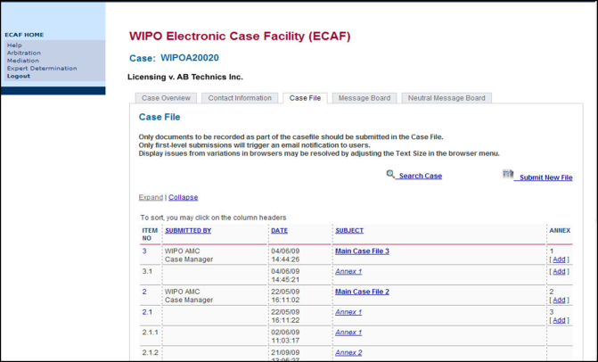
WIPO ELECTRONIC CASE FACILITY (ECAF)
Easy; instant; centralized; location-independent; secure; available at parties’ option

Slide 165
WIPO ADR SERVICES FOR SPECIFIC SECTORS
Domain Names (40,000+ cases since 1999)
Research and Development/Technology Transfer
ICT ( WIPO Arbitration for FRAND Disputes)
Intellectual Property Offices :
  IPO Singapore
  INPI Brazil
http://www.wipo.int/amc/en/center/specific-sectors/

Slide 166

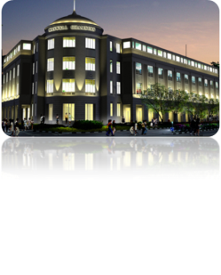
ADDITIONAL INFORMATION
Download more model clauses : http://www.wipo.int/amc/en/clauses/
Information on WIPO Rules, procedures, cases examples:
    http://www.wipo.int/amc/en/
Contact information:
  WIPO Center Office in Geneva
  WIPO Headquarters
+41 22 338 8247
  WIPO Center Office in Singapore Maxwell Chambers
+65 6225 2129
    arbiter.mail@wipo.int

Slide 167

GLOBAL DATABASES FOR IP PLATFORMS AND
TOOLS FOR THE CONNECTED KNOWLEDGE ECONOMY
Speaker: Glenn MacStravic, Head, Brand Database Section, Global Infrastructure Sector

Slide 168
STRATEGIC GOALS OF GLOBAL DATABASES AND TOOLS
2 related goals:
  “Coordination and Development of Global IP Infrastructure”
  “World Reference Source for IP Information and Analysis”

Slide 169
BENEFITS TO STAKEHOLDERS
For Business/Research:
  Providing search facilities for IP collections (patents, trademarks, industrial designs)
  Simplifying application procedures to multiple IP authorities
  Providing IP related matchmaking services
For IP offices:
  Assisting automation, IP information dissemination to the public, and exchange of IP documents with other offices

Slide 170
GLOBAL DATABASES, TOOLS, AND PLATFORMS FOR IP BUSINESS (FREE)
PATENTSCOPE
Global Brand Database
WIPO Lex
WIPO IPAS, WIPO DAS
WIPO CASE
WIPO RE:SEARCH
WIPO GREEN

Slide 171
PATENTSCOPE
2.4 million PCT data (first publish every week, high quality full text)
35 million records from 36 countries or regions
Full text data from 18 countries or regions
15,000 pageviews per hour
Analyze results by graphs and charts
Search and read in your language
How to use it?

Slide 172
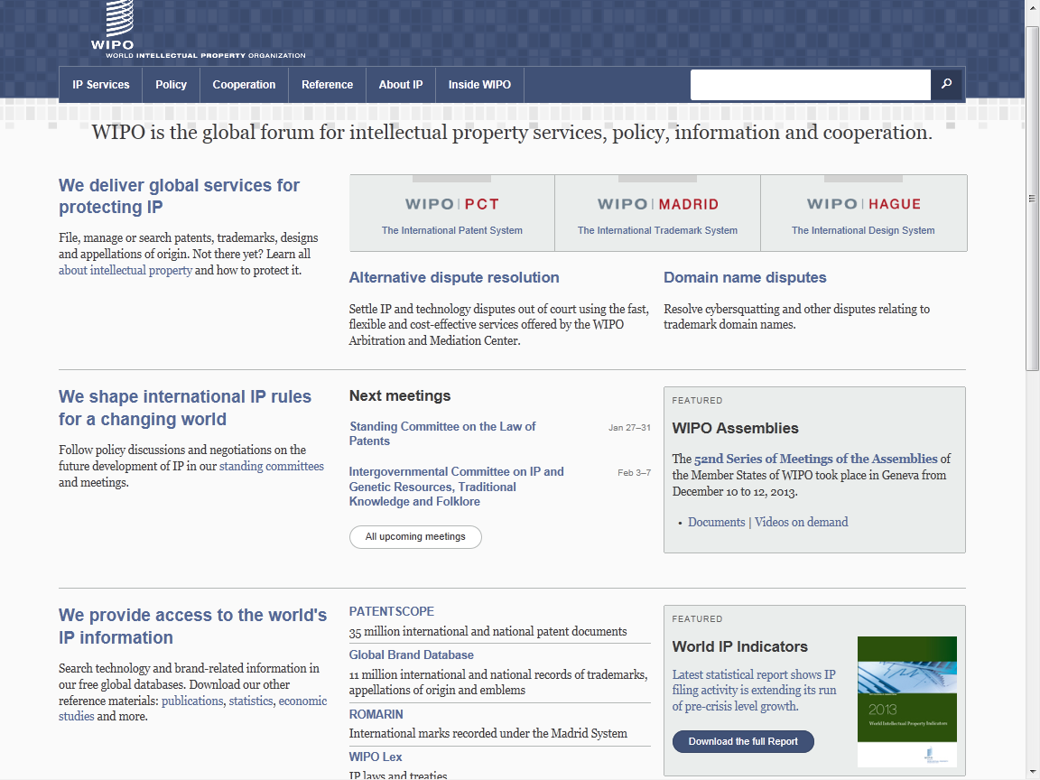
www.wipo.int

Slide 173


Slide 174



Slide 175


Slide 176


Electric car - only 16,000 hits
Search Query
(synonyms & technologically related terms)

Slide 177


Slide 178

???

Slide 179


Slide 180


Slide 181

What if you do not know a term in English?

Slide 182


Slide 183


Slide 184


Slide 185


Slide 186


Slide 187


Slide 188


Slide 189


Slide 190


Slide 191

TAPTA

Slide 192


Slide 193


Slide 194

Survey in 2013

Slide 195


Who are using PATENTSCOPE ?

Slide 196

71% : interface is good

Slide 197

Monthly webinar

Slide 198
GLOBAL DATABASES, TOOLS, AND PLATFORMS FOR IP BUSINESS (FREE)
PATENTSCOPE
Global Brand Database
WIPO Lex
WIPO IPAS, WIPO DAS
WIPO CASE
WIPO RE:SEARCH
WIPO GREEN

Slide 199
GLOBAL BRANDS DATABASE
Over 12 million records relating to internationally-protected trademarks, etc.
Free of charge simultaneous brand-related searches across multiple collections, including:
  Trademarks registered under Madrid System
  Appellations of Origin registered under Lisbon System
  Emblems protected under the Paris Convention 6ter
  Algeria, Australia, Canada, Egypt, Estonia, Israel, Morocco, Singapore, Switzerland, UAE, US

Slide 200
www.wipo.int

Slide 201


Slide 202


Slide 203


Slide 204


Slide 205


Slide 206


Slide 207


Slide 209


Slide 210
GLOBAL DATABSES, TOOLS, AND PLATFORM FOR IP BUSINESS (FREE)
PATENTSCOPE
Global Brand Database
WIPO Lex
WIPO IPAS, WIPO DAS
WIPO CASE
WIPO RE:SEARCH
WIPO GREEN

Slide 211
www.wipo.int

Slide 212


Slide 213


Slide 214


Slide 215


Slide 216


Slide 217


Slide 218
GLOBAL DATABASES, TOOLS AND PLATFORMS FOR IP BUSINESS (FREE)
PATENTSCOPE
Global Brand Database
WIPO Lex
WIPO IPAS, WIPO DAS
WIPO CASE
WIPO RE:SEARCH
WIPO GREEN

Slide 219
IPAS AND DAS
IPAS (IP Office Administration System) used by 60 IPOs
A WIPO software enabling small IPOs to electronically process patent, trademark, design applications
DAS (Digital Access System) used by 11 IPOs
A System that allows IPOs and applicants to securely exchange or submit a digital copy of priority documents to multiple IPOs

Slide 220
GLOBAL DATABASES, TOOLS, AND PLATFORM FOR IP BUSINESS (FREE)
PATENTSCOPE
Global Brand Database
WIPO Lex
WIPO IPAS, WIPO DAS
WIPO CASE
WIPO RE:SEARCH
WIPO GREEN

Slide 221
WIPO CASE
“Centralized Access to Search and Examination Reports”
Started with an initiative of IP Australia and the Vancouver Group (AU, CA, UK)
Online patent work-sharing platform for patent examiners worldwide—secure sharing search and examination documentation
IPOs can enhance quality and efficiency of patent examination
CASE will be linked to Open Portal Dossier of IP5 to become the Global Portal Dossier
How will it work?

Slide 222
WIPO CASE (CONTINUED)
The System functions to:
  search by patent number and retrieve simple results or a list of patent family members.
  view bibliographic data, citation data (if available) and lists of documents available for each patent record.
  view and/or download the available documents.
  subscribe to notifications of updates to a given patent record.
Will be linked to OPD of IP5 -> “Global Dossier”

Slide 223


Slide 224




GLOBAL DOSSIER PLATFORM (WIPO-CASE, OPD AND PATENTSCOPE)
Public Users
(including IP office users)
Examiner of IP5 Office not participating in WPO/CASE
OPD
Feed dossier information that OPD/CASE Offices agree to publish
Public Domain
OPD
WIPO CASE
Not accessible to the public and for PTO official use only
IPAS+
CASE depositary
System
Examiner of CASE participating office
Examiner of IP5 Office participating in WPO/CASE
CASE depositary Office using IPAS
CASE depositary Office using own EDMS
E.g. Australia

Slide 225
GLOBAL DATABASES, TOOLS, AND PLATFORMS FOR IP BUSINESS (FREE)
PATENTSCOPE
Global Brand Database
WIPO Lex
WIPO IPAS, WIPO DAS
WIPO CASE
WIPO RE:SEARCH
WIPO GREEN

Slide 226


Partnership platforms designed to facilitate collaboration and the sharing of technologies to address major challenges
Broad aims:
  Match-making for technology transfer and collaborations
  Reduce transaction costs
  Develop multi-stakeholder approaches
  Demonstrate practical means for the global policy issues

Slide 227
WIPO RE: SEARCH
A Global Database and Platform to bridge partners to use IP (including know-how and data) to facilitate R&D on neglected tropical diseases, tuberculosis, and malaria
Royalty-free for R&D, manufacture and sale in LDCs
Over 60 partners (pharmaceutical industry, research institutes such as NIH, Universities)
As of January 2014, 44 collaborations

Slide 228

www.wipo.int/research

Slide 229


Slide 230













WIPO RE:SEARCH
Sharing Innovation in the Fight Against Neglected Tropical Diseases
Get involved:
As a user
As a provider
As a supporter
(Adhere to Guiding principles, contact email: re_search@wipo.int)
…

Slide 231
WIPO GREEN
A global database allowing users to make green technologies available for licensing or partnership, enter technology needs, search for technologies and needs
Started a pilot with Japan Intellectual Property Association in 2011
Launched in November 2013
as of January 2014, over 800 offers
Green tech providing companies in Germany, Japan, US etc.
Partners include companies, universities, UN agencies, governments, IPOs, NGOs, etc.

Slide 232































PARTNERS OF WIPO GREEN

Slide 233

www.wipo.int/green

Slide 234

SIX AREAS OF GREEN TECHNOLOGY MARKETS

Slide 235

THE CHALLENGE
International Transfer of wind power technology, 1988-2007,
OECD 2010

Slide 236



EXAMPLE: PRODUCT TO LICENSE OR SELL
TEIJIN Limited (Japan)

Slide 237
GET INVOLVED
Become a Partner and shape the further development of WIPO GREEN
Register to:
    communicate your green innovation and technology needs
    advertise your inventions, technologies, products and services
    connect with the innovation and business communities globally

Slide 238
CONCLUSION
WIPO Global Databases and Platforms will promote global partnerships among multiple stakeholders
DB, Tools, Platforms need to be easy to search, most updated, interactive/dynamic, multilingual, and robust

