Slide 1
WIPO IP Diagnostics Presentation
22 July
2022
Mariana Velasco
IP for Business Division

Slide 2
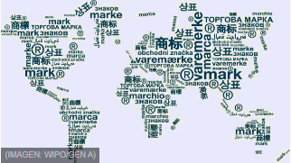





Intellectual Property
Copyright ©
Apps, computer programs, databases, advertisements, maps and technical drawings.
Trademarks ®
Industrial designs
Geographical indications
Trade secrets
Patents

Slide 3
How IP contributes to SMEs sustainable economic growth
SMEs play a key role in national economies around the world, generating employment, adding value and contributing to innovation.
Understanding the Benefits of IP for SMEs
Access technical and business information and knowledge
Avoid the risk of unknowingly using third party proprietary content
Generate new revenues Joint ventures, financing / investment, licensing
Establishing business competitive space
Visibility in crowded markets

Slide 4
IP & SMEs
SMEs that use IP in their business strategies
Generate performance revenues up to 50% higher than SMEs without IP Rights
21% more likely to grow in the following three years, and 10% more likely to become a high growth firm when combining multiple IP rights
Account for about 90% of firms globally
Provide more than 50% employment worldwide
Play a critical in economic growth and sustainable development

Slide 5




However, most SMEs don’t use IP in their business strategies
Lack of awareness of intellectual property assets and insufficient information on the relevance of IP in day-to-day business
Lack of professional advise and perception that the IP system is too complex and time-consuming
Perceived high costs associated with obtaining and enforcing IP rights
Limited assessment techniques

Slide 6
An on-line IP self-assessment tool for small businesses
Provides a customized report on the IP assets of the business and how they may be protected, managed and exploited based on the answers provided by the user to a series of questions
Is free, easy to use and requires no registration
Is available in English, French, Spanish, Russian, Chinese, Arabic and Japanese
WIPO IP Diagnostics

Slide 7


https://www.wipo.int/ipdiagnostic/
Developed by experts
Support for buiding an IP strategy
Blind spots and red flags
Business-friendly language
Key aspects of IP for business
Pre assessment + detailed report on 10 issues
Free of charge and simple to use
Helps guide discussions with an adviser
Enforcement
IP-driven business development
The IP Diagnostics Tool is not a substitute for professional legal advice

Slide 8
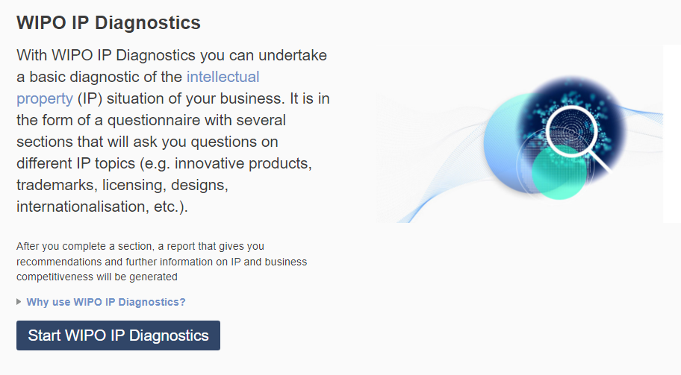
The IP Diagnostics Tool: how does it work?
Access the page WIPO IP Diagnostics and click on start WIPO IP diagnostics.
No registration required.

Slide 9
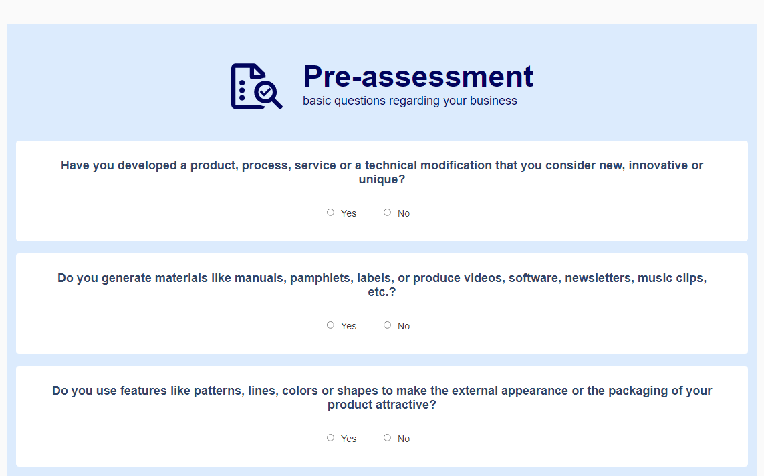
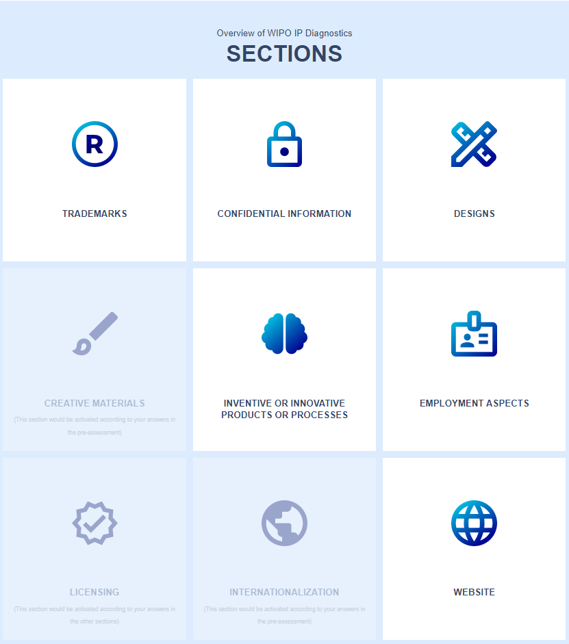

The second layer questionnaire adapts to the specific business based on the responses in the pre-assessment
Sections cover 10 business-relevant IP issues (patents, trademarks, designs, copyrights, and trade secrets).
The tool explores IP in all areas of business activity (employees, external suppliers, subcontractors, international trade, licensing and franchising).
First layer questionnaire about general information from the business
No time limit, possibility to interrupt and resume the session any time
Duration: approx. 1 hour for the 10 sections
Accessible from a computer or a smartphone

Slide 10

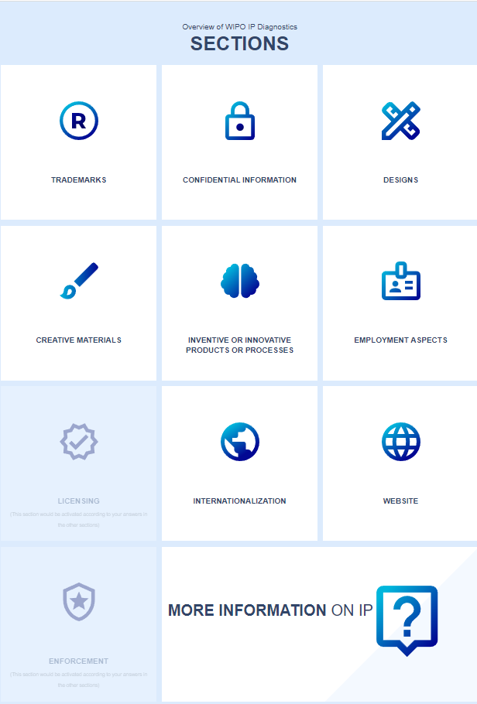
Rosita Rice Ltd.
Manufacturer, Trading Company, Distributor.
Product: Grain rice
Internet advertisement, Flyers, propaganda etc.
Attractive packaging
Distinctive logo
Supplies grains from external providers
Website
Local and international sales
5 total employees

Slide 11
Next Steps
Read the report and identify potential intangible assets
Book a date with an advisor
Design an IP strategy
Protect your IP
Monitor and update IP strategy to reach commercial goals

Slide 12


Useful guides for SMEs
Second edition
Publication year: 2022
Publications: Intellectual Property for Business (wipo.int)

Slide 13


Thank you!
Mariana Velasco
@WIPO, 2022
  Attribution 3.0 IGO
  (CC BY 3.0 IGO)
The CC license does not apply to non-WIPO content in this presentation.

