Slide 1
WHY IS BUILDING RELIABLE ALLIANCES IMPORTANT IN BUSINESS?
WOMEN WEDNESDAYS
Women Innovators and Entrepreneurs in Asia-Pacific Program - World Intellectual Property Organization (WIPO)

Slide 2
Congratulations!
You are woman innovators, founders, and business leaders/owners.
What you do now is bigger than yourself.
Notes:
Contributing to families, communities, society.

Slide 3
Right now, RELIABLE ALLIANCES ARE more important than ever.
COVID-19 and uncertainty about the future
Competitiveness
Technology
Exploding Data
Competencies
Knowing when to embrace change
Other roles as a woman (mother, wife, daughter)
Notes:
We cannot do this alone, we must thrive together

Slide 4
BUT FIRST, YOU MUST BECOME A RELIABLE ALLy TO OTHERS.

Slide 6
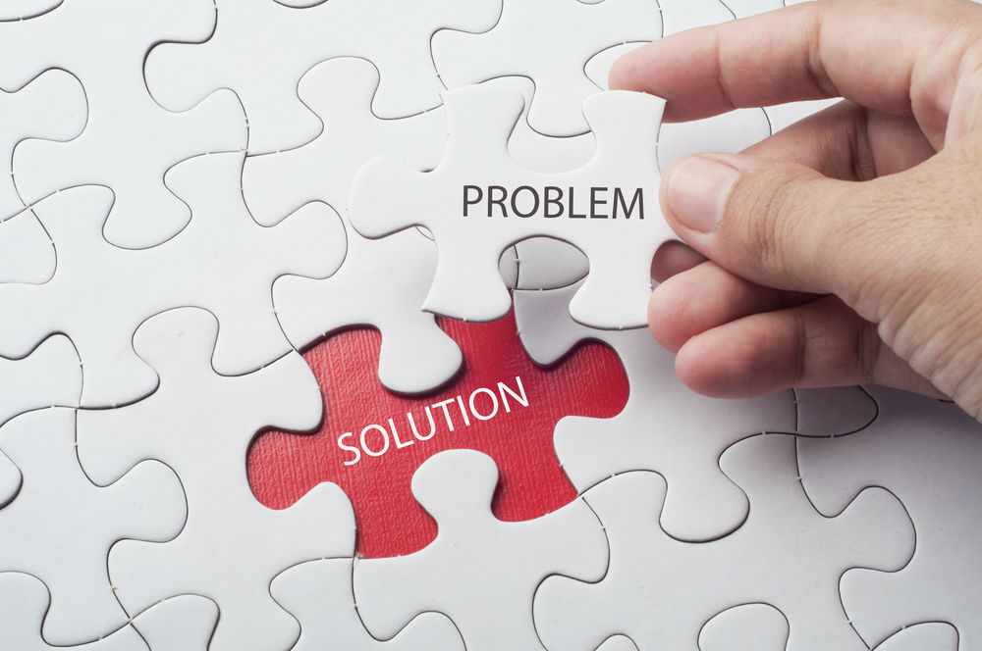
Remind yourself and fall back in love to the problems you Are trying to solve

Slide 7
BUILD YOUR STRONG BUSINESS FOUNDATION
AND STANDPOINT
Answer these:
Is still it relevant?
Does it provide (a) solutions?
Does it make positive impacts?

Slide 8
NETWORKING

Slide 9
CORE OF NETWORKING
Building a broad and diverse set of relationships so you can help others and they can help you.
Law of reciprocity. Someone who is fighting the good fight beside you, and vice versa.

Slide 10
Network as infrastructure
Creating a robust network
Strategic: who can help you with priorities, capabilities, constraints.
Operational: who you can rely on to get the job done, advice, info, support, resources.
Development: who you can go to in terms of profession, career promotion, opportunities, social, support, protection from adverse situation.

Slide 11
No matter how uncomfortable it may be, you need to be able to network.
Research shows that networking can make people anxious, and one in four people don’t network at all.
However, networking allows us to meet influential people in our field and helps us grow professionally. Not to mention, people who make an effort to improve their networks are 42%–74% more likely to be promoted than those who didn’t.
*Richard Newman’s “How To Network When You Hate Networking”

Slide 12
Relationship
Resources
Leadership Capability
Learning
- Show genuine interest
- Learn about them
- Find common interest
- Discover how you’re
different
- Offer something valuable
- Ask/prepare list of questions
Notes:
You can’t be a reliable ally to others if they don’t perceive you as a good leader or manager

Slide 13
Be an effECTIVE leader AND/OR manager

Slide 14
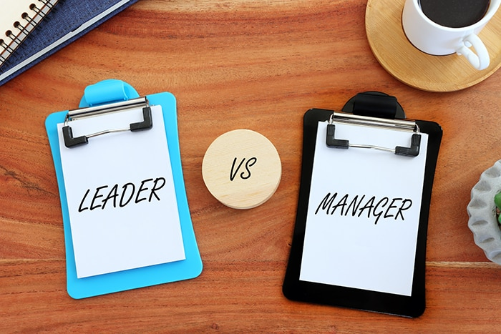
What’s the difference between leaders and
managers?
Effective leaders: Create conditions for others to thrive by motivating, influencing, inspiring,
as well as offering support and development.
Effective managers: Deliver what’s planned and/or promised on time, within budget, at a good quality and with minimum of variability even in the face of unexpected events.
*Harvard Business School Online
Notes:
Manager -> getting the job done
Leader -> providing structure and direction

Slide 15
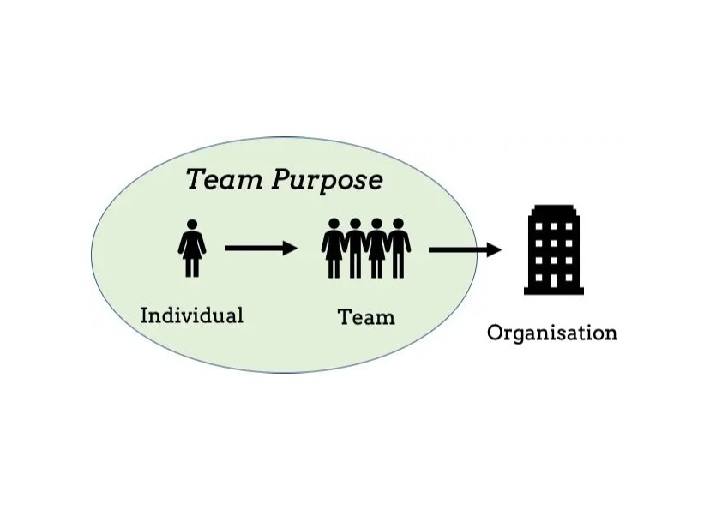
MANAGING YOUR TEAM
YOUR PURPOSE = YOUR TEAM PURPOSE
Notes:
The key driver behind my resilience is my purpose. Having a defined goal or reason for doing what you do means that even in the toughest times, when it feels like the world is against you, there is a reason to keep moving forward. This is vital not only for individual managers and leaders, but for entire businesses too.

Slide 16
MASTERING THE ‘3C’
Clarity: clear direction on where team is going and how to get there?
Challenging: what challenge that will motivate this goal?
Consequential: why is it important to achieve this goal?
Notes:
Clarity: how will you get from starting point A to end at point B?
Challenge: What actions, system, incentives do the journey require?
Cons: How can we ensure those actions were taken?

Slide 17
SETTING THE STAGE IN COLLABORATIVE WORKING
Head: - Cognitive Level
- Understand why the change need to happen
- Take the objective view of poor performance/management
Heart: - A sense of emotional urgency to change
- Dedicated to shared values
Hands: - Engage in new ways of working
- Create opportunities to practice new behaviors, skills and competencies
Notes:
Psychological safety environment
Feedback

Slide 18
How do you forge deeper partnerships and collaborations?
1. Connect with people who have different strengths and skills
2. Stay open to different ideas, opinions, and views on life
3. Break down hierarchies and build relationships based on equality
4. Don’t be afraid to challenge each other
Notes:
surrounded myself with people who knew what they were doing, who all trusted each other and were motivated by the same purpose
Listen more, before talk. Trust my intern with digital and social media because they just don’t understand them, they live in them. View conversation as a learning opportunity.
It’s difficult to form meaningful connections and vulnerable to bias. Embrace diversity and people authenticity
Psychological safety, healthy debate.

Slide 19
AND… BE resilient!
Resilience is like a muscle.
Whilst some may have a natural proclivity for it, there is no fixed limit on our own resilience. The more you ‘work out’ your resilience and put it to the test, the stronger and more developed it will be in time.

Slide 20
How can managers and leaders build resilience?
Building resilience comes down to effectively managing change and finding solutions to new challenges presented by the changing world around us. For managers and leaders looking to flex their resilience muscle, key skills in good communication, people management and problem solving can all work together to build this feeling of agility and strength. Sometimes a crisis provides a perfect opportunity to sharpen these skills, but effective training and development opportunities are essential in facilitating this.

Slide 21
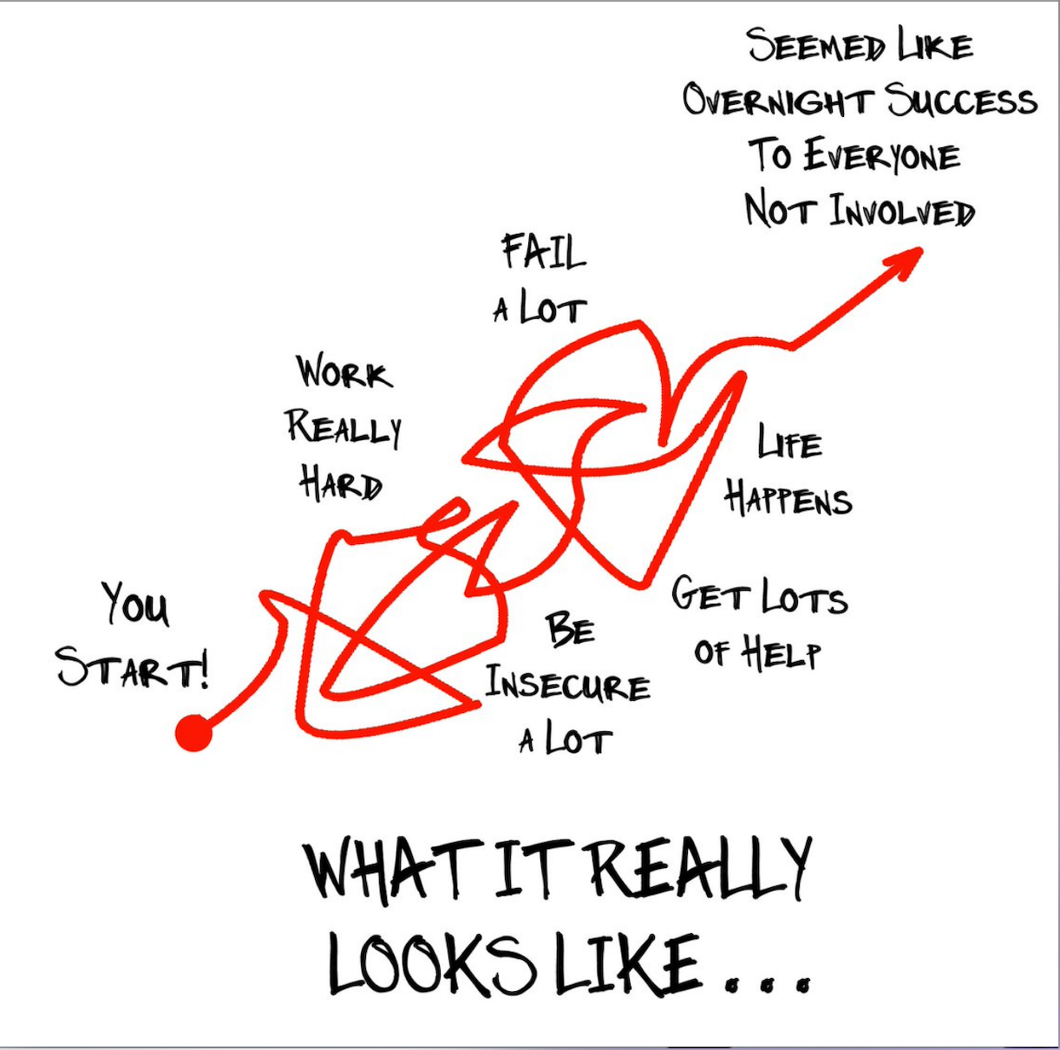
Notes:
In this process, we make alliances, collabs, build resilience, manage people

Slide 22
Self-discipline
ROUTINE
RITUALS

Slide 26
Self-care
Curate your problems
Do I have a problem?
Yes
No
Does it have a solution?
WHY BOTHER?
Yes
No
Notes:
It’s OK to say no and let go of what we can’t control

Slide 27
How have past events shaped you and how does it cost you?

Slide 29
THANK YOU!

