Slide 1
Jane Payumo*, Howard Grimes, & Keith Jones* Washington State University, Pullman, WA, USA
Assessing the Impact of Intellectual Property Rights (IPR) in Agriculture and Responses of Developing Asia
.
Learning from Existing Evaluation Practices on the Impacts and Effects of Intellectual Property on Development
World Intellectual Property Organization Geneva, Switzerland October 5-6, 2011

Slide 2
introduction
IPR important for policy making in agriculture
present tools to evaluate impact of IPR in agriculture and responses of public sector research to IPR developments
econometric approach – analyze relationship of strengthened IPR with agricultural development of TRIPS member countries; and
web-based survey - measure attitudes and perspectives, of public sector personnel on IPR and their implications.

Slide 3
methodology
Tool No.1 : Econometrics
econometrics = economic theory + statistics
steps to doing econometric study
1
3
5
7
literature survey and hypothesis
2
4
model adequacy test
6
use model for prediction
econo- metric model
data collection
parameter estimation
hypothesis test
Notes:
To discuss innovations done. Darker blue box.

Slide 4
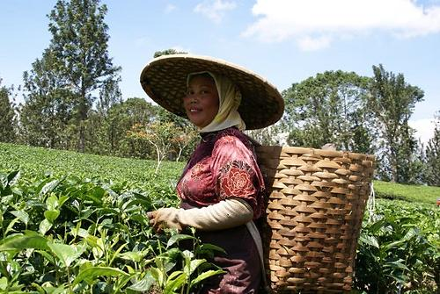
methodology
main question: Is IPR a positive/negative factor in agricultural development?
evaluation questions
which data to use? source?
which variables need to be included in the study?
which technique can provide better parameter estimates for the models? Which statistical software to use?
what are the policy implications/consequences of the quantitative relationships?
Plantations and agriculture in Indonesia.

Slide 5
methodology
econometric models used
e.g. Y = a + bX,
Independent + control variables
Dependent variable
Model | Dependent variable | Independent variables | Control variables
1 | Agricultural gross domestic product (GDP) | Ginarte-Park Index | Agricultural development indicators: agricultural area, irrigated land, fertilizer use, post-secondary education; and presence/absence of genetically modified crops
2 |  | Number of domestic patents
3 |  | Tier classification based on number of domestic patents
4 |  | Presence/absence of patent and plant variety protection laws

Slide 6
findings
positive correlation between agricultural GDP and measures of strengthened IPR protection
significant relationship of agricultural GDP with GPI, domestic patents, tier classification, and PVP;
reaffirmed influence of traditional economic indicators: agricultural area, irrigation, fertilizer, and human capital to agricultural development; and
GM crop commercialization no significant influence on agricultural GDP
Notes:
Positive association between agricultural GDP and three measures of strengthened IPR protection.
significant relationship of agricultural GDP with GPI, domestic patents, tier classification , and PVP;
reaffirmed influence of traditional economic indicators: agricultural area, irrigation, fertilizer, and human capital to agricultural development;
GM crop commercialization has no significant influence (3 out of 4 models) on agricultural GDP of all TRIPS member countries.

Slide 7
key lessons
Econometric tools useful to extract and infer useful information to determine impact of IPR to agriculture:
time series cross section data better than time series or cross section data alone: enables analysis of cross sectional variation (among TRIPS member countries) and time series variation (before and after TRIPS);
success of any econometric study hinges on quality and quantity of data.;
choice of variables important to generate econometric models that represent reality;
use modern econometric software (e.g. SAS) that offers robust and powerful estimation.
Notes:
Econometrics provided the tools to extract and infer useful information to determine impact of IPR:
Time series cross section data enables cross sectional variation (among TRIPS member countries) and time series variation (before and after TRIPS).
Success of any econometric study hinges on quality and quantity of data.
Use of reliable and comprehensive sources such as global databases of World Bank, FAO, WIPO
Care in data handling (be systematic)
Choice of proxy variables especially to represent strengthened IPR are important to generate econometric models that represent reality (i.e. expansion of IPR in agriculture)
Use modern econometric software (e.g. SAS) that greatly facilitates model formulation, estimation and validation
offers practicality, speed (programming codes), and accuracy
provides helpful graphical information as well as tables of output.

Slide 8
methodology
Tool No.2 : web-based survey
steps to doing web-based study
1
3
5
7
2
4
survey invitation & follow-up *
6
data verifi-cation, collection, & analysis
identify/ define research problem
sampling method
research objective
question-naire design*
host survey in Internet*
Notes:
To discuss innovations done. Darker blue box.

Slide 9
methodology
main question: are public research institutions in developing Asia ready to embrace IPRs?
evaluation questions
which countries and institutions need to be sampled?
what survey questions need to be asked?
how to assure reliability, validity, and unbiased results in web-based survey?
4. what other information is useful for policy decisions related to institutionalization of IPR in public sector?
Notes:
Are public research institutions in developing Asia ready to embrace IPRs? Do institutions have similar responses for the new IPR paradigm?
- Do international regime developments affect their system of access and transfer of genetic materials and research tools from other research centers?
Do IPRs impact acquisition, generation, and commercialization of agricultural biotechnology and does it exert pressure for these institutions to change?
Are current efforts adequate to help these institutions address IPR issues affecting agricultural research? What then remain to be the main gaps in managing IP, and what are the capacity needs of these institutions?
Are scientists in the public sector, being one of the most important human resource of the public research institutions, aware and ready for the impacts of IPRs? Are they following the trend and footsteps of their private sector counterparts?
What are the factors affecting their acceptance/non-acceptance of the concepts and benefits/risks of IPRs? What are the relationships among these factors? What are the theoretical and policy implications of these relationships?
Which research institutions and from which countries in Asia need to be included in the research? Where to get the data and contact information?
What survey questions need to be included to reflect their perceptions, status, and needs of the different public research institutions on IPRs?
If it will be web-based data collection, how to assure reliability, validity, and unbiased results?
What innovation in the approach can be done to increase response rate without sacrificing data quality?
6. What other useful information can be extracted from the survey that can be useful for policy decisions related to IPR institutionalization in public sector?

Slide 10
methodology
 | No. of respondents | Response rate
Institutional heads | 43 | 47%
Researchers and scientists | 258 | 30%

Slide 11
findings
changing mindset towards importance of IP management is already happening in the different institutions surveyed
current capacity needs: commercialization and marketing of technologies.
IP legal regime did not impair institution’s access to technologies needed for research (e.g. biotechnology).
IP management initiatives did not create conflict with researchers, and stakeholders.
Notes:
Changing mindset towards importance of IP, and its management (generation, protection and commercialization) is already taking stage in the different institutions.
Current IP management capacity needs: commercialization and marketing of technologies.
IP legal regime did not impair institution’s access to technologies needed for research (e.g. biotechnology) .
IP management initiatives did not create conflict with researchers, and stakeholders they serve.

Slide 12
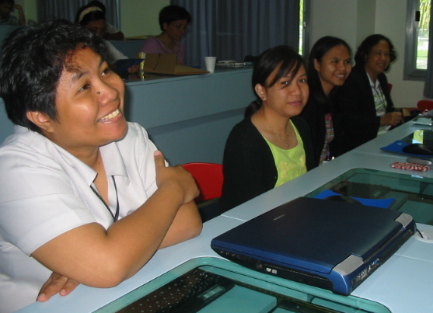
findings
awareness on IPR and issues
aware of IPR concept and familiar with existing international treaties and local IPR policies and laws;
very familiar with MTA: need training on other IPR instruments;
socio-demographic factors can influence attitudes of public sector personnel on IPRs and their implications.
Researchers from Philippines during one of their IP education seminars.
Notes:
Majority of researchers (94%) are aware of IPR though only few (29.4%) had attended formal trainings on it. They are familiar with existing international treaties especially TRIPS and local IPR policies and laws.
Yet majority of the respondents have no IPR yet on their name, some are already in process (esp. patents).
MTA is the IP instrument that many of the respondents (38.5%) are very familiar with. They need training on other IPR instruments (invention disclosure, assignment, etc.).
Socio-demographic factors (education, country of citizenship, and position held) can have predictive impacts on attitudes of public sector personnel on IPR and its implications (esp. R&D focus).

Slide 13
key lessons
key is carefully designed web-based surveys
role of Research Assurances Committee (e.g. Institutional Review Board for WSU);
pre-testing of questions;
web-based survey’s validity through firewalls and unique personal codes for each respondents;
ask as few questions as necessary; and
importance of follow up and deadline.
Notes:
Carefully designed web-based surveys generate quick, reliable, and cost-effective measure of attitudes, perspectives, and responses of public sector research on IP and its implications:
Questionnaires need to be reviewed and approved by Research Assurances Committee (e.g. Institutional Review Board for WSU) to ensure questions are not discriminatory and won’t cause harm embarrassment and stress to respondents;
Questions need to be pre-tested for clarity, understandability, usefulness, and validity;
Setting up of firewalls and unique personal codes for each respondents to demonstrate survey validity;
Ask as few questions as necessary to get information needed.
Follow up and deadline

Slide 14
conclusion
Overall, econometric and survey-based procedures as evaluation tools were useful in generating these results:
Strengthening of IPR due to TRIPS contributes to agricultural development for both developed and developing countries.
Public research institutions, at least in developing Asia, have realized the importance of IP and its management.
Socio-demographic factors can have predictive impacts on attitudes of public sector personnel on IPR and can be used for capacity building efforts.
Notes:
Overall, econometric and survey-based procedures as evaluation tools were useful in generating these results:
Strengthening of IPR due to WTO-TRIPS contributes to agricultural development for both developed and developing countries.
Public research institutions, at least in developing Asia, have realized the importance of IP and its management in this changing IPR regime.
Socio-demographic factors can have predictive impacts on attitudes of public sector personnel on IPR and its implications and can be used in building institutional IP management capabilities.

Slide 15
moving forward
more evaluation studies on impact of TRIPS and other IP treaties to agriculture and climate change; link of IPR, foreign direct investment, research expenditures in agriculture of developing countries;
adequate systems to monitor impact of strengthened IPR using new indicators;
capacity evaluation and design of appropriate IP training for public research institutions in developing countries;
evaluation studies on technology transfer models to promote better access, protection, and commercialization esp. for agricultural and environmentally sound innovations; and
more case studies on success stories and benchmark studies on IP management and technology transfer among WIPO members
contact us
Dr. Keith Jones
Dr. Jane Payumo
wsurf@wsu.edu
Notes:
More evaluation studies on the impact of TRIPS and other international IP treaties to agriculture and climate change:
studies on post-TRIPS implementation will be useful for review of TRIPS provisions and can serve as reference for other countries wanting to be TRIPS members
conduct more IP studies: economic, social and cultural impact assessment in the agricultural sector;
Adequate systems to monitor impact of strengthened IPR using other indicators beside Index (e.g. Ginarte Park Index);
Continued evaluation research on the links between IPRs, foreign direct investment, and research investment in the agricultural sector of developing countries;
Capacity evaluation and design of appropriate training for research institutions in developing countries;

