Slide 1




Copyright for AI-generated works?
Setting out the arguments against © protection
Hanani Hlomani
Research ICT Africa, Intaka Centre for law and technology

Slide 2
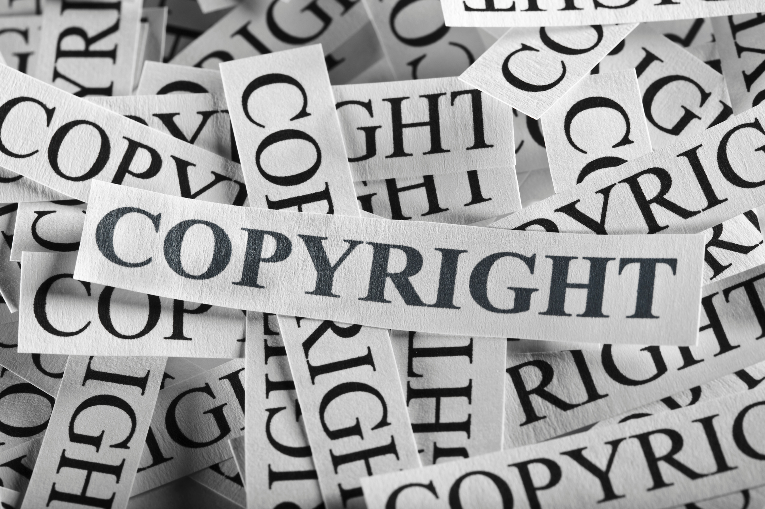
The Problem
  Platforms like ChatGPT and DALL-E produce text and images that are so coherent and creative that they are often indistinguishable from those crafted by human hands.
  Moving on to the legal realm, we encounter a significant challenge: the copyright status of AI-generated works remains unclear.
  Existing copyright laws were not designed to address this novel phenomenon, creating a legal vacuum.
  What were they designed for?

Slide 3

What Copyright law was created for.
  Copyright is intended as an incentive for humans to create, produce text, images, video, and software.
  AI does not need copyright as an incentive to produce the outputs, it simply performs the operation it was created to perform with little human oversight.
  Reward: Copyright is also meant to reward creativity.

Slide 4
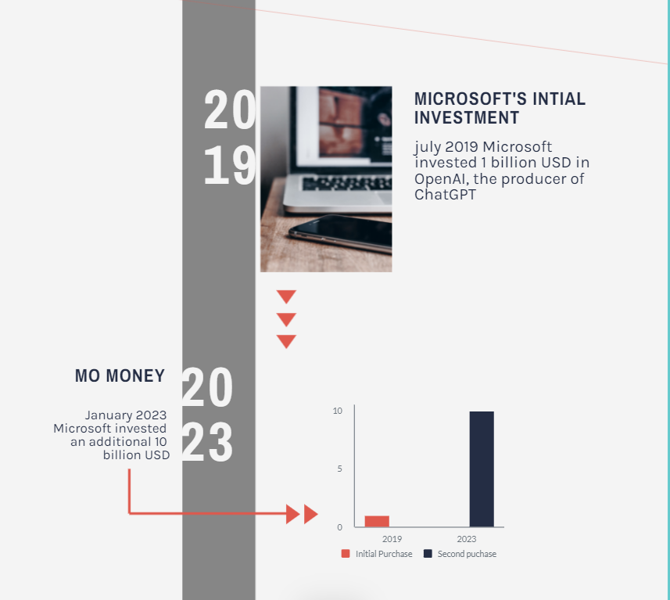
Investment in AI
Microsoft and other big tech developers of AI claim not to be interested in copyright so much as in producing general purpose AI (Lomas, 2023)

Slide 5
Why Copyright should not vest in AI-generated works
Logic:
  AI processes that produce outputs that resemble human creative processes are probabilistic. Generative AI relies heavily on the training data provided; so it's doubtful if they can create anything even if they combine human creativity in unexpected ways.
  Humans do not create probabilistically; instead, humans attempt to convey meaning through text and images. Ascribing meaning to AI outputs is a logical fallacy.
Ownership and Attribution:
  Most AI systems that produce outputs that mimic human creativity were trained on many creative inputs without consent or attribution toward the authors. If the developer of the AI owns AI in the outputs that would be similar to a software vendor owning the copyright in everything produced using the software that is licensed to end users.

Slide 6
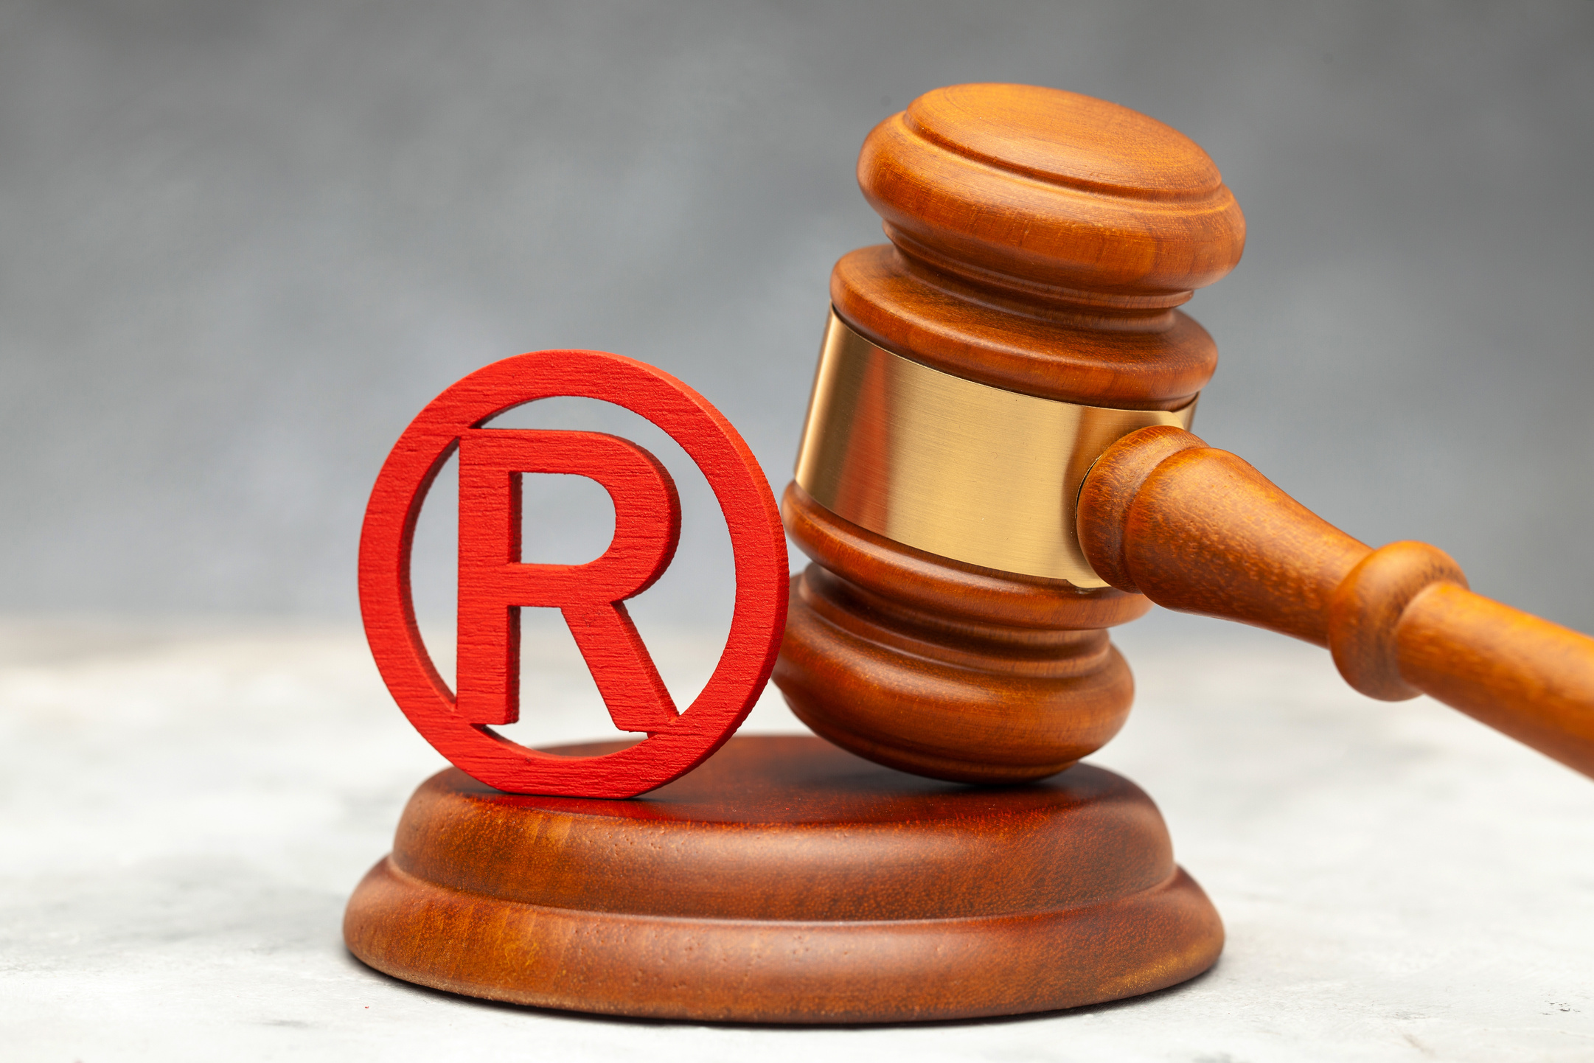
Continued..
  Ethical Considerations: Is it fair for AI to claim copyright over outputs heavily reliant on the creativity of countless human contributors?
  Impact on African Creativity: The consequences of this uncertainty extend to the heart of our creative industries. If left unaddressed, this lack of clarity threatens the livelihoods of our talented creators and potentially stifles the growth of creative sectors that are essential for our economic development.

Slide 7


Direction so far….
  The US Copyright Office has refused to register AI outputs due to lack of human authorship and issued guidelines requiring disclosure of AI use. (Thaler v Perlmutter)
  Similarly, patent offices and courts have refused to recognise AI as an inventor for patent. (Thaler v. Vidal (Fed. Circ), 2022).

Slide 8
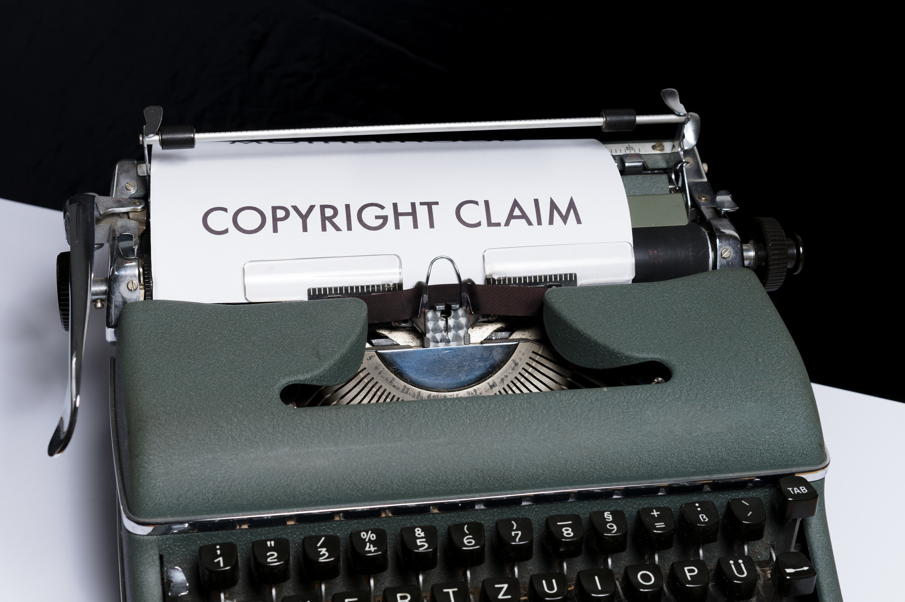
Conclusion
  In conclusion, the path forward is multifaceted. The decisions we make regarding AI-generated content and copyright will reverberate through our cultural, economic, and ethical landscapes. I implore us to engage in a thoughtful dialogue, recognizing that the core principle of copyright is to reward human creativity.

