Slide 1
WIDI NUGROHO
Deputy EVP Digital & Technology Platform
WIPO Conversation on Intellectual Property (IP) and Frontier Technologies
Divisi Digital Business & Technology - PT. Telkom Indonesia

Slide 2
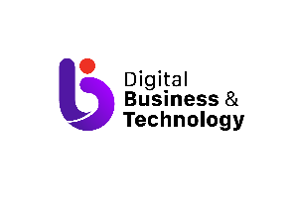
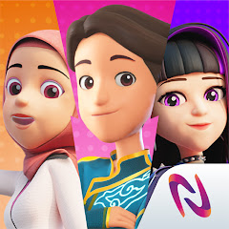
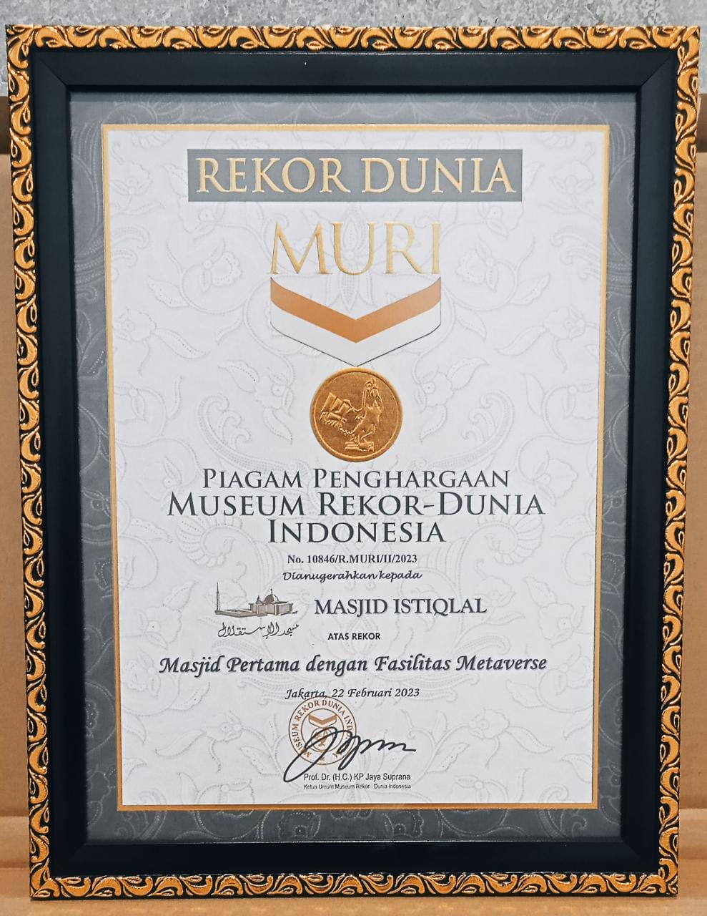
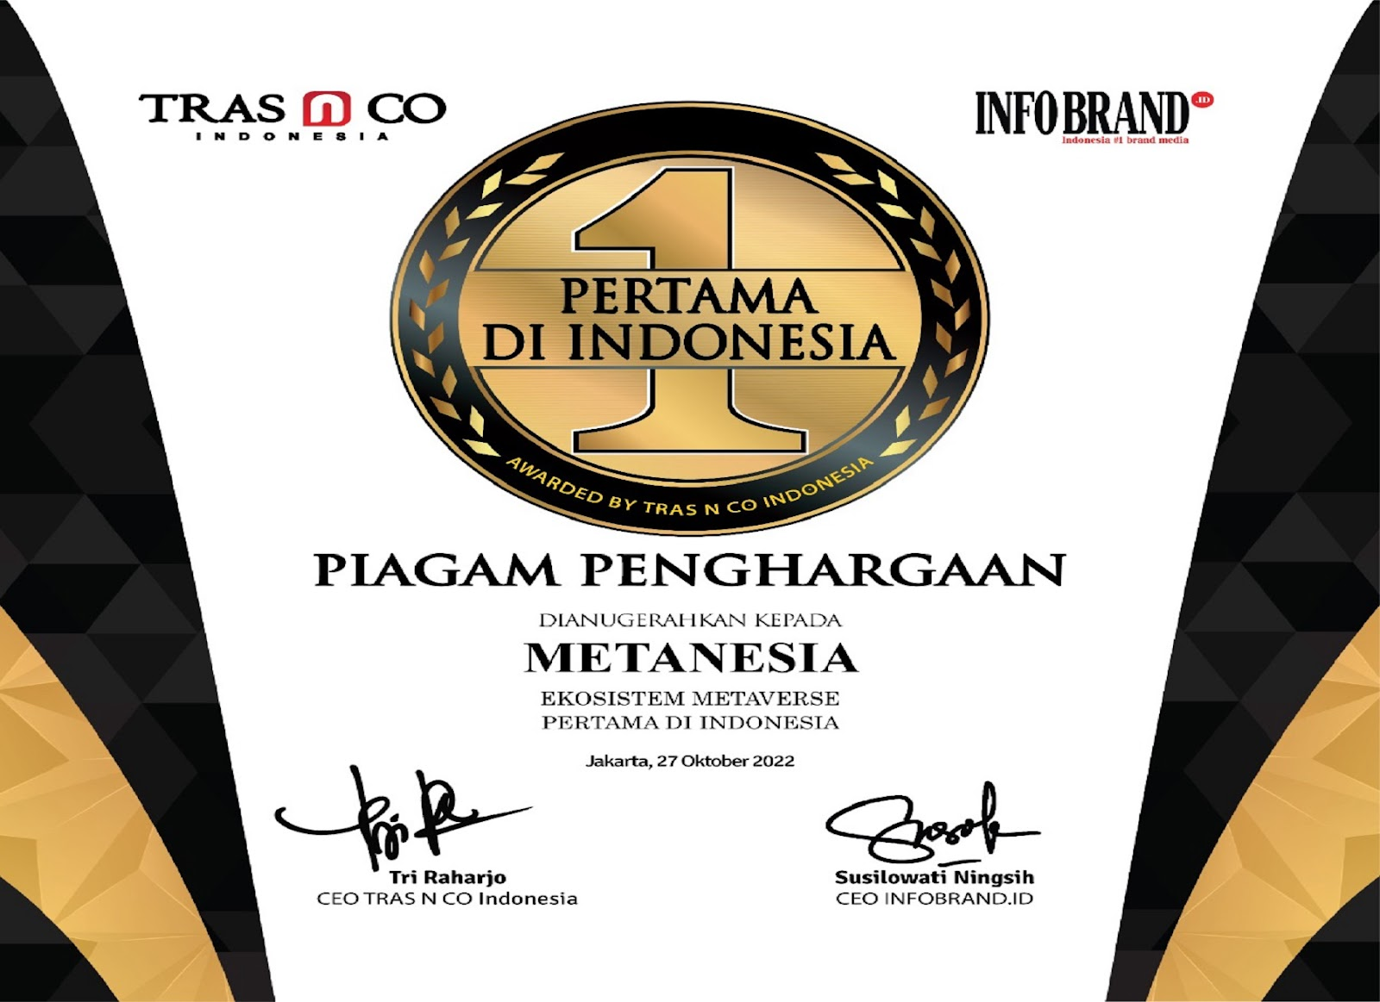
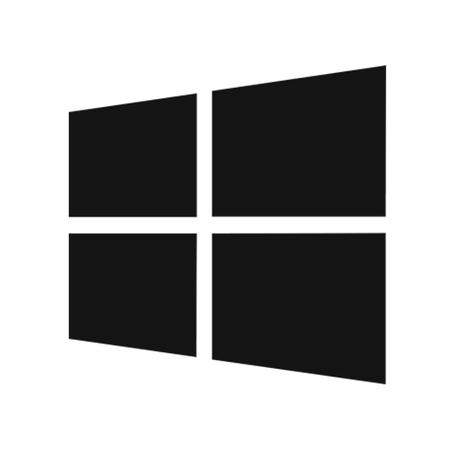
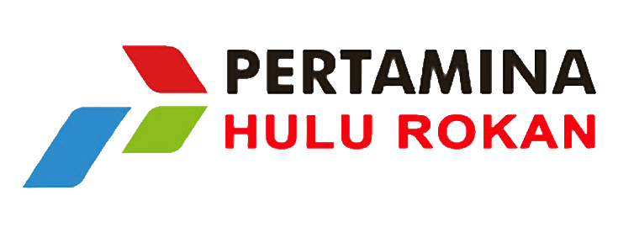
Metanesia Overview
Award:
25K+
Users Based
10K+
App download
4.3★
Rating
5K+
MAU
Available on:
Award 1st Metaverse in Indonesia Tras&Co InfoBrand
World Record MURI First Mosque in Indonesia
Our Partners:
Digital Business Technology - Telkom Indonesia | page 3
Notes:
Detail terkait government support.
Kesiapan penggunaan metaverse memerlukan dukungan dari pemerintah untuk meningkatkan taraf talent serta mempermudah urusan legalitas teknologi pendukung metaverse

Slide 3
Metanesia Overview
metaNesia is the first Metaverse ecosystem in Indonesia made by Telkom
metaNesia aims to accelerate digitalization in Indonesia, and synergize SOEs, Private and MSMEs. It connects users and brands to promote, interact, and also do business in the form of a 3D virtual world.
Award
25K+
Users Based
10K+
App download
Award 1st Metaverse in Indonesia Tras&Co InfoBrand
World Record MURI First Mosque with metaverse feature in Indonesia
4.3★
Rating
5K+
MAU
Available on:
Partners
Digital Business Technology - Telkom Indonesia | page 3
Digital Business Technology - Telkom Indonesia | page 1
Notes:
Detail terkait government support.
Kesiapan penggunaan metaverse memerlukan dukungan dari pemerintah untuk meningkatkan taraf talent serta mempermudah urusan legalitas teknologi pendukung metaverse

Slide 4
Metanesia: Metaverse Ecosystem in Indonesia
Personal User & Community Based
Small & Medium Enterprise
Private Company
IP
Creator
Public Company &
Government
Institution & Foundation
Digital Economy
Access via
Windows, Mac, IOS, Android, VR
Marketplace
(Blockchain based, listing NFT, payment, custodial wallet, fiat Rupiah)
Space Platform
(Custom Interior, Exterior, building)
Avatar Platform
(Custom creation face, body, wardrobe)
Enabler Digital Economy
Text Chat, Video Chat, Share screen, Account System
Telkom Network Infrastructure & Digital Capabilities
Digital Business Technology - Telkom Indonesia | page 2
Notes:
Detail terkait government support.
Kesiapan penggunaan metaverse memerlukan dukungan dari pemerintah untuk meningkatkan taraf talent serta mempermudah urusan legalitas teknologi pendukung metaverse

Slide 5
Metaverse and Demographic Challenge in Indonesia​
204.7 mio Users
>50%
Early Stage for Immersive Technology
Internet user in Indonesia
Game Industry dominate Virtual Item Purchase
High internet usage by the public makes the metaverse have a large market opportunity in Indonesia.
SEA's population of online gamers use their money for games
96% 18% 5.5%
Smartphone Laptop VR Device
VR ownership is still small and there are no official device sales in Indonesia. So the concept of metaverse needs to be adjusted to the existing market conditions.
Indonesian Economy In Building Metaverse
12.4 mio Investor
360K km Fiber Optic
Early Stage for Cryptocurrency
Infrastructure In Indonesia For Metaverse
Metaverse requires a number of equipment that is not cheap, so massive utilization in Indonesia will still be difficult
In Indonesia there are 12.4 million Cryptocurrency Investors, 4.5% of the total population in Indonesia. growth of 4.2% from 2021.
Availability of telecommunications network infrastructure will support the use of metaverse
Digital Business Technology - Telkom Indonesia | page 3
Notes:
1. Indonesia memiliki prospek paling cerah sebagai pasar metaverse, seiring dengan tingginya demografi pengguna internet yang mencapai 204.7 jt
2. Industry game mendominasi pembelian barang virtual ( item game, skin dll) menjadi peluang karena habit/kebiasaan gamers atau pengguna teknologi yang membeli barang virtual. lebih dari 50% populasi SEA’s menggunakan uangnya untuk games dan 95% dari populasi tersebut menghabiskan uangnya untuk membeli item games
3. Belum banyak yang menggunakan device yg mendukung metaverse seperti VR
4. Kesiapan Indonesia dalam sisi ekonomi untuk menunjang peralatan serta kebutuhan dalam membangun metaverse
5. Ada 12.4 jt investor crypto (4.5%) dari total populasi. Yg berarti masih sedikit masyarakat yg tertarik akan crypto
6. Diperlukan ketersediaan infrastruktur telekomunikasi diindonesia untuk mendukung menggunaan metaverse secara massive

Slide 6
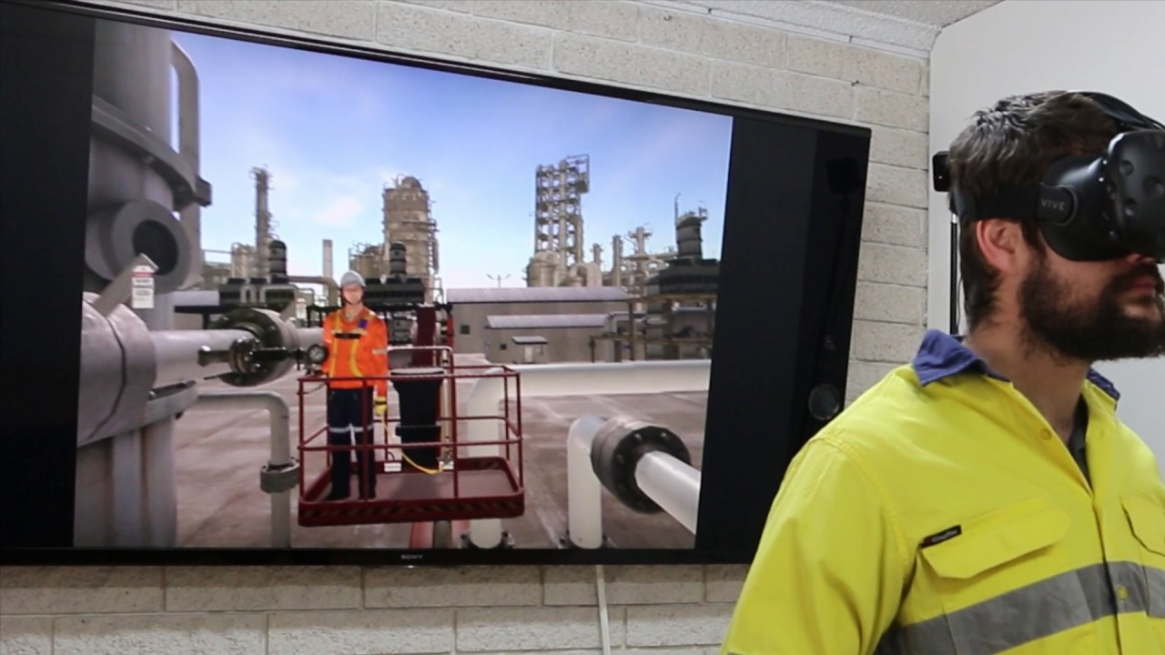
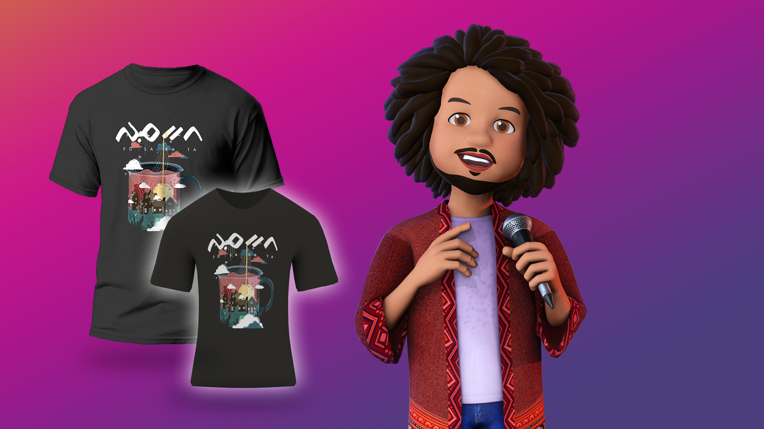
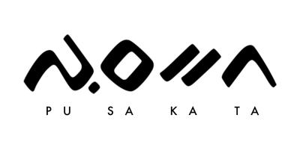
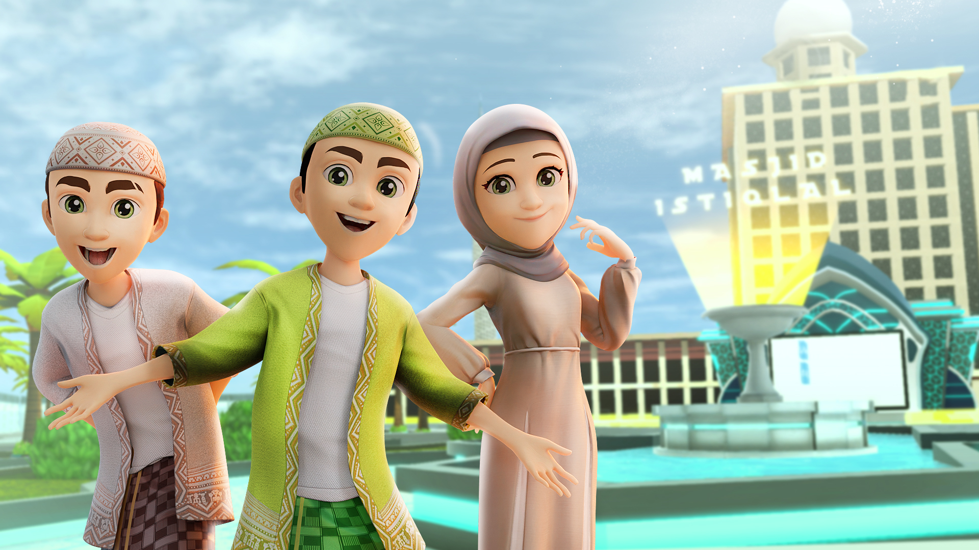
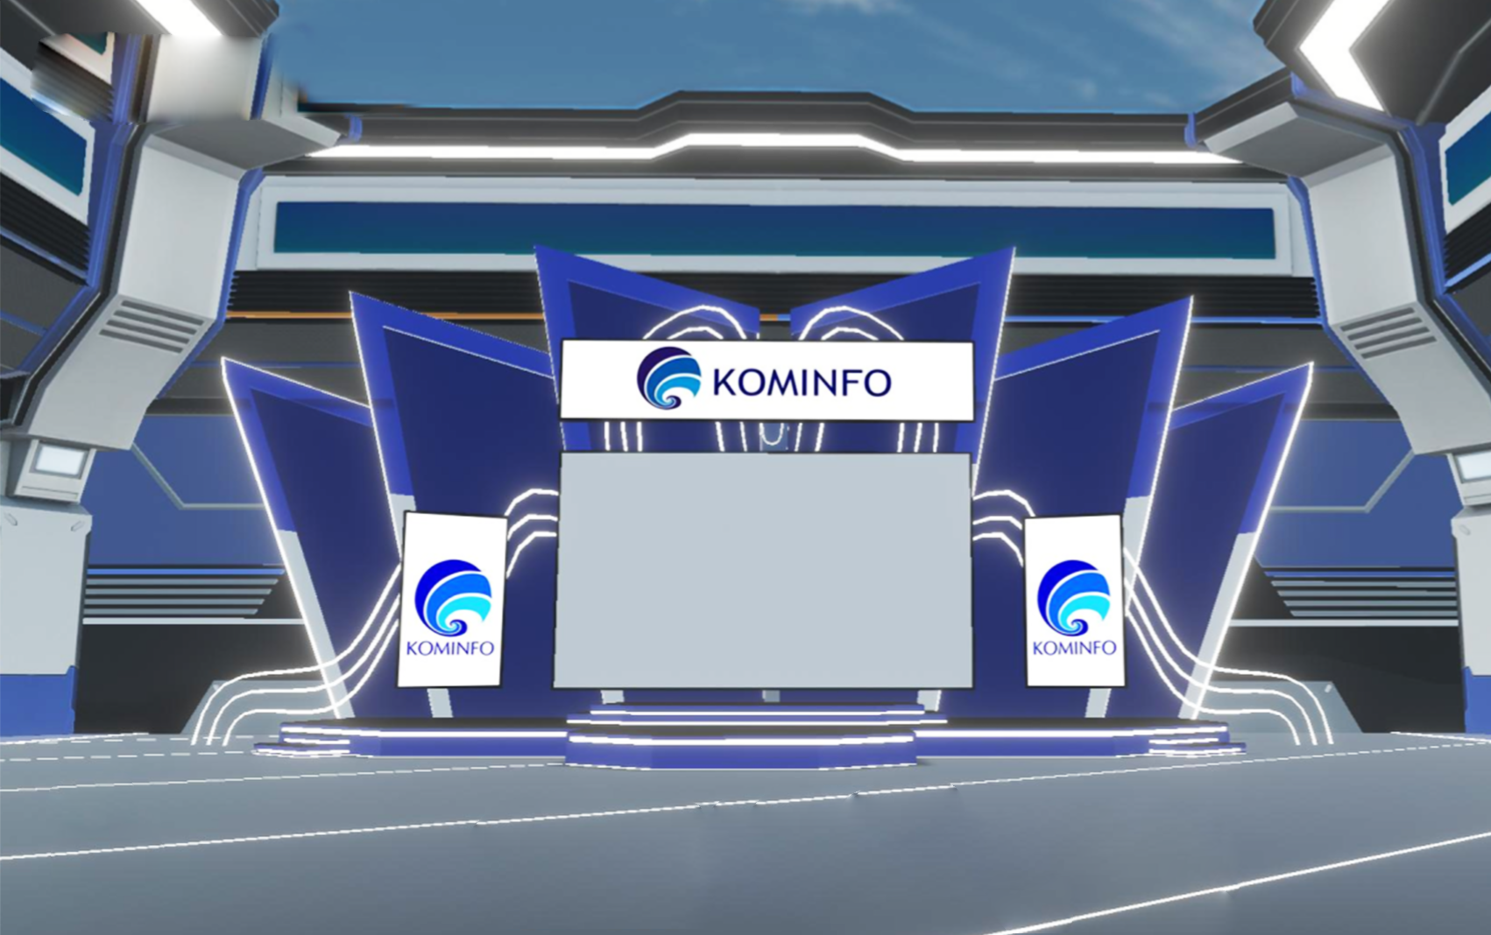
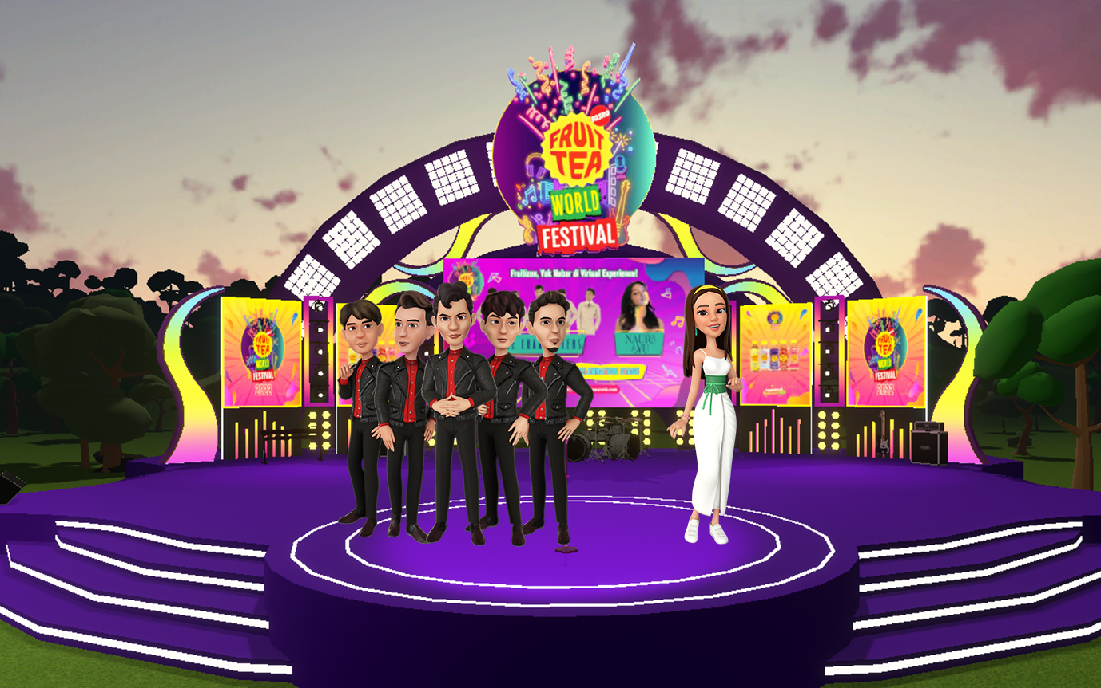
Use cases in Metanesia
Pertamina VR Training
Saving Cost & Zero Risk Training
BBI Virtual Expo
Showcase product
NFT digital twin utility in Metanesia
Enabler new revenue stream
Istiqalverse
Enabler Digital Twin
Kominfo Virtual Stage
Expand new customer segment
Fruit Tea Concert
Increase customer engagement
Digital Business Technology - Telkom Indonesia | page 4
Notes:
Detail terkait government support.
Kesiapan penggunaan metaverse memerlukan dukungan dari pemerintah untuk meningkatkan taraf talent serta mempermudah urusan legalitas teknologi pendukung metaverse

Slide 7
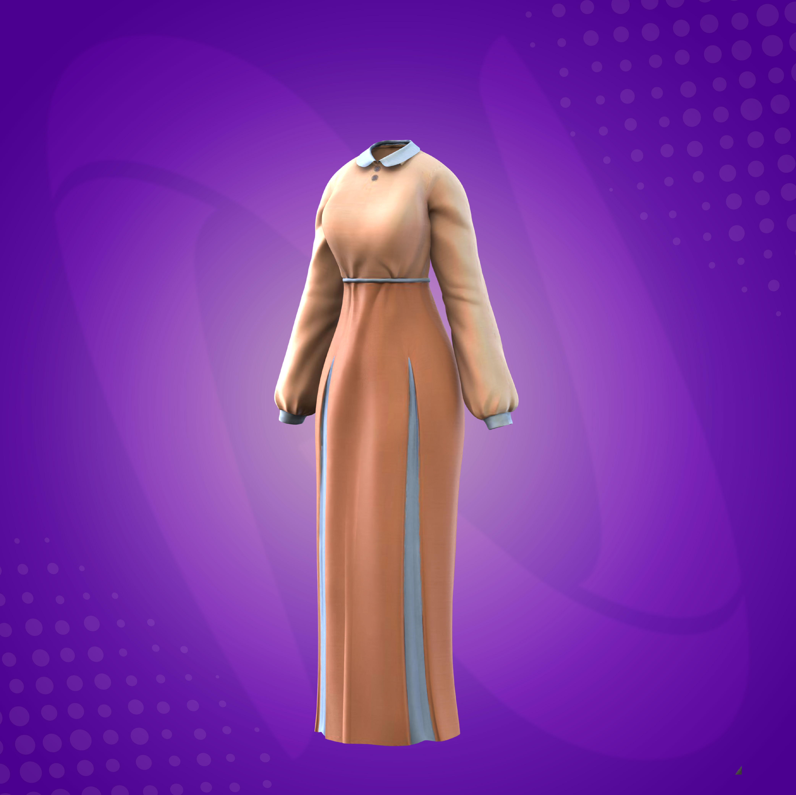
NFT on metaNesia
For now, NFTs in MetaNesia are primarily used for avatar wardrobes.
These NFTs can be obtained through airdrops or campaigns that we conduct in MetaNesia. In the next development, we plan to open UGC (User Generated Concent) features so that artists or IP creator can join and get benefit in the metaverse."
Digital Business Technology - Telkom Indonesia | page 5
Notes:
Detail terkait government support.
Kesiapan penggunaan metaverse memerlukan dukungan dari pemerintah untuk meningkatkan taraf talent serta mempermudah urusan legalitas teknologi pendukung metaverse

Slide 8
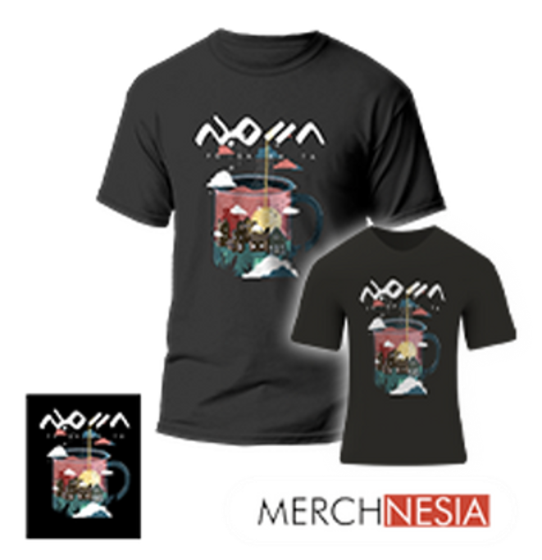
Phygital NFT Wardrobe
metaNesia also provides a digital twin, where the purchased NFT can become a wardrobe for avatars in MetaNesia and can also be redeemed for real t-shirts.
This method also helps to bridge the adaptation to the metaverse world.
Digital Business Technology - Telkom Indonesia | page 6
Notes:
Detail terkait government support.
Kesiapan penggunaan metaverse memerlukan dukungan dari pemerintah untuk meningkatkan taraf talent serta mempermudah urusan legalitas teknologi pendukung metaverse

Slide 9
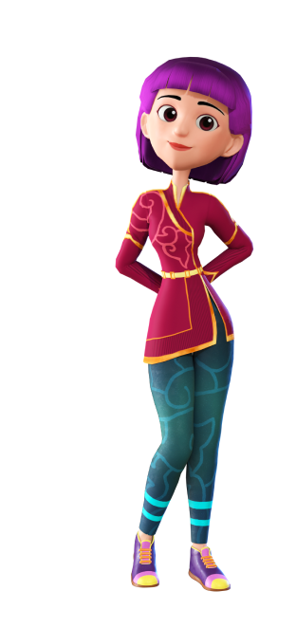
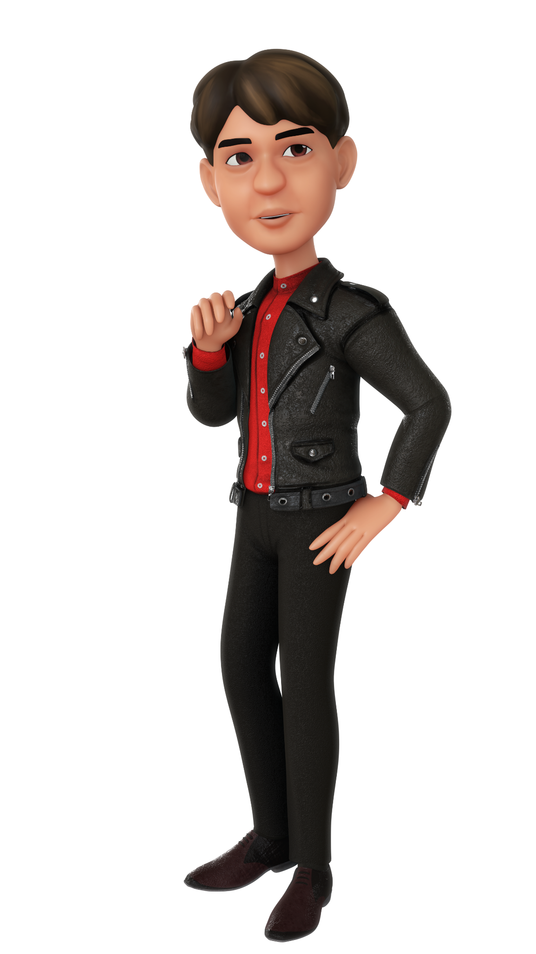
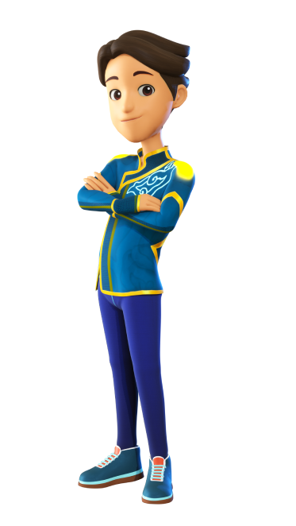
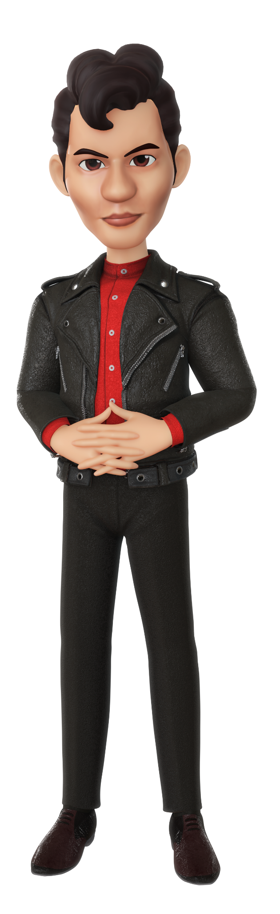
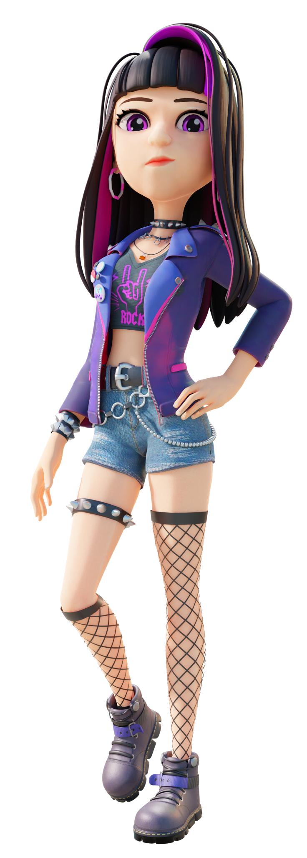
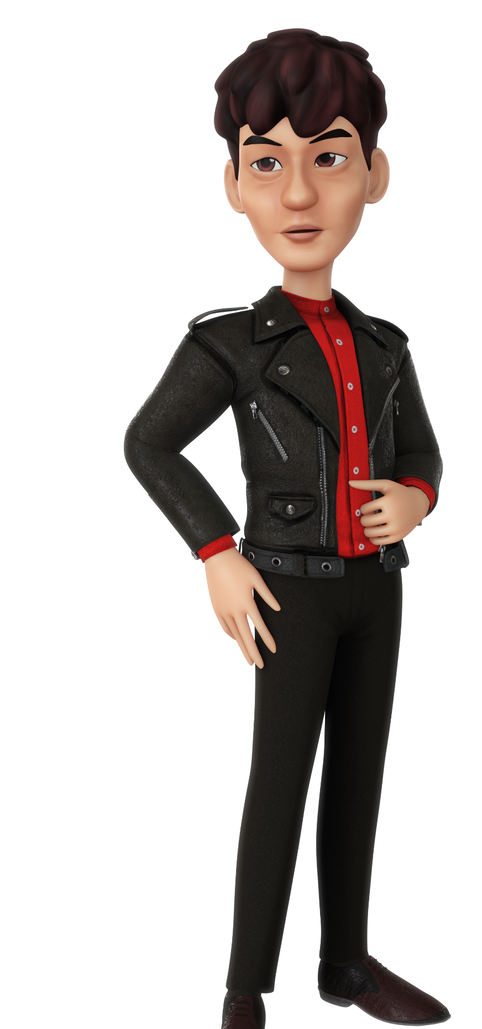
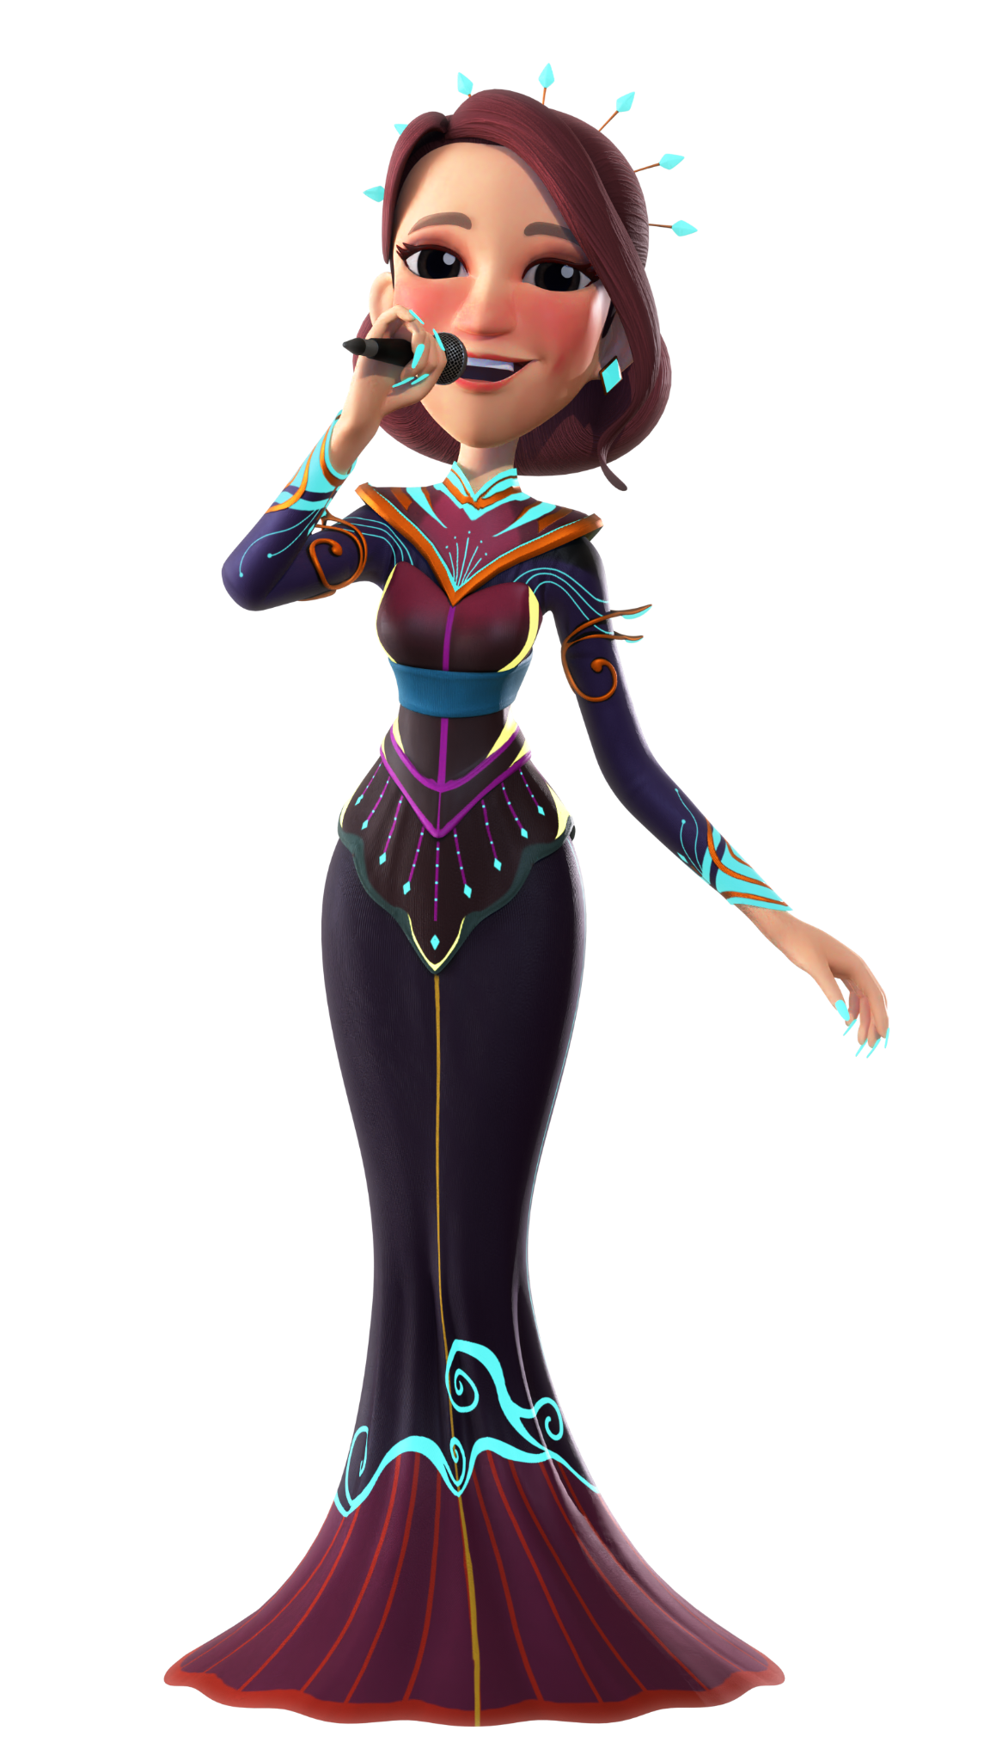
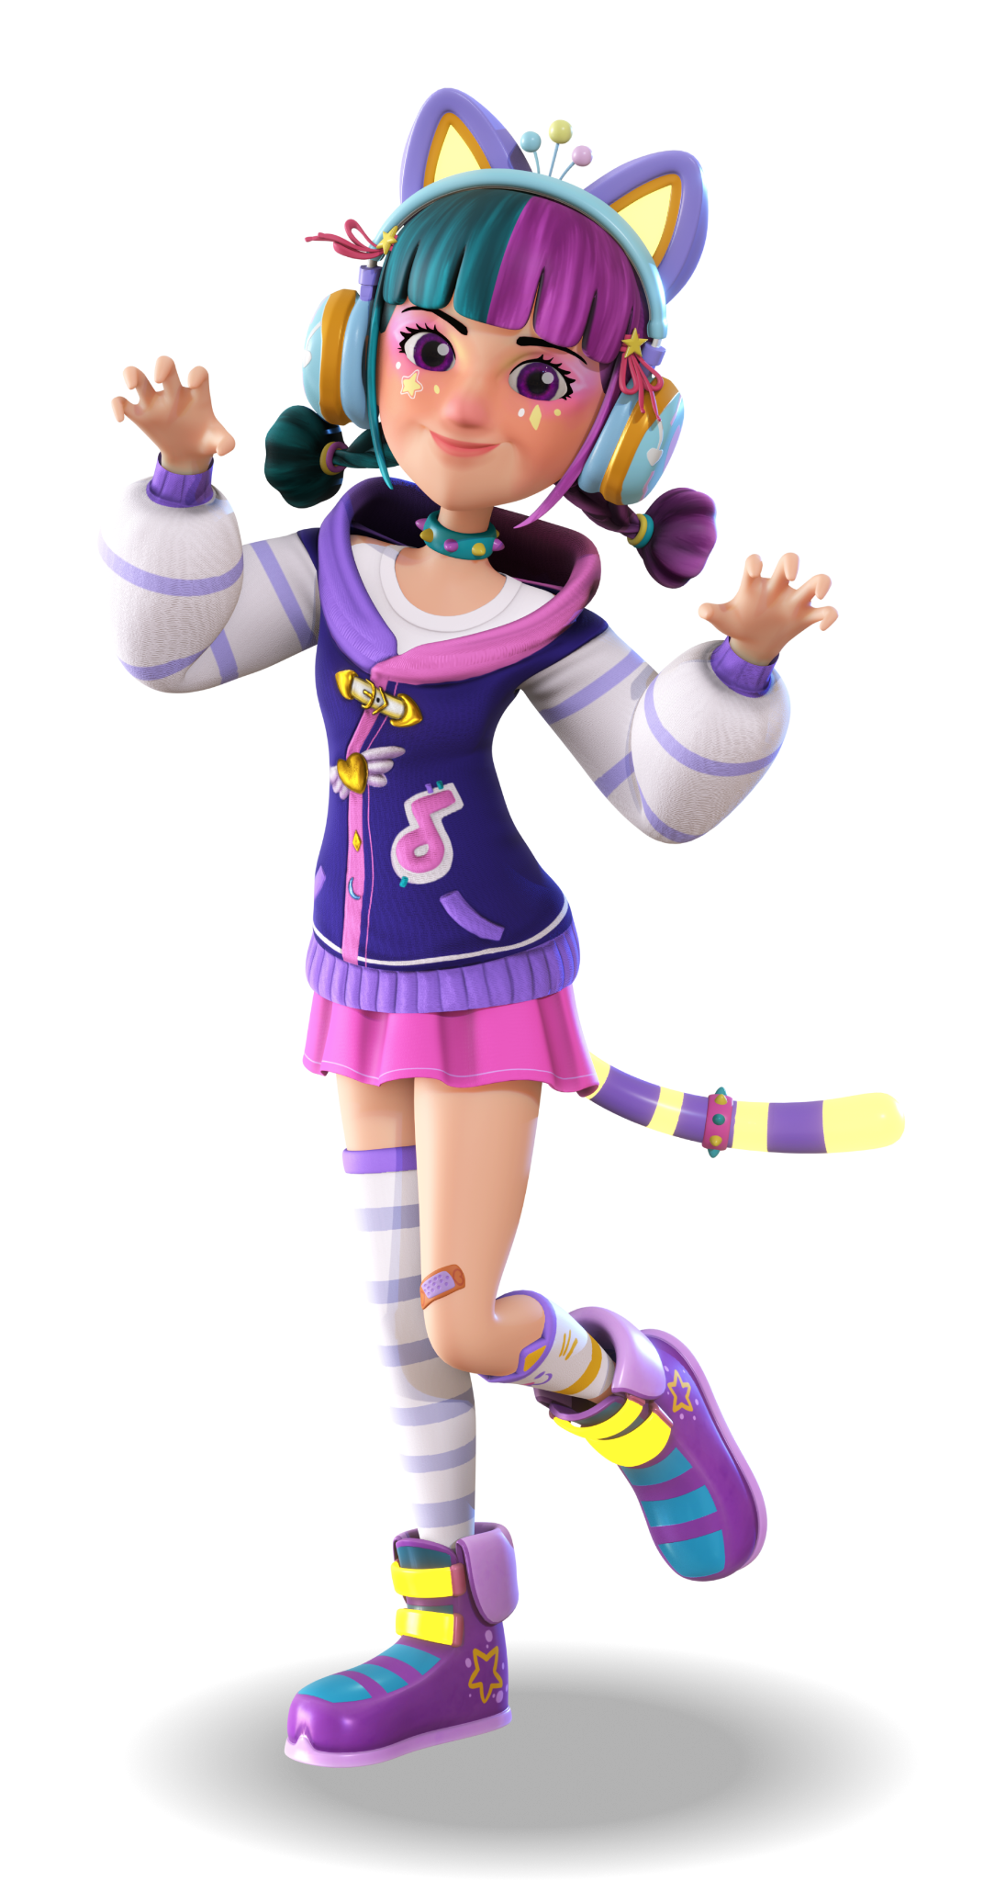
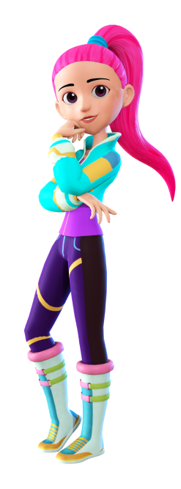
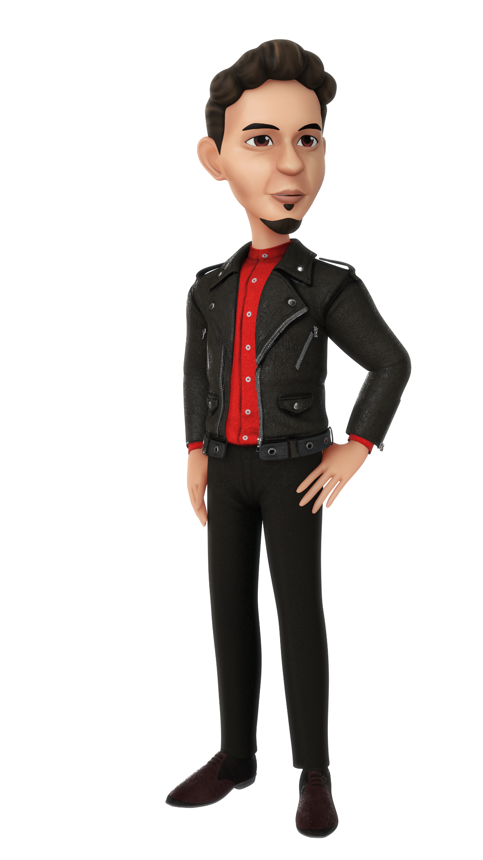
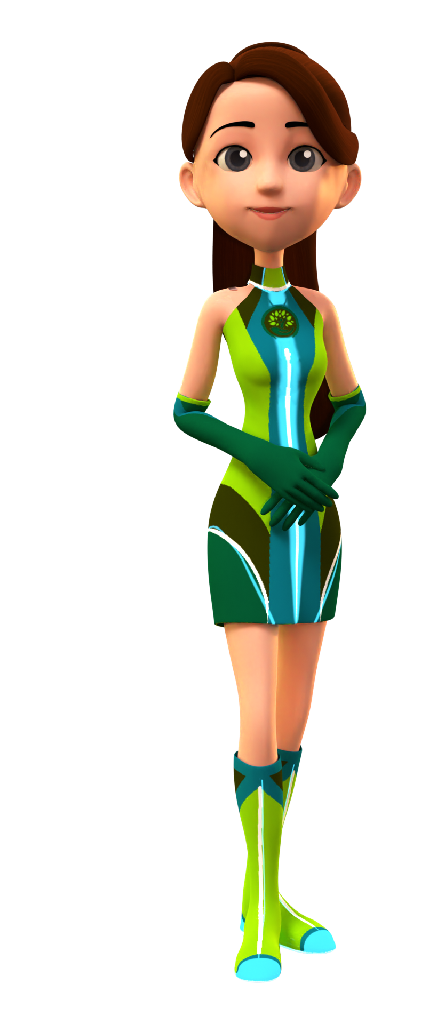
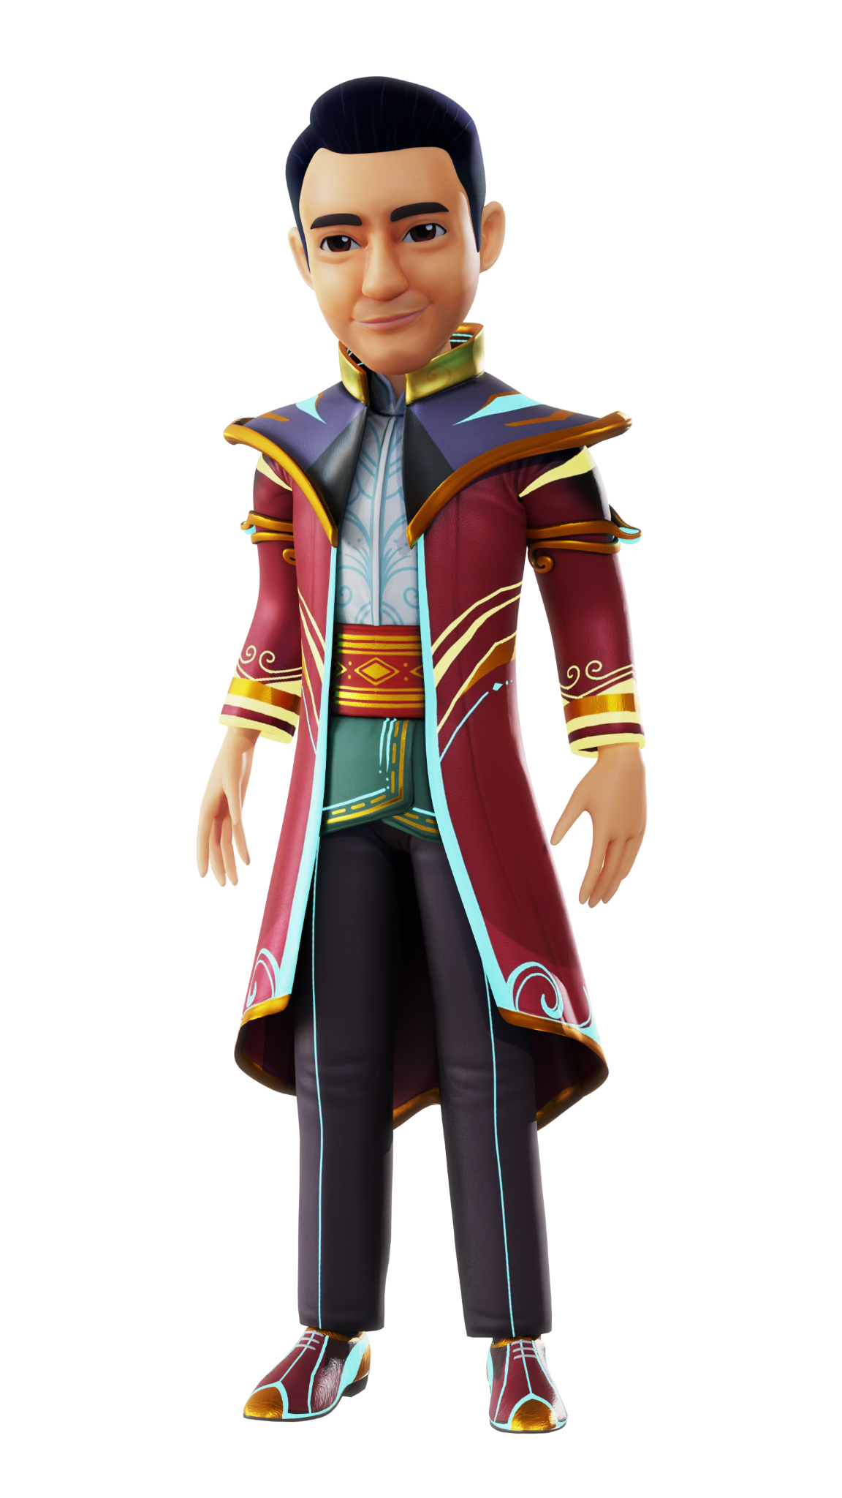
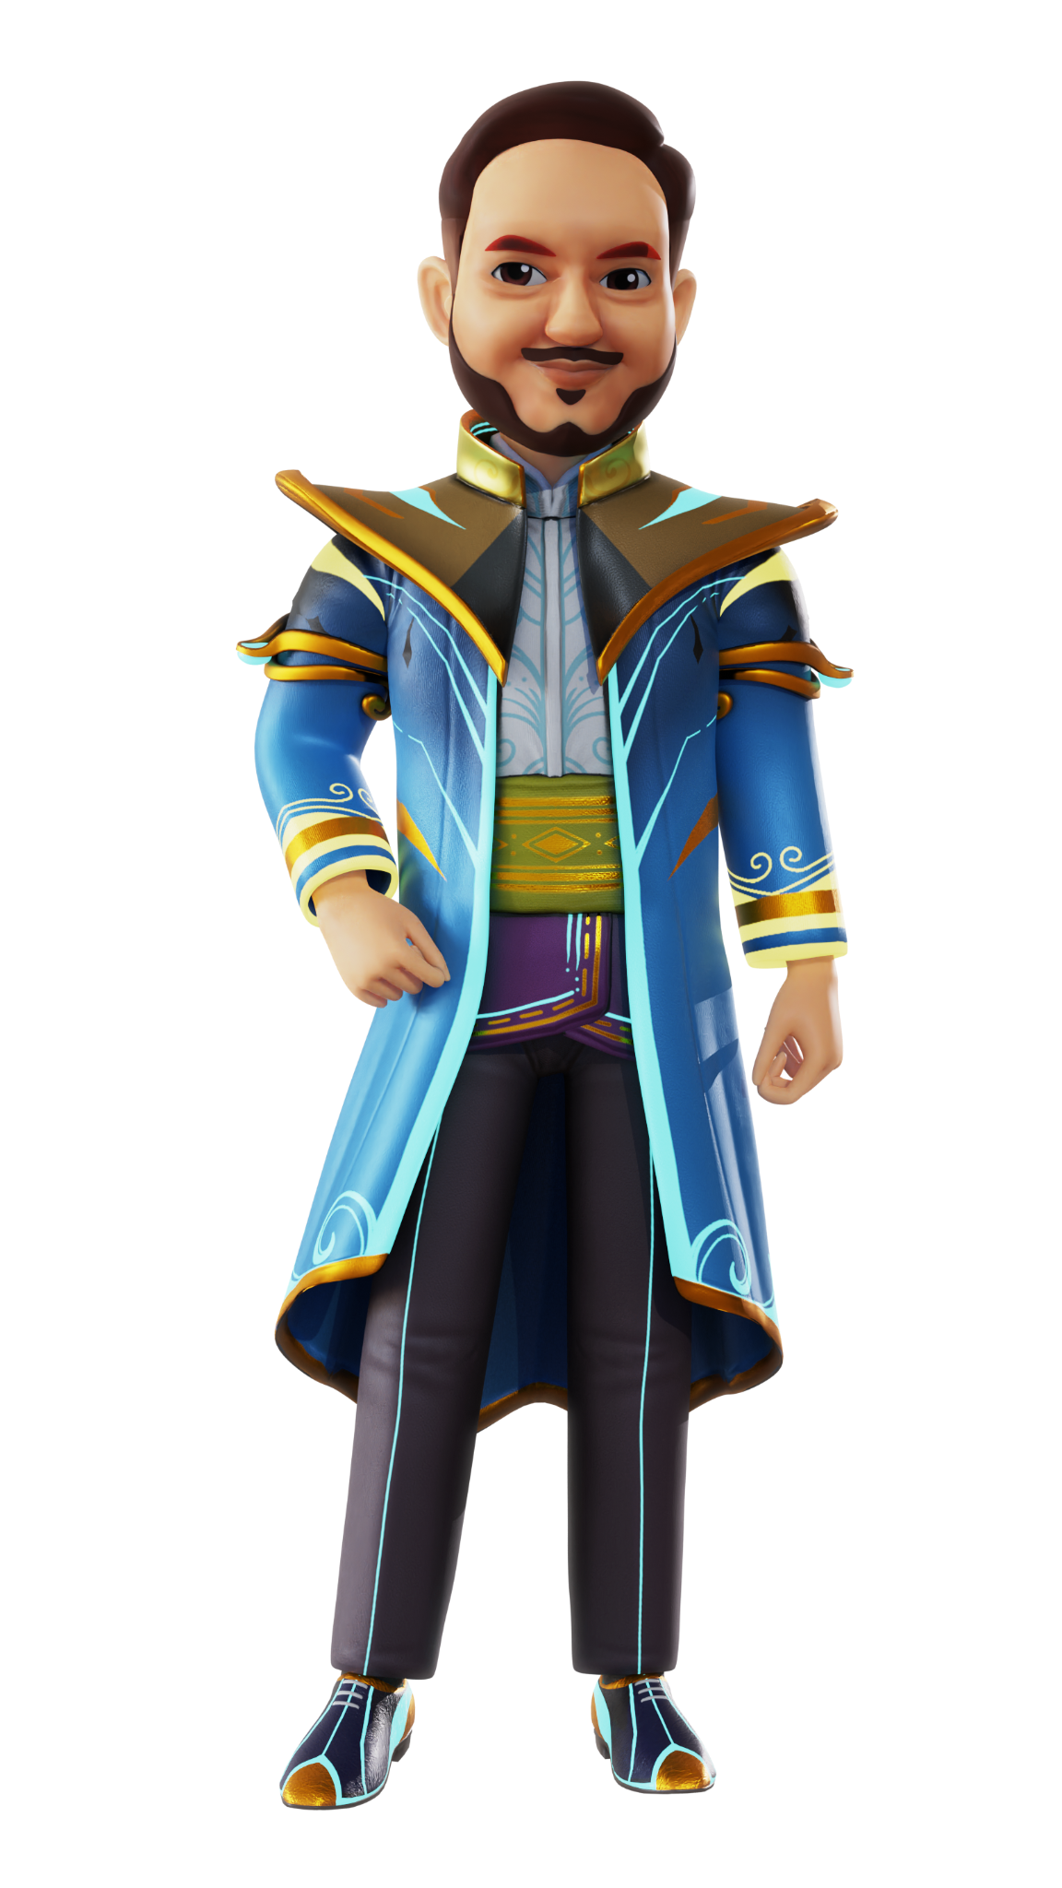
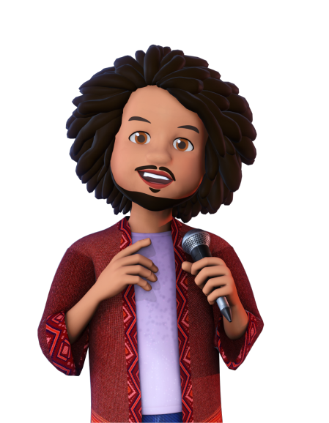
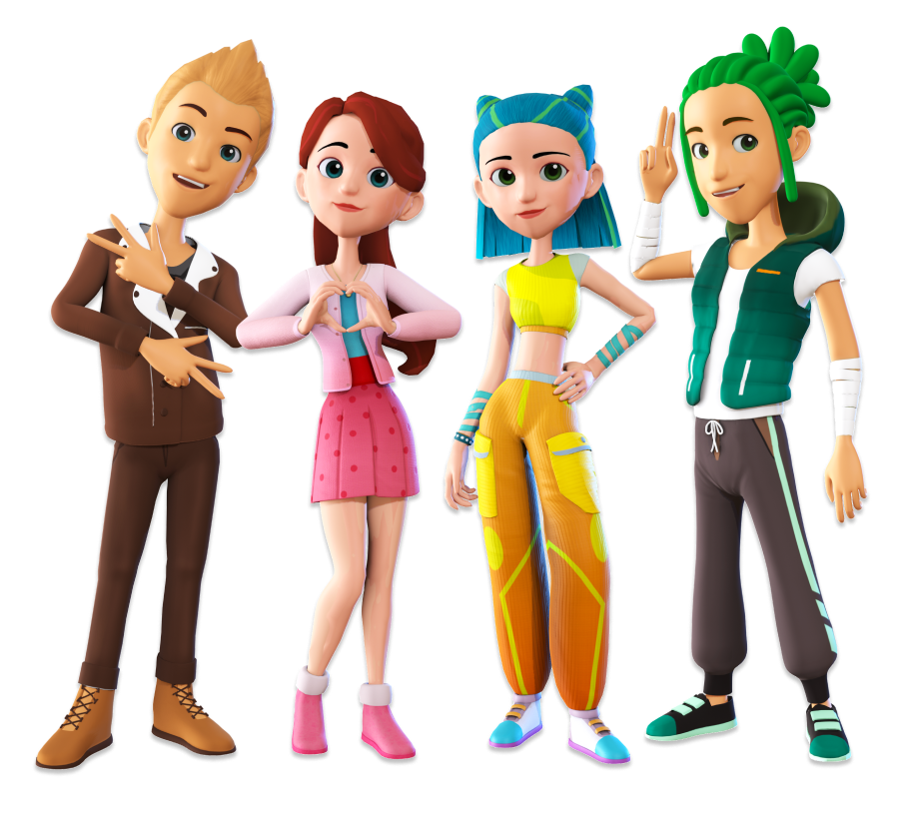
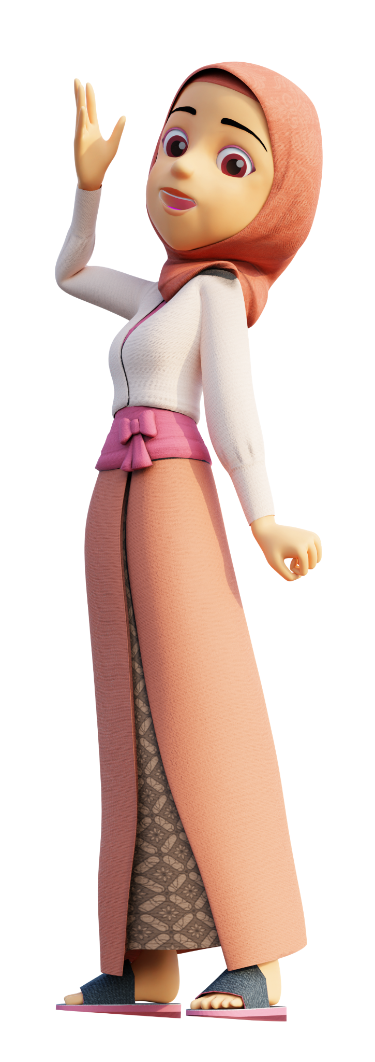
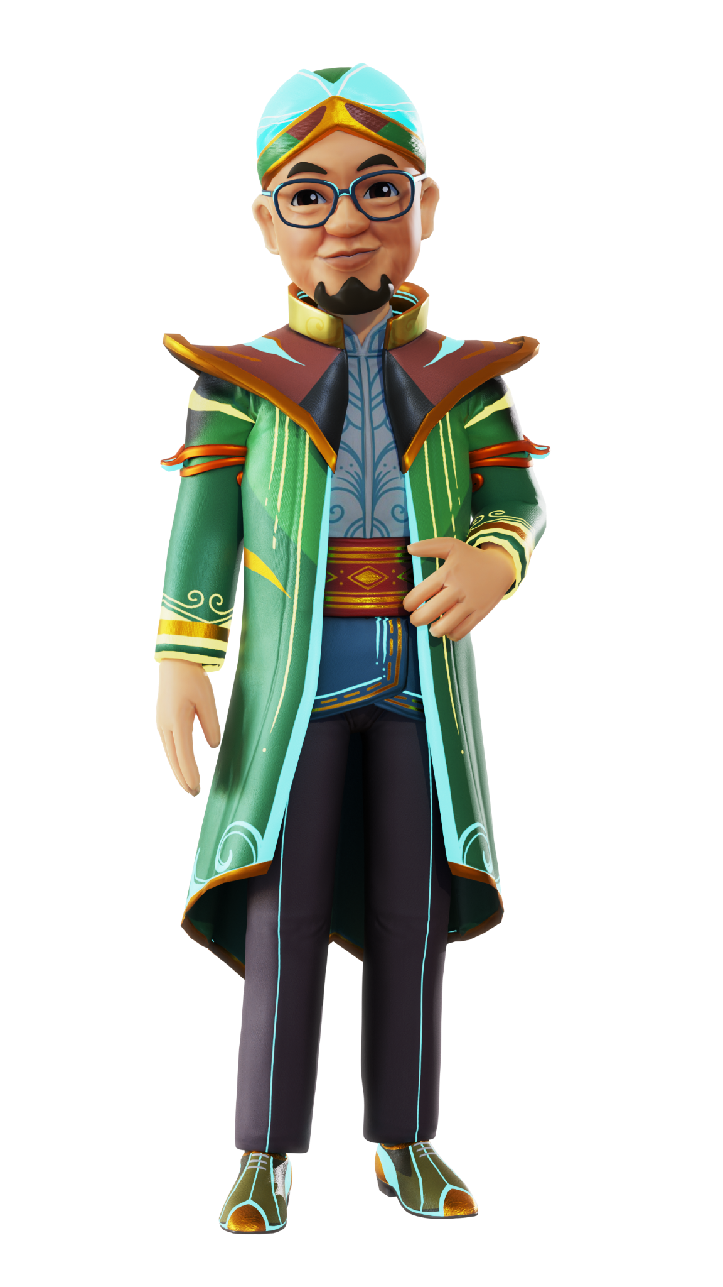
See You in metaNesia
#unlockYourDreams

