Slide 1
DOING BUSINESS INTERNATIONALLY
The inaugural WIPO SEMINAR SERIES
WIPO Programs and Services for Business
Australia
August 2013
Yo Takagi
Assistant Director General, Global Infrastructure

Slide 2
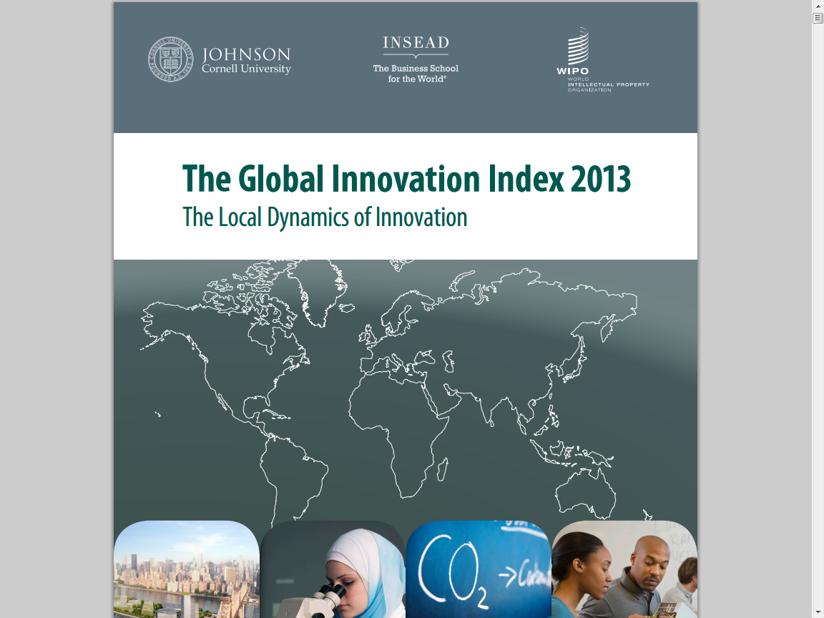

Slide 3
Business and Innovation
Australia is ranked at 19th.
The role of local champions and interaction of innovation clusters
Funding for the development of start-ups
Linkages among stakeholders (Government, firms, academia, and society)
Incubators and technology transfer programs
Global networks and value chains
-> IP policy and services?

Slide 4
IP and Innovation
“Intellectual property plays an essential role in innovation by capturing the economic value of innovation…”
Dr. Francis Gurry at the launch of the Global Innovation Index 2013 in July

Slide 5
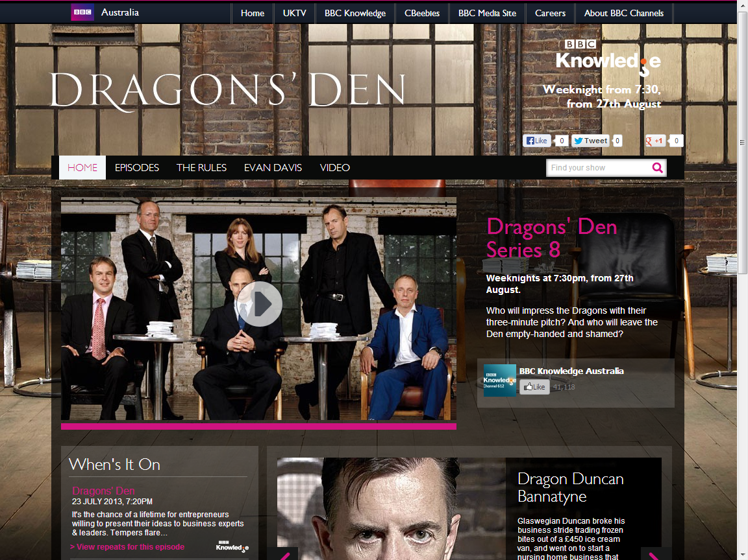

Slide 6
Four Typical IP-related Qs by Dragons
Do you know if your product is new?
Have you got a patent and where?
What is your brand and marketing strategy?
Are you in trouble with competitors?

Slide 7
Four Typical IP-related Qs by Dragons
Do you know if your product is new?
PATENTSCOPE
Have you got a patent and where?
PCT
What is your brand and marketing strategy?
Madrid
Are you in trouble with competitors?
Alternative Dispute Resolution

Slide 8
WIPO; the Service-Oriented Unique UN Agency
Strategic Goals (IP Treaties, Premier Global IP Services, Global IP Infrastructure, World Reference Source for IP Information, Building Respect for IP)
Service Orientation set as a key Core Value
Global service delivery enabled by Data, Customer-friendly online Tools, and global platform
-> What WIPO services are available?

Slide 9
WIPO Services
Premier Global IP Services (PCT, Madrid, Hague, Arbitration and Mediation Center services)
Global Databases, Tools, and Platform for IP business

Slide 10
Global Databases, Tools, and Platform for IP business (free)
PATENTSCOPE
Global Brand Database
WIPO Lex
WIPO IPAS, WIPO DAS
WIPO CASE
WIPO RE:SEARCH
WIPO GREEN

Slide 11
PATENTSCOPE
2.2 million PCT data (first publish, high quality full text)
30 million national data collections (30 countries or regions)
Full text search
Cross Lingual Information Retrieval (CLIR)
Machine translation tools (Google, Microsoft) Translator)
Analysis and graphical presentation

Slide 12
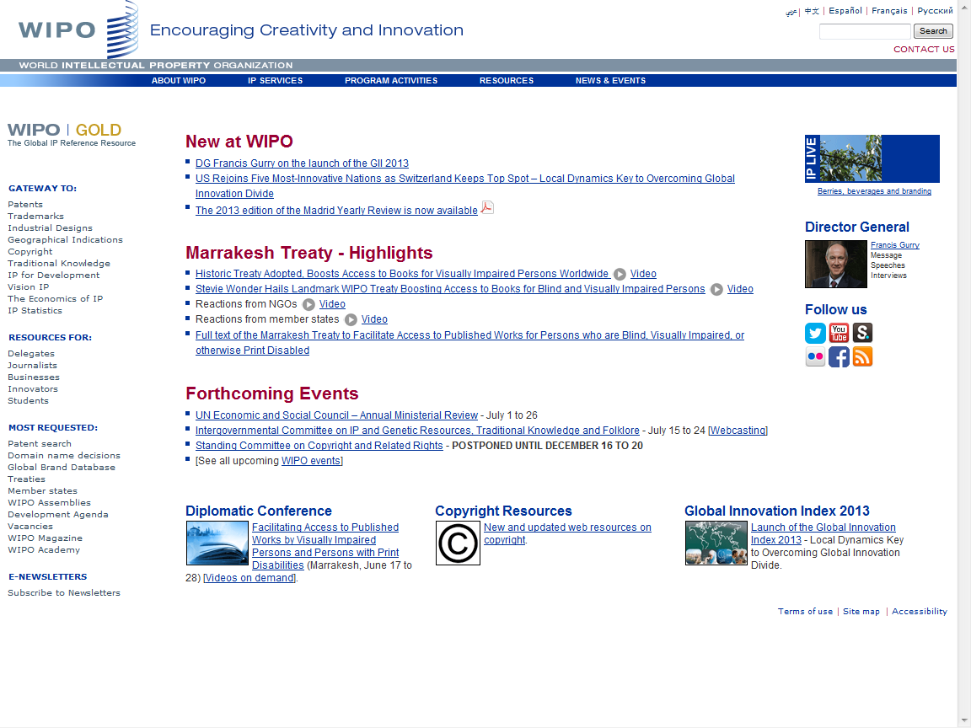

Slide 13
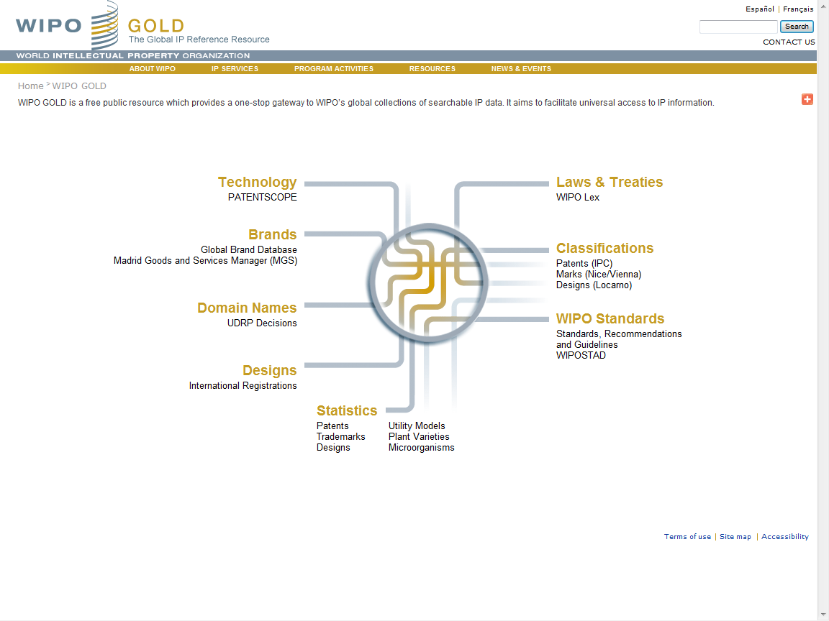

Slide 14
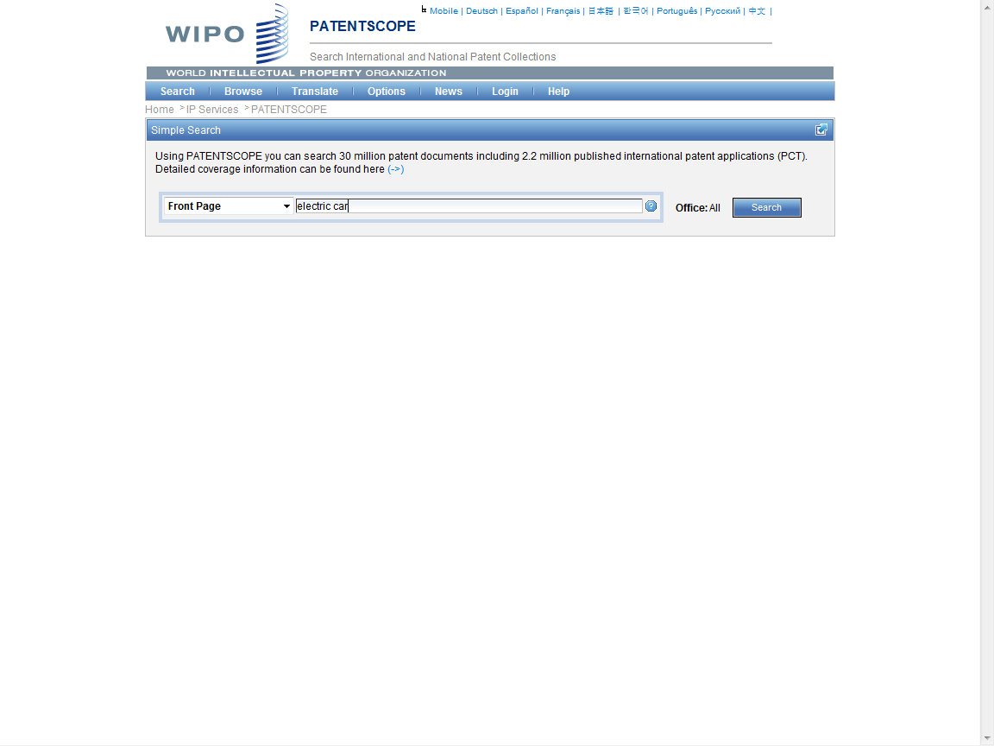

Slide 15
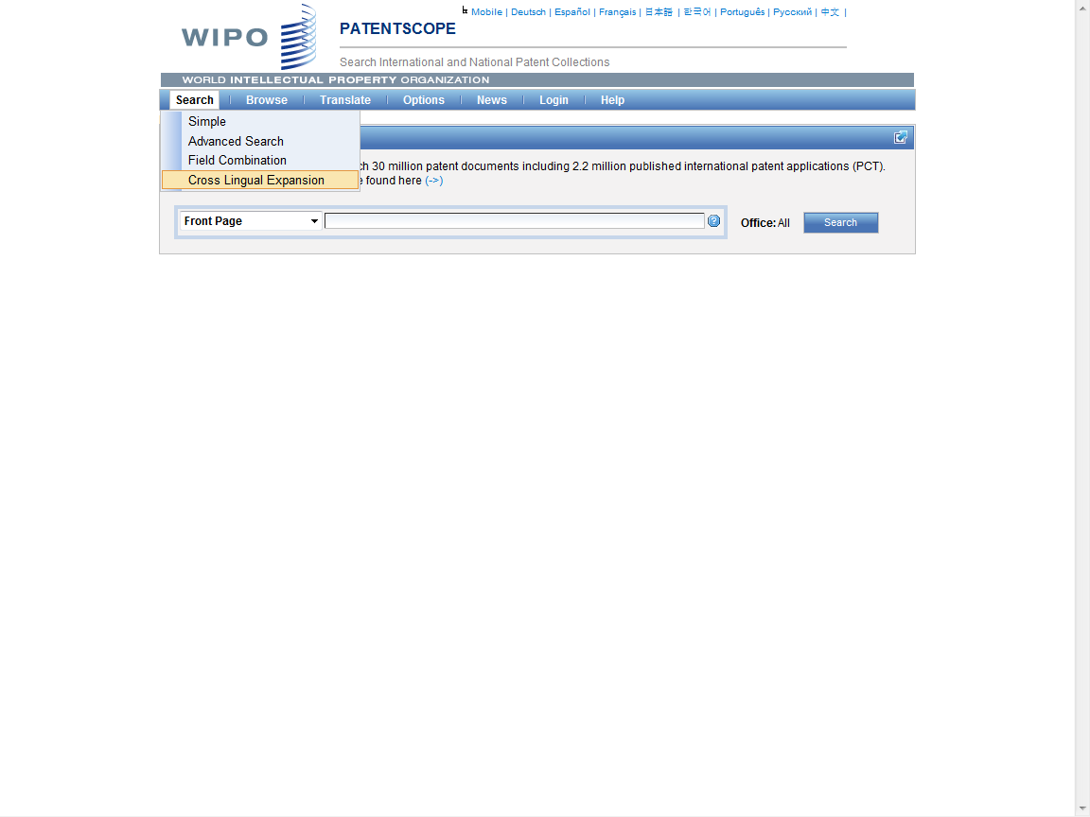

Slide 16
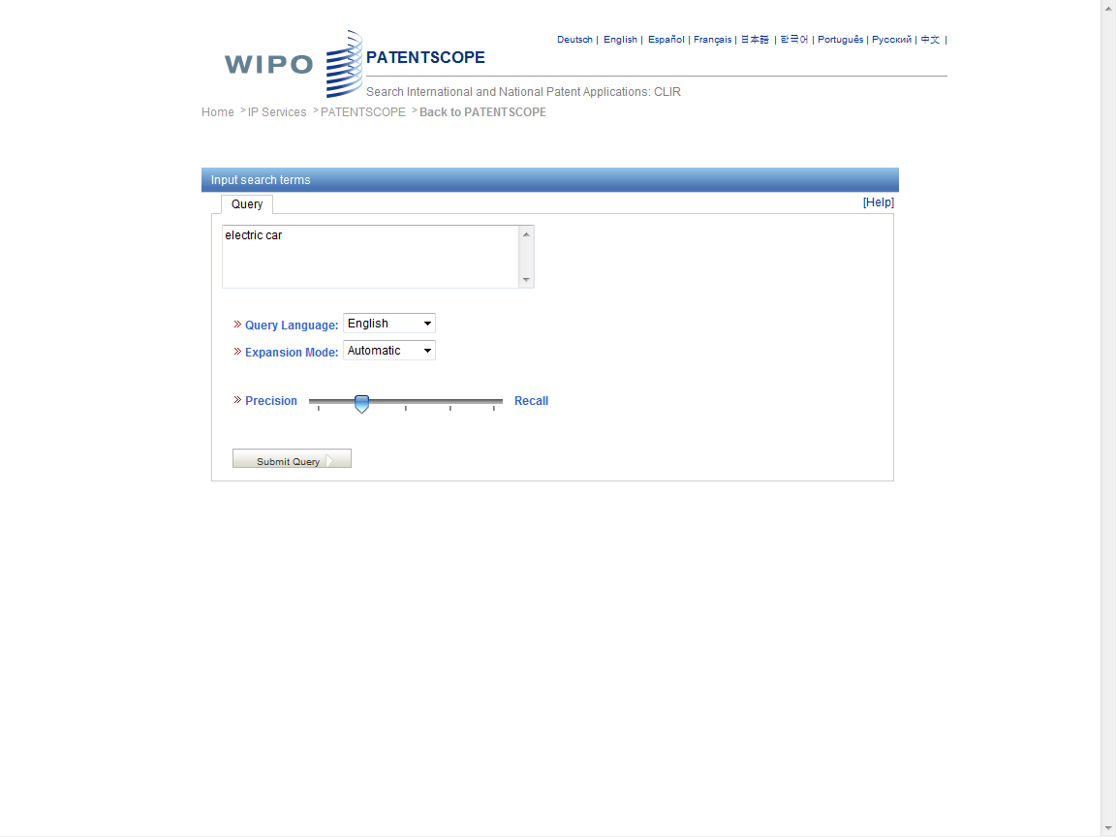

Slide 17
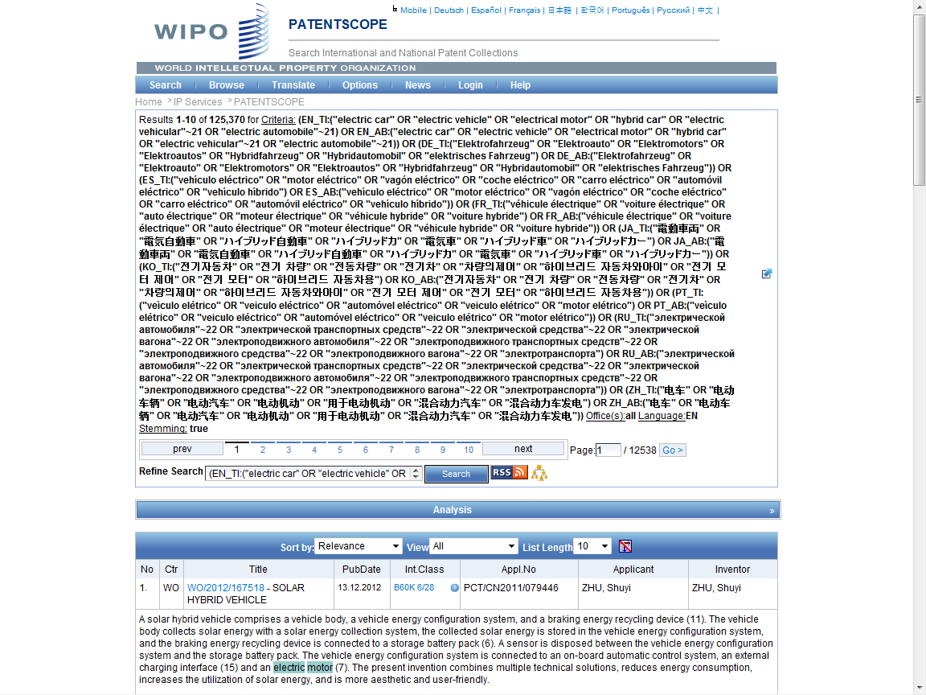
Search Query

Slide 18
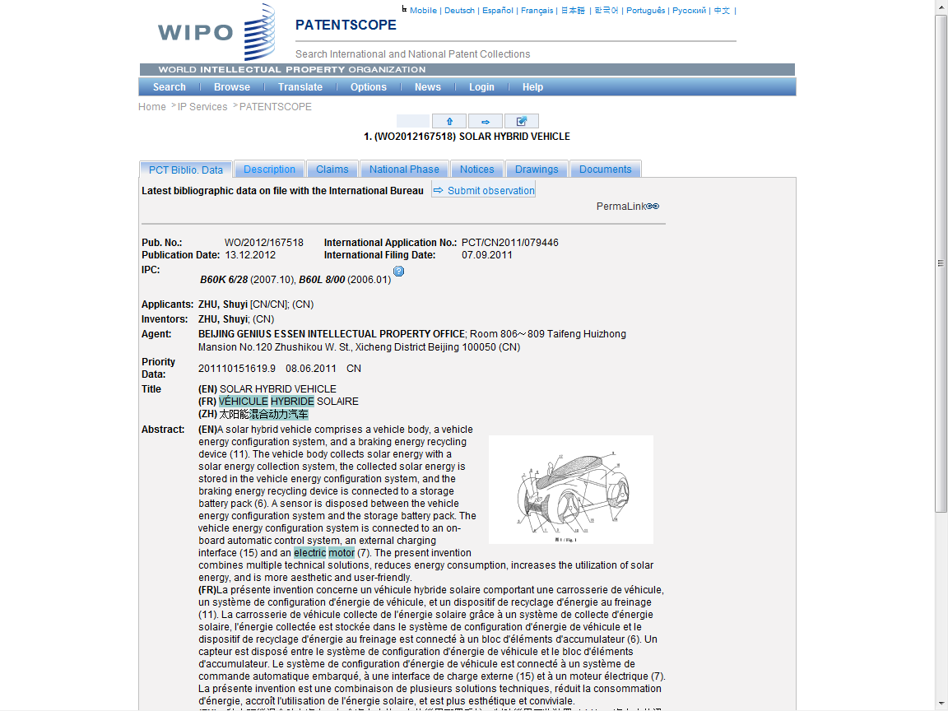

Slide 19
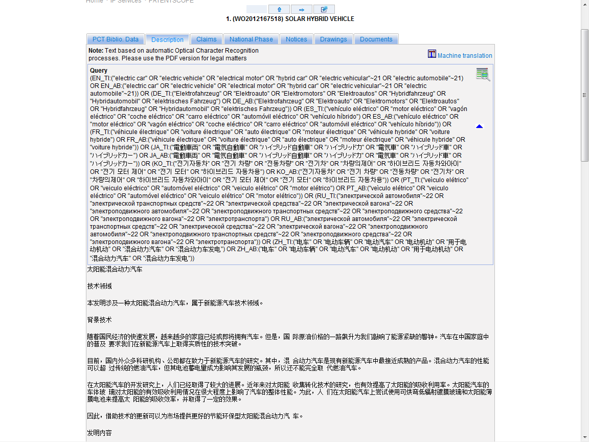
??

Slide 20
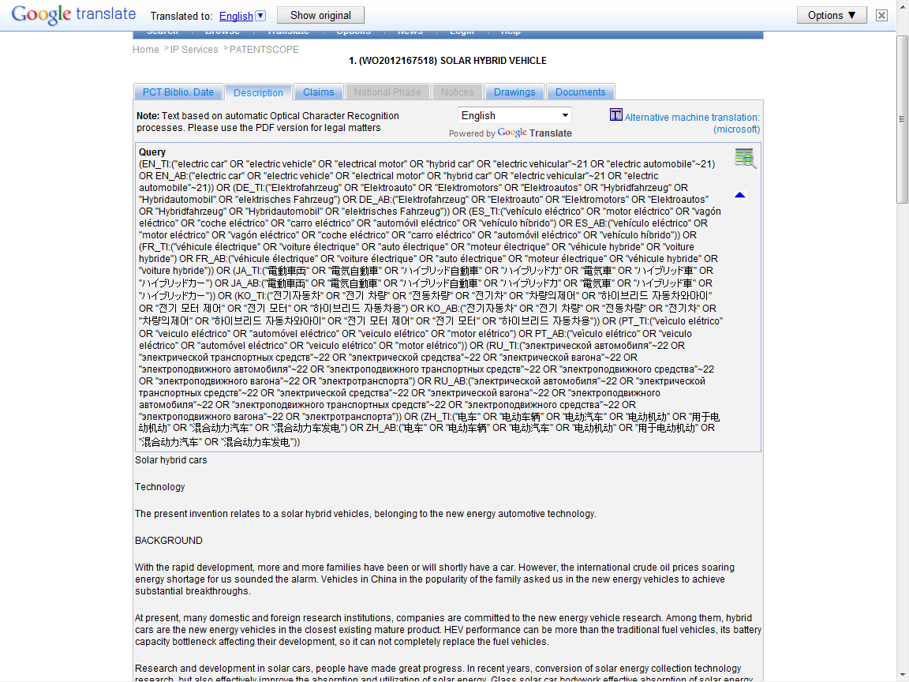

Slide 21
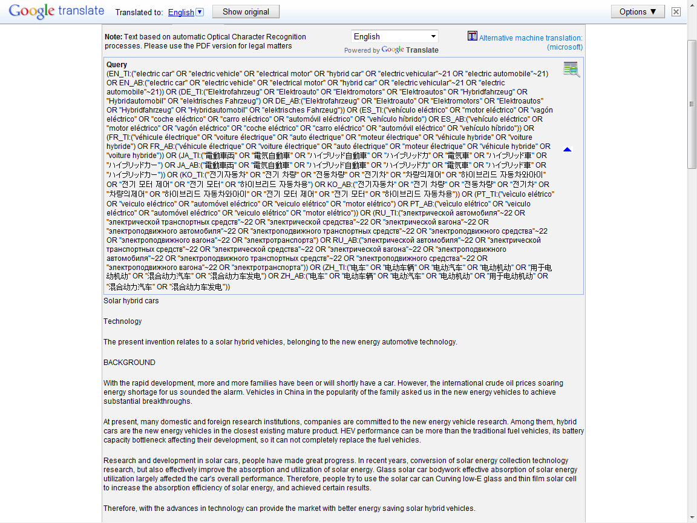

Slide 22
Global Databases, Tools, and Platform for IP business (free)
PATENTSCOPE
Global Brand Database
WIPO Lex
WIPO IPAS, WIPO DAS
WIPO CASE
WIPO RE:SEARCH
WIPO GREEN

Slide 23
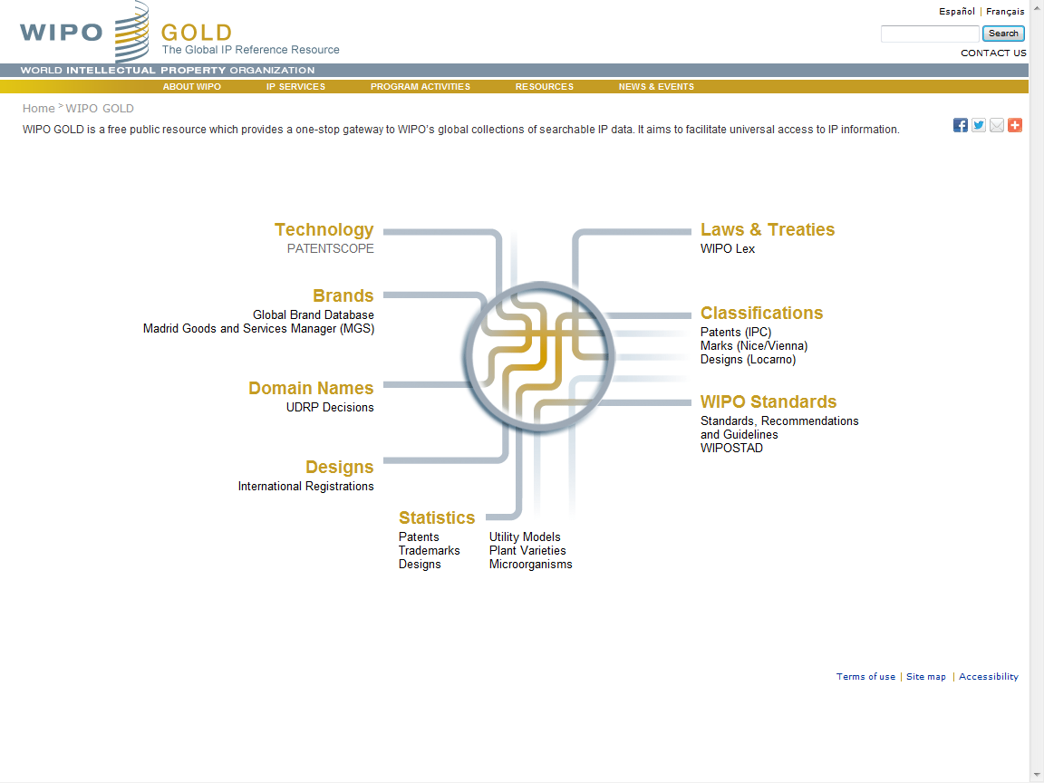

Slide 24
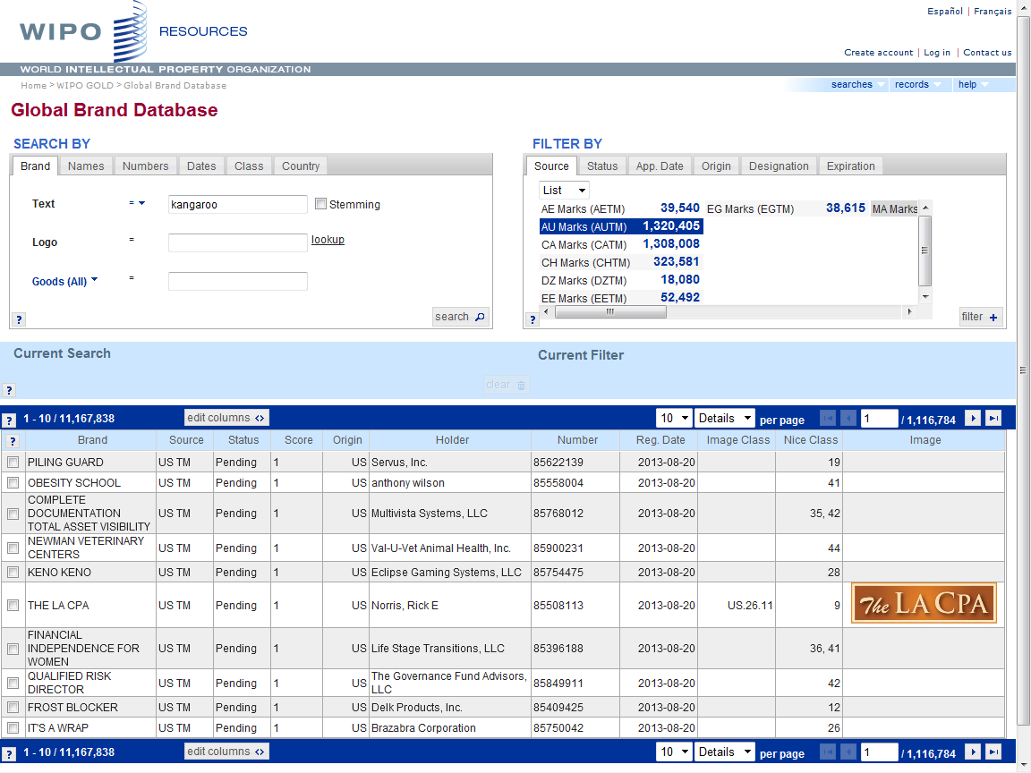

Slide 25
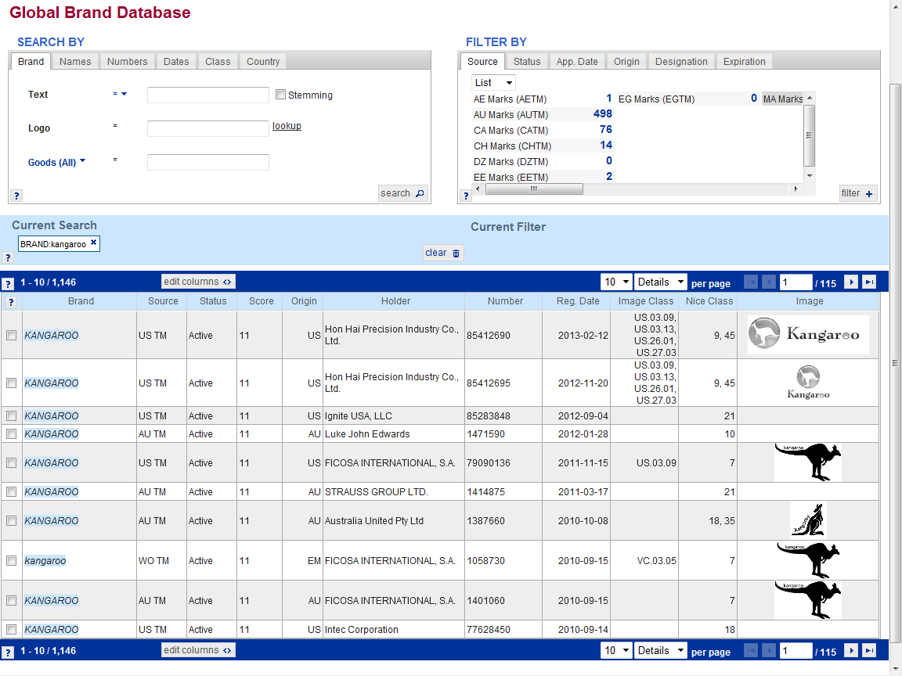

Slide 26
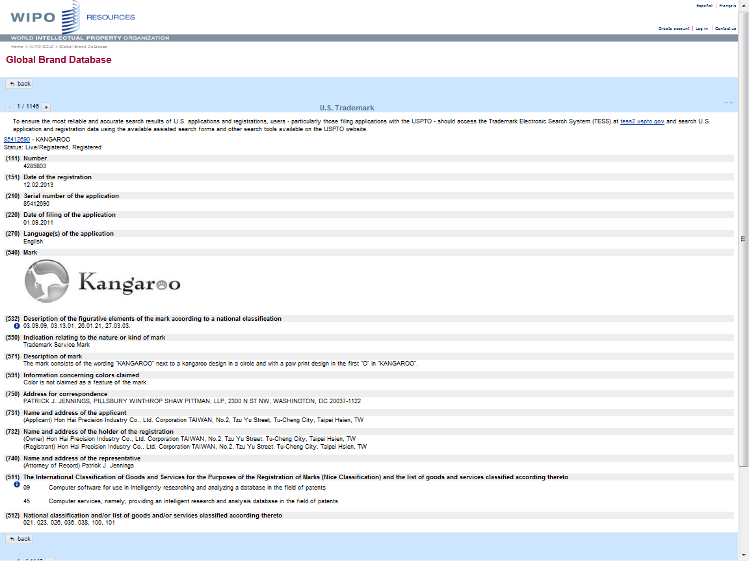

Slide 27
Global Databases, Tools, and Platform for IP business (free)
PATENTSCOPE
Global Brand Database
WIPO Lex
WIPO IPAS, WIPO DAS
WIPO CASE
WIPO RE:SEARCH
WIPO GREEN

Slide 28
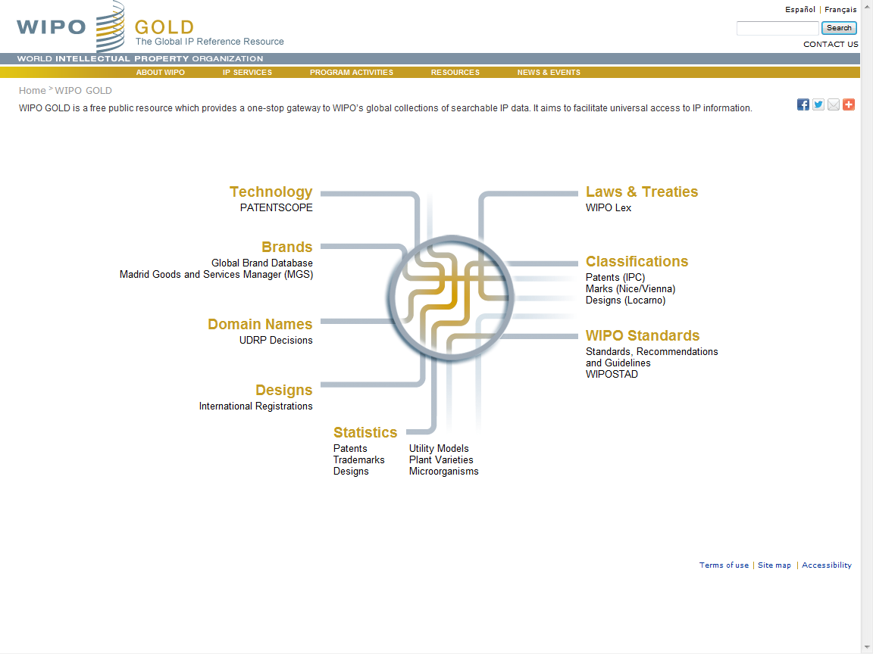

Slide 29
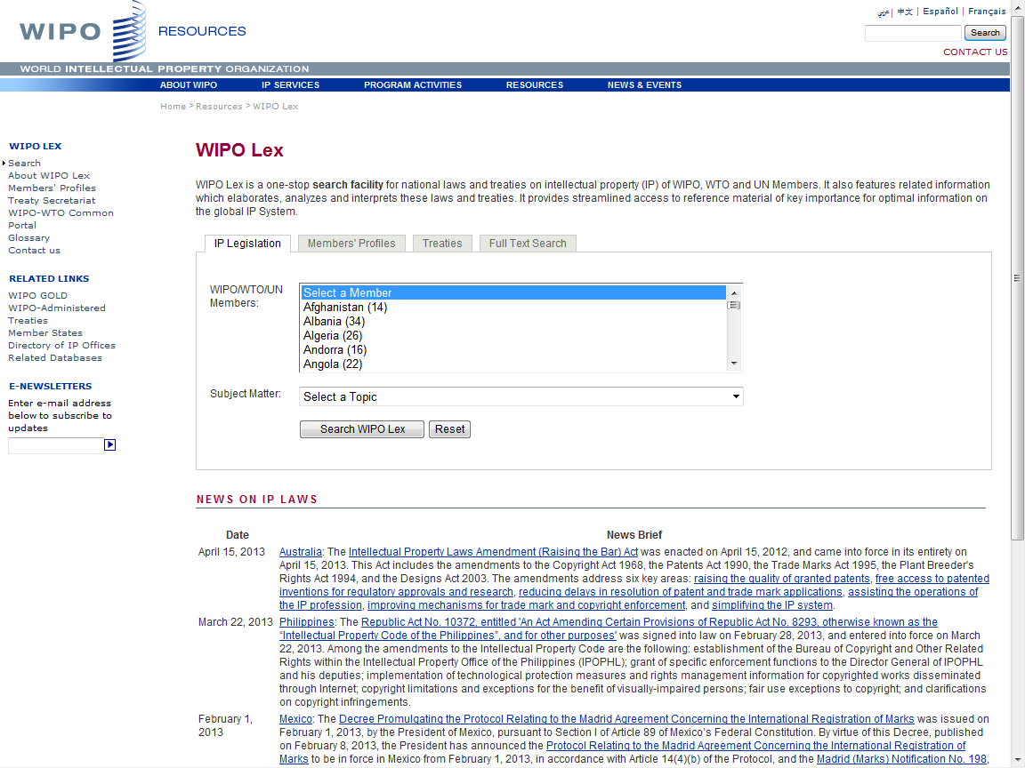

Slide 30
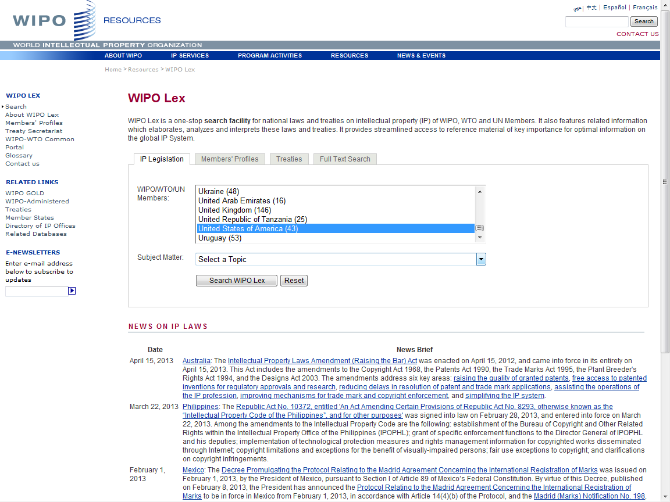

Slide 31
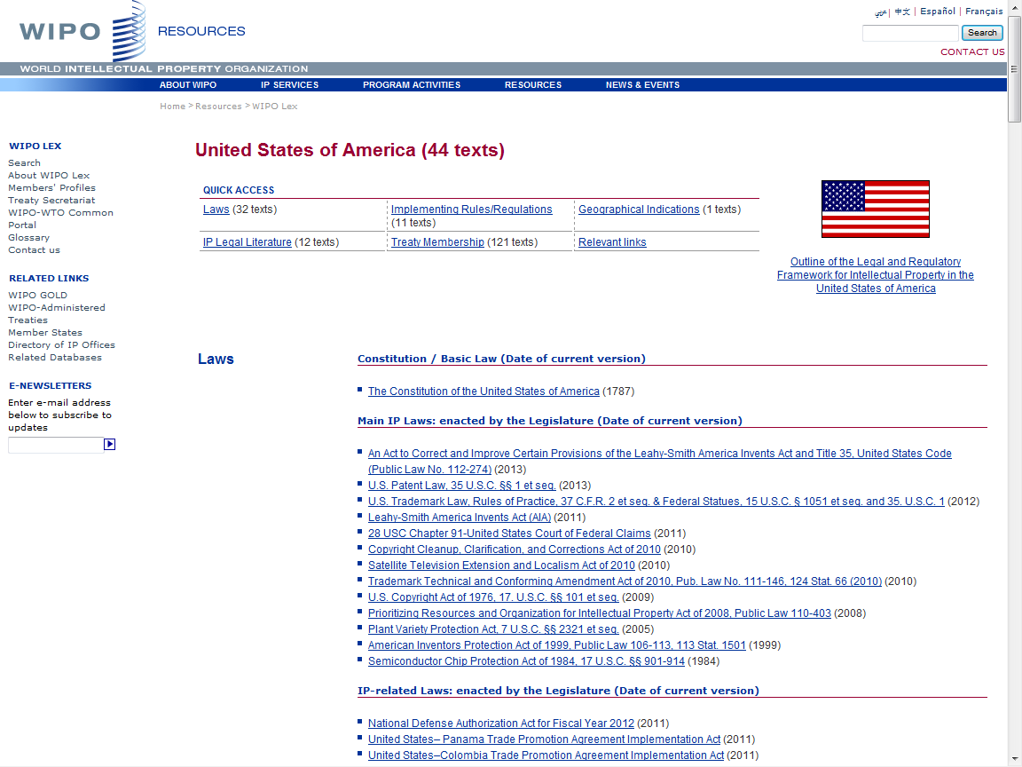

Slide 32
Global Databases, Tools, and Platform for IP business (free)
PATENTSCOPE
Global Brand Database
WIPO Lex
WIPO IPAS, WIPO DAS
WIPO CASE
WIPO RE:SEARCH
WIPO GREEN

Slide 33
IPAS and DAS
IPAS (IP Office Administration System) used by 55 IPOs
A WIPO software enabling small IPOs to electronically process patent, trademark, design applications
DAS (Digital Access System) used by 11 IPOs
- A System that allows IPOs and applicants to securely exchange or submit a digital copy of priority documents to multiple IPOs

Slide 34
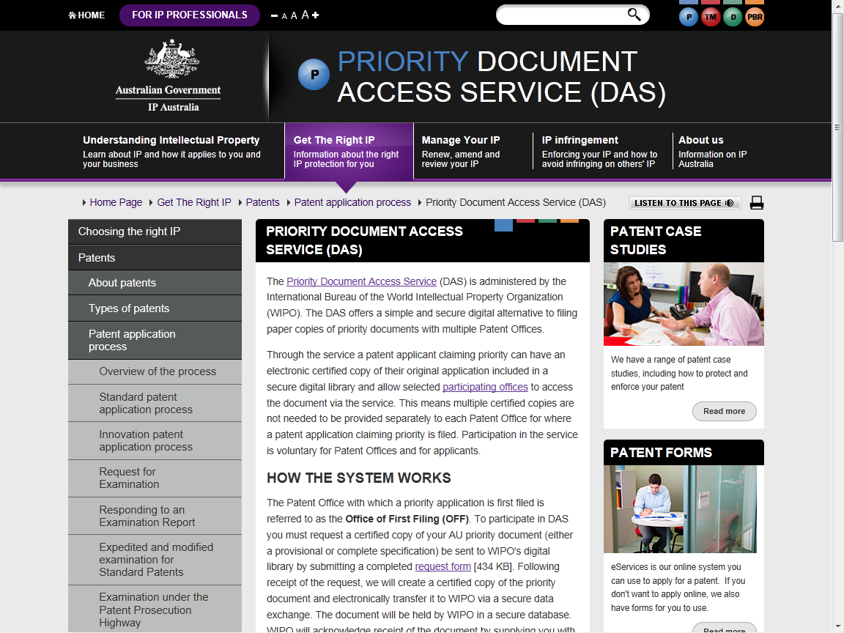

Slide 35
Global Databases, Tools, and Platform for IP business (free)
PATENTSCOPE
Global Brand Database
WIPO Lex
WIPO IPAS, WIPO DAS
WIPO CASE
WIPO RE:SEARCH
WIPO GREEN

Slide 36
WIPO-CASE
“Centralized Access to Search and Examination Reports”
Started with an initiative of IP Australia and the Vancouver Group (AU, CA, UK)
Online patent work-sharing platform for patent examiners worldwide
IPOs can enhance quality and efficiency of patent examination
CASE will be linked to Open Portal Dossier of IP5 to become the Global Portal Dossier
How will it work?

Slide 37
WIPO-CASE (continued)
The System functions to:
Search by patent number and retrieve simple results or a list of patent family members.
View bibliographic data, citation data (if available) and lists of documents available for each patent record.
View and/or download the available documents.
Subscribe to notifications of updates to a given patent record.
-> will be linked to OPD of IP5 -> “Global Dossier”

Slide 38
“World Patent Office” on Global Dossier Platform
(WIPO-CASE, OPD and PATENTSCOPE)
PATENT
SCOPE
Public Users
(including IP office users)
Examiner of IP5 Office not participating in WPO/CASE
OPD
Feed dossier information that
OPD/CASE Offices agree to publish
Public Domain
OPD
Not accessible to the public and for PTO official use only
WIPO CASE
IPAS+
CASE depositary
System
Examiner of CASE participating office
Examiner of IP5 Office participating in WPO/CASE
CASE depositary Office using IPAS
CASE depositary Office using own EDMS
E.g. Australia

Slide 39
Global Databases, Tools, and Platform for IP business (free)
PATENTSCOPE
Global Brand Database
WIPO Lex
WIPO IPAS, WIPO DAS
WIPO CASE
WIPO RE:SEARCH
WIPO GREEN

Slide 40
WIPO RE:SEARCH
A Global Database and Platform to bridge partners to use IP (including know-how and data) to facilitate R&D on neglected tropical diseases, tuberculosis, and malaria.
Over 60 partners (pharmaceutical industry, research institutes such as NIH, Universities)
As of July 2013, 25 license agreements concluded

Slide 41
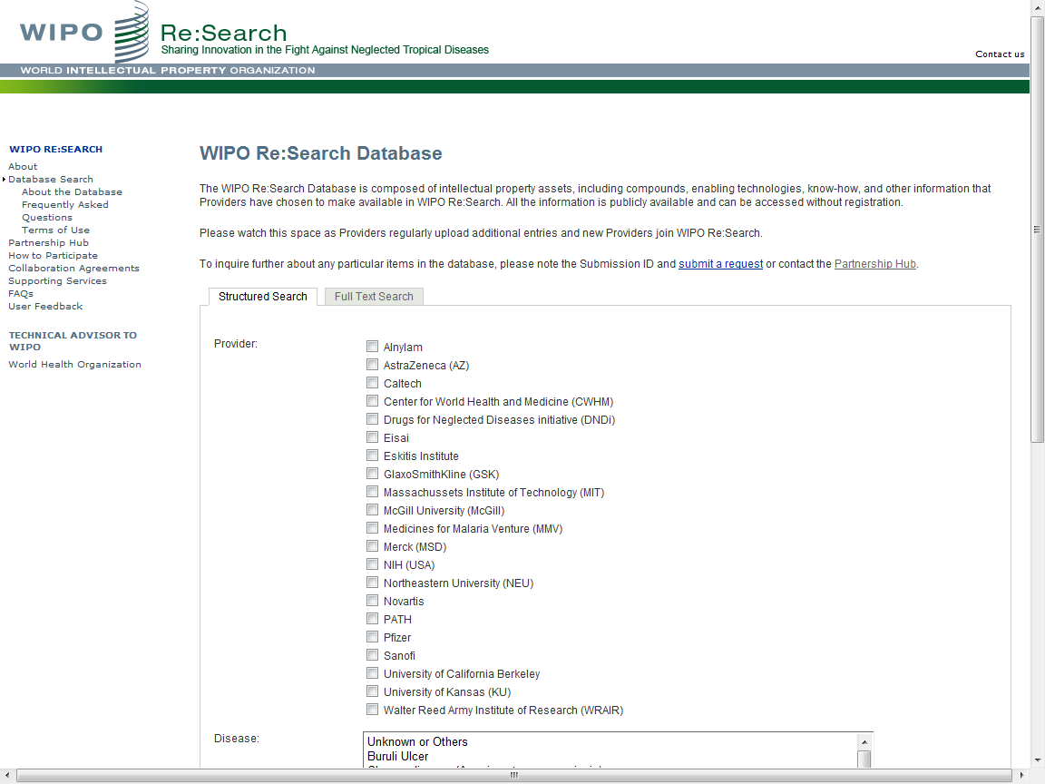

Slide 42
Global Databases, Tools, and Platform for IP business (free)
PATENTSCOPE
Global Brand Database
WIPO Lex
WIPO IPAS, WIPO DAS
WIPO CASE
WIPO RE:SEARCH
WIPO GREEN

Slide 43
WIPO GREEN
A Global Database to bridge providers of green tech and commercial partners
To be launched in November 2013

Slide 44
Vision
WIPO Global Databases and Platforms will promote global partnerships among multiple stakeholders
DB, Tools, Platforms need to be easy to search, most updated, interactive/dynamic, multilingual, and robust

Slide 45
Thank You!
www.wipo.int
“CONTACT US” Web Site at
http://www.wipo.int/contact/en/

