Slide 1
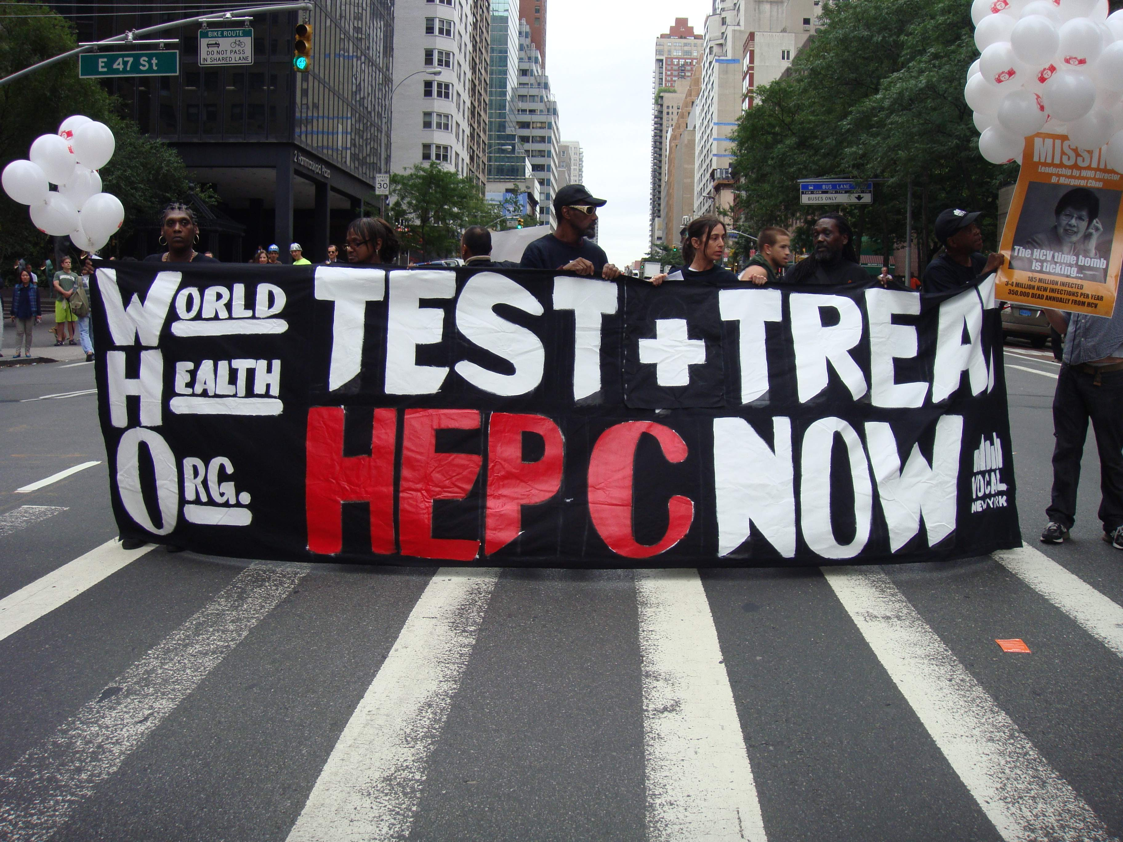
Innovation and Access to Medicines: A Case Study for HIV/AIDS and Hepatitis C
Dr Manica Balasegaram, WIPO Seminar, 2014

Slide 2

Generic competition needed
MSF Access Campaign

Slide 3
HIV: early successes not sustained
1st line ARVs: no product patent protection in India until 2005 = rock bottom prices.
2nd line ARVs: successful use of TRIPS flexibilities (pre-grant patent oppositions on secondary applications) = competition and reduced prices.
3rd line ARVs: patents on new drugs = high prices.
Drug challenges: developing FDCs, inclusion in the Medicines Patent Pool, patenting in India and single drug registration (eg TAF).
MSF Access Campaign

Slide 4
Email to MSF pharmacist
“In Myanmar, we have trained our doctors in the effective screening and treatment of
CMV retinitis. However, the current treatment is long and uncomfortable. It involves repeated intraocular injections of ganciclovir and has medical risks. An effective oral agent, valganciclovir, exists and avoids the need for injections into the eye, but it remains largely inaccessible due to its high cost.”
Generic producer – prequalification dossier request
With specific reference to your email, please note that there are territories wherein at least a patent for Valganciclovir is still in force, hence, it would depend on the exact country(ies) where we intend this product to be offered. This is the information that I would have to provide internally for processing the dossier.
Can you provide us with some more information about:
countries of interest
preliminary patent information regarding these countries etc.
MSF Access Campaign

Slide 5
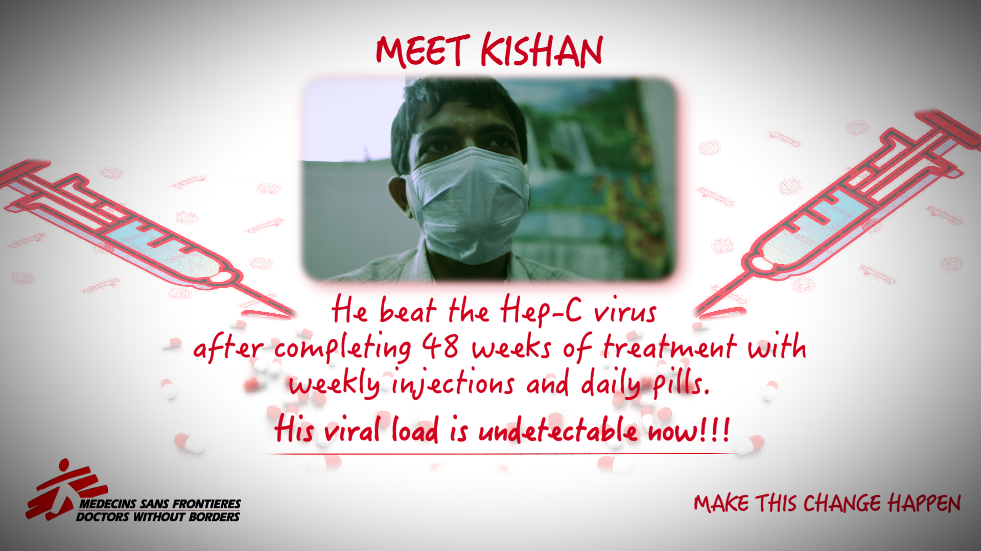
MSF Access Campaign

Slide 6
HCV treatment: DAAs and combinations
DAA combinations
R7128 +
ITMN-191
DAA:
Nuc-
Polymerase
inhibitors
PSI-7977 + PSI-938
Phase I
IDX-184 + IDX-320
GS-9190 +
GS-9256
BI-207127
BI-201335 +
BI-207127
Telaprevir
+ VX-222
Phase II
RG7348
HTA:
Cyclophilin Inhibitors
MK-0608
BMS-790052 +
BMS-650032
TMC-649128
SCY635
Phase III
BMS-790052 +
PSI-7792
R7128
PSI-7977
DEBIO-025
(Novartis)
Approved
IDX-184
AZD07295
PF-868554
Boceprevir
GS-9190
ABT-072
BMS-790052
Telaprevir
ABT-333
BMS-824393
ANA-598
ABT-837093
TMC435
BI201335
VX-222
DAA:
NS5A inhibitor
MK5172
BMS650032
BI201127
VX-985
MK7009 (vaniprevir)
ITMN-191/R7227
DAA:
Non Nuc-
Polymerase
inhibitors
ABT-450
ACH1625
BMS791325
IDX-320
DAA = direct-acting antiviral
HTA = host-targeting antiviral; Nuc = nucleos(t)ide
DAA:
Protease
inhibitors
NOT EXHAUSTIVE
MSF Access Campaign

Slide 7
Shortlisted DAAs for access
Early identification of pipeline drugs:
Gilead: Sofosbuvir, ledipasvir, GS5816
BMS: Daclatasvir
Merck: MK-8742, MK-5172
MSF Access Campaign

Slide 8
MSF accessing DAAs: Issues with Sofosbuvir
Registration: Some LICs where MSF is operational are not a priority for Gilead.
No local registration = MSF access to drugs on a CU basis.
Quoted treatment price of 900 USD. Reality for MSF patients depends more on final regimen used.
Pricing still not available for Gilead ‘commercial countries’ (inc Ukraine & Iran) where MSF notes medical needs.
VL blocks generics from entering the market in MICs.
Non provision of drugs for trials = no effective combination with daclatasvir established.
MSF Access Campaign

Slide 9
Gilead’s anti diversion programme
Gilead claims a world-wide anti diversion programme is needed to prevent LICs to M&HICs diversion. Required of all distributors and voluntary licensees.
Ethical issues: patient confidentiality, data management and privacy, viral load monitoring protocols, suspended access.
Patient exclusion: no identification, refugees, IDUs, homeless or unstable living arrangements.
Retail sale prevention may keep treatment in the hands of elite groups of hepatologists. The oncology model (drugs sold through physicians) can lead to unethical practices.
Gilead granting an exception to MSF puts us in a difficult position: how can we ensure access and basic rights for all?
MSF Access Campaign

Slide 10
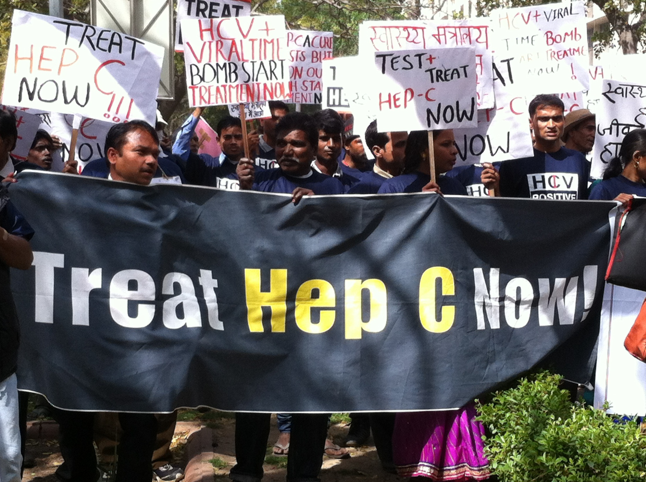
Thank you!

