Slide 1
WIPO’s Rewards and Recognition Program (RRP)
Geneva
January 29, 2016
Cornelia Moussa
Director, Human Resources Management Department (HRMD)
With respect to illustrations in this presentation, credit is given to iStock.

Slide 2
Aim of the Pilot Program
Publically recognize and reward exceptional performance in WIPO
Generate interest of other staff members to receive similar rewards

Slide 3
Scope of the Pilot Program
Recognition:
about 140 staff members received certificates for outstanding performance
Rewards:
12 Individual Rewards (2,500 CHF)
3 Individual Rewards (training program)
3 Team Rewards (5,000 CHF)
Notes:
About 1100 staff members were covered under the Program
Care was taken to establish clear links with WIPO’s core values and strategic goals, as well as the PMSDS
Recognition:
All staff who demonstrated outstanding performance in 2012 received a certificate from the Director General.
Rewards:
Individual Reward: Results and Service-Orientation rewards For having achieved outstanding results or for demonstrating outstanding service-orientation. One staff per sector; in sectors with more than 100 staff, one reward per 100 staff
Individual Reward: Innovation and Efficiency For achieving outstanding results in an area related to innovation or in an area related to significant efficiency gains resulting in cost savings for WIPO. Three individuals: 1 senior staff (P5 to D2), 1 mid‑level staff (G7 and P1 to P4), 1 support staff (G2 to G6)
Team Reward: Working as One rewards For exceptional team performance

Slide 4
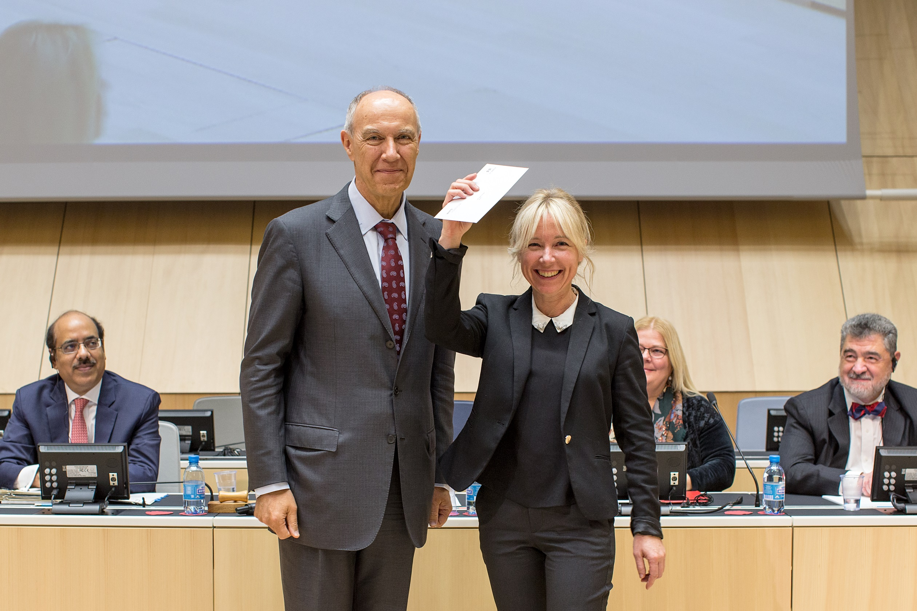
The Ceremony …

Slide 5
Assessment of the Pilot
to learn from experience before designing the formal program
Notes:
After the ceremony HRMD wanted to assess the RRP to learn from the experience and to further improve the progarm before its final establishment.

Slide 6
Looking for Help
Experience
Neutrality
=> Internal Oversight Division

Slide 7
The Evaluation – A Two Step Approach
Step 1: Lessons Learned Review Workshop (after the Pilot 2013)
=> Continue with the pilot in 2014
Step 2: Detailed Evaluation (after the Pilot 2014)
=> Design the formal program

Slide 8
Lessons Learned Review Workshop
About 40 participants
Facilitated by Internal Oversight Division and HRMD
Outcome
Right mix of recognition and rewards
More tools for informal acknowledgement
Ceremony was appreciated
Better communication needed
Notes:
About 40 selected staff members (mainly team and individual beneficiaries of the pilot 2013) and one SMT member participated.
Outcome:
The pilot has the right mix of informal acknowledgement, formal acknowledgement and rewards
There should be more tools for informal acknowledgement.
The ceremony was appreciated by all staff.
The positive effects could have been maximized by better, clearer and timelier communication to the nominated staff.

Slide 9
Step 2: The Evaluation (after the pilot 2014)
All staff survey (good participation, about 360 people)
Additional survey for the Senior Management Team
Outcome
Over 66% were of the opinion:
RRP is relevant to recognize good performance
Criteria for the rewards were clear and appropriate
Shortcomings: e.g. transparency, communication and staff involvement

Slide 10
Recommendation I
Prioritize in-kind and intangible awards
New handbook for managers on “Showing Recognition”

Slide 11
Recommendation II
Improve and engage staff in the nomination and selection processes
WIPO staff nominates and selects three staff members for a new reward (2,500 CHF)
For the other rewards, WIPO managers instead of Program Managers are now responsible for the nomination of staff members and teams
Notes:
New reward: Environmental, Social and Governance Responsibility reward
For having significantly contributed to a positive and harmonious work environment with his or her highly professional attitude and behavior in the execution of work, for example in the way he or she has shared knowledge, provided services or demonstrated team spirit.

Slide 12
Recommendation III
Better inform staff on the RRP
WIPO Intranet site dedicated to the RRP
RRP email account

Slide 13
Implementation - The 2015 Rewards
New Reward
9 nominations for the three rewards
good participation of staff in the online poll
2015 Ceremony
Individual rewards: 22 staff members
Team rewards: 65 staff members (3 teams) e.g. “New Conference Hall” team
Notes:
New reward: “Environmental, Social and Governance Responsibility” Reward
For three staff member who have significantly contributed to a positive and harmonious work environment with his or her highly professional attitude and behavior in the execution of work
Nominated and selected by staff
Selection process: on-line poll -> good participation, about 400 staff members = one-third of WIPO staff
2015 Ceremony – December 8, 2015
New Conference Hall Team: The team worked collaboratively from January to September 2014, with over 100 external professional firms and companies on the worksite - to deliver the completed New Conference Hall on time for the 2014 Assemblies

Slide 14
Conclusion
Involvement of the Internal Oversight Division led to:
a better formal RRP
Increased competence in HRMD to evaluate projects

