Slide 1
SANTOS - WIPO
French manufacturer of commercial electrical equipment for juice bars, snacking, coffee shops, hotels, bars, restaurants…
A Practical approach of the Hague System

Slide 2
Part 1 : “Who is SANTOS ?”
SANTOS PRESENTATION
SANTOS - WIPO
“Who I am” →… will define… “My IP strategy”
Business model Designs, brands, patents ?
Markets Countries ?
→… different choices…
Customers
Type of product Budget ?

Slide 3
SANTOS - WIPO
… All our products are designed and assembled in Santos headquarters in Lyon.
Professional equipment : Worldwide B to B Market - 80% export – 130 Countries

Slide 4
Small, Commercial & Electrical
Santos was created in 1954 by André Fouquet, to provide commercial electrical equipment to bars, restaurants, hotels, coffee shops, juice bars…
A worldwide trademark synonymous of reliable and sturdy products.
The trademark : (via WIPO since1988 !)
SANTOS PRESENTATION
SANTOS - WIPO

Slide 5
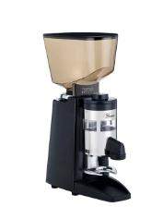
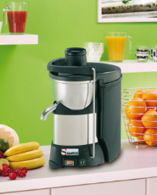
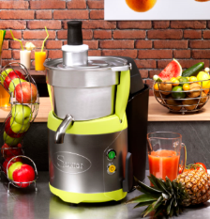
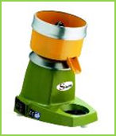
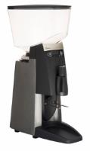
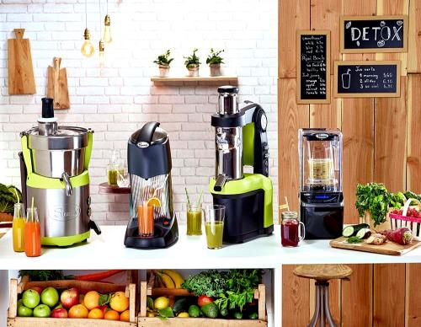
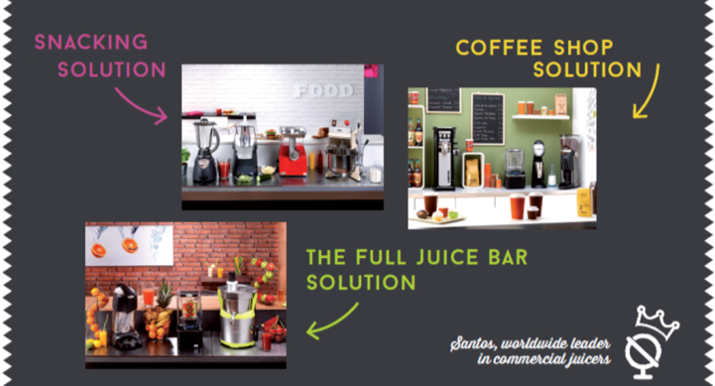
Some Santos best sellers :
SANTOS PRESENTATION
Citrus juicer « Classic » N°11
« Silence » Coffee grinders N°40A and 55
SANTOS - WIPO
Juicers N°50 and 68
Full Juice Bar Solution

Slide 6
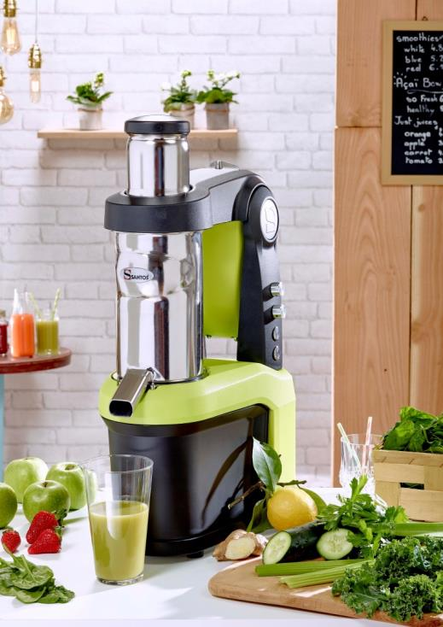
New product : NUTRISANTOS N°65
Commercial appliance: Aluminum body and stainless steel food zone. Reliable induction motor.
Patented slow juicing system: Slow extraction of juice preserving nutrients, enzymes, minerals and vitamins. Minimizing juice separation and oxidation.
A new way of juicing: Set your speed and your filtration size to get the juice you want
Fresh raw juice: made on-demand, in front of the customer.
Cost effective: Extracts the maximum juice (excellent yield).
Easy to use: XL chute (ø79,5 mm). Removable pusher and juicing system for an easy cleaning.
SANTOS - WIPO

Slide 7
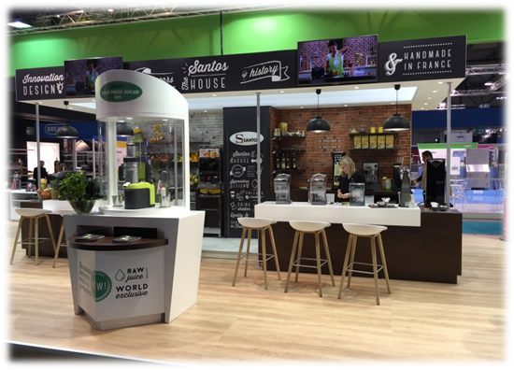
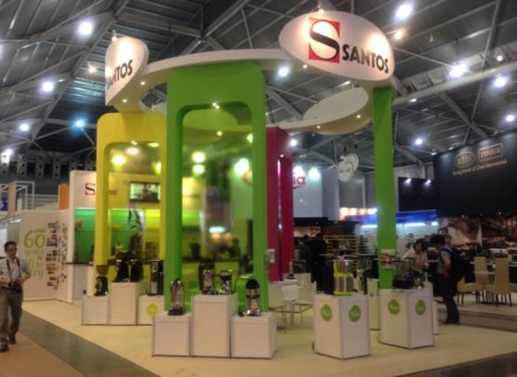
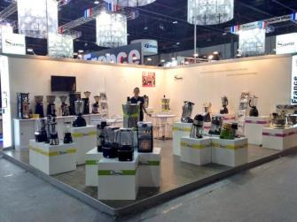
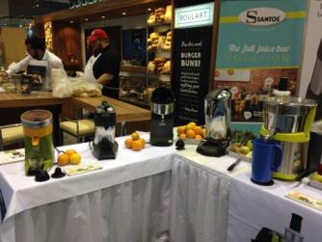
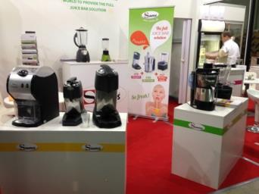
Worldwide network & Experience
Santos is represented in more than 130 countries
We participate in the most important tradeshows all over the world
SANTOS PRESENTATION
SANTOS - WIPO
MILAN
SINGAPOUR
DUBAI
CHICAGO
MOSCOU

Slide 8
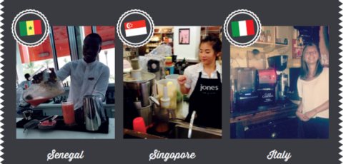
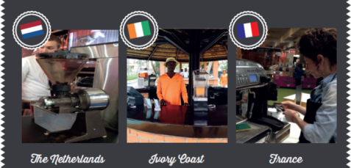
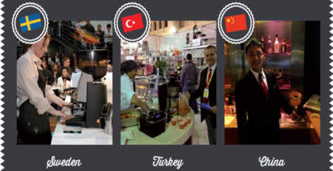
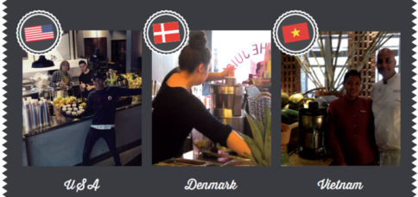
Santos products are all around the world!
SANTOS - WIPO
… our users are our best Ambassadors

Slide 9
SANTOS - WIPO

Slide 10
SANTOS - WIPO

Slide 11
Part 1 Conclusion ?
SANTOS PRESENTATION
SANTOS - WIPO
SME businesses need IP
Your creation, your product deserves a protection.
… because the entire world may buy it ?

Slide 12
Part 1I : “My IP Strategy”
SANTOS PRESENTATION
SANTOS - WIPO
Who I am → My IP strategy
Business model Designs, brands, patents ?
Markets Countries ?
→
Customers Budget ?
The Hague System → Why a Design protection ?

Slide 13
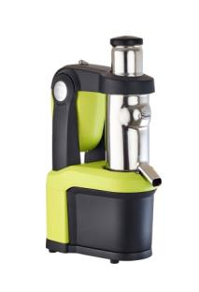
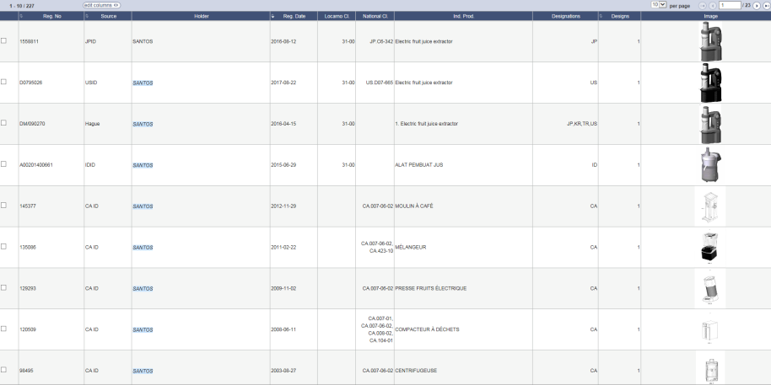
Industrial Designs - The Hague System
Via our Patent Attorney
Be one step further, protect the investments, keep the market monopole
Industrial Designs are very dissuasive :
Very often used for letters of formal notice
No trial in our history (trials only occurred on technical patents)
SANTOS PRESENTATION
SANTOS - WIPO
http://www.wipo.int/designdb/en/index.jsp

Slide 14
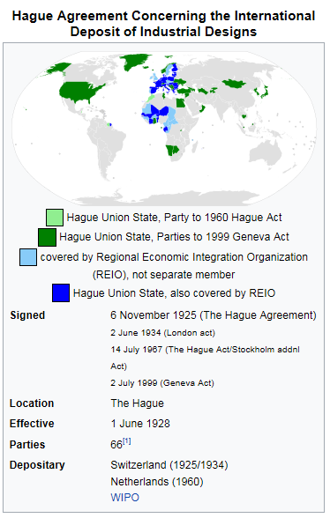
Industrial Designs - The Hague System
SANTOS PRESENTATION
Advantages of The Hague System :
Better cost efficiency / budgets
Easier and centralized portfolio management
High interest for new members in the system (Japan, South Korea, USA…)
SANTOS - WIPO
… for a «worldwide » protection of our products
Source : Wikipedia : https://en.wikipedia.org/wiki/Hague_Agreement_Concerning_the_International_Deposit_of_Industrial_Designs

Slide 15
Some limits of the system ?
Despite the guidance on WIPO website, it’s hard to avoid extra costs sometimes
(http://www.wipo.int/export/sites/www/hague/en/how_to/pdf/guidance.pdf )
SANTOS PRESENTATION
SANTOS - WIPO
Example : Official letter + answer → extra cost of 1000 to 1500 $ for the USA ?
May this be a too high extra cost very smell businesses or startups ?
Major actors shall join The Hague System : China ?
(Russia joined in March 2018)

Slide 16
R&D Budget – IP Budget
Santos strategy :
10% of our annual turnover is invested in R&D
1 new product every 1 or 2 years (including restyling)
Each new product has an Industrial Design patent
SANTOS PRESENTATION
SANTOS - WIPO
Market, Competitors
Idea
Specifications
including technical, design, budget with IP
SANTOS Marketing & Sales force
Santos R&D dept.
Designer
Contract + transfer of rights
Industrial Design
Choice of the countries !

Slide 17
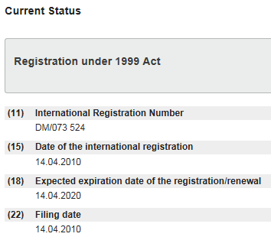
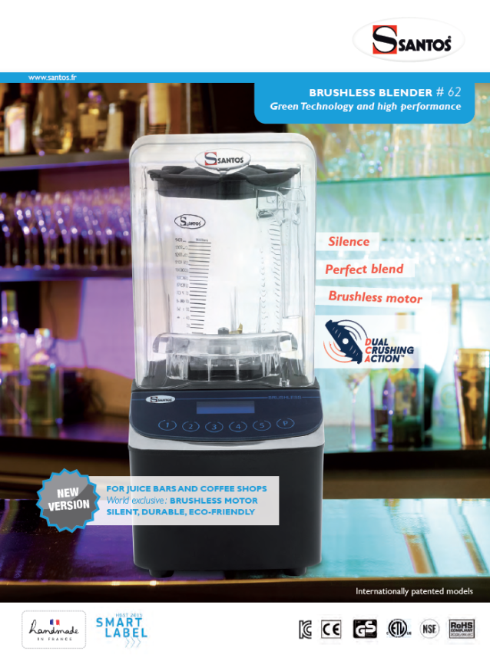
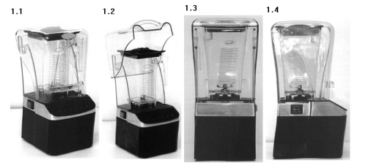
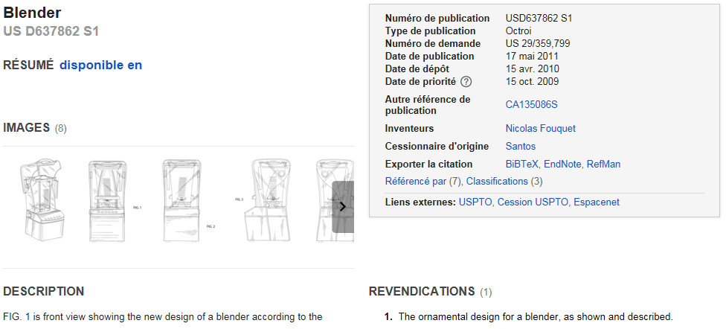
IP = Dissuasion
Example on the Blender :
http://www.wipo.int/designdb/hague/en/
SANTOS PRESENTATION
SANTOS - WIPO
http://google.es/patents/USD637862

Slide 18
Design protection through The Hague System
I use it, what is my conclusion about it ?
SANTOS PRESENTATION
SANTOS - WIPO
It is a cost efficient tool for the protection of each of our new product,
It will help launching and developing the sales of this product worldwide.

Slide 19
Thank you for your attention
SANTOS - WIPO
Nicolas FOUQUET
CEO – General Manager
SANTOS – Vaulx-en-Velin – France
www.santos.fr
nfouquet@santos.fr

