Slide 1
Overview of the PATENTSCOPE search system
Online
September
2019
Sandrine Ammann
Marketing & Communications Officer

Slide 2
Raise your hand only if you can hear me otherwise please send me a message using the Questions box

Slide 5
Questions/concerns
patentscope@wipo.int

Slide 8
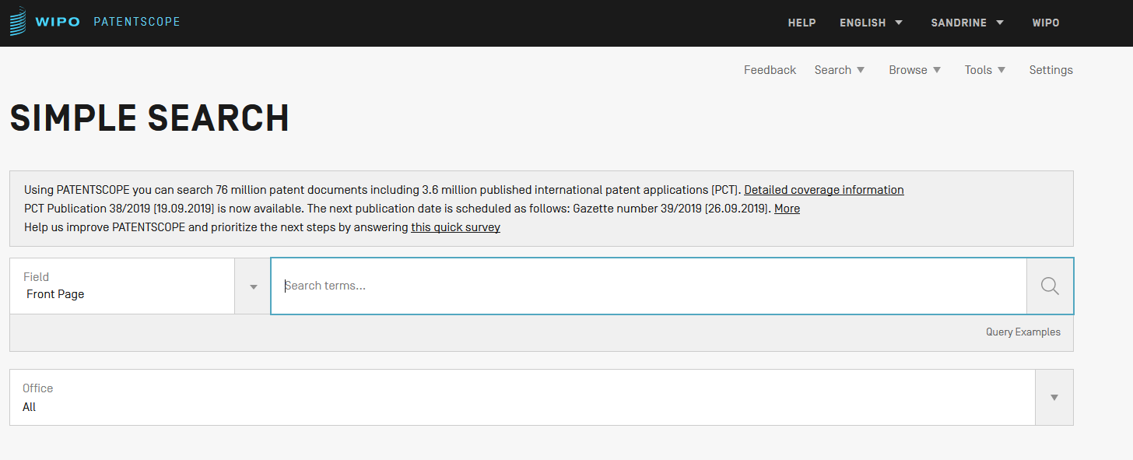

Slide 9
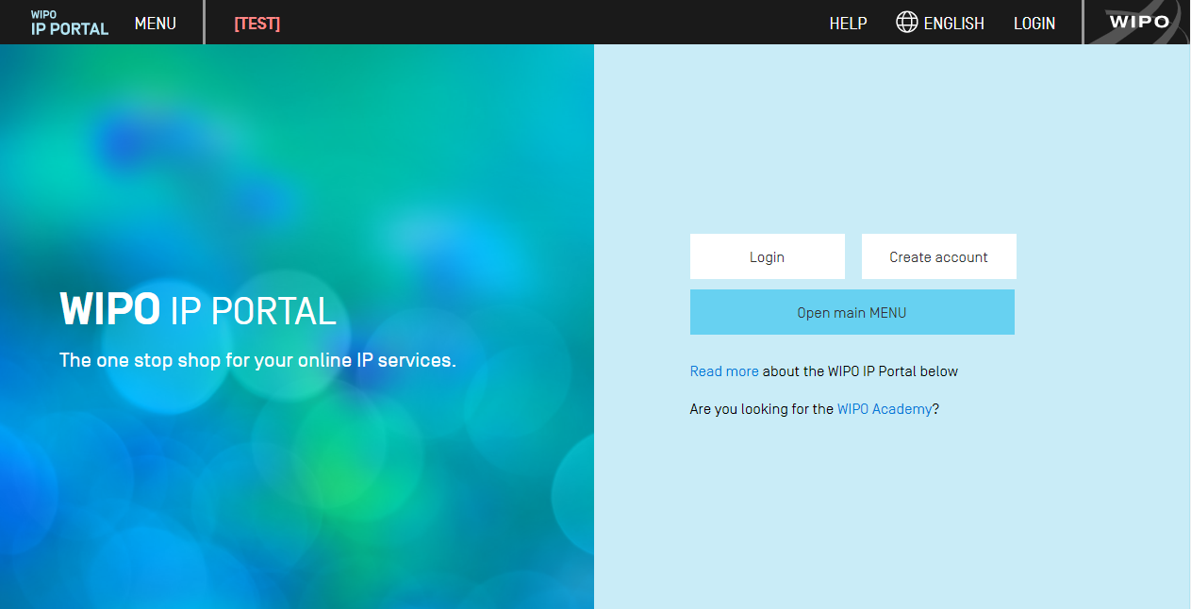
https://ipportal.wipo.int/

Slide 10
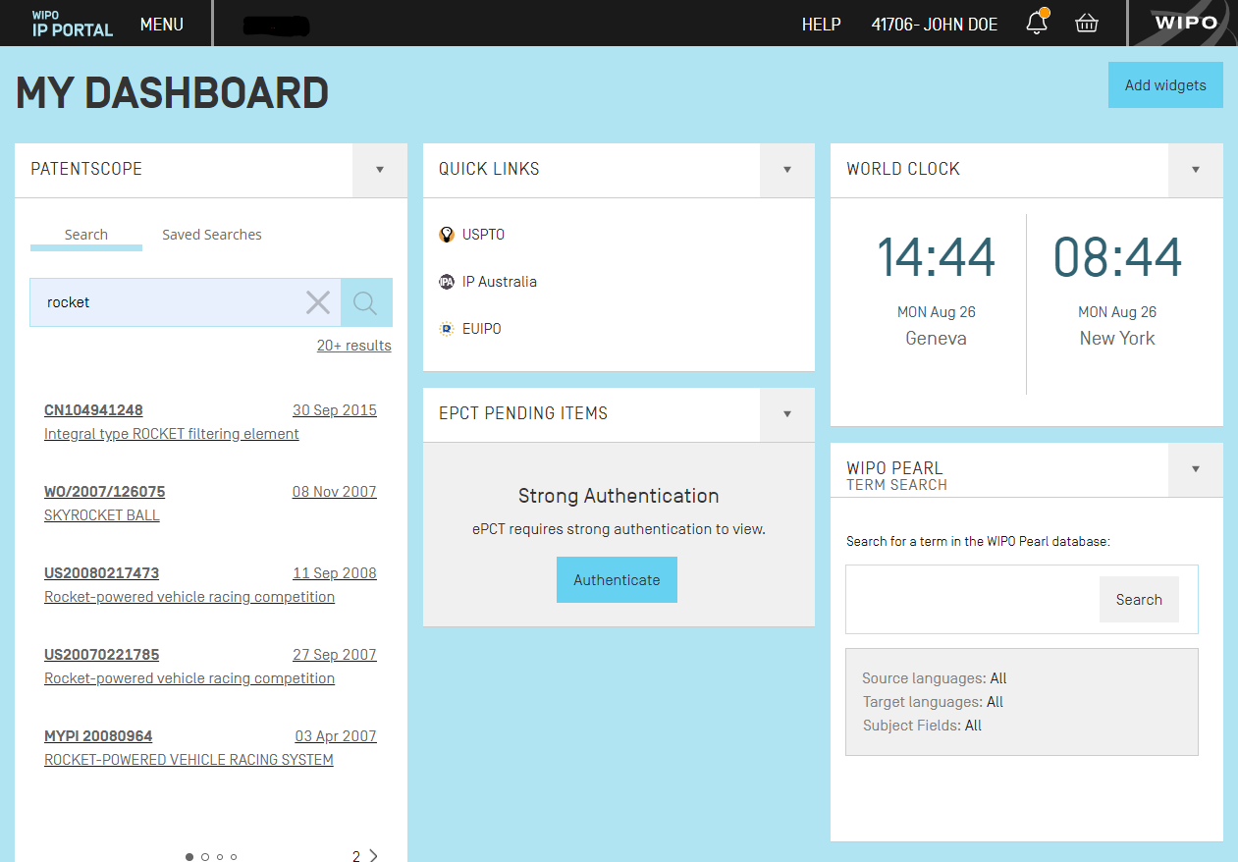

Slide 11
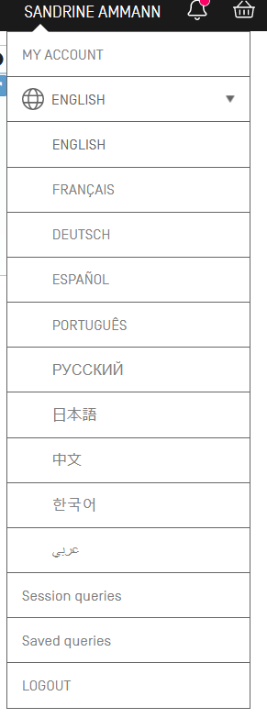
https://patentscope.wipo.int/beta

Slide 15
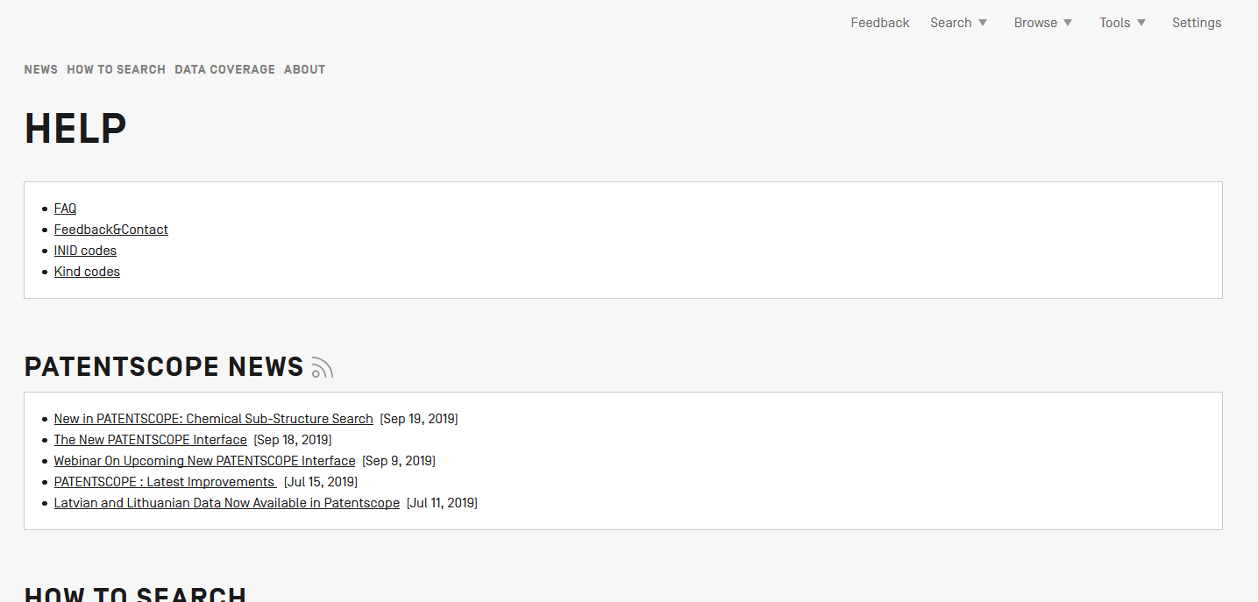

Slide 17
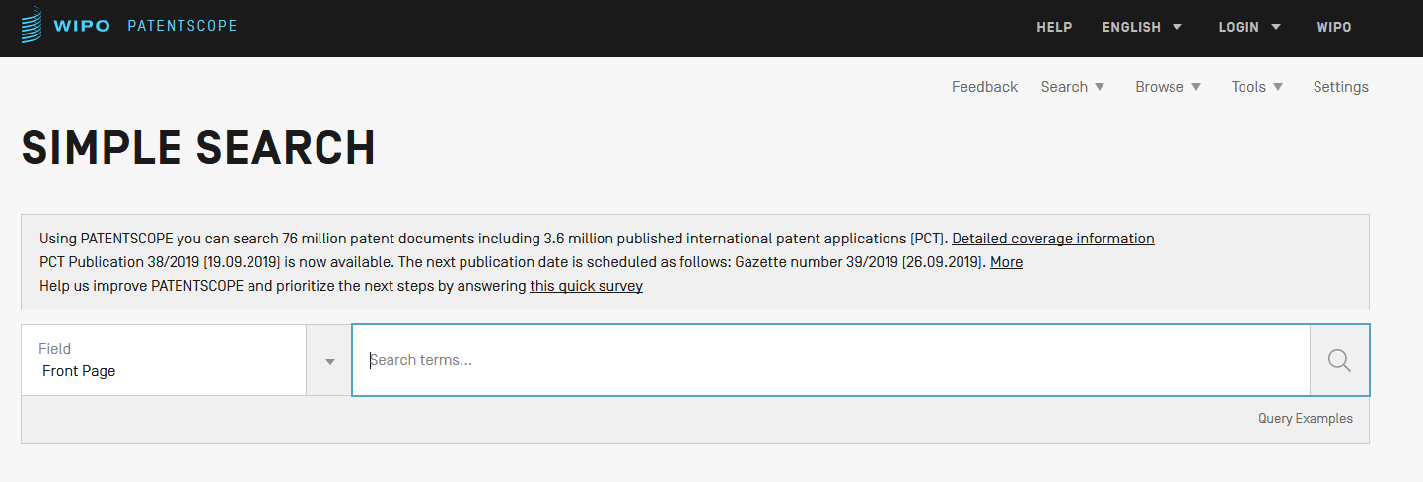

Slide 20
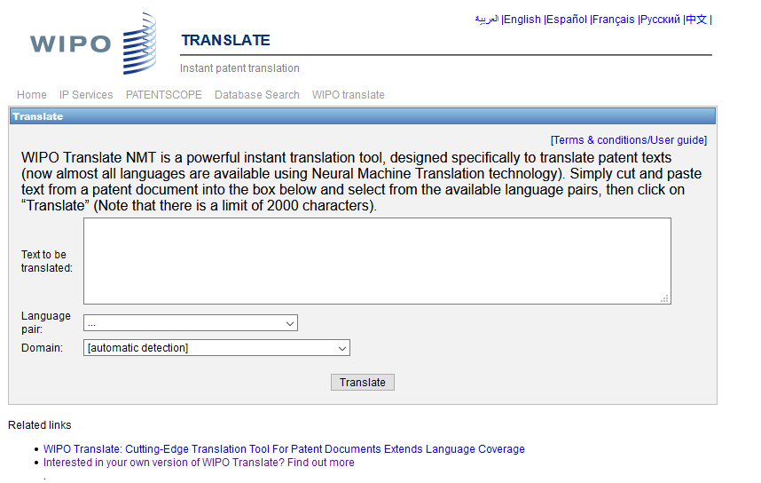
WIPO Translate

Slide 21
32 Technical domains from the IPC
[ADMN] Admin, Business, Management & Soc Sci
[AERO] Aeronautics & Aerospace Engineering
[AGRI] Agriculture, Fisheries & Forestry
[AUDV] Audio, Audiovisual, Image & Video Tech
[AUTO] Automotive & Road Vehicle Engineering
[BLDG] Civil Engineering & Building Construction
[CHEM] Chemical & Materials Technology
[DATA] Computer Sci, Telecom & Broadcasting
[ELEC] Electrical Engineering & Electronics
[ENGY] Energy, Fuels & Heat Transfer Eng
[ENVR] Environmental & Safety Engineering
[FOOD] Foods & Food Technology
[GENR] Generalities, Language, Media & Info Sci
[HOME] Home Contents & Household Maintenance
[HORO] Precision Mechanics, Jewelry & Horology
[MANU] Manufacturing & Materials Handling Tech
[MARI] Marine Engineering
[MEAS] Standards, Units, Metrology & Testing
[MECH] Mechanical Engineering
[MEDI] Medical Technology
[METL] Metallurgy
[MILI] Military Technology
[MINE] Mining, Oil & Gas Extraction & Minerals
[NANO] Nano Technology
[PACK] Packaging & Distribution of Goods
[PRNT] Printing & Paper
[RAIL] Railway Engineering
[SCIE] Optical Engineering
[SPRT] Sports, Leisure, Tourism & Hospitality
[TEXT] Textile & Clothing Industries
[TRAN] Transportation

Slide 22
Language pairs

Slide 23
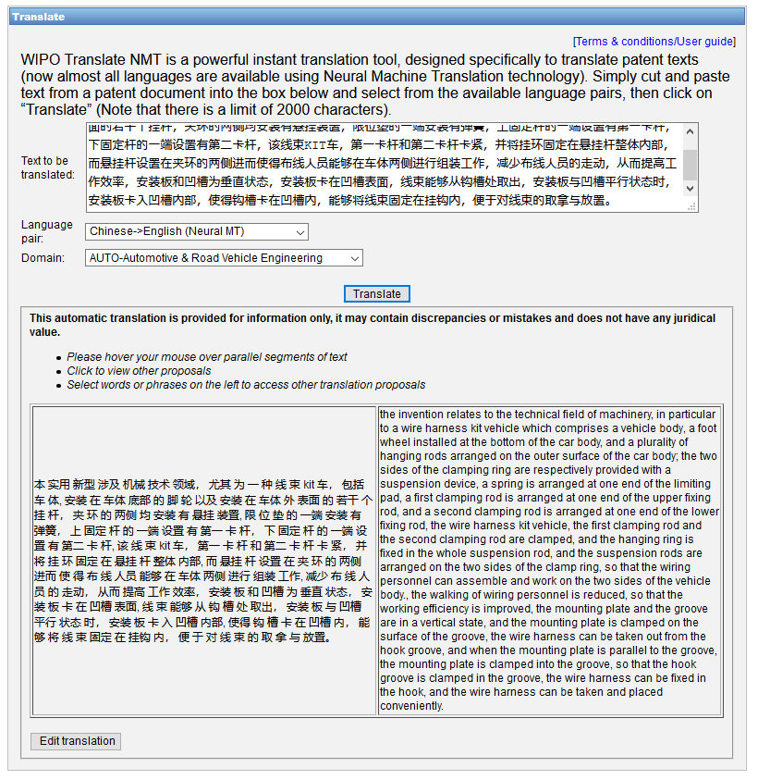

Slide 24
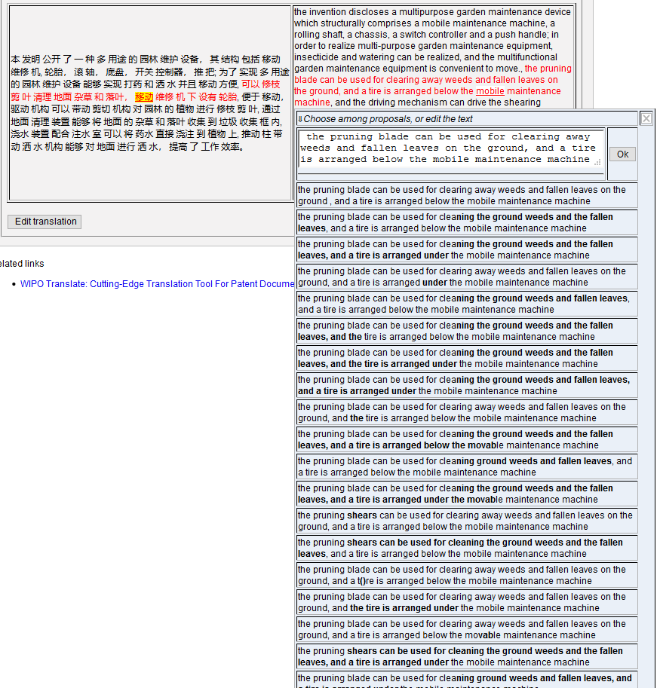
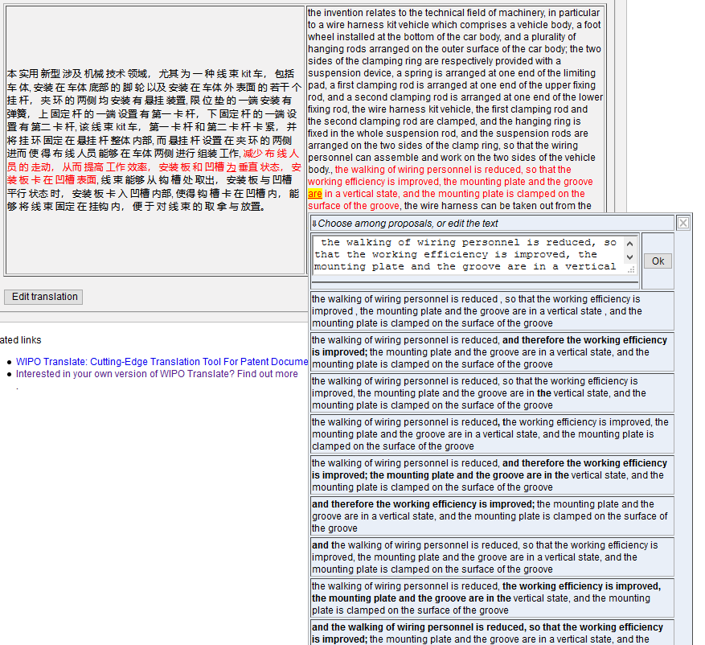

Slide 25
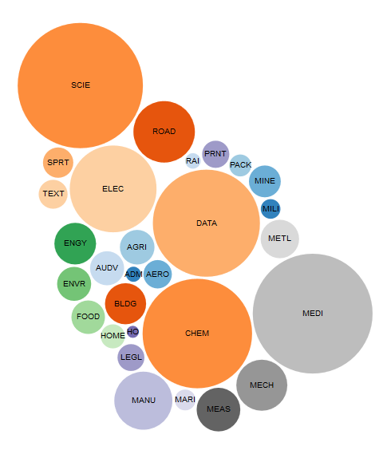
WIPO Pearl

Slide 26
WIPO Pearl
WIPO’s online terminology database
18’000 concepts, 180’000 terms
10 languages
Contents validated by WIPO language experts and terminologists

Slide 27
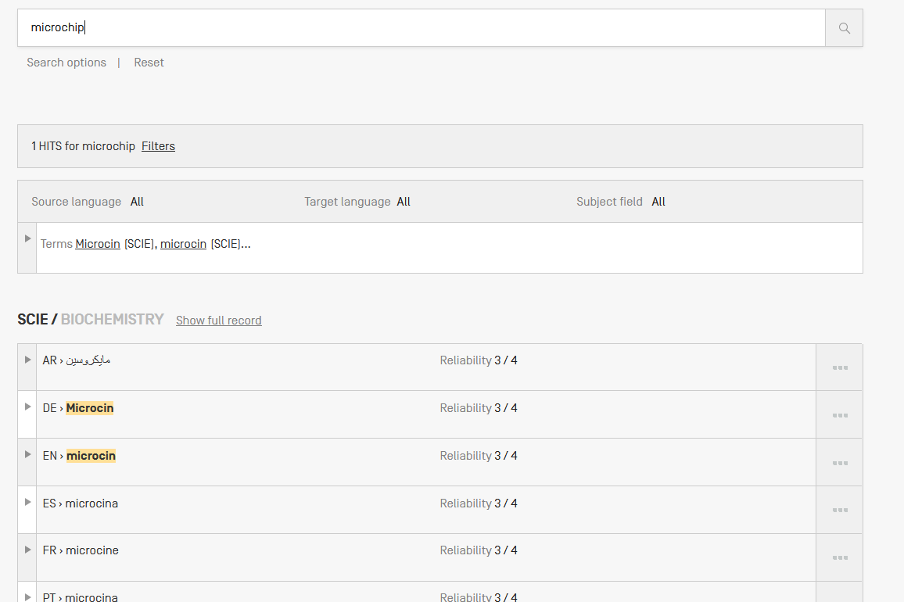
Example: microchip

Slide 28
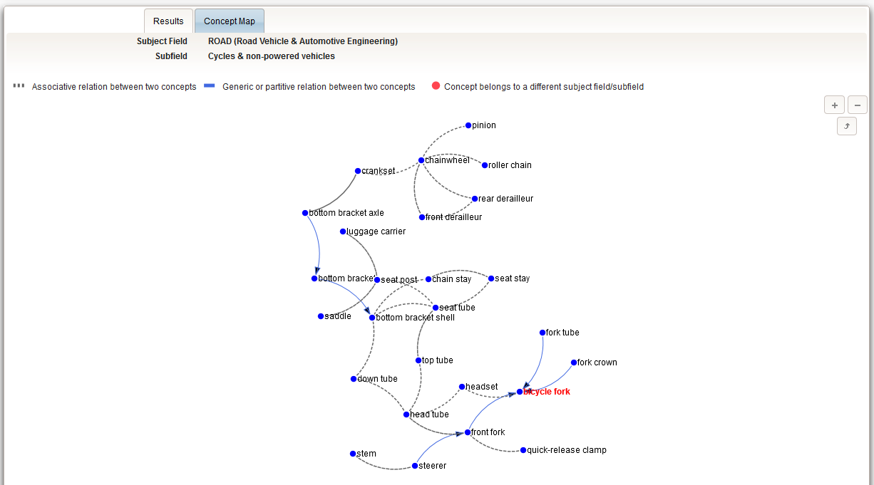

Slide 29
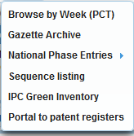

Slide 30
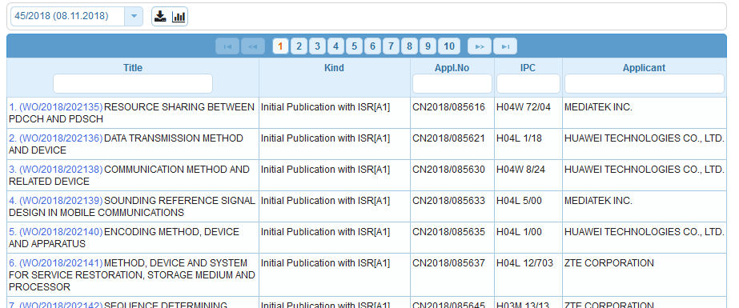
Weekly PCT publication

Slide 31
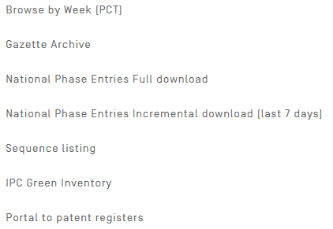

Slide 32
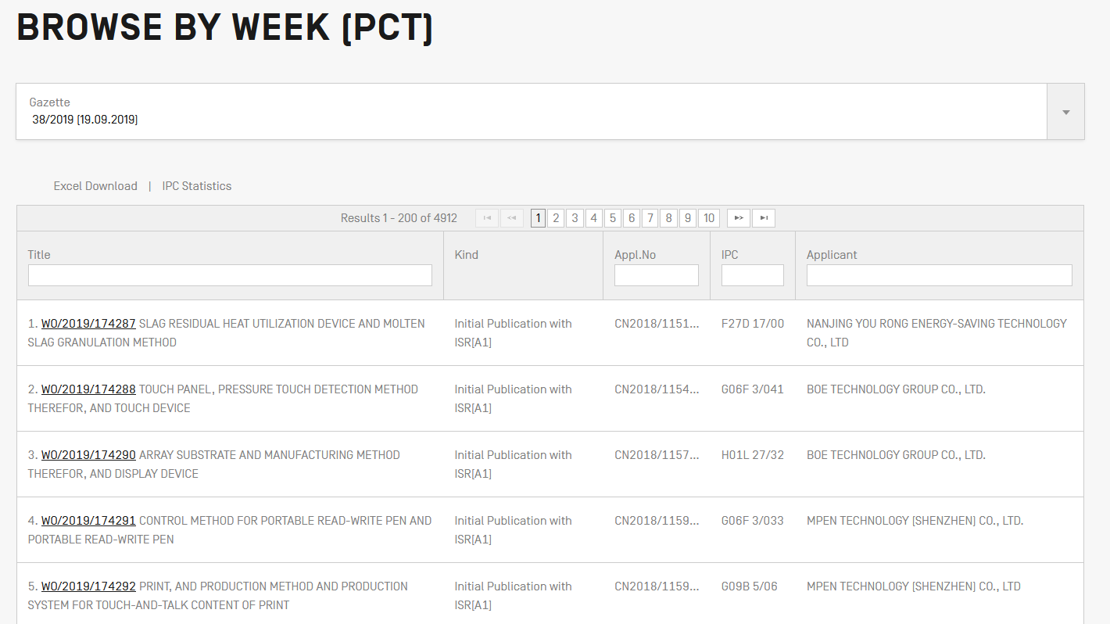

Slide 33
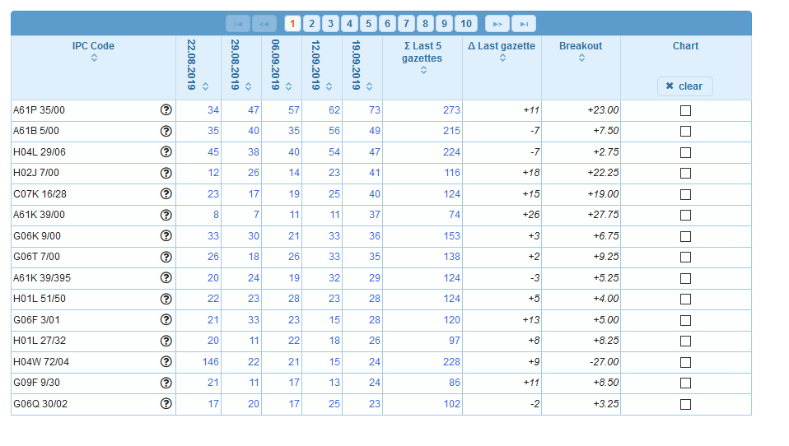
IPC Statistics

Slide 35
Gazette Archive

Slide 37
Gazette Archive

Slide 39
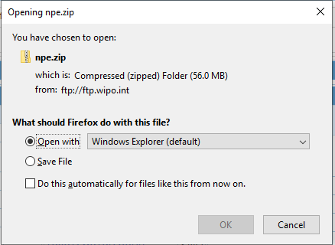
National Phase Entries

Slide 41
National Phase Entries

Slide 43
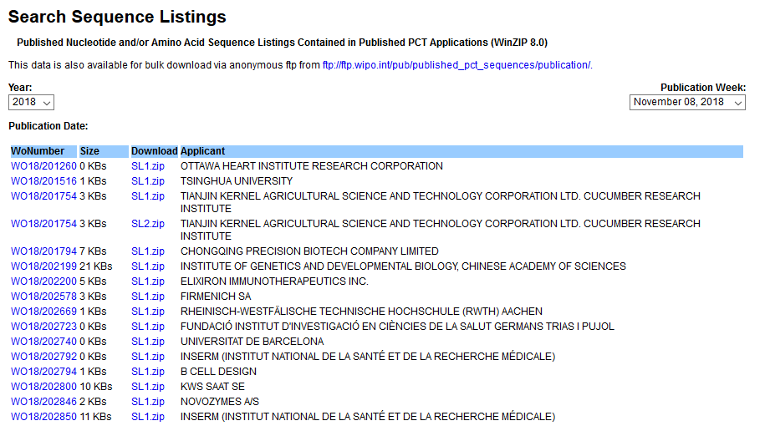
Sequence Listing

Slide 45
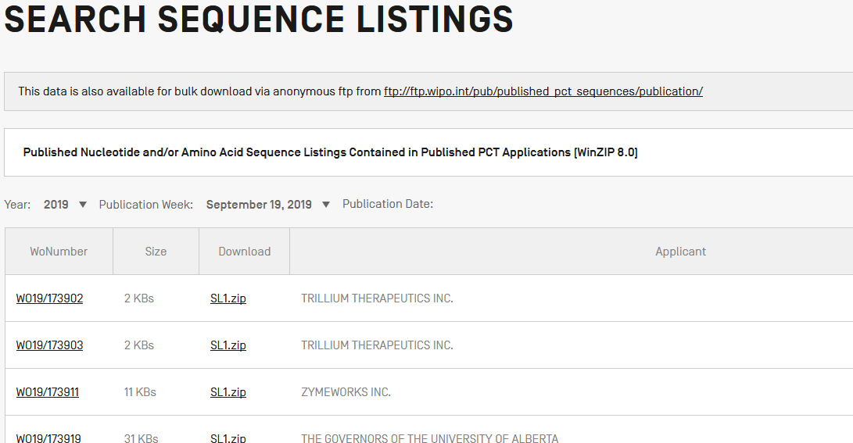

Slide 48
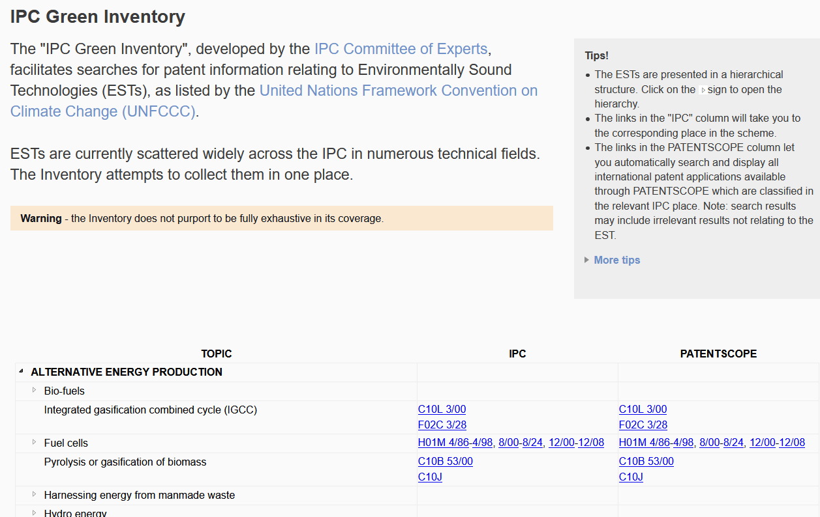
IPC Green Inventory

Slide 51
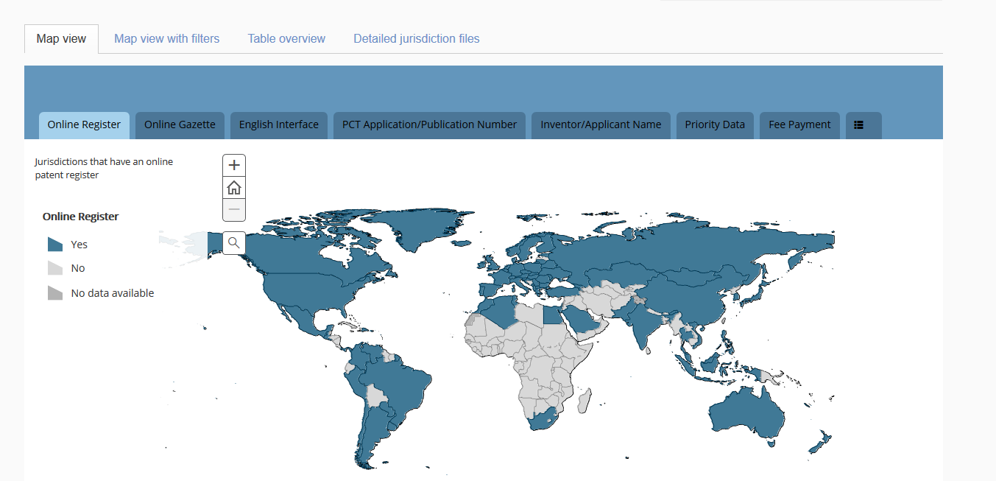
Portal to patent registers

Slide 52
Searches

Slide 53
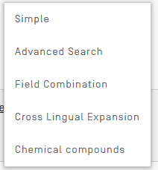
Searches

Slide 54
Chemical compounds

Slide 55
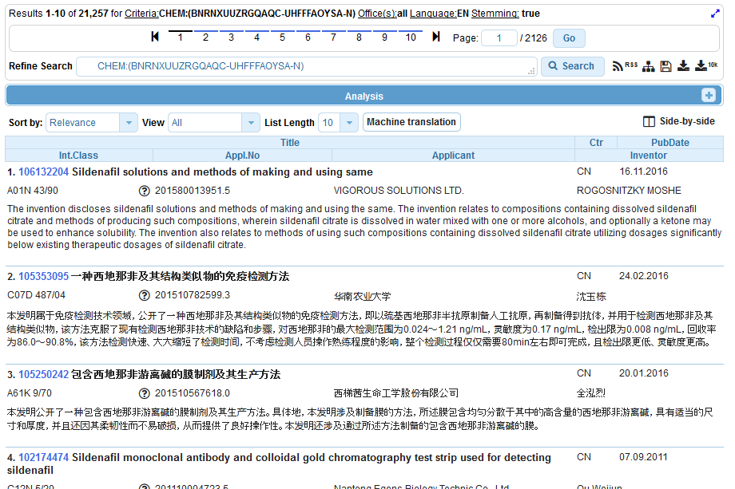

Slide 56
Searches

Slide 57
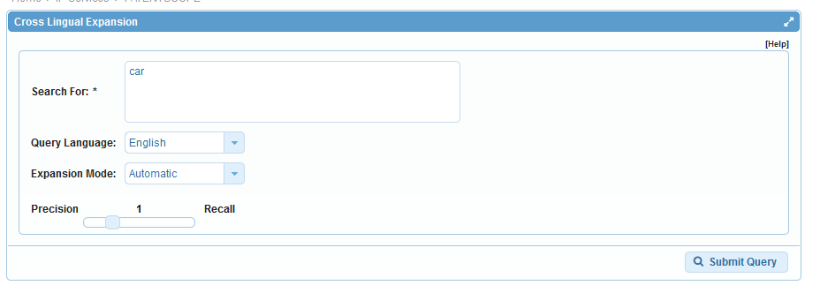
CLIR

Slide 59
Languages
Chinese
Danish
Dutch
English
French
German
Italian
Japanese
Korean
Polish
Portuguese
Russian
Spanish
Swedish

Slide 60
Searches

Slide 61
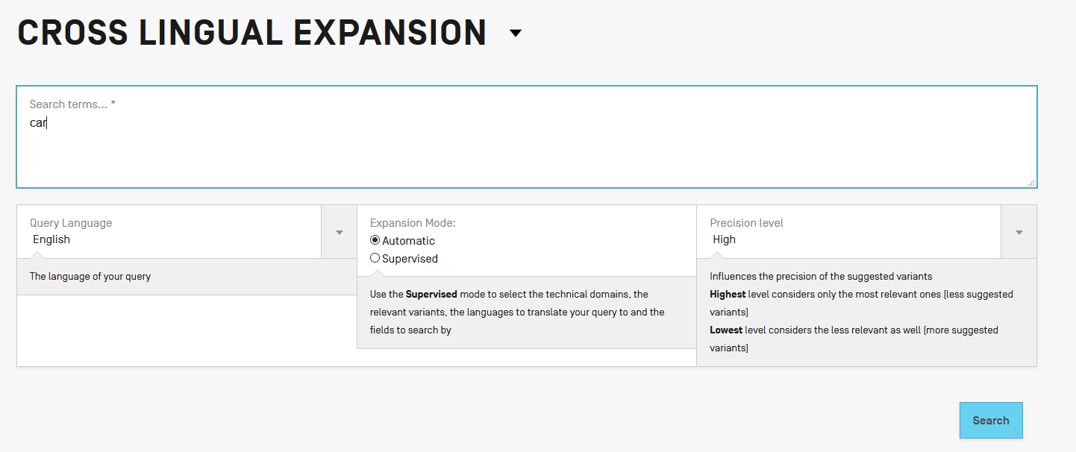

Slide 63
Searches

Slide 64
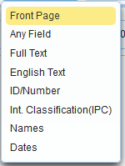
Simple seach

Slide 65
Searches

Slide 66
Simple Search

Slide 67
Searches

Slide 68
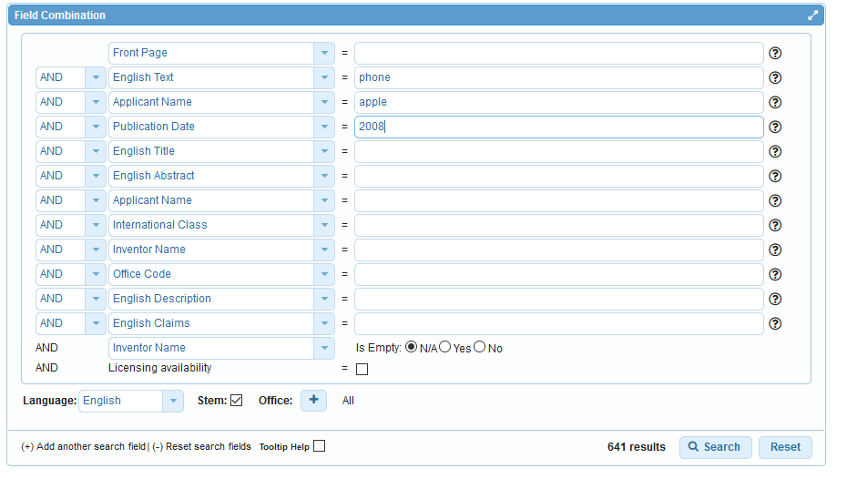

Slide 69
Searches

Slide 70
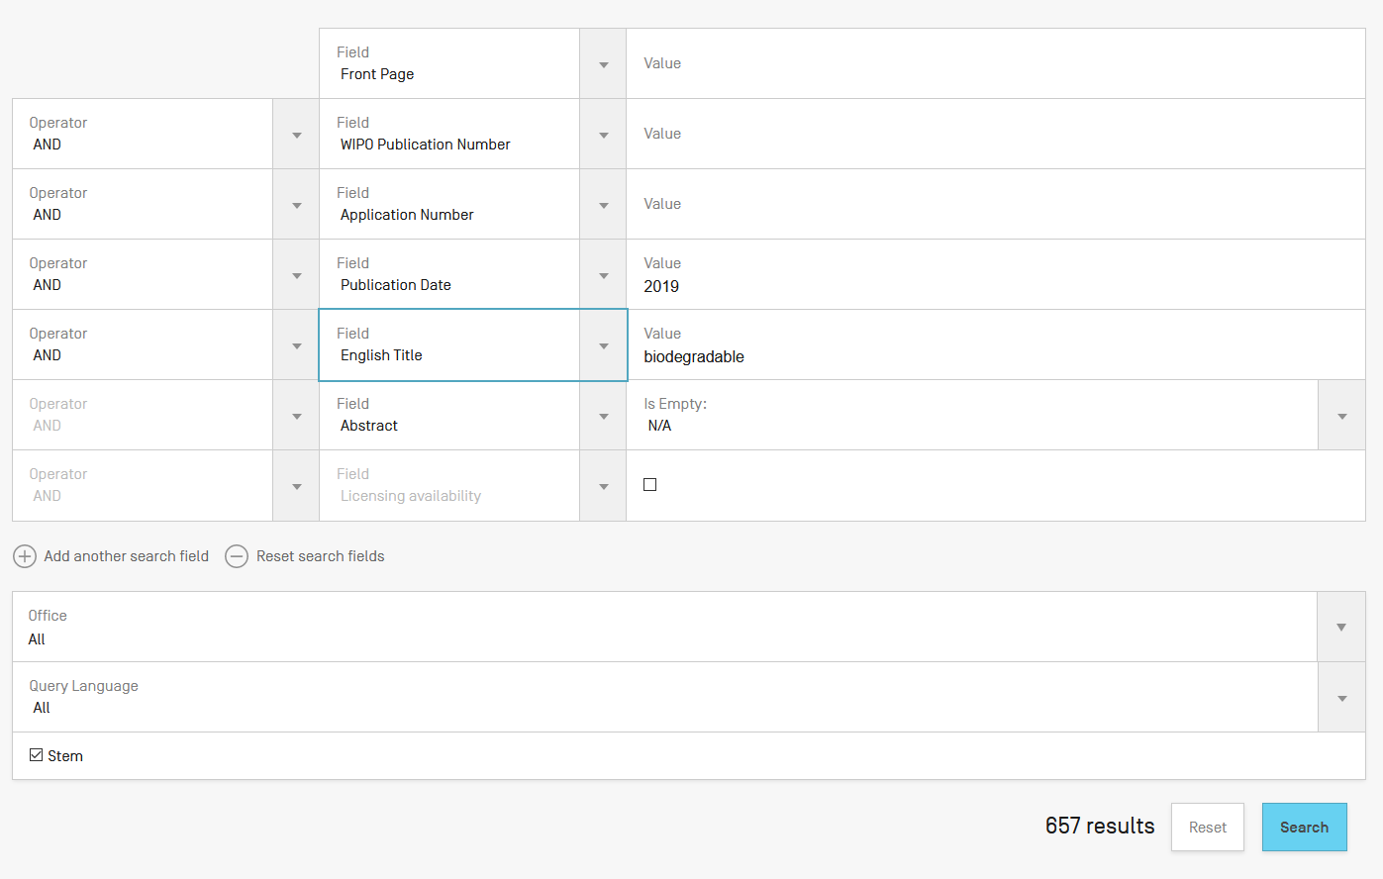

Slide 71
Searches

Slide 72
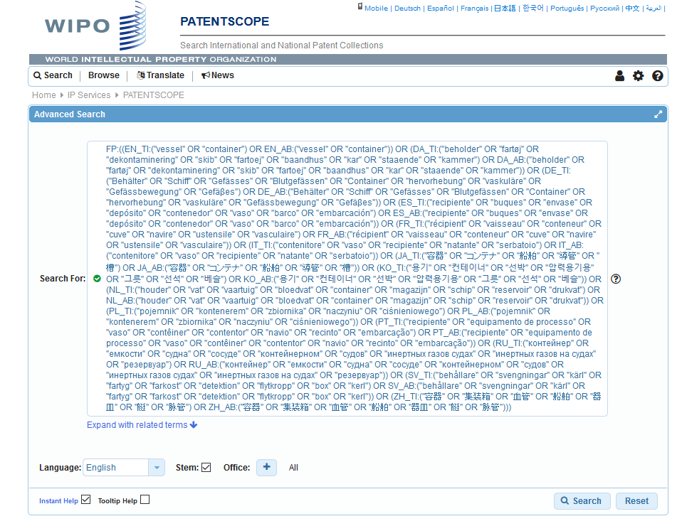
Interface: Advanced search

Slide 73
Searches

Slide 74
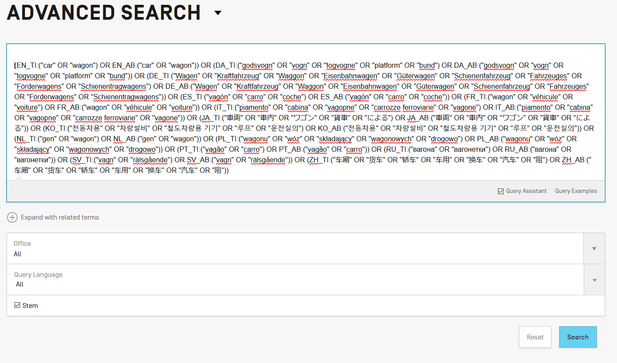

Slide 75
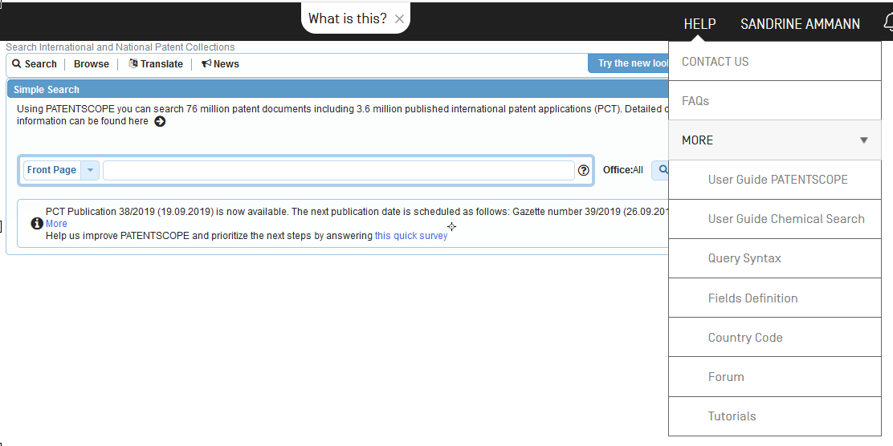

Slide 77
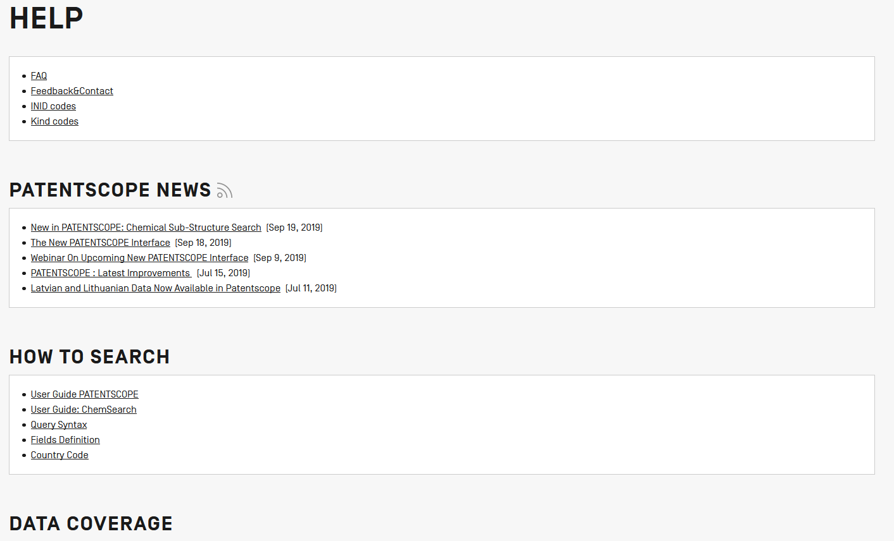

Slide 79
Coverage: what is included?
PCT published applications
National/regional patent collections

Slide 80
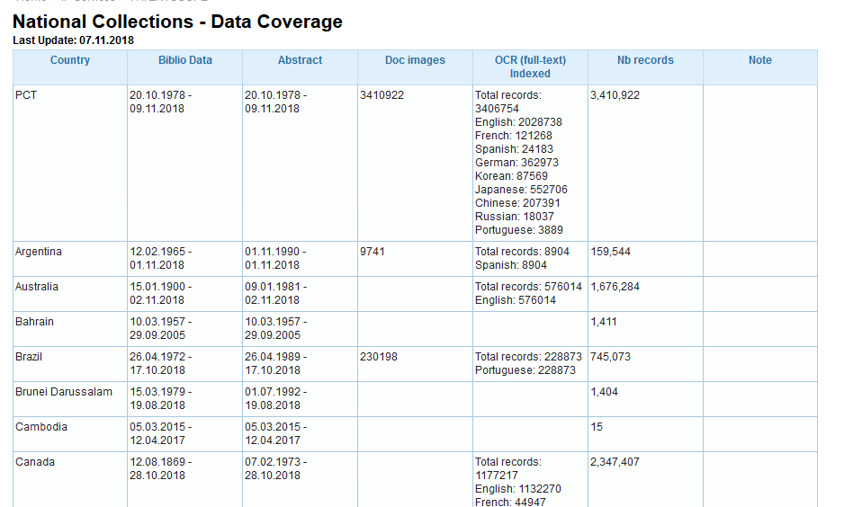
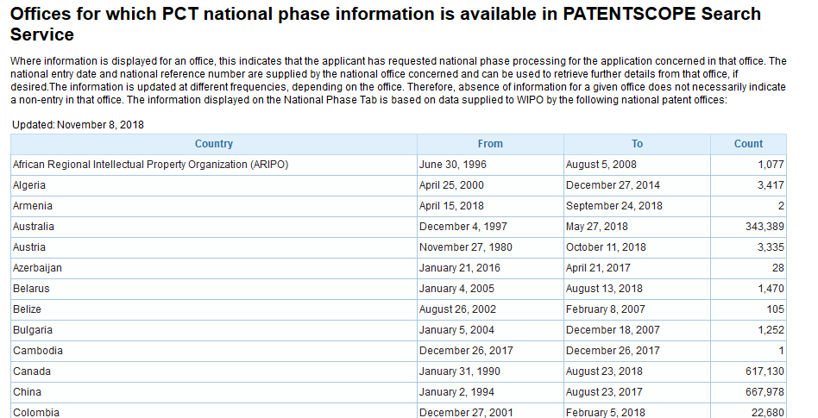
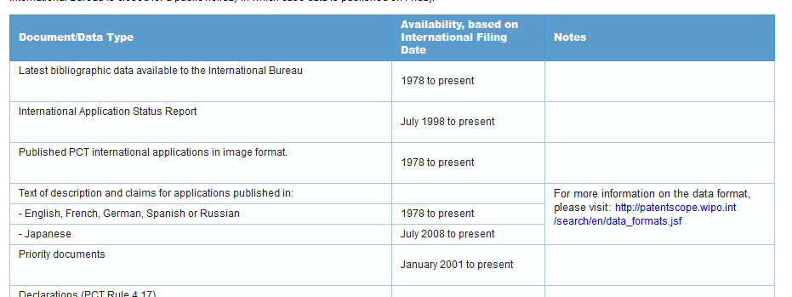

Slide 81
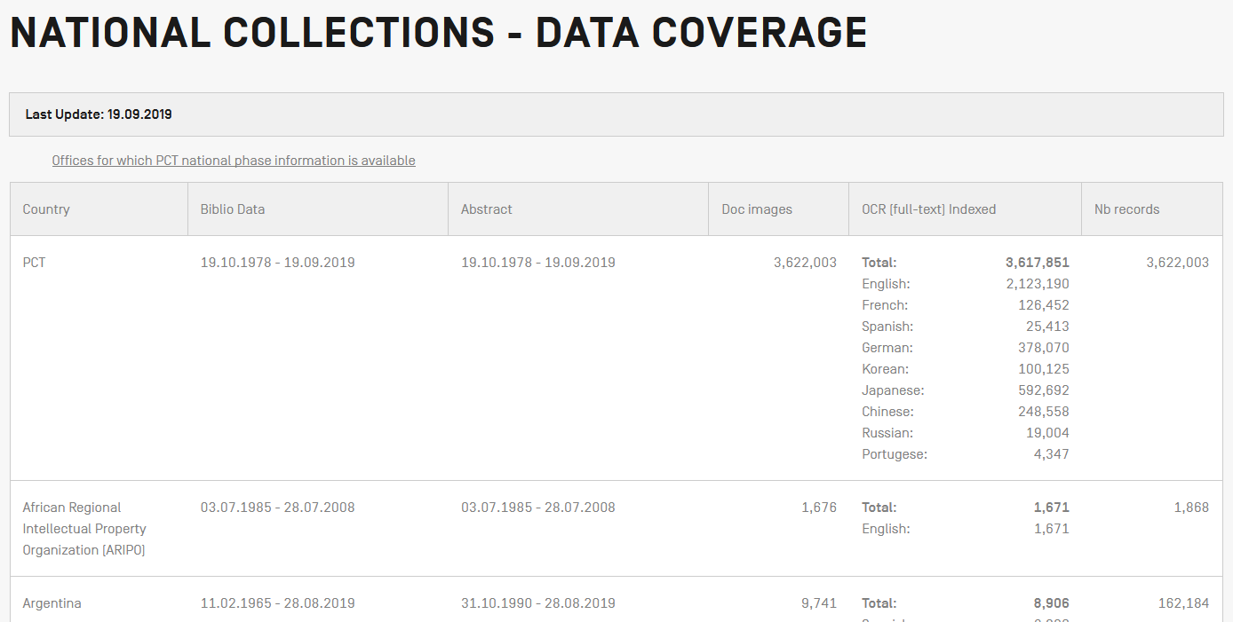
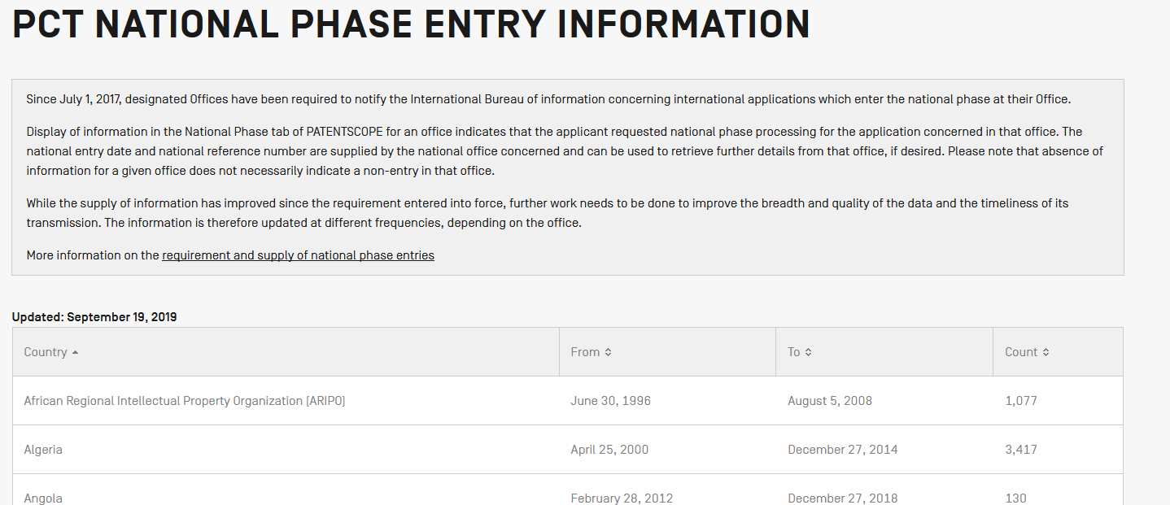
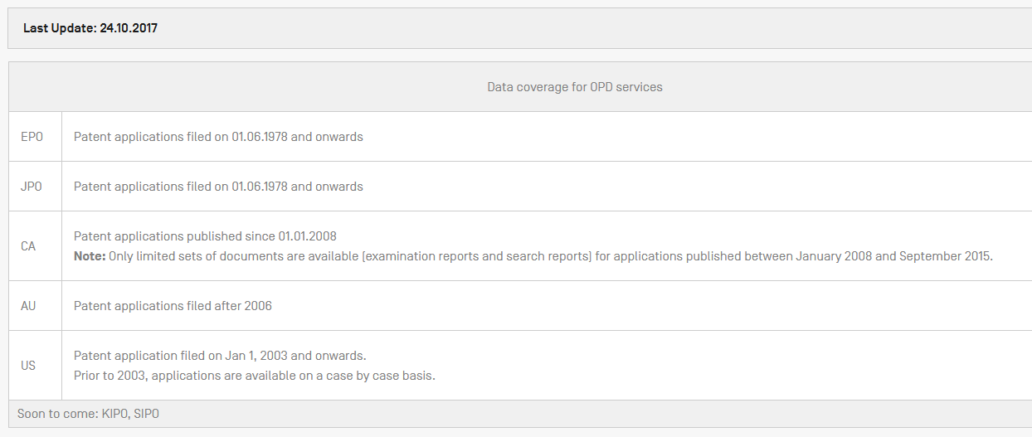

Slide 82
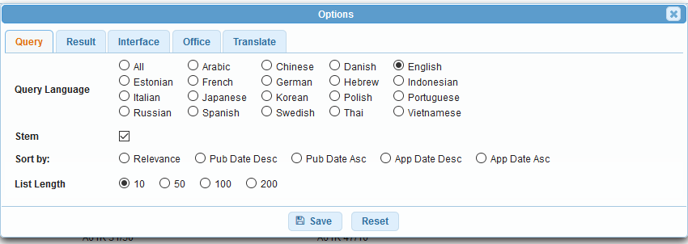

Slide 84
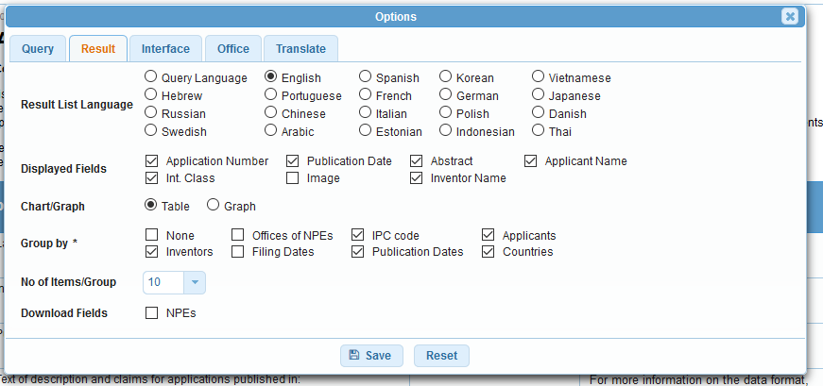
Options - results

Slide 85
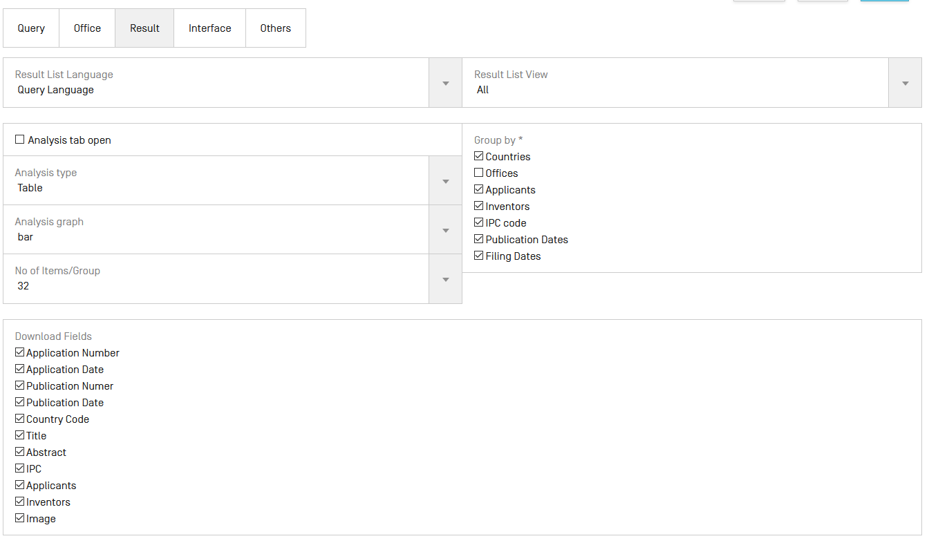

Slide 86
Options - results

Slide 87
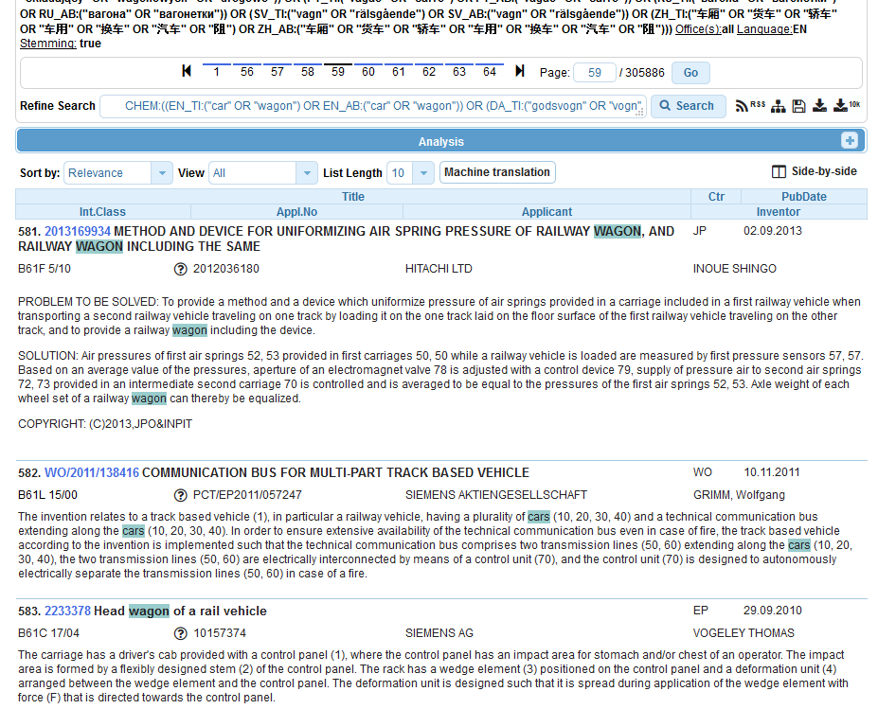

Slide 89
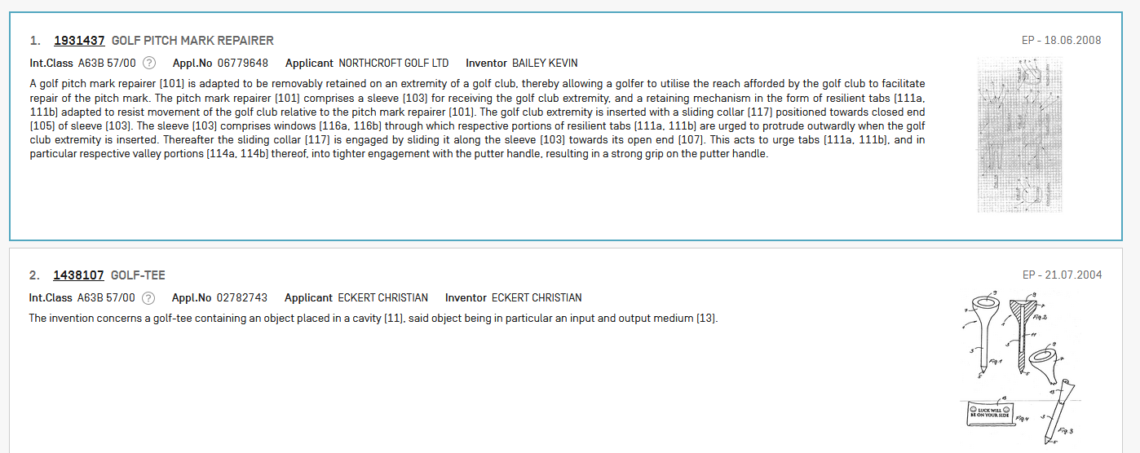

Slide 90
Options - results

Slide 91
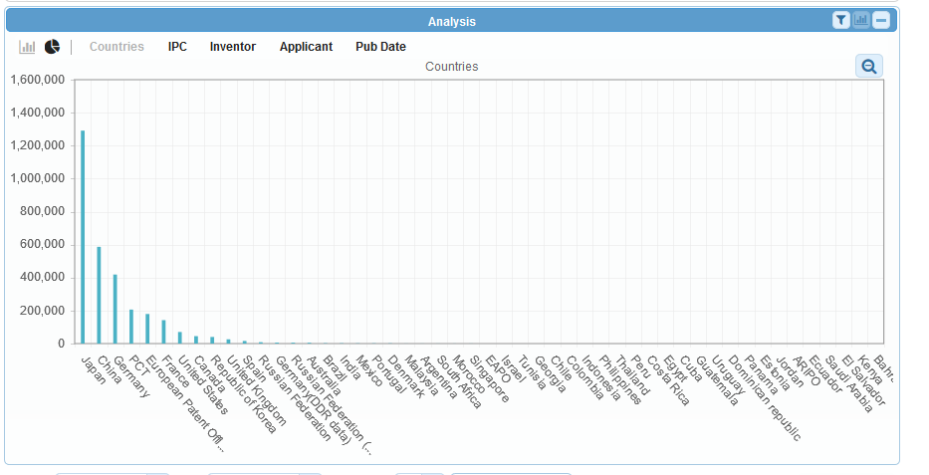
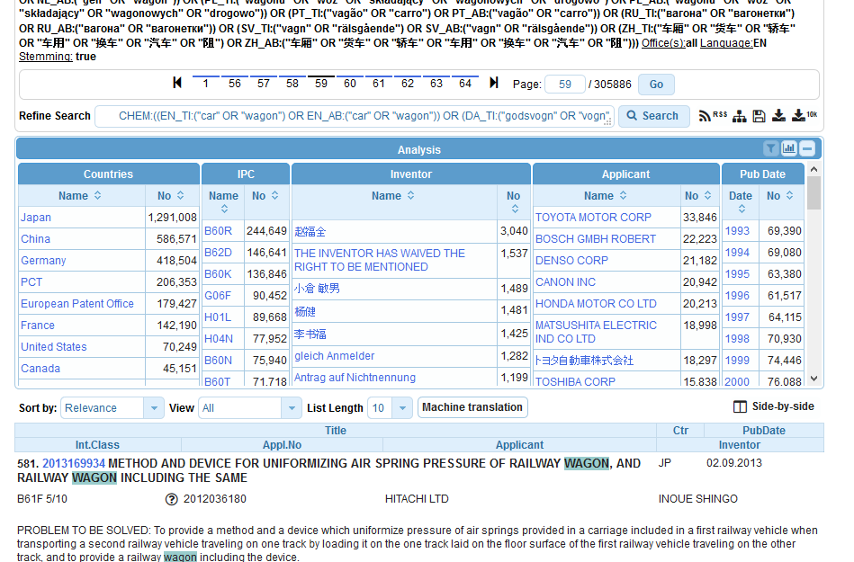
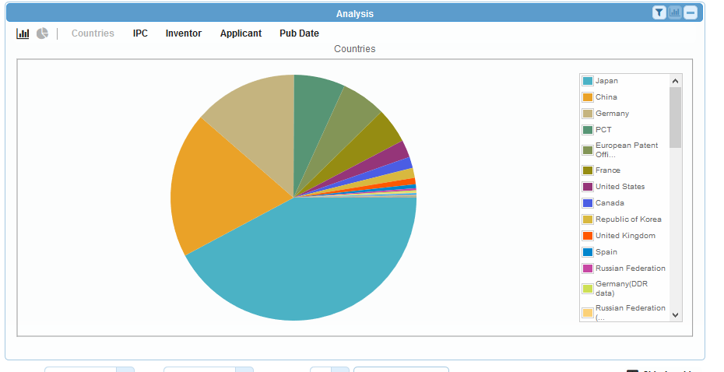

Slide 93
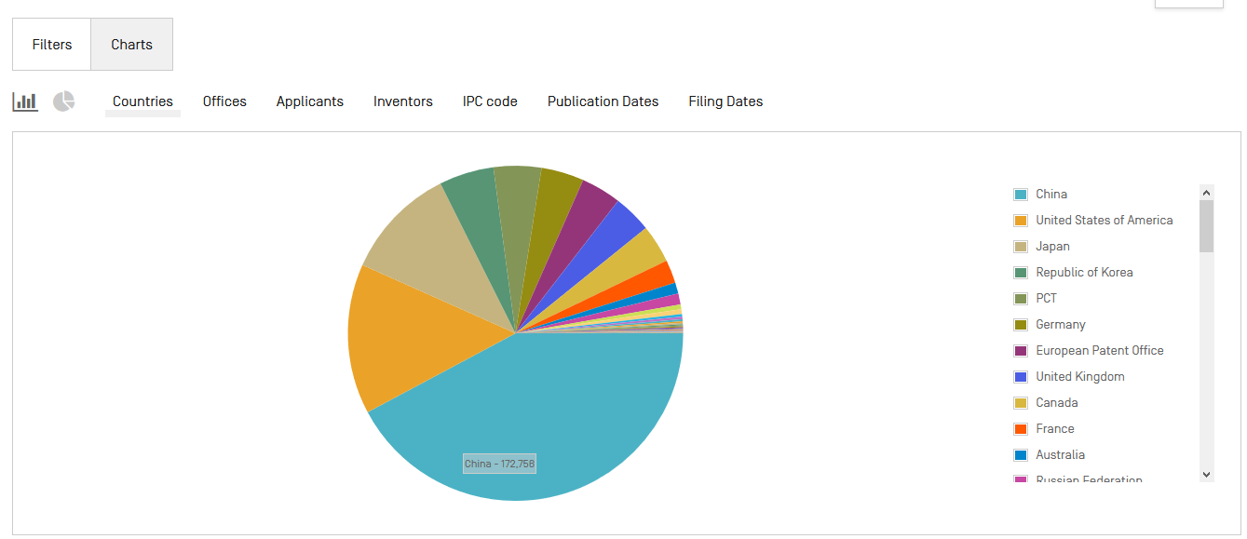

Slide 94
Options - results

Slide 97
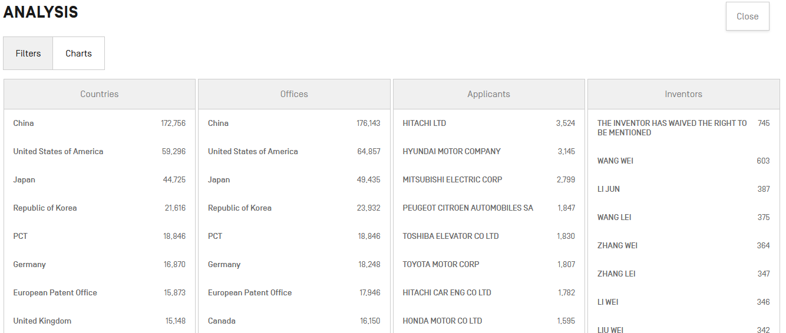

Slide 98
Options - results

Slide 102
Options - interface

Slide 104
Options: office - translate

Slide 115
Next webinar
Complex queries
October 15 or 17
To register: https://attendee.gotowebinar.com/rt/5746100939357645059

Slide 116
wipo.int/patentscope/en/webinar

Slide 117
Global Brand Database, Global Design Database
Webinars:
https://www.wipo.int/reference/en/branddb/webinar/index.html
https://www.wipo.int/reference/en/designdb/webinar/index.html

Slide 118
patentscope@wipo.int

Slide 121
What is the utility of the query tree?
It shows the breakdown of your results.
When the beta version will be definitive ?
There is not a set date yet: not before 2020.
Is the chemical search in full text or specific part of the text?
In the title, abstract, description and claim fields.
Where to find the data coverage in the new system?
In the Help menu in the black navigation on top of the interface.

Slide 122
When downloading a result set in excel, the column with "Priority Data" isn't available anymore. Is there a possibility to have it again?
It is currently under consideration.
Can you download the results without being logged in?
No
How to find a family of patent number in PATENTSCOPE?
Yes under Also published as at the moment and there will be more information in the near future.

Slide 123
What is the use of WIPO pearl?
WIPO Pearl gives access to scientific and technical terms derived from patent documents. It helps promote accurate and consistent use of terms across different languages, and makes it easier to search and share scientific and technical knowledge.

Slide 124
patentscope@wipo.int

