Slide 1
Andres Guadamuz
Software Interoperability and Standards
SCRIPT Centre for IP and Technology Law University of Edinburgh

Slide 3
Standards

Slide 4
Defining standards
Technical standard
It is usually a formal document that establishes uniform engineering or technical criteria, methods, processes and practices.
De facto standard
It is a convention, product or corporate practice that becomes standard because of market dominance and/or wide use.

Slide 5
How are standard set?
The easiest way is for a technology to become standard because of its widespread use. Typically cited example is the VHS format, which became the industry standard in detriment of Betamax. HD-DVD and Bluray.
Unilateral action by market leader or monopoly (doc, ppt).
Industry-wide negotiations.
Standard-setting body brings stakeholders together and they agree on a standard.

Slide 6
Typical standard-setting procedure
When an organization develops standards which may be used openly, it is common to have formal rules published regarding the process. This may include:
Who is allowed to vote and have input on new or revised standards
What is the formal step-by-step process
How are bias and commercial interests handled
How are negative votes or ballots handled
What type of consensus is required

Slide 7
Some standard setting bodies
International Organization for Standardization (ISO)
International Electrotechnical Commission (IEC)
International Telecommunication Union (ITU)
World Standards Cooperation (WSC)
Internet Engineering Task Force (IETF)
World Wide Web Consortium (W3C)
Institute of Electrical and Electronics Engineers (IEEE)

Slide 8
The Internet Engineering Task Force (IETF)
The goal of the IETF is simple, its stated purpose is "to make the Internet work better".
Anyone can join the IETF, and it operates through a complex network of workshops, thematic working groups and regional working groups.
Most of the executive technical work is performed by a tighter and more exclusive group of experts called the Internet Engineering Steering Group (IESG).

Slide 9
The World Wide Web Consortium (W3C)
The W3C is a much more formal institution dealing with the internet.
It is the main body in charge of setting internet standards, but it also issues technical guidelines for the management of the network.
However, the W3C is not a legislative institution and it cannot compel member or states to adopt its recommendations.
The W3C is a consortium of organisations, made-up mainly by multinational technology and teclecomms corporations such as British Telecomm, AT&T, Adobe Systems, Microsoft and Nokia. It also has membership from governments and academia (i.e. the University of Edinburgh and the Spanish government).

Slide 10
International Telecommunications Union (ITU)
International organization within the UN system where governments and the private sector coordinate global telecom networks and services.
Membership is both governments and private sector.
Operates in three main sectors:
Radio communication Sector
Standardization Sector
Development Sector

Slide 11
Web standards

Slide 12
What is the Internet?
The IETF defines the Internet as a network which contains several defining architectural characteristics.
The Internet is “a network of networks”, which means that it is made up of a vast array of sub-networks interconnected to one another through a global infrastructure.
Most importantly, all of these networks communicate using standard protocols.

Slide 13
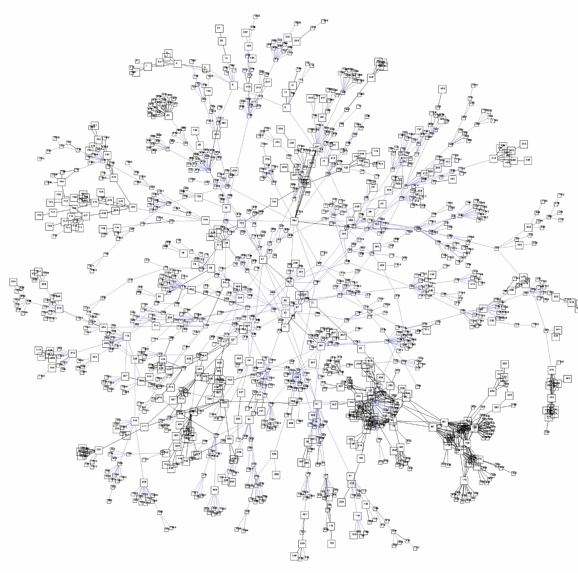
Web

Slide 14
Global backbone

Slide 15
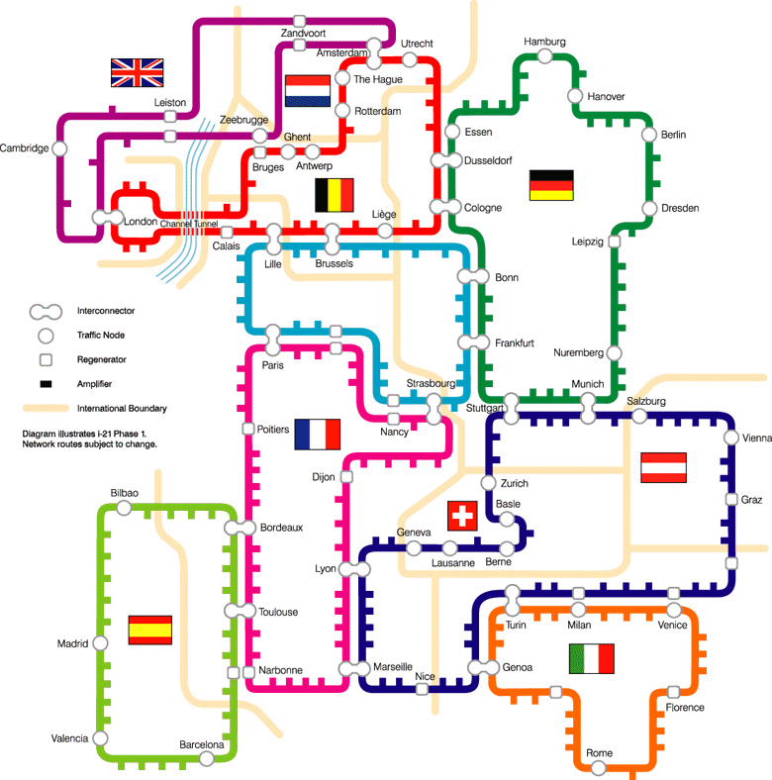
Regional backbone

Slide 16
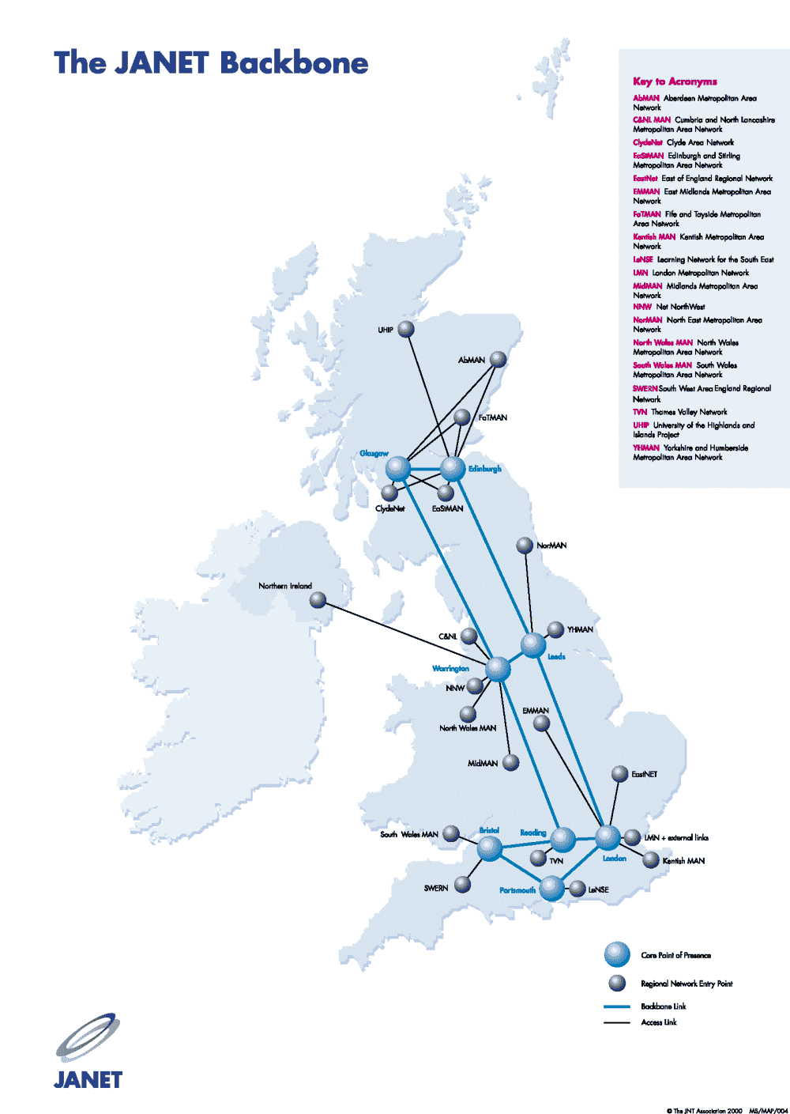
National backbone

Slide 17
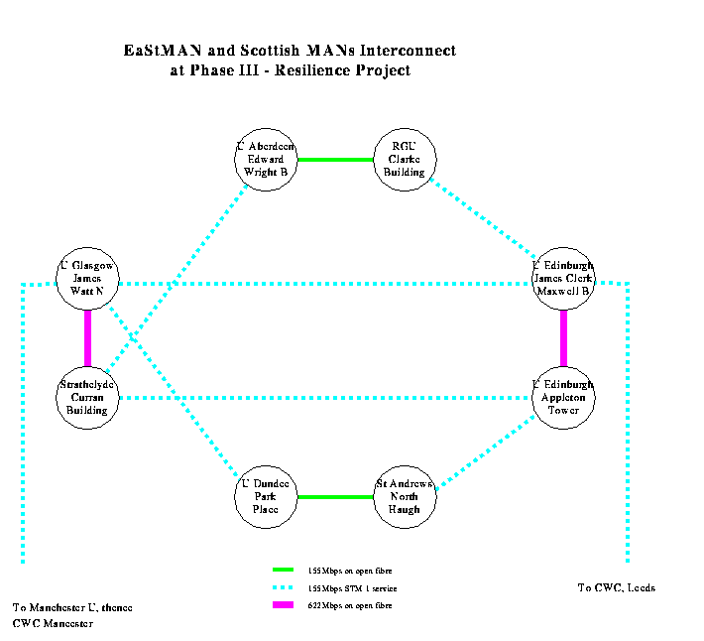
Local backbone

Slide 18
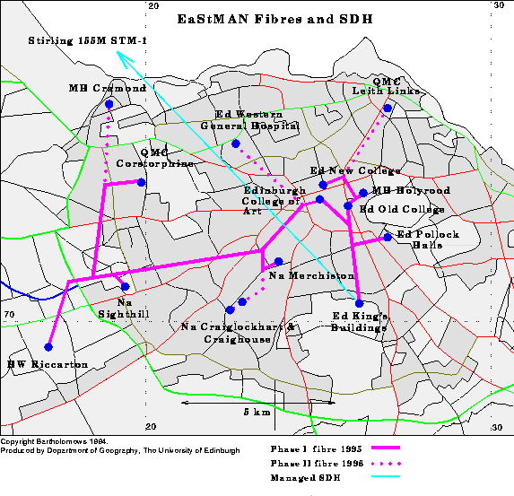
Metropolitan Area Network

Slide 19
The web of protocols
1984-988, the European Organization for Nuclear Research (CERN) achieved an important stage in the development of the Internet by implementing the Internet Suite, consisting of a collection of protocols such as the Transmission Control Protocol (TCP) and the Internet Protocol (IP), known collectively as TCP/IP.
There are four layers in the Internet Suite: Application layer, transport layer, Internet layer and link layer.
The Domain Name System and the Internet Protocol are what allow a computer to know where to go when the address “www.google.com” is entered into a browser. Every computer connected to the Internet has a numerical Internet Protocol address.

Slide 20
“On the Internet, nobody knows you’re a dog…”

Slide 21
On the Internet... you are nothing but an IP Address!
www.redhat.com
66.187.232.50
www.google.com
www.apnic.net
216.239.39.99
202.12.29.20
www.ietf.org
www.ebay.com
4.17.168.6
192.168.1.65
66.135.208.101
www.dogs.biz
www.ebay.com
209.217.36.32
66.135.208.88
www.doggie.com
198.41.3.45
www.gnso.org
199.166.24.5

Slide 22
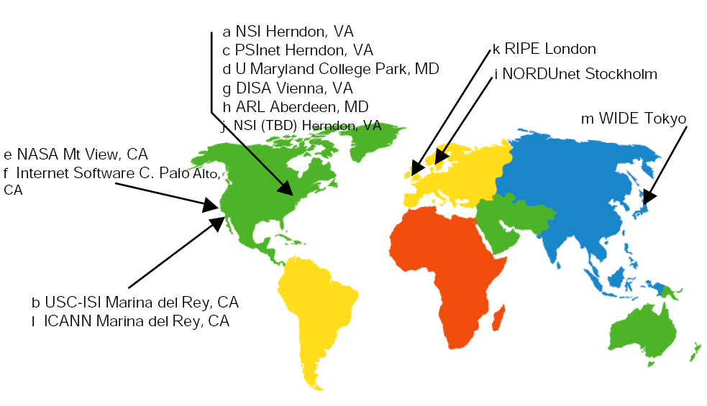
DNS root servers

Slide 23
Software standards

Slide 24
In few words…
It’s a bit of a mess…
It’s free for all most of the time, with various groups and alliances agreeing on standards.
The key is interoperability, programs need to interact with one another.

Slide 25
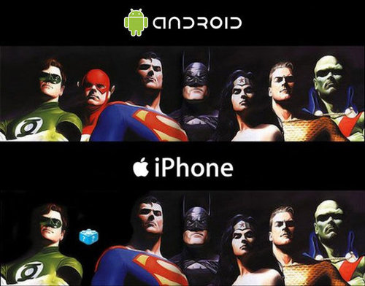
No standards may lead to this

Slide 26
Interoperability?
iTunes
Napster
Yahoo
Music
MSN
Music
Virgin
MTV
Urge
Sony Connect
Apple
FairPlay
Microsoft
WMA DRM
Atrac
iPod
Creative
Samsung
Philipps
Toshiba
Sony Walkman

Slide 27
Lines of code
Operating System | Single Lines of Code (millions)
Windows 3.1 (1993) | 6
Linux Kernel (2006) | 5.2
Windows XP (2001) | 29
Windows Vista (2007) | 50
Debian 2.2 (2002) | 55
Mac OSX 10.4 (2006) | 86
Debian 4.0 (2007) | 213

Slide 28
IP and interoperability

Slide 29
Directive 91/250/EEC on the legal protection of computer programs
Article 6 Decompilation
1. The authorization of the rightholder shall not be required where reproduction of the code and translation of its form within the meaning of Article 4 (a) and (b) are indispensable to obtain the information necessary to achieve the interoperability of an independently created computer program with other programs, provided that the following conditions are met:
(a) these acts are performed by the licensee or by another person having a right to use a copy of a program, or on their behalf by a person authorized to to so;
(b) the information necessary to achieve interoperability has not previously been readily available to the persons referred to in subparagraph (a); and (c) these acts are confined to the parts of the original program which are necessary to achieve interoperability.

Slide 30
2001/29/EC Information Society Directive
Technological protection measures.
“(54) Important progress has been made in the international standardisation of technical systems of identification of works and protected subject-matter in digital format. In an increasingly networked environment, differences between technological measures could lead to an incompatibility of systems within the Community. Compatibility and interoperability of the different systems should be encouraged. It would be highly desirable to encourage the development of global systems.”

Slide 31
DADVSI
Loi sur le Droit d’Auteur et les Droits Voisins dans la Société de l’Information.
Providers of DRM systems should give the necessary technical documentation to any party needing it to ensure that interoperability
Interoperability authority that can look at source code.
Apple claimed that DADVSI amounted to "state-sponsored piracy”.

Slide 32
Open source and open standards

Slide 34
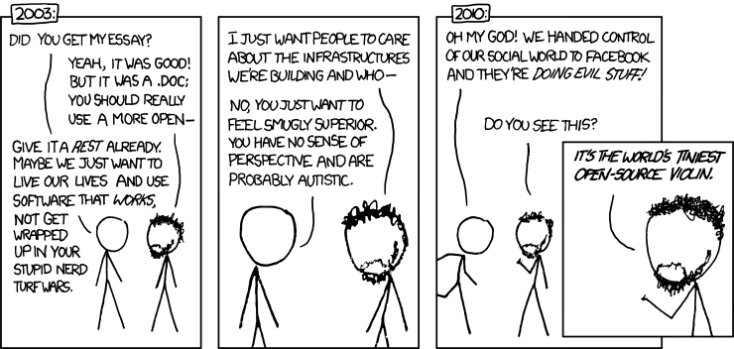
Open standards

Slide 35
Some other legal issues

Slide 36
Patents
Complex contractual issues.
Most technical standard setting bodies and groups have to declare all patents and patent applications they have in the technology discussed.
These include non-disclosure agreements.
Sometimes the agreement may include patent licence grants, or cross-licensing agreements between participants.
If not everyone complies, things can get ugly…

Slide 37
Patents and standards
Holders on patented standards must usually disclose terms in RAND (Reasonable And Non-Discriminatory terms).
These contracts can be enforceable in court, and be taken in consideration to determine bad faith in negotiations.

Slide 38
Rambus
Rambus is a memory chip manufacturer.
In the early 90’s, it was invited to join the JEDEC Solid State Technology Association, an industry standard group. They joined discussion on standards that would become SDRAM and DDR chips. They however did not sign the patenting cross-licensing agreement, and withdrew in 1995.
Rambus used information gained in the negotiation process to file for patents, and then sued several chip manufacturers for patent infringement.
The FDC and European Commission have investigated Rambus, and found misconduct.
Several lawsuits have ensued.

Slide 39
Competition law
Microsoft competition case (T-201/04 Microsoft v Commission). 2003-2007.
Microsoft was found to have an advantage in server market.
The Commission ruled that Microsoft had to release Windows Server 2003 service pack 1 to members of its Work Group Server Protocol Program (WSPP).
The case has not resulted in increased competition in server market.

Slide 40
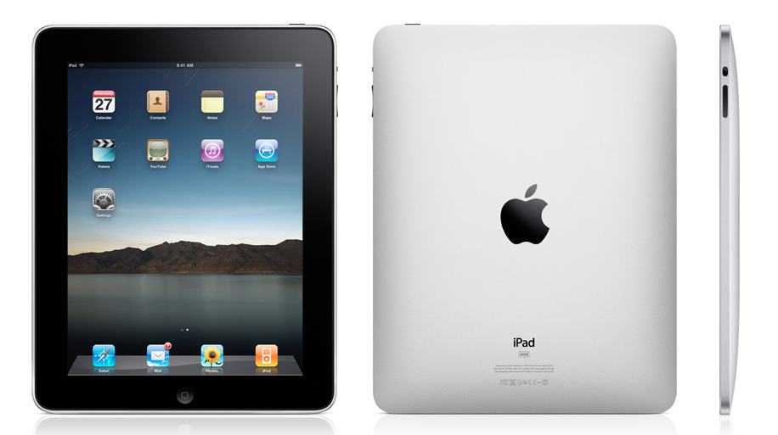
The future…

Slide 41
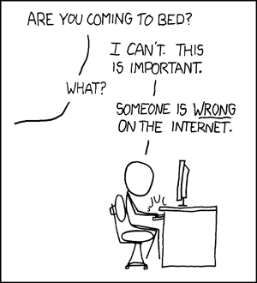
a.guadamuz@ed.ac.uk
http://www.technollama.co.uk
@technollama on Twitter

