Slide 1
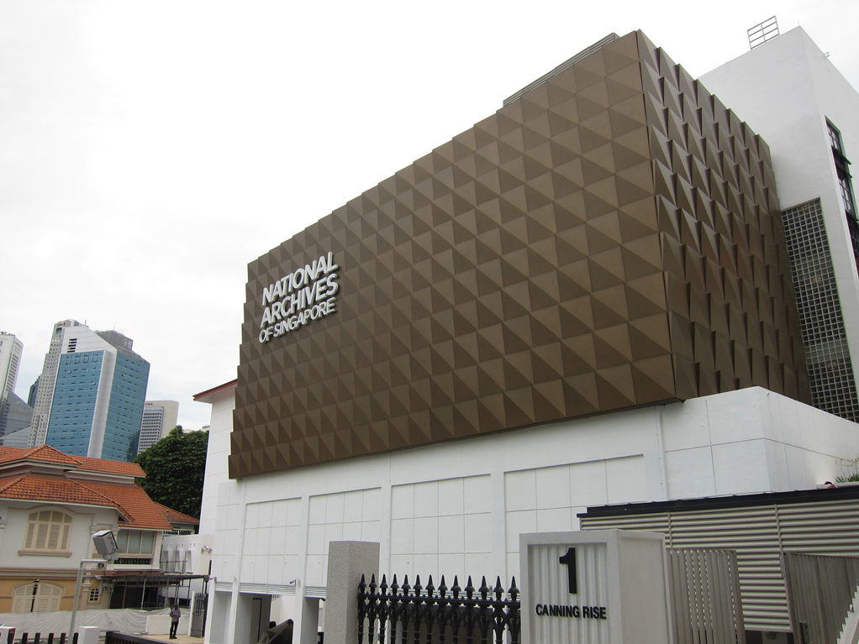
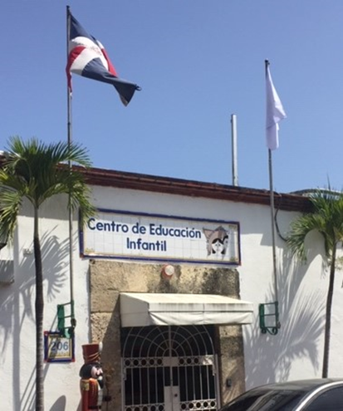
Copyright Exceptions for Archives: A Typology Analysis
Kenneth D. Crews, J.D., Ph.D.
World Intellectual Property Organization
Geneva, Switzerland
21 October 2019

Slide 2
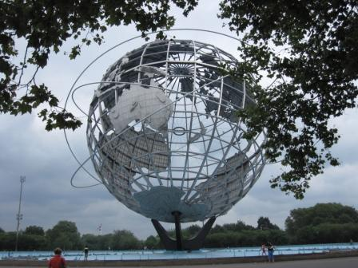
The Objectives: A Typology Analysis
Protecting Collections
Building, Preserving, Organizing
Facilitating Access
Opening, Sharing, Publishing
Promoting Cultural Heritage
Creating, Disseminating, Learning

Slide 3
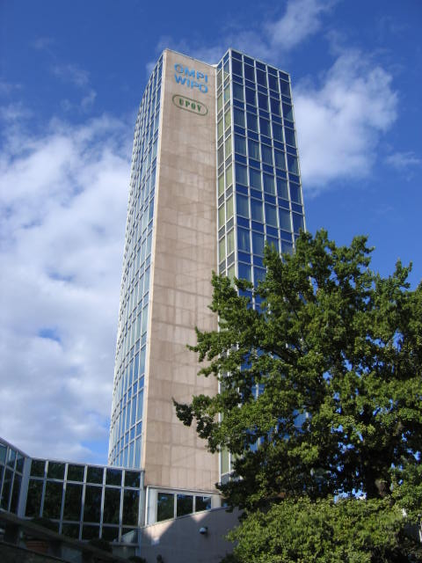
The Analysis: Exceptions for Libraries & Archives
First Study of E&L for Libraries and Archives:
SCCR/17 – November 2008
Report: http://bit.ly/1tB8ryb
149 Member States
Most Recent Study:
SCCR/35 – November 2017
Report: http://bit.ly/2htmCf6
191 Member States

Slide 4
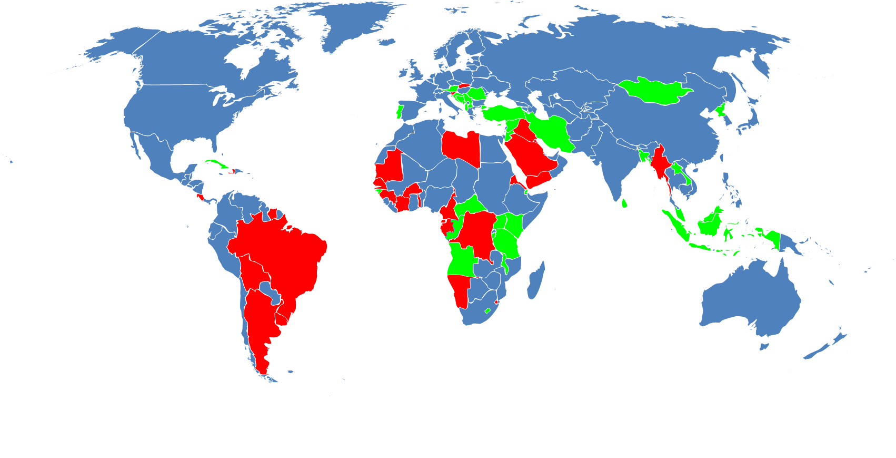
Red: No Library Exception Green: General Exception Only (2017 Study)

Slide 5
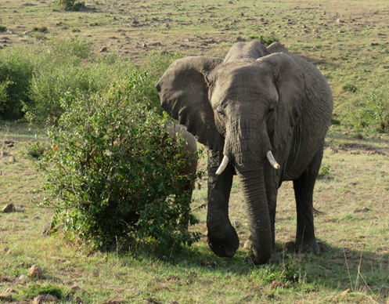
The Role of Archives: Scope of Copyright E&Ls
Identification of Topics (examples):
Preservation & Replacement Copies
Copies for Private Study & Research
Exhibition of Materials
Additional Issues:
Text Mining & Data Mining
Orphan Works
Limits on Infringement Liabilities

Slide 6
Preservation Exceptions: Diversity of Statutes
Who may Use the Exception?
Libraries? Archives? Museums? More?
What may be Copied?
All Works? Short Works? Published Works?
Specific types of Works?
Conditions of the Work?
Physical Damage? Lost? Deteriorating?
Not on the Market?
Medium of Use: Digital? Reprographic?

Slide 7
Copyright Exceptions: Distinct Nature of Archives
Large Collections & Diverse Materials
Often Associated with an Organization
Unpublished and Rare Materials
At High Risk of Loss
Distinct Objectives
Records of a Nation and Culture
Unpublished and Unidentified Works
Subject to Other Legal Restrictions
Privacy, Security, Public Access

Slide 8
Preservation Exception: Diversity of Statutes
Who may Use the Exception?
Country A: Libraries.
Country B: Libraries and archives.
Country C: Public libraries, non-commercial document centers, educational establishments, and scientific and cultural institutions.
Country D: Cultural institution, defined as a library, archive, museum, or gallery that is publicly funded in whole or in part.

Slide 9
Preservation Exception: Diversity of Statutes
What may be Copied?
Country A: Works (in the collection).
Country B: Non-digital works.
Country C: Literary, dramatic, or musical works, including any artistic work contained within the work and the typographical arrangement.
Greater Detail in the Typologies:

Slide 10
TOPIC: Preservation of Works Definition: Copyright exception authorizing archives to make reproductions and other uses of copyrighted works for the primary purpose of preserving the works.
Category of Archive Activity | Owner’s Rights Implicated | Elements of Statutory Exceptions | Elements for Ongoing Consideration
Statutory Provision: Preservation of Works for Official Purposes. Preservation of Works for Research and Cultural Heritage. Archives Functions: Copies to prevent loss. Copies in response to loss or damage. Copies for deposit in other archives for security or safekeeping. Copies for storage of originals to safeguard cultural heritage. Copies to assure official access and reference. Copies to add to other specialized collections. | Primary: Reproduction. Secondary: Distribution (if the copies may be loaned by the archive or deposited elsewhere). Derivatives (translations and revisions of official documents). Circumvention (if the original is secured by TPM). Moral rights (protecting integrity and identity of authorship; first publication of unpublished works). Licensing and implications for terms of acquisition of works and collections. Extended collective licensing and implications for uses. | Scope of Works: Audiovisual works. Published or unpublished works. Textual and printed works. Official or institutional documents. Photographs and images. Images accompanying textual work. Audiovisual works. Music and sound recordings. Works protected by neighboring rights. Condition of the Works: Copying regardless of condition to prevent loss of official archives. Copying regardless of condition of unpublished works to prevent loss of unique items. Copying of works that are damaged, etc. (see library typology). Orphan works (especially prevalent in archives). Purpose of Use: Preservation. Official access. Add to collections. Add to collections of another archive as a safe haven. Add to collections of another archive to combine split collections. | Application of digital technology. Implications of public domain for public sector documents. Implications of longer duration for some works (e.g., Crown copyright). Number of copies allowed to be made. Permitted uses of the copies by the archive or by researchers. Simultaneous availability of the original and the copy. Authority for cross-border transfers of works or copies to readers. Making copies of works for safekeeping before lending or exporting originals. Liability for subsequent activity by users. Liability protection for archives. Extent of proof or documentation of compliance with statute.

Slide 11
Closer Look at the Analysis: Column 1
Identifies and Organizes:
Conceptual Topics
Statutory Provisions
Archives Services and Functions

Slide 12
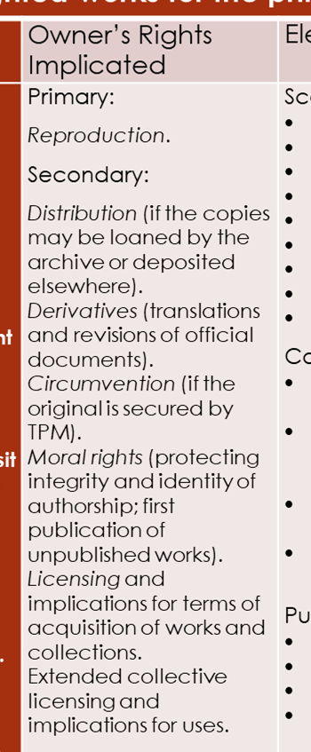
Closer Look at the Analysis: Column 2
Identifies and Organizes:
Rights of Copyright Owners
Rights Affected Primarily
Rights Affected Secondarily

Slide 13
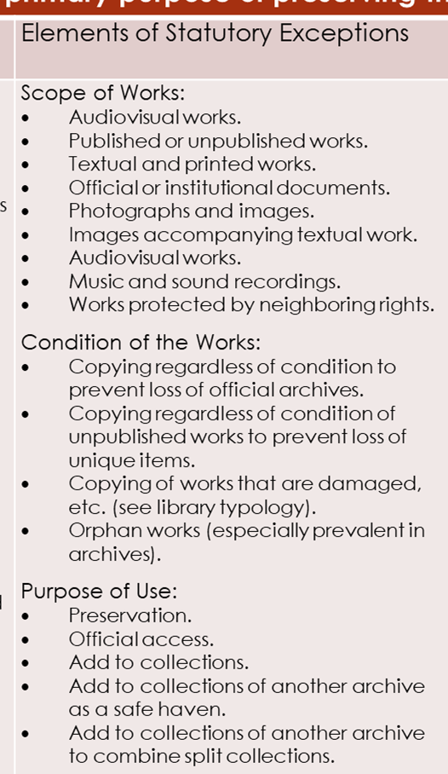
Closer Look at the Analysis: Column 3
Identifies and Organizes:
Scope of Works
Purpose of the Use
Amount of the Work Used
Condition of the Works

Slide 14
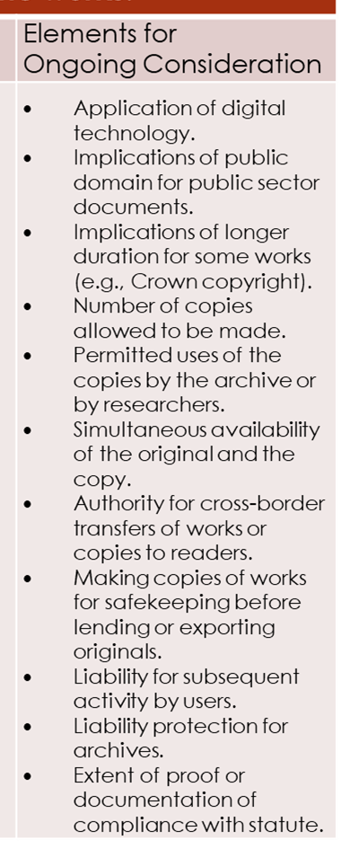
Closer Look at the Analysis: Column 4
Ongoing Considerations:
Digital Technologies
Role of Licenses
Application of ECL
Cross-Border Transfers
Subsequent Uses

Slide 15
Objectives of the Analysis
Systematic Perspective to Copyright Limitations & Exceptions
Identify Relationships among Interests:
Archives, Authors, Publishers, Public, More.
Understanding of Legal Standards
Elements of E&L as Choices in Lawmaking
Policies & Priorities
Domestic Legislation
International Instruments

Slide 16
The Analysis: Benefits for Law and WIPO
Guidance for:
National Legislation
Multinational Guidance for Member States
Elements of New Legal Drafting:
Elements Define the Reach of the Law
Elements Create Choices for Lawmakers
Elements Remind Lawmakers of the Issues Needing Attention
Elements and the Role of Licensing:
Licensing has the Potential to Serve Many Needs
Elements can Define the Application and Limits of Licensing

Slide 17
Guiding Policy Decisions: Finding the Right Equation
Domestic Legislation
Which Elements are Most Important?
What Domestic Needs Merit Attention?
International Instrument
Which Elements are Critical for Achieving Objectives in Member States?
What Level of Detail Should be Confirmed?
What Flexibilities Should be Allowed to States?
Allowed for a Changing Future?

Slide 18
Guiding Policy Decisions: Finding the Right Equation
Diversity of Stakeholders
Recognition of Practical Limits
Shaping the Way Forward
Diversity of Interests
Diversity of Views & Priorities
Diversity of Guidance Details
Diversity of Works
Public Interest and the Future

Slide 19
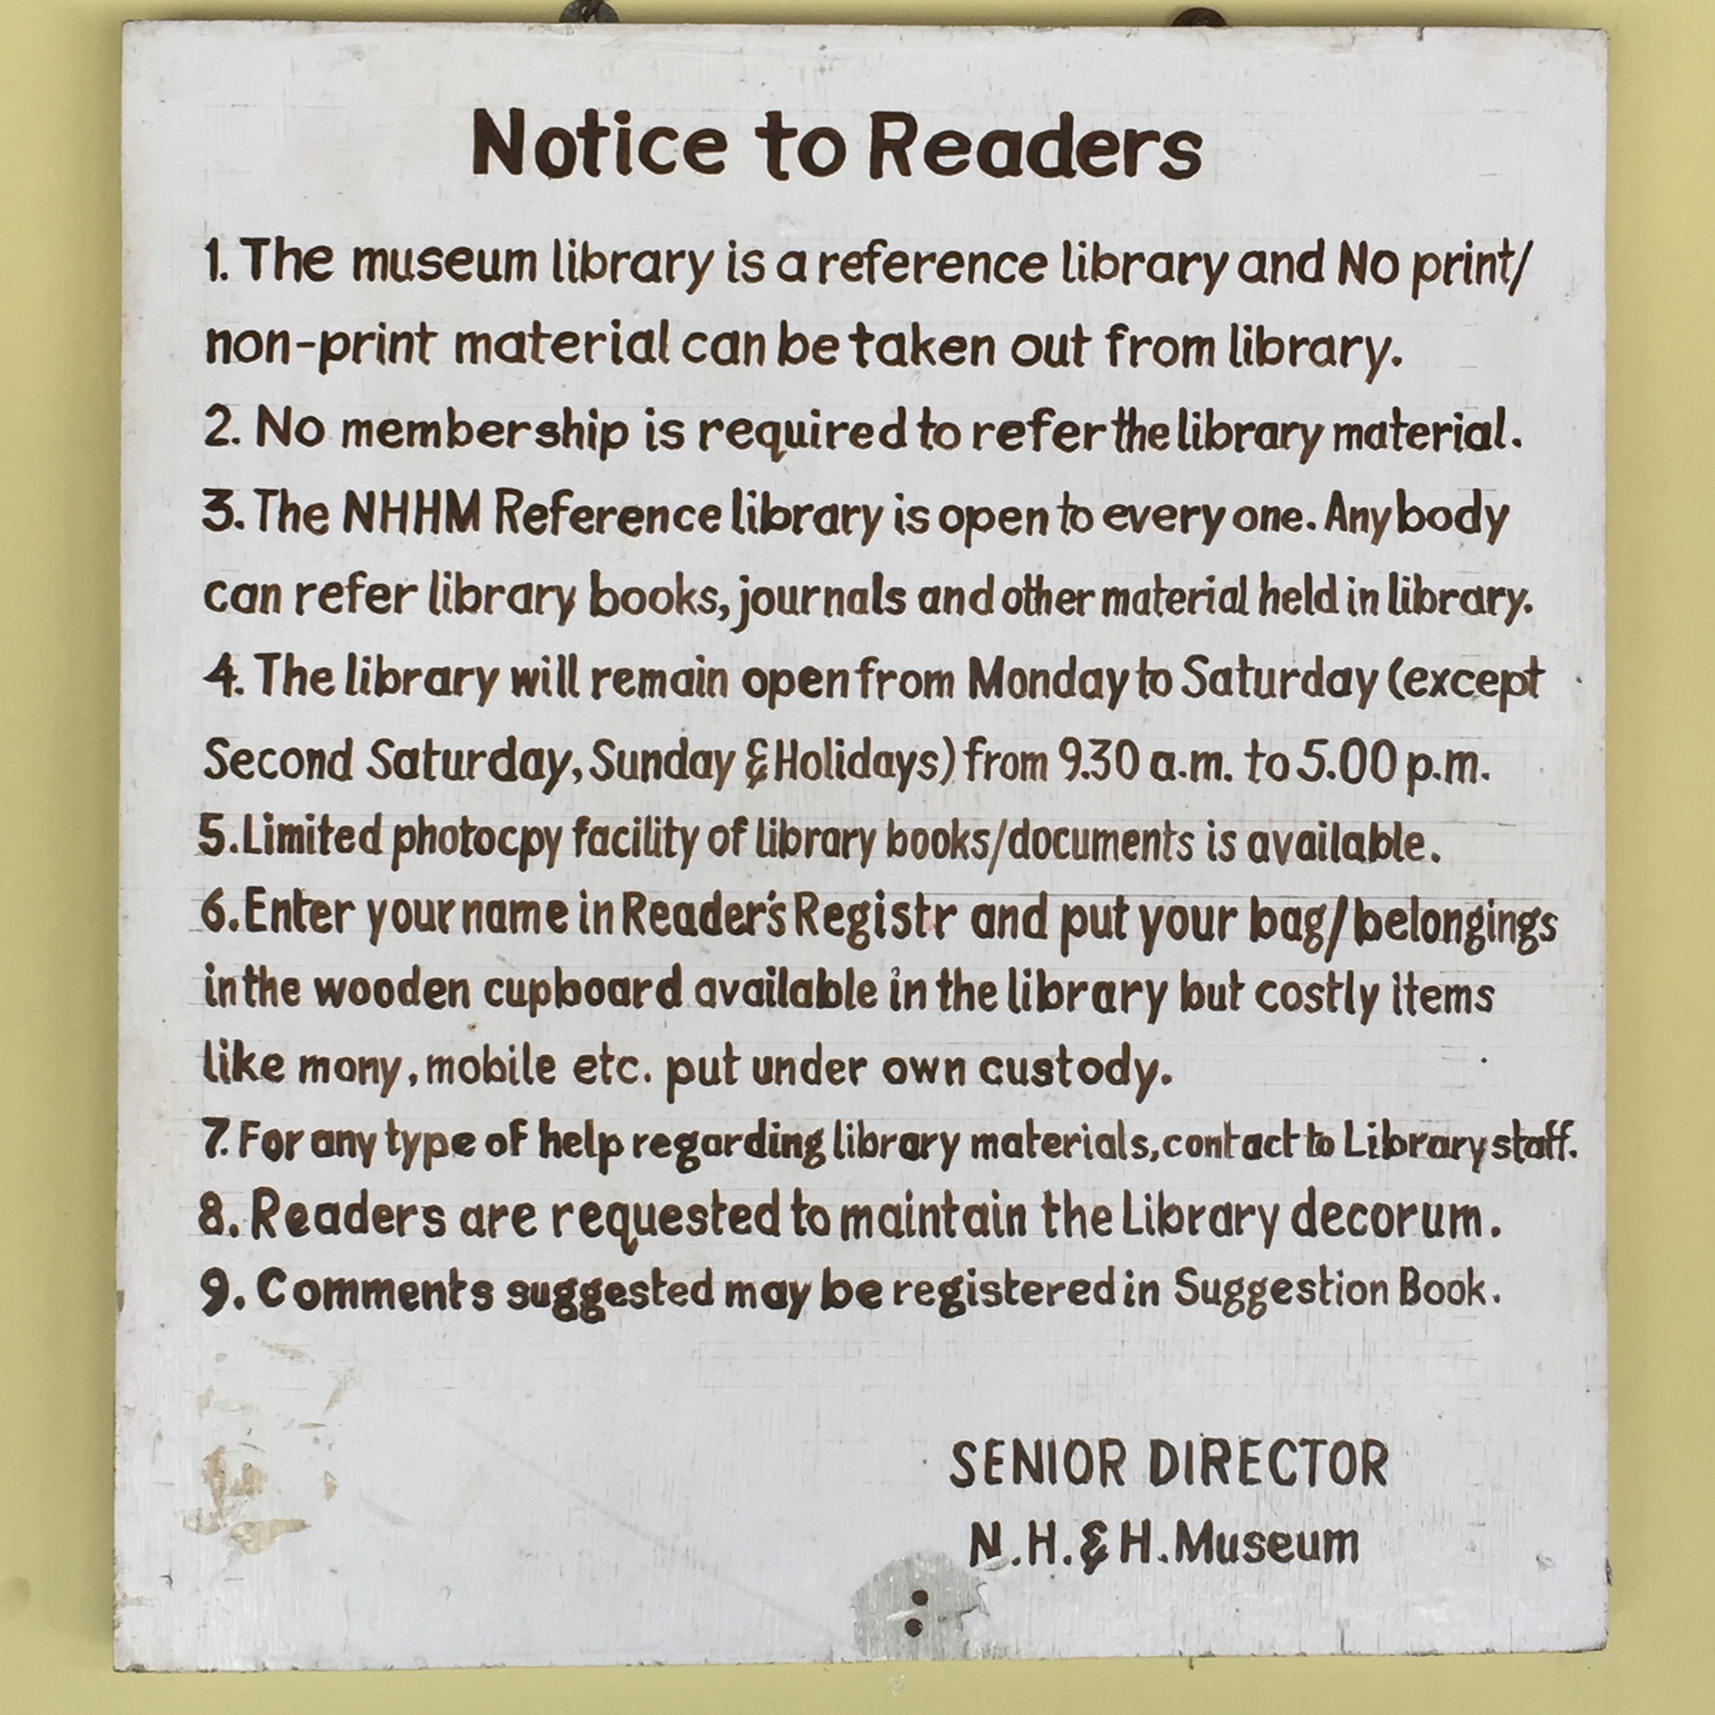
Copyright Exceptions: A Typology Analysis
Thank You!
Kenneth D. Crews, J.D., Ph.D.
World Intellectual Property Organization
Geneva, Switzerland
21 October 2019

