Slide 1
Tools for Competency Based Learning Management
Lutz Mailänder
Head, Cooperation on Examination and Training Section
PCT International Cooperation Division
Geneva
20 February 2020

Slide 2
Quality and Capacity of Examination
Correlates with capacities of individual examiners which evolve through training at all stages of career
  Initial training (phases) after recruitment
    Comprehensive basic skill set
  Continual learning throughout professional career
    Changes of legislation, new case law
    Evolving examination tools and resources
    Emerging new technologies (AI, …)
Quality management should
  assess competencies and capacities of examiners
  assure a consistent training approach
  measure and evaluate the impact of training
  identify needs for improving training infrastructure/methodology
  identify training needs of individuals or organisational units
Continual learning and assessments throughout career
Notes:
Linkage between qm and learning management

Slide 3
What is needed? Learning Infrastructure
Learning plans (curricula) for
  Individuals (no "one-fits-all"; size of IPO, access to databases, technologies)
  Groups of individuals with shared job descriptions (learning plan templates)
Learning opportunities/activities with appropriate content and qualified trainers
Assessment methodologies for measuring
  Impact/success of learning activities
  Competencies of examiners irrespective of participation in learning activities
Tools for
  developing and implementing the above
  reporting and monitoring purposes
Catering to
  approaches of blended learning
  training from different providers
  different sizes of IPOs and examination policies

Slide 4
WIPO activities on examiner training
Pilot project of ASPAC Bureau in cooperation with PCT ICD, for developing:
  Framework of technical Competencies (CF) for substantive examination of patents
    Generic skill set
      as comprehensive as possible
      as detailed as needed
    Customized skill set (adapted to national specifics, e.g. IPOPHL)
  Learning Management System (LMS)
    Open source software (Moodle), GNU public licence
    Local site (work station, no server functionality yet)
    Web-based site (Moodlecloud; browser based access) as prototype for local sites of IPOs: https://icblm.moodlecloud.com
      Demonstrating and testing some functions of LMS, and for
      Viewing and editing the competency framework (CF)

Slide 5
Tool: Competency Framework
How do we describe / measure (assess) capacities (qualitative manner)?
  In terms of competencies, for example:
    "Develop an effective search strategy"
  Different competency levels/grades, for example:
    basic, advanced, expert, …
    Not competent, competent, highly competent, …

Slide 6
Competency model/framework/dictionary
Competency models derived from/related to job descriptions: "job deliverables"
Different categories of competencies
  Behavioral, e.g. communication, managing, ..
  Technical (functional) competencies
To attain/demonstrate a specific technical competency, a set of distinct
  skills and
  knowledge elements is required
Technical competencies may be
  Generic (applicable to examiners of all jurisdictions)
  Related to national specifics (depending on national legislation)
Individual competency model: all generic and custom competencies (skills/knowledge) which an individual examiner needs to acquire for successful performance on the job
In the context of learning, they are frequently called Learning Plans (LP) and form the basis for curricula (sets of training activities/courses to be attended)

Slide 7
Competeny framework of ASPAC ICBLM is a more detailed inventory of knowledge and skills required for conducting a prior art search

Slide 8
Principles guiding the competency framework
Competencies on the lowest level are worded such that they enable assessments, for example:
  Knowledge: "Explain the concept of recall"
  Skill: "Modify a given search query such that recall improves"
Hierarchially higher levels are worded such that they enable a meaningful ordering of the skills and knowledge elements
Order of the competencies does not reflect workflow; framework only attempts to reflect any skill and knowledge needed for successful performance of tasks included in workflow
Where possible, competencies are linked to (official) documentation from which the competency can be derived (for example Guide to the IPC; PCT S&E Guidelines)

Slide 9
Sample domain 'Patent Classification'
Wording of skills is such that they enable assessments
Description part of the CF element includes a reference to the official Guide to the IPC explaining the background of this skill

Slide 10
Why do we need detailed competency models?
Sufficiently detailed competency models/frameworks facilitate
  Define individualized competency models (learning plans) catering to individual job requirements and office resources/policies
    Only detailed learning plans permit an accurate and precise measuring of competencies and indentification of training gaps
  Consistent and efficient communication of training needs
    From requesting office to providing office/WIPO
    From individual examiner to training manager
  Definition of prerequisites for training activities (by provider)
    Ensures efficient use of training opportunities
  Consistent description of course content and learning outcomes of training activities (by provider/organizer)
  Standardized tracking of training progress in terms of competencies
    Participation
    Success of learning (assessments)
  Detailed reporting

Slide 11
Tool: Learning Management System
(Moodle based )

Slide 12
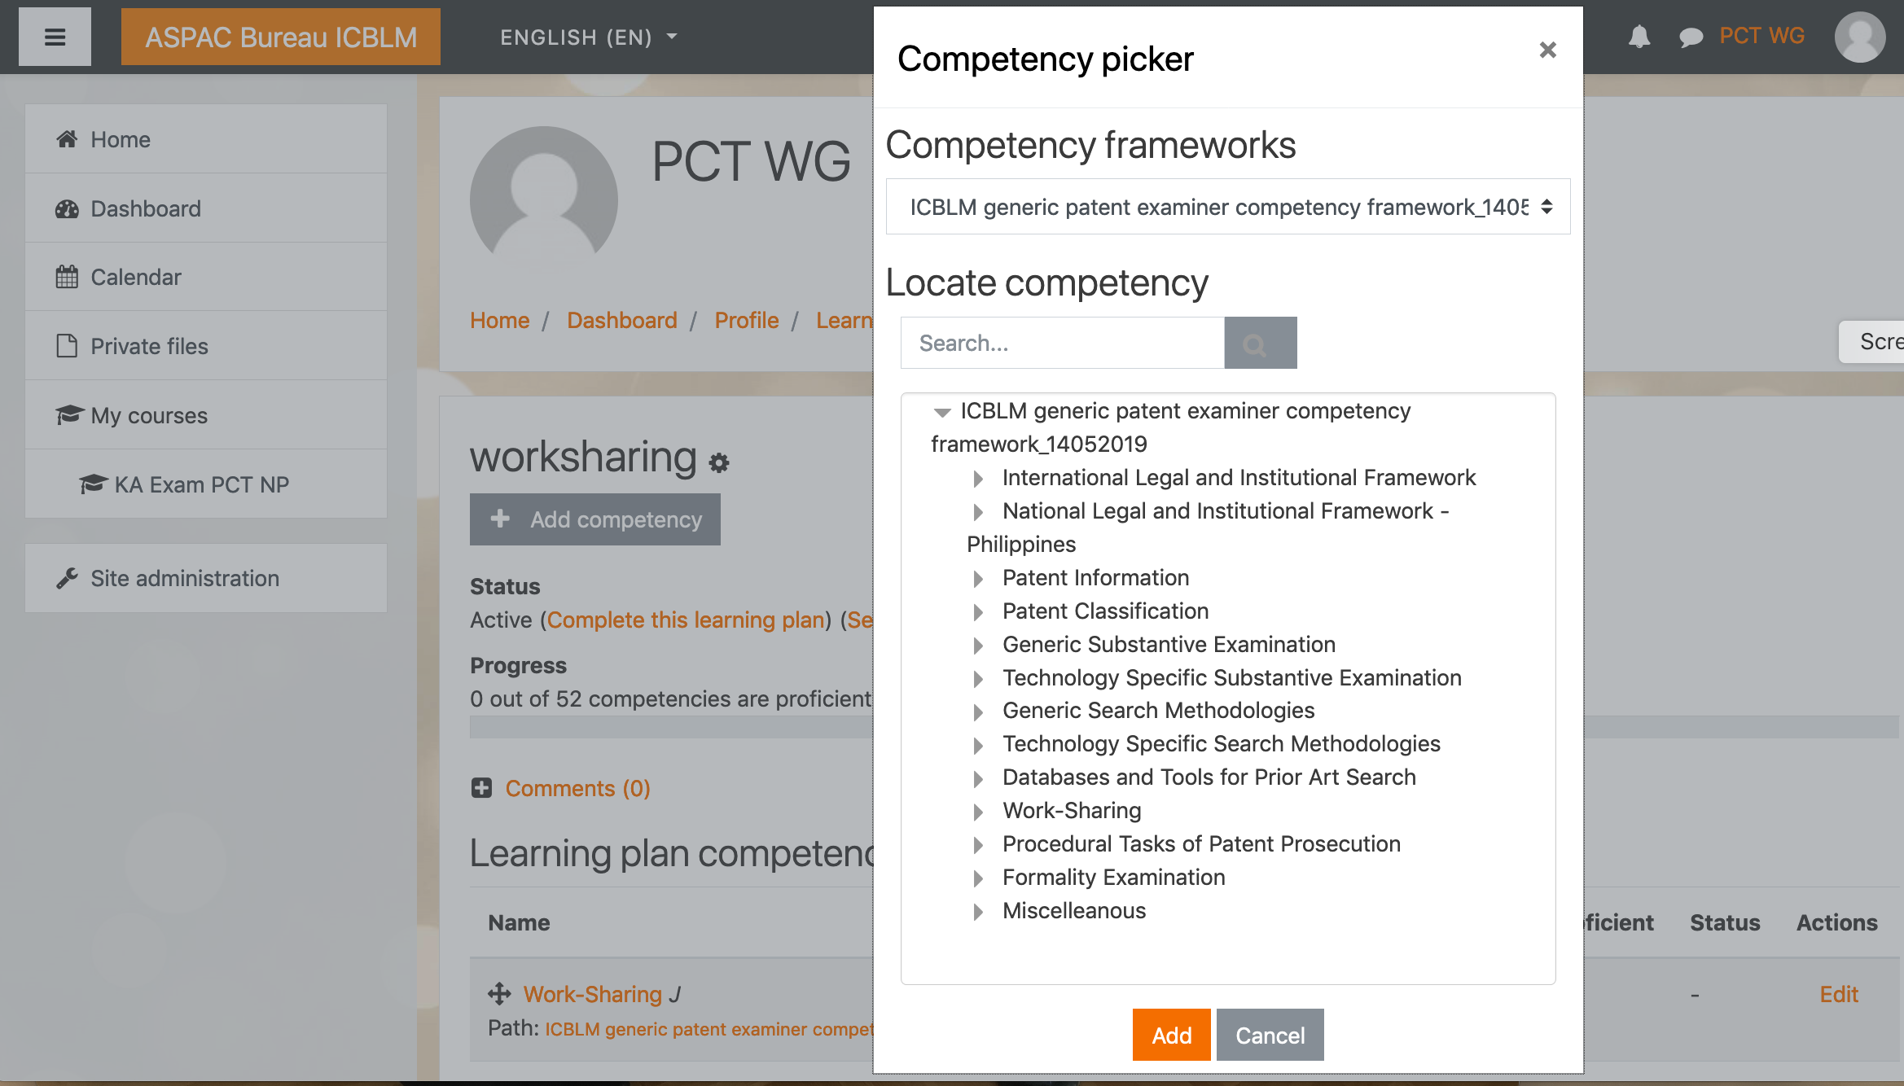
Edit learning plan (individual competency model)

Slide 13
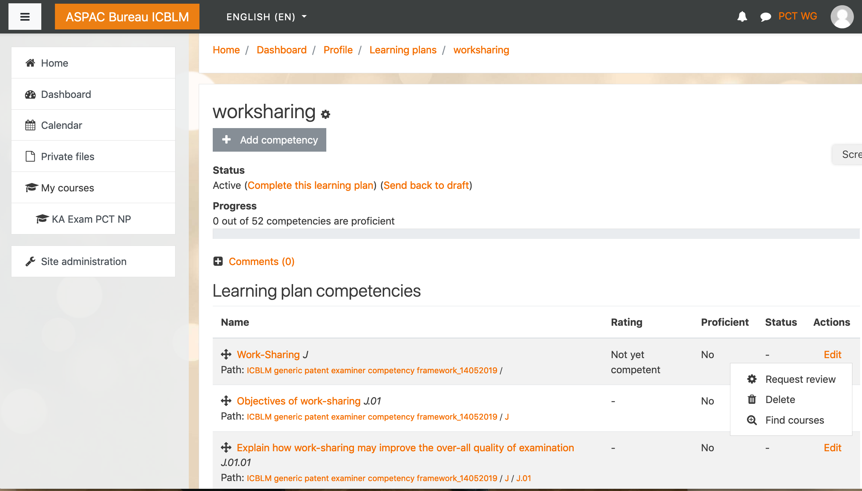
Trainee’s proficiency & Finding suitable courses

Slide 14
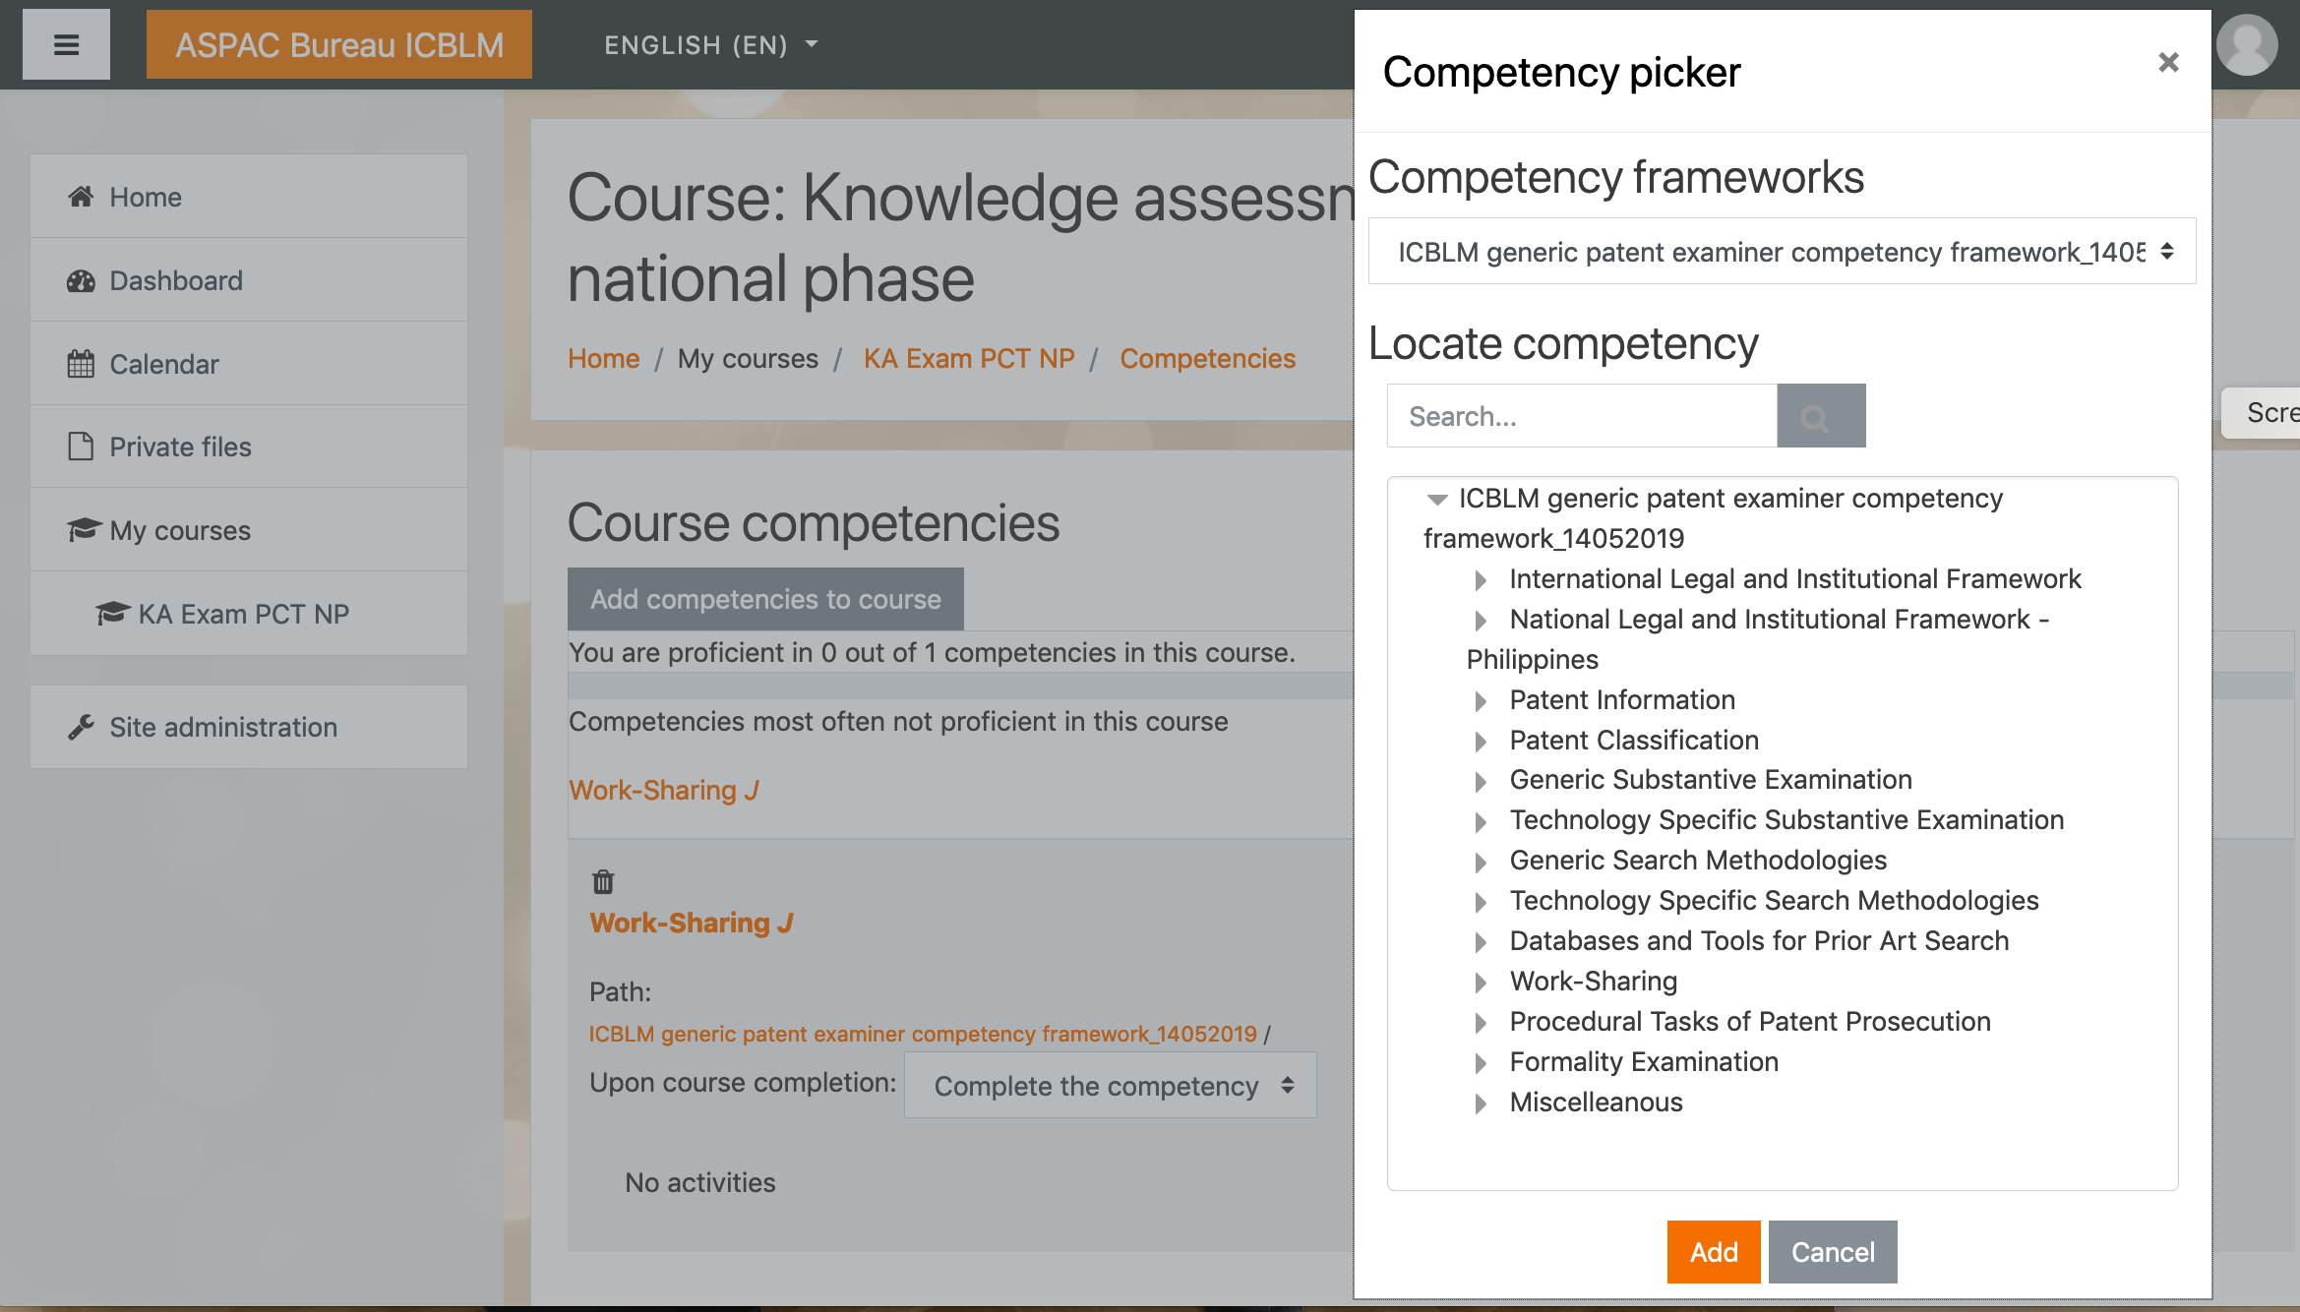
Assigning competencies to training activities

Slide 15
LMS: Tracking Learning Progress
Individual curriculum
Examiner
Examiner self assessment
prior learning
course learning
Individual Competency model
Assessment by Donor
course related
LMS
Assessment by IPO
Skills | required | participated | validated
A | ☒ | ☒ | ☐
B | ☒ | ☒ | ☒
C | ☐ | ☐ | ☐
….

Slide 16
Thank you
lutz.mailander@wipo.int

