Slide 1
Outline of NCL Revision with NCLRMS
(Nice Classification Revision Management Solution)
Kunihiko FUSHIMI
Director
International Classifications and Standards Division
Geneva
May 4 , 2018

Slide 2
Overviews
Timeframe
Impact on NCL Revision procedure from Office’s point of view

Slide 3
Timeframe of the implementation of NCLRMS and its use for NCL Revision procedure
NCLRMS will be used from NCL Revision leading to NCL (11-2021)
Implementation of NCLRMS
Training
NCL Revision by using NCLRMS
CE28, April 2018
CE29, Spring 2019
CE30, Spring 2020

Slide 4
Impacts on NCL Revision
1. Direct inputs through user interface or
Bulk submission with predefined Excel format to NCLRMS
2. Submission of proposals to NCLRMS during specific period
e-forum
Submission of proposals
Comments to proposals
3. Preliminary voting via NCLRMS
Offices & IB
Response to comments by proposing offices or IB
Adopted amendments
New edition every five years
Discussion and decisions at CE
By the end of October (of year X-2 )
Adopted changes
By the end of December (of year X-2)
The end of April to the beginning of May
By the end of January (of year X-1 )
Entering into force of new version on Jan. 1 (of year X)
every year
2 months before the CE session
(around February)
After the CE session
6 months before the entering into force
IB
Start of Translation
Preparation of working documents
Preparation of technical annex of the CE report
Early Publication in NCLPUB
4. Technical annex in Excel format
Preparation of excel table reflecting changes (Revision file)
external company
by RMS
Preparation of master file

Slide 5
1. Direct inputs through user interface
(Proposals, Comments, Revised proposals)

Slide 6
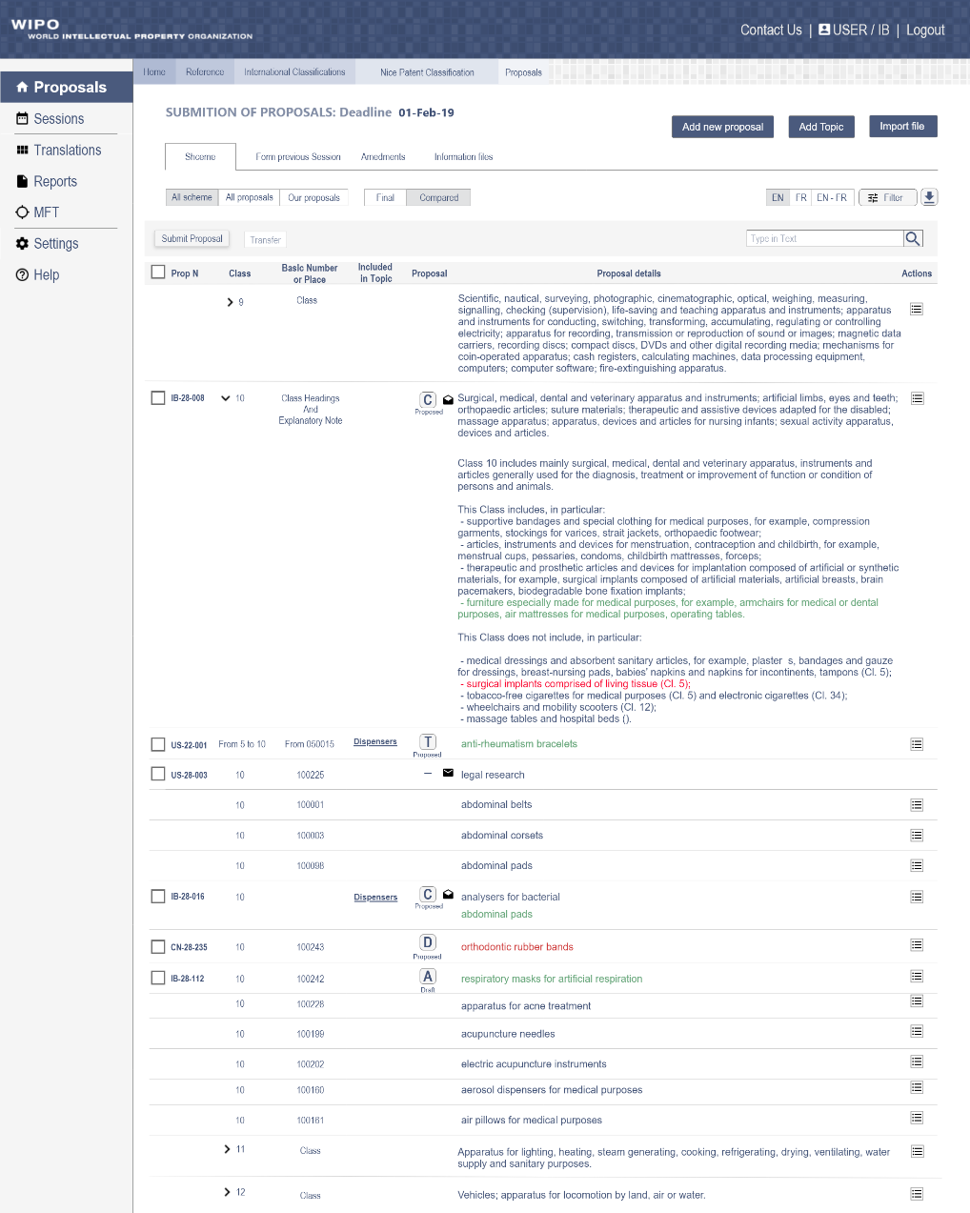
MGS terms will be included in the system as candidates of the proposal by offices/IB

Slide 7
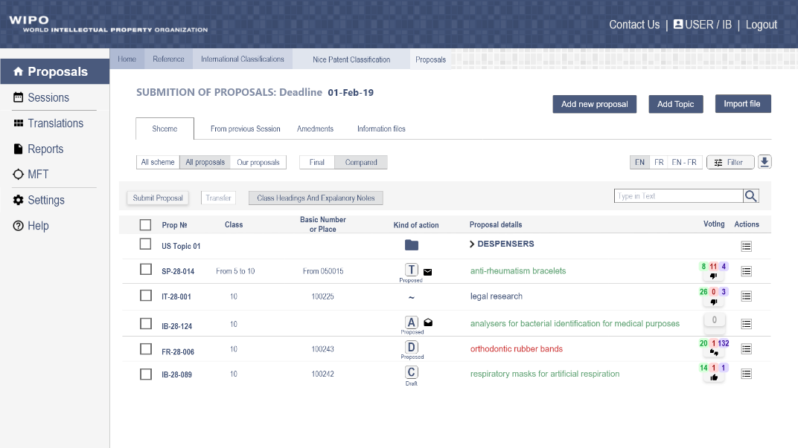
Submission of proposals with predefined excel format would also be possible

Slide 8
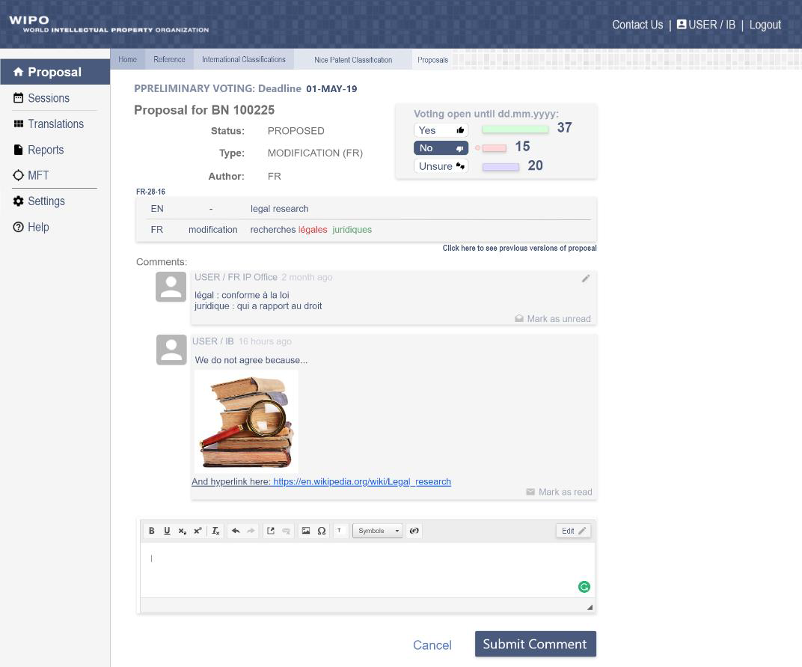

Slide 9
2. Submission of proposals
during specific period

Slide 10
Now
Proposals can be submitted any time before deadline
October 31, 20YY
CE XX, Spring 20YY+1
Future
NCL(20YY+1) is fixed
Proposals can be submitted only during specific period
Specific date after
July 1, 20YY
October 31, 20YY
CE XX, Spring 20YY+1

Slide 11
3. Preliminary voting

Slide 12
1. Proposals that don’t receive any negative votes
Result of preliminary voting
For Against Unsure
Proposal 1 40 0 0
Proposal 6 40 0 0
Proposal 7 10 0 0
Proposal 9 40 0 0
Proposal 10 40 0 0
For Against Unsure
Proposal 1 40 0 0
Proposal 2 35 0 5
Proposal 3 37 2 0
Proposal 4 20 10 0
Proposal 5 0 35 0
Proposal 6 40 0 0
Proposal 7 10 0 0
Proposal 8 35 5 0
Proposal 9 40 0 0
Proposal 10 40 0 0
In principle, adoption at CE without the need for further individual discussion
(An office can still raise any issues at CE if they so wish)
2. All other proposals
For Against Unsure
Proposal 2 35 0 5
Proposal 3 37 2 0
Proposal 4 20 10 0
Proposal 5 0 35 0
Proposal 8 35 5 0
Individual further discussion at CE as is presently the case

Slide 13
4. Technical annex
Now: Word format Future: Excel format
5. Revision file in Excel format
Survey : How is this file used by Offices ?

Slide 14
Thank you for your attention !

