Slide 1

WIPO IPAS
Juneho Jang
Senior Regional Manager

Slide 2
2
WIPO Systems
Filing/Reception
IPAS+ Reception Module
Administration
IPAS Core System
Publication, Information Dissemination
IPAS Journal Management Module
WIPO File
Online Filing
WIPO Publish
Archive & File Management
IPAS dossier tracking
Examination
IPAS Support for TM Examination
Integration with Global IP Systems
Madrid Module
WIPO Scan
WIPO EDMS
PCT Download

Slide 3
IPAS
Industrial Property Automation System
Trademarks
Industrial Designs
Patents
Utility Models

Slide 4

        Applications
        Configurable Application Types, Application Sub Types (Goods Mark, Service Mark, Domestic Mark, Foreign Mark, etc)
        User Documents
        Configurable User documents (Renewal, Change of Name/Address, Pre-application search, Opposition, Withdrawal request, Cancellation request, etc)
Applications
User documents

Slide 5

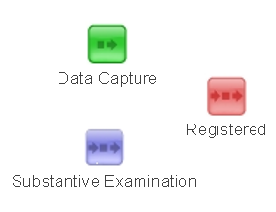



Office Documents Templates
Official letters, notifications, certificates
Statuses
Office Actions

Slide 6
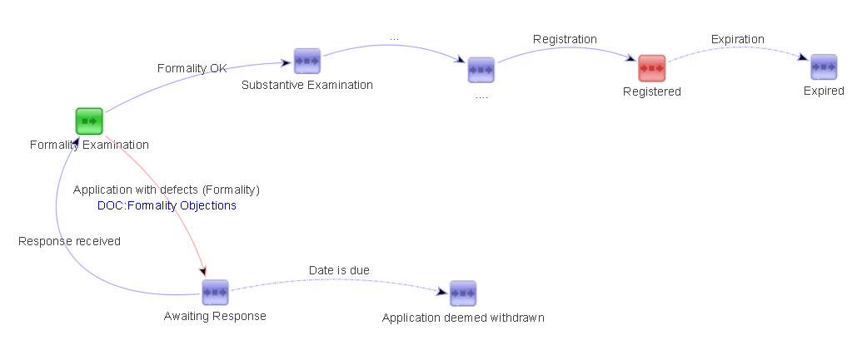
IPAS Workflow
Statuses, Manual actions, Actions with time limits, Automatic actions, Actions with document outputs, Actions linked with User Documents

Slide 7
IPAS Workflow
User documents
Applications
Workflows

Slide 8


IPAS
IPAS+
Reception, Data Extraction
PCT Download
Internet
IPAS WEB
IPAS EDMS
WIPO
PatentScope
IPAS ADMIN
WIPO Scan
IPAS CORE
IPAS Madrid Module
Internet
WIPO IB
FTP Server
IPAS Designer
IPAS Manager
IPAS Database
Oracle / Microsoft SQL

Slide 9
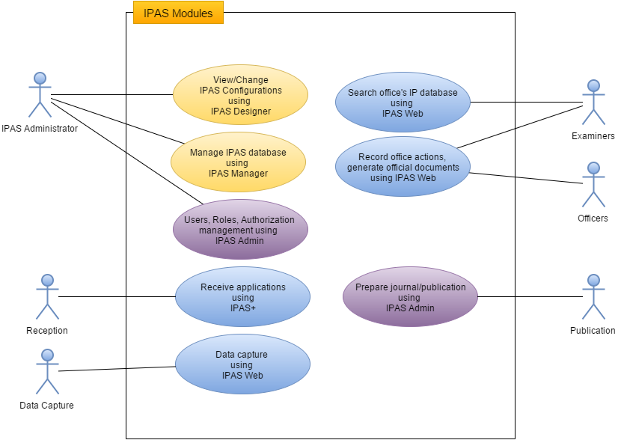
IPAS

Slide 10
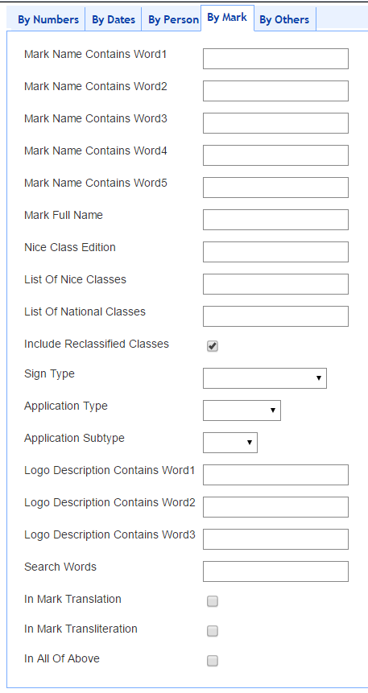
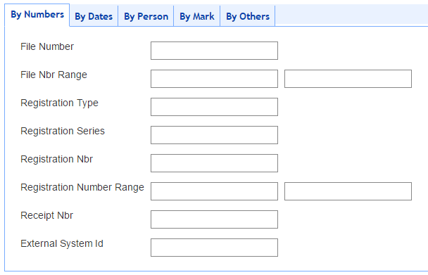
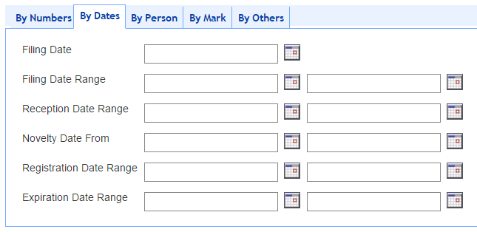
Trademark Search

Slide 11
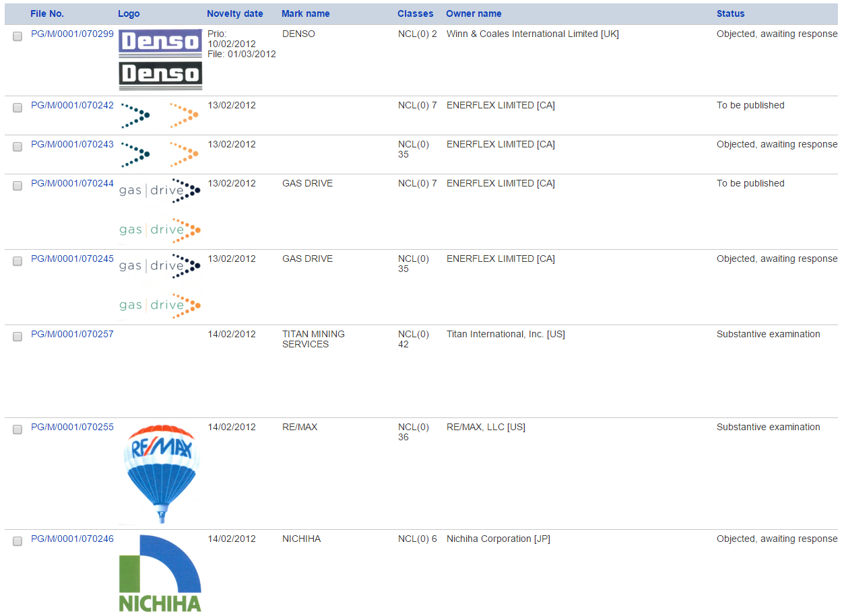
Trademark Module

Slide 12
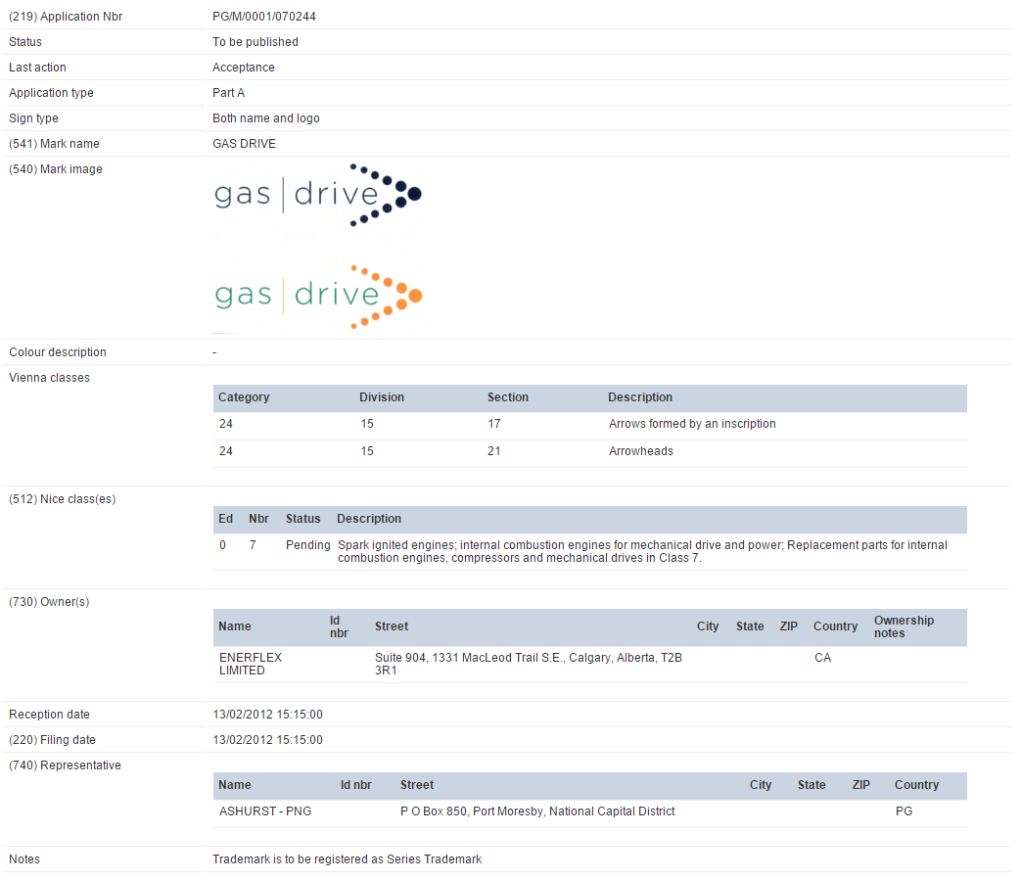
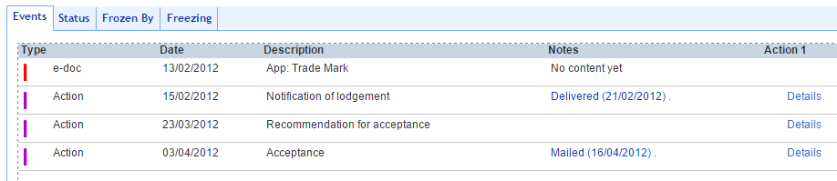
Trademark Module

Slide 13
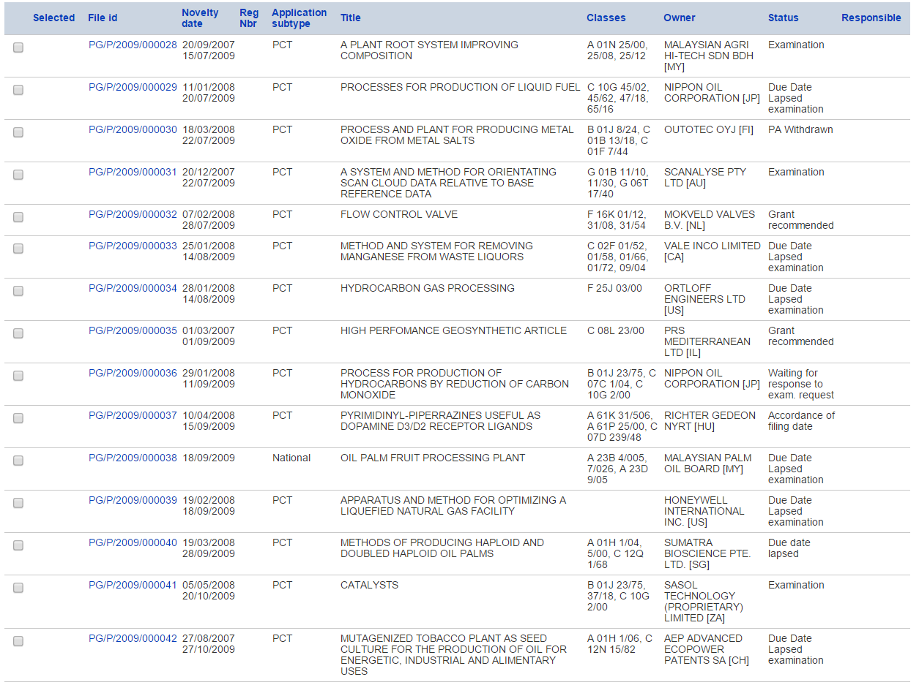
Patent Module

Slide 14
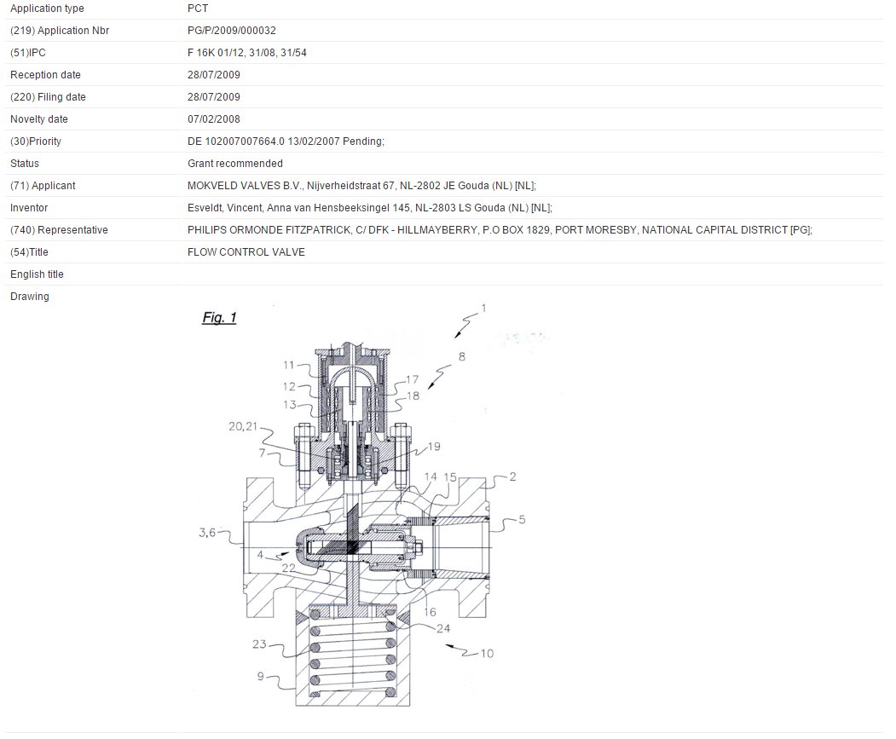
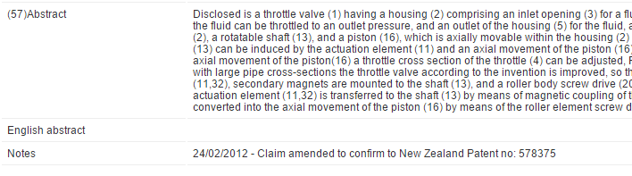
Patent Module

Slide 15
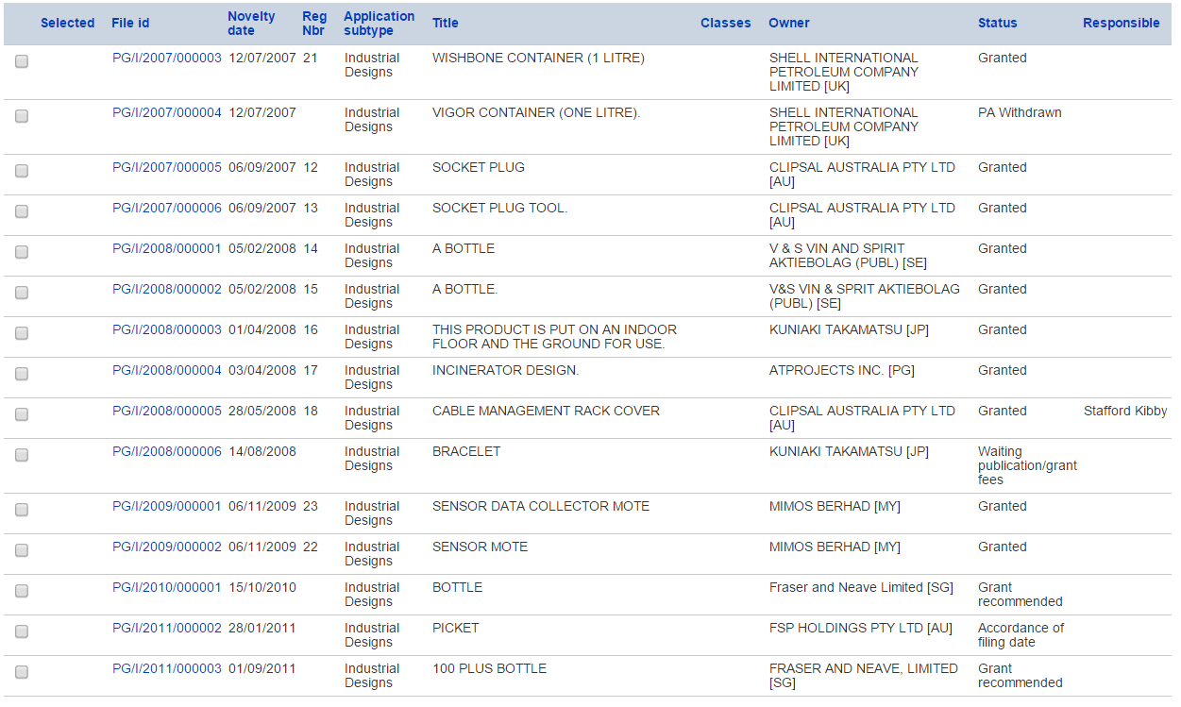
Industrial Design Module

Slide 16
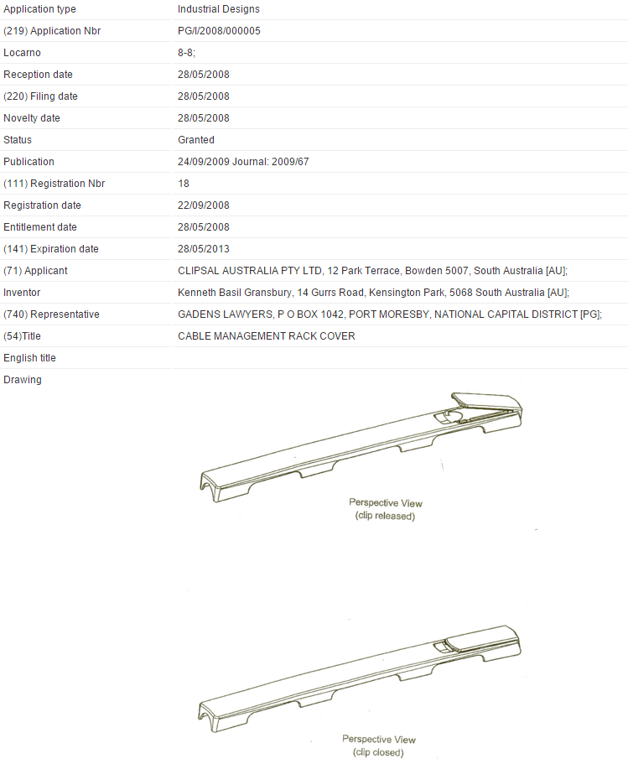
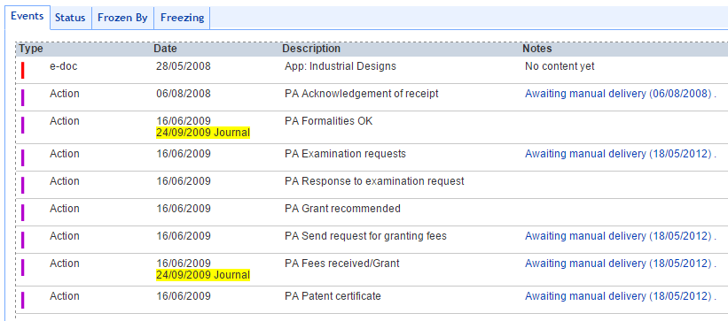
Industrial Design Module

Slide 17
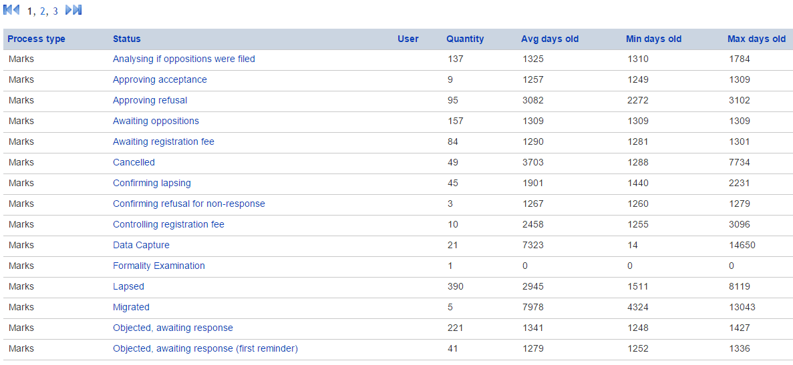
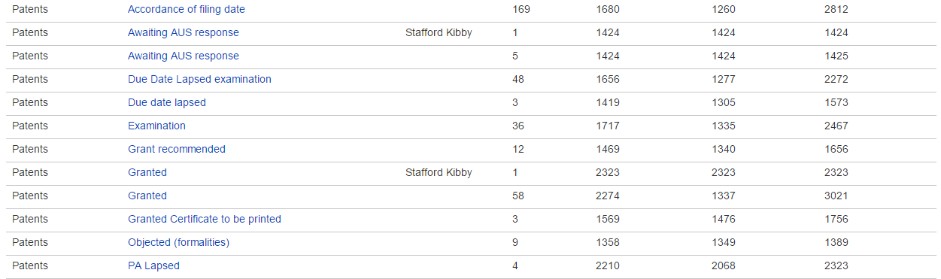
Number of Applications by Statuses

Slide 18

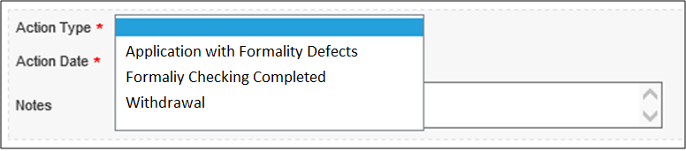
Recording Office Action
1
2
3
1
2
3

Slide 19
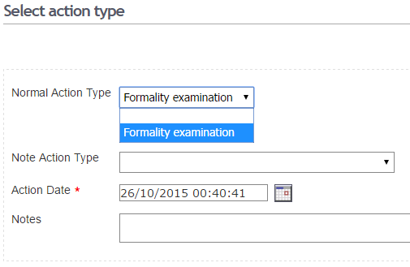
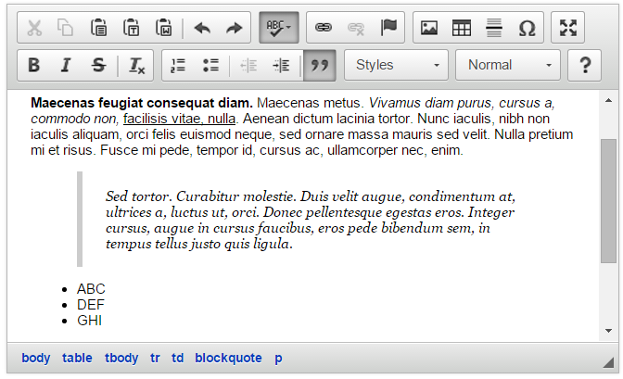
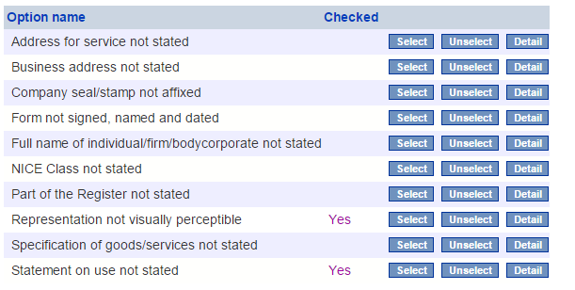
Recording Office Action

Slide 20
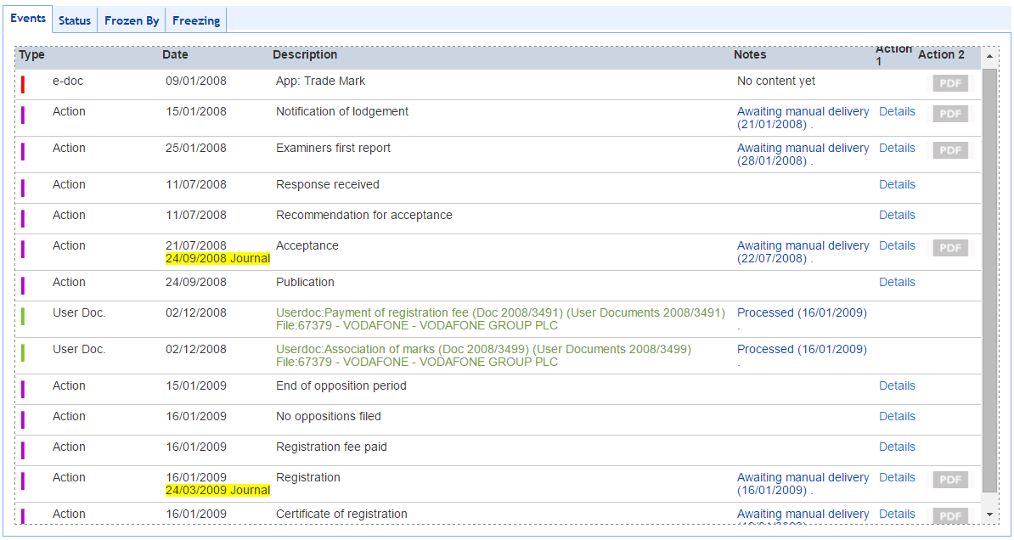
Process History

Slide 21
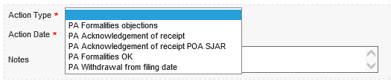
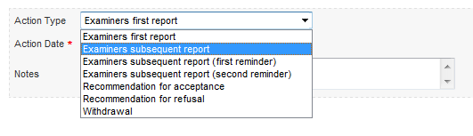
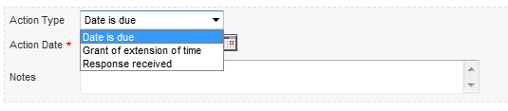
Recording Office Action

Slide 22
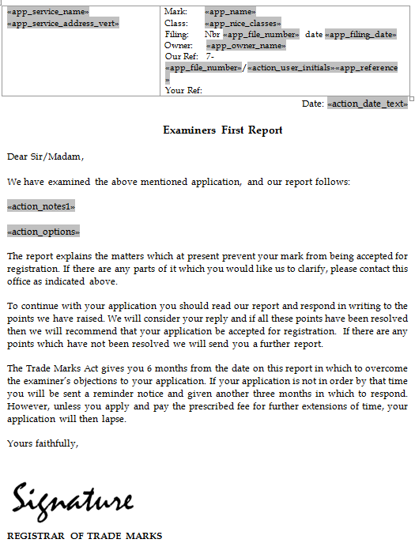
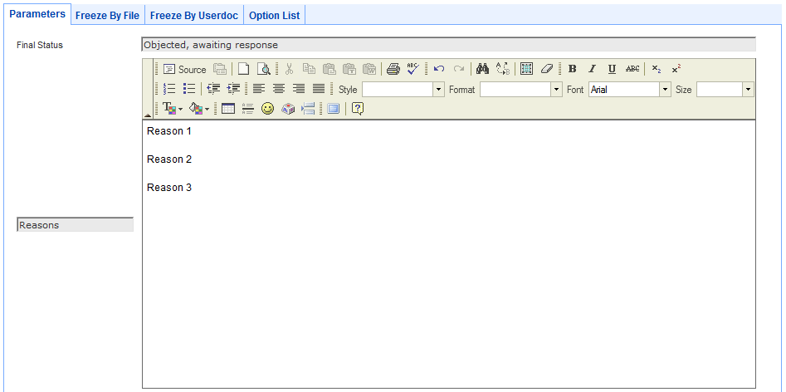
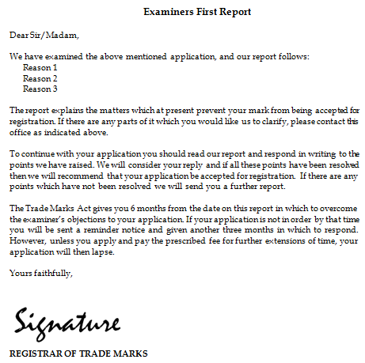
Office Documents

Slide 23



Office Document Templates
IPAS
Office Document Templates
Output Document
<<Service_Address>>
Mark Application No: <<App_File_Id>>
Logo: <<File_Picture>>
Filing Date: <<App_Filing_Date>>
Expiry Date: <<File_Expiry_Date>>
ABC Co., Ltd.
No. 123, Street 45
Mark Application No: KH/T/2012/12345
Logo:
Filing Date: Jan 1, 2010
Expiry Date: Jan 1, 2020

Slide 24
IPAS Workflows
PA workflow
Trademark
application
Patent application
Change of name
TM workflow
Renewal
UD workflow
For changes
Design
workflow
Priority Document
UD workflow
Simple request
Design
application
Office
Documents
OD
workflow
Certificate duplicate

Slide 25
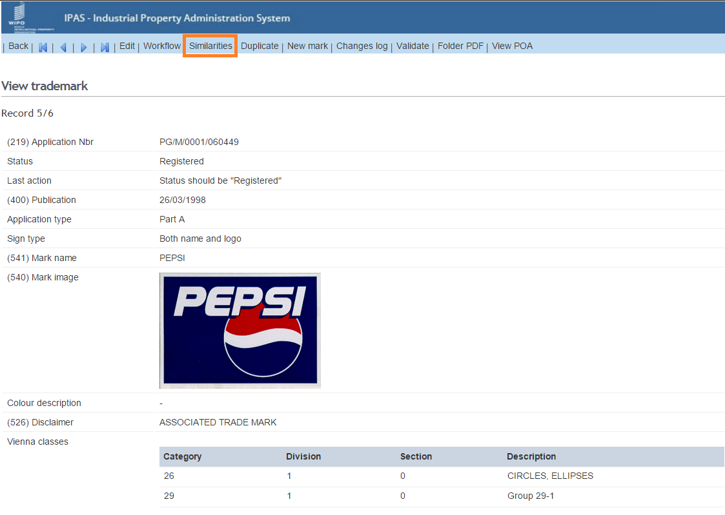
Trademark Similarities

Slide 26
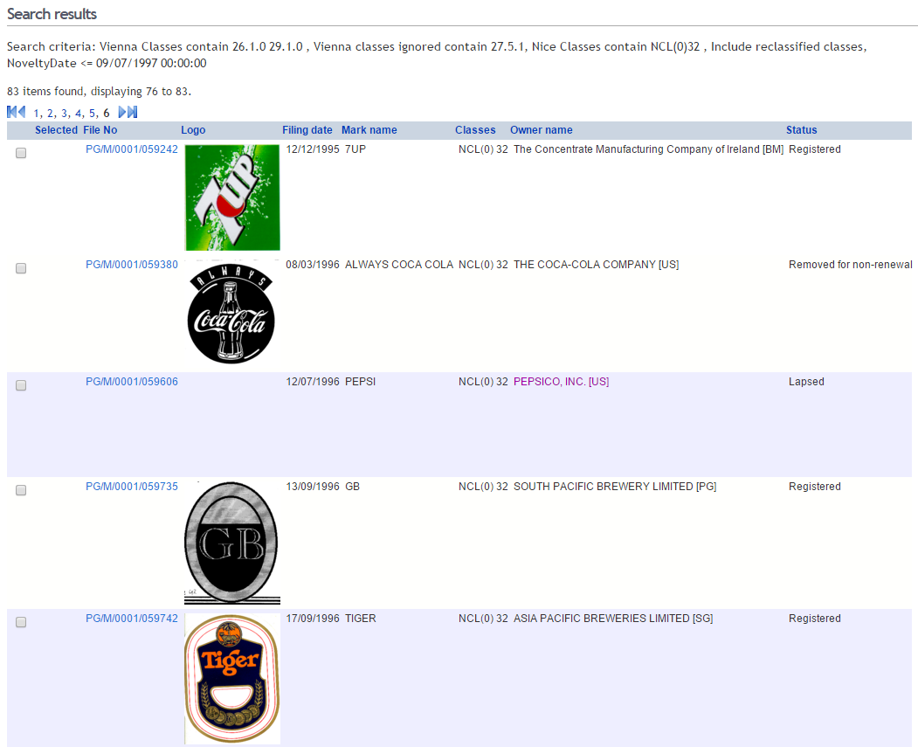
Trademark Similarities

Slide 27
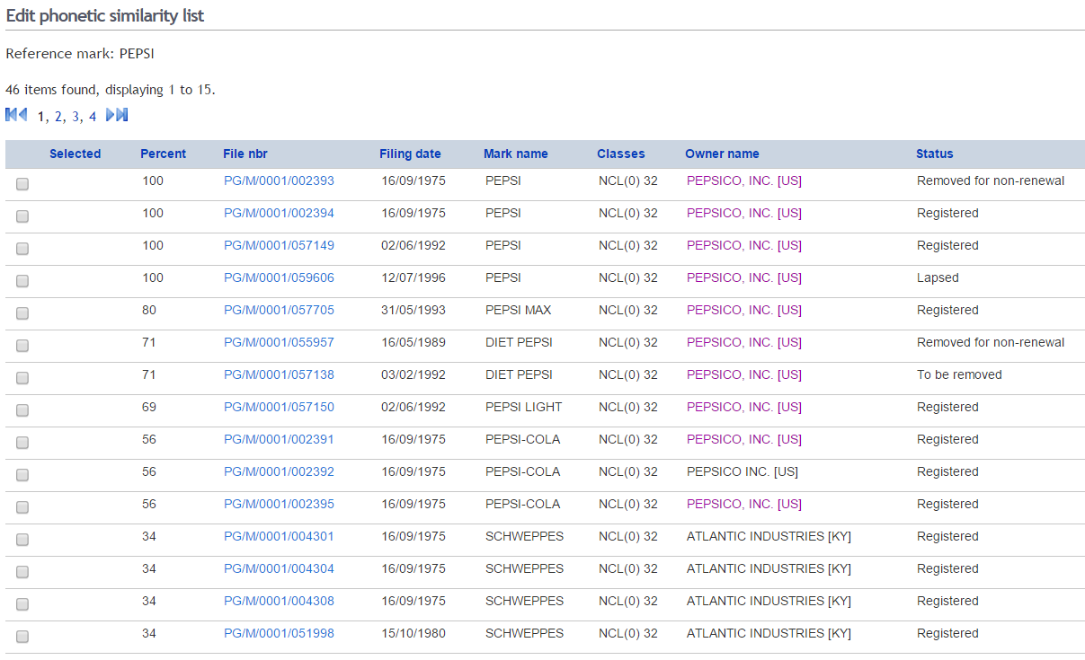
Trademark Similarities

Slide 28
More Features
Processing Renewals of trademarks and industrial designs
Processing assignments, merger, change of name and/or address, etc…etc.
Annuities generation and payment tracking
Journals/Gazettes preparation
Pre-Filing Search
Dossier Tracking
Productivity Report
Yearly Statistic Report
Linkage with electronic document management system

Slide 29
Key Technologies in IPAS
JavaEE
Oracle/Microsoft SQL Server
is made possible by IPAS API and IPAS Web Service
Integration with Other Systems

Slide 30
IPAS
Extensive customization including:
  National IP legislation,
  Workflow processes, legal time-periods and deadlines,
  Templates of official correspondences, certificates, gazettes,
  Language, terminology
No programming is required to customize IPAS

Slide 31


IPAS Madrid Module
Optional module of IPAS to process Madrid notifications
IPAS Madrid Module

Slide 32








IPAS Madrid Module
New application or
Request for Changes
Limited information made available to public using IPAS at the Office
Applicant
Office of Origin
MADRID
Notifications
Designated Contracting State
IPAS Madrid Module
Internet
Malaysia
WIPO
Office examiners access IPAS via web browser
United States
Designated Contracting State
using WIPO IPAS
Japan
United Kingdom

Slide 33
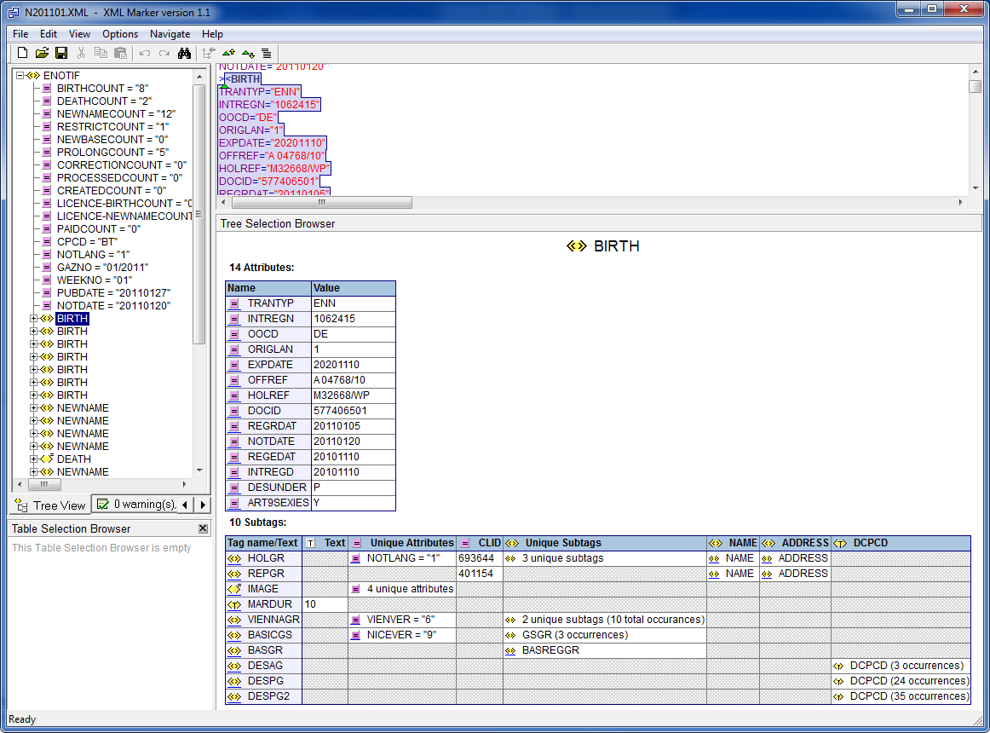
Madrid Notification

Slide 34
Madrid Module
Converts Notifications to Applications and User Documents to be processed in IPAS.
Madrid
User Documents
Madrid
Application
workflow
workflow

Slide 35
Madrid Module Deployment Activities
Define Application numbering (Local number or IRN)
Define workflow
(Create new or update existing trademark workflow)
Define official document templates
User training

Slide 36

PCT National Phase Entry Download
Reception Module
PCT National Phase Download
Internet
IP OFFICE
WIPO

Slide 37
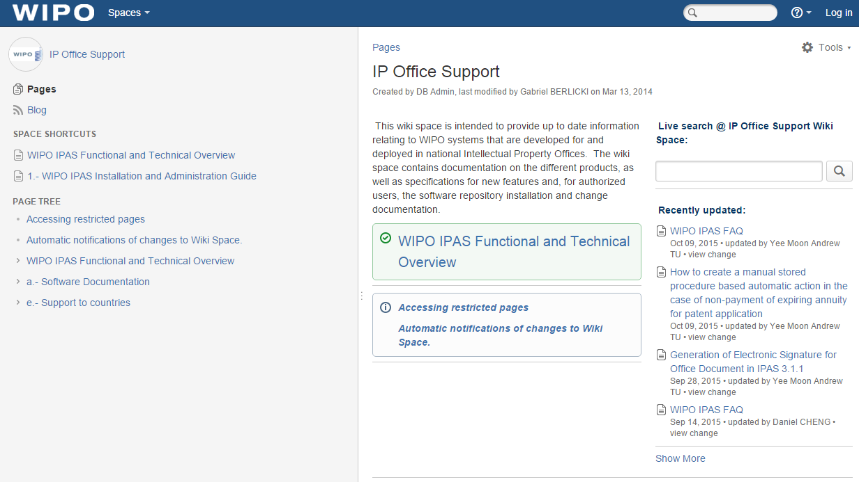
For more information
https://www3.wipo.int/confluence/display/wipoimd/IP+Office+Support

