Slide 1


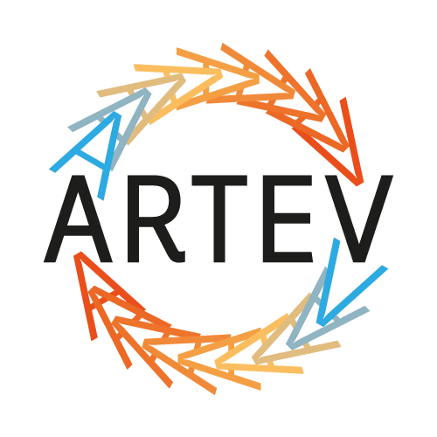

“IP Management @ Universities” Istanbul ,May 16 to 18, 2012 Albert Long Hall, BOGAZICI UNIVERSITY
ARTEV MANAGEMENT PLATFORM
What ARTEV is
Why we did what we did
How it fits the current landscape around technology commercialization
What was the impact to date
Future of such an initiative
ARTEV MANAGEMENT PLATFORM Zeynep Birsel
Manager, TTO
Sabancı University, İstanbul Turkey

Slide 2


“IP Management @ Universities” Istanbul ,May 16 to 18, 2012 Albert Long Hall, BOGAZICI UNIVERSITY
ARTEV MANAGEMENT PLATFORM
What ARTEV is: ARTEV stands for Research based Intellectual Asset Management Platform
It is an initiative co-funded by the İstanbul Development Agency and ARTEV consortium
Goal is to support the environment for transforming new knowledge and technology into economic value. ARTEV vision is focused on the strategic management perspective of intellectual assets to attain the above stated goal.
ARTEV MANAGEMENT PLATFORM Zeynep Birsel
Manager, TTO
Sabancı University, İstanbul Turkey

Slide 3




“IP Management @ Universities” Istanbul ,May 16 to 18, 2012 Albert Long Hall, BOGAZICI UNIVERSITY
ARTEV MANAGEMENT PLATFORM
ARTEV Consorsium
Difference in approach:
Intellectual Asset vs Intellectual Property
Strategy vs legal or technical alone
Practical knowledge
Education: qualified professionals > Key
Main activities:
Awareness building (5 seminars & workshops + 4 professional trainings)
Professional training curriculum
Reports (IAM and tech commercialization)
Government and NGO liason (TUBITAK, TPE, TUSIAD, ISO …)
ARTEV MANAGEMENT PLATFORM Zeynep Birsel
Manager, TTO
Sabancı University, İstanbul Turkey

Slide 4
“IP Management @ Universities” Istanbul ,May 16 to 18, 2012 Albert Long Hall, BOGAZICI UNIVERSITY
ARTEV MANAGEMENT PLATFORM
Why we did what we did...
Perception on the impact of research has seen a paradigm shift globally
  EC 8th framework > Innovation...
  US > Translational research (SBIR Funds, Science parks..)
  Entrepreneurship, angel investment, VC… > tools for transforming new ideas into practice
Turkey is economically vibrant and there is a pressure to further advance
Government primarily through TUBİTAK is ready to introduce new instruments to foster technology transfer and commercialization
Foreign investment towards R&D positioning in Turkey tends to grow
Market for tech transfer is immature...
ARTEV MANAGEMENT PLATFORM Zeynep Birsel
Manager, TTO
Sabancı University, İstanbul Turkey

Slide 5
“IP Management @ Universities” Istanbul ,May 16 to 18, 2012 Albert Long Hall, BOGAZICI UNIVERSITY
ARTEV MANAGEMENT PLATFORM
How it relates to current landscape
Establishment of tech transfer offices
Incentives for academic entrepreneurship
Entrepreneurial University Index
Restructuring of academic performance system
23 rd BTYK decisions
  Industry oriented actions
  University oriented actions
  Entrepreneurial environment
Recent policy and legal framework
  TUBITAK law
  Patent law
  Knowledge transfer centers
Demand for skilled workforce
ARTEV MANAGEMENT PLATFORM Zeynep Birsel
Manager, TTO
Sabancı University, İstanbul Turkey

Slide 6
“IP Management @ Universities” Istanbul ,May 16 to 18, 2012 Albert Long Hall, BOGAZICI UNIVERSITY
ARTEV MANAGEMENT PLATFORM
Impact in 9 months
Reached out to 450 + individuals
Became a reference point from government perspective
Actively contributed to policy making efforts
Expanded Turkey’s representation among technology commercialization circles worldwide
  140 + formal networks
  International collaborations with AUTM and LES
Established formal collaborations with NGOs primarily TUSIAD (integration into recent recommendations on incentives)
Set an example for a lucrative collaboration platform whereby members are 5 of the leading institutions of higher education + expanded the partnership base
ARTEV MANAGEMENT PLATFORM Zeynep Birsel
Manager, TTO
Sabancı University, İstanbul Turkey

Slide 7
“IP Management @ Universities” Istanbul ,May 16 to 18, 2012 Albert Long Hall, BOGAZICI UNIVERSITY
ARTEV MANAGEMENT PLATFORM
Impact in 9 months
Established a communication platform for mutual understanding among research universities and enterprises
Deep dive into enterprise IAM> feed in to HR development through professional education > curriculum + policy & law making functions
  Variations based on size
  Variations based on sector
  Variations based on business model
  Variations based on enterprise structure (ie JV)
ARTEV MANAGEMENT PLATFORM Zeynep Birsel
Manager, TTO
Sabancı University, İstanbul Turkey

Slide 8
“IP Management @ Universities” Istanbul ,May 16 to 18, 2012 Albert Long Hall, BOGAZICI UNIVERSITY
ARTEV MANAGEMENT PLATFORM
What lies ahead...
Professional education
  Degree
  Non-degree (4 Professional trainings)
  Certification (International accreditation)
Policy development
  Internal
  Government level
Collaborative Business models (competition-collaboration, IP issues in collaborations, new concepts, new working policies; open innovation, social entrepreneurship)
Resource optimization: tech transfer enablers
ARTEV MANAGEMENT PLATFORM Zeynep Birsel
Manager, TTO
Sabancı University, İstanbul Turkey

Slide 9
“IP Management @ Universities” Istanbul ,May 16 to 18, 2012 Albert Long Hall, BOGAZICI UNIVERSITY
ARTEV MANAGEMENT PLATFORM
Pilot professional trainings
IP Mapping & Intelligence May 4-5, 2012
  Instructor: Kevin Nahtrab
  Where: SU Karakoy Communication Center
IP Valuation (emphasis on early stage tech) May 18-19, 2012
  Instructor: Roy D’Souza (Ocean Tomo)
  Where: Sabancı Center
Strategic Intellectual Asset Management May 25-26, 2012
  Instructor, Ada Nielsen
  Where: Sabancı Center
Tech commercialization management June 1-2, 2012
  Jim O’Connol (Director, Venture accelerator, U. Michigan)
  Where: SU Karakoy Communication Center
ARTEV MANAGEMENT PLATFORM Zeynep Birsel
Manager, TTO
Sabancı University, İstanbul Turkey

Slide 10
“IP Management @ Universities” Istanbul ,May 16 to 18, 2012 Albert Long Hall, BOGAZICI UNIVERSITY
ARTEV MANAGEMENT PLATFORM
Thank you...
Zeynep Birsel (zeynepbirsel@sabanciuniv.edu)
Manager, TTO – Sabancı Universitesi
ARTEV MANAGEMENT PLATFORM Zeynep Birsel
Manager, TTO
Sabancı University, İstanbul Turkey

