Slide 1
Knowledge Management and
IP Monetization Models
Mr. Gary N. Keller, MsB
CEO
Xomix Ltd

Slide 2
Xomix, Ltd. is a biotechnology accelerator and venture catalyst
Intellectual asset management
Creation and development of technology startups
Technology commercialization and partnering
Planning and implementation of strategic initiatives

Slide 3
Intellectual Property Knowledge Management
How to Maximize Value and Impact?
Knowledge management (KM) comprises a range of strategies and practices used in an organization to identify, create, represent, distribute, and enable adoption of insights and experiences.
Source: Wickipedia.com

Slide 4
Creating Value from Intellectual Property
Service to Research Inventors
Revenue Stream for the Research Institution
Technology Led Economic Development

Slide 6
Association of University Technology Managers (AUTM) Licensing Activity Survey
Establishment of startup companies driven by university developed IP;
Number of licenses/options executed to startups;
Total number of licenses and options;
Research expenditures: total R&D, federal, and industrial spending;
Number of invention disclosures;
Number of new patent applications;
Number of new patent issuances; and
Total license income

Slide 7
“IP Management @ Universities” Istanbul, May 16 to 18, 2012 Albert Long Hall, BOGAZICI UNIVERSITY
IP Monetization Models
Internal Development
Commercialization (Licensing)
-Existing Companies
-Formation of Startup Companies
Defense - Infringement
Auction
Exchange
Knowledge Management and
IP Monetization Models

Slide 8
“IP Management @ Universities” Istanbul, May 16 to 18, 2012 Albert Long Hall, BOGAZICI UNIVERSITY
Integrated Commercialization Models
Key Benefits:
Resource Sharing
Critical Mass of Technologies and Companies
Knowledge Management
Increased Collaboration
Culture of Innovation
Knowledge Management and
IP Monetization Models

Slide 9
“IP Management @ Universities” Istanbul, May 16 to 18, 2012 Albert Long Hall, BOGAZICI UNIVERSITY
Florida Institute for the Commercialization of Public Research
“Igniting Florida’s Innovation Economy”
Institute formed in 2007 as “One Stop” shop
matches seasoned entrepreneurs, and venture, angel and individual investors to startup companies
creates funded companies and high value-added jobs
Knowledge Management and
IP Monetization Models

Slide 10
“IP Management @ Universities” Istanbul, May 16 to 18, 2012 Albert Long Hall, BOGAZICI UNIVERSITY
Institute Partners
PUBLIC INSTITUTIONS
Florida Agricultural and Mechanical University
Florida Atlantic University
Florida Gulf Coast University
Florida International University
Florida State University
New College of Florida
University of Central Florida
University of Florida
University of North Florida
University of South Florida
University of West Florida
PRIVATE INSTITUTIONS
Burnham Institute for Medical Research
Institute for Human and Machine Cognition
Max Planck Institute of Bio-imaging
NASA’s Kennedy Space Center
National Center of Excellence for Simulation & Training
Nova Southeastern University
Roskamp Institute
Scripps Florida
SRI International
Torrey Pines Institute for Molecular Studies
Vaccine and Gene Therapy Institute
University of Miami
Knowledge Management and
IP Monetization Models

Slide 11
“IP Management @ Universities” Istanbul, May 16 to 18, 2012 Albert Long Hall, BOGAZICI UNIVERSITY
Institute Activities
Gather data and establish relationships on:
Technologies
Start-ups
Entrepreneurs
Funding Sources
Establish knowledge management system and Institute website
Knowledge Management and
IP Monetization Models

Slide 12
“IP Management @ Universities” Istanbul, May 16 to 18, 2012 Albert Long Hall, BOGAZICI UNIVERSITY
Midwest University Research Network (MRUN)
Regional cooperation directed at commercialization of university research
Information exchange and collaboration
Best practices
Angel and seed stage financing
Focus on start-up enterprise development
Knowledge Management and
IP Monetization Models

Slide 13
“IP Management @ Universities” Istanbul, May 16 to 18, 2012 Albert Long Hall, BOGAZICI UNIVERSITY
MRUN Model Regional Collaboration to Catalyze Commercialization
Startup Ventures
Technology Commercialization
50 Midwest
Institutions
Academic and Institutional Research
Knowledge Management and
IP Monetization Models

Slide 14
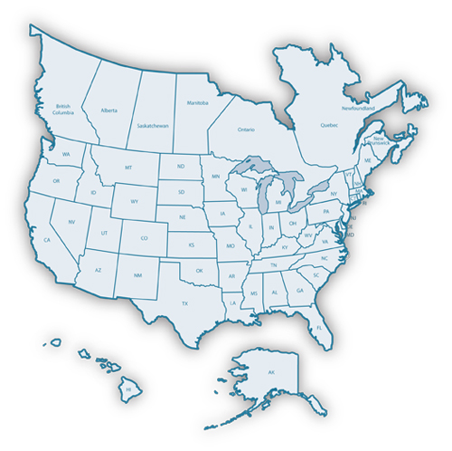
“IP Management @ Universities” Istanbul, May 16 to 18, 2012 Albert Long Hall, BOGAZICI UNIVERSITY
MRUN, Inc.
The MRUN Region
MN, IA, MO, WI, IL, IN, OH, MI
KS, KY, NE, ND, SD, western PA
Canadian Provinces of Manitoba and Ontario
Knowledge Management and
IP Monetization Models

Slide 15
“IP Management @ Universities” Istanbul, May 16 to 18, 2012 Albert Long Hall, BOGAZICI UNIVERSITY
MRUN Activities
Local Role
MRUN members are a resource for
Concept stage projects (raw technology or an idea in a corporate shell)
Emerging start-up companies
Regional Role
MRUN members create links across the region to leverage local resources
Knowledge Management and
IP Monetization Models

Slide 16
“IP Management @ Universities” Istanbul, May 16 to 18, 2012 Albert Long Hall, BOGAZICI UNIVERSITY
Integrated Commercialization
An IP Model to Optimize Knowledge Management
Benefits
Knowledge sharing and integration
Resource sharing and collaboration
Attraction of funding and management
Development of critical mass
Establishment of a culture of innovation
Knowledge Management and
IP Monetization Models

Slide 17
“IP Management @ Universities” Istanbul, May 16 to 18, 2012 Albert Long Hall, BOGAZICI UNIVERSITY
Questions
“ One must learn by doing the thing, for though you think you know it, you have no certainty until you try.”
Sophocles
Knowledge Management and
IP Monetization Models

Slide 18
“IP Management @ Universities” Istanbul, May 16 to 18, 2012 Albert Long Hall, BOGAZICI UNIVERSITY
Contact Information
Gary N. Keller, Ms.B., CEO
Xomix Ltd.
3712 N. Broadway, #462
Chicago IL 60613
Tel: 773 - 251-8214
Fax: 773-584-0868
gary.keller@xomix.com
Knowledge Management and
IP Monetization Models

