Slide 1
Setting Copyright Royalties
Nancy M. Livak, J.D. Candidate 2013
University of Connecticut School of Law

Slide 2
Today’s Presentation
What licenses are currently given
How countries set these rates
Germany, England, US
How countries enforce these rates
Potential international system

Slide 3
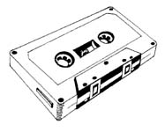
Mechanical Rights
Notes:
In Germany and UK licensing from mechanical rights societies is mandatory while in US the choice is left to the copyright owner
Songwriter collects these royalties from record sales plus performance royalties
Usually have compulsory licenses

Slide 4
Performance Rights
Notes:
Performers need to join performing rights society in order to easily collect their royalties
Songwriters collect from airplay while performers only collect after album recoups its budget
Can have compulsory or individual negotiations

Slide 5
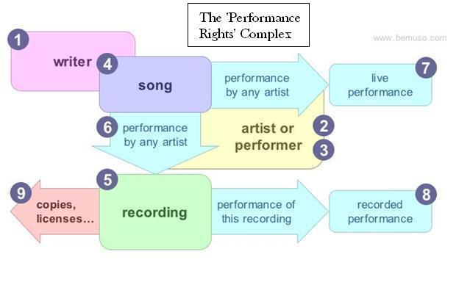

Slide 6
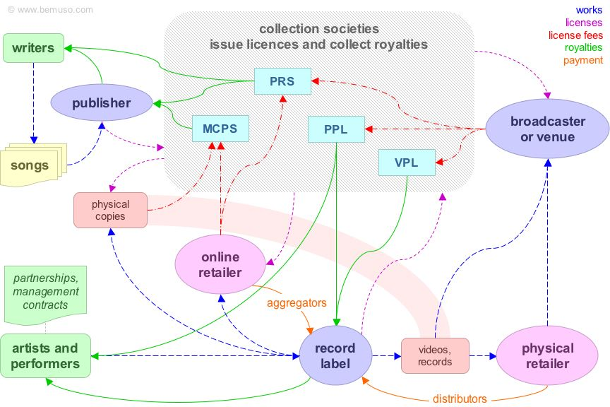
Collection Societies

Slide 7
Germany

Slide 8
German Copyright Law
Looks to protect the personal relationship of the creator to his work
Gives monopoly to GEMA to collect both performance and mechanical rights licenses
Does not set statutory rates for licenses
Notes:
Since GEMA has a monopoly they are required to deal with everyone
International and EU compulsory licenses

Slide 9
GEMA
Collects and negotiates royalty rates
Mechanical royalties set as percentage of published price to the dealer (PPD)
Performance royalties set by number of performances
Notes:
If a digital download is delivered to users in Germany, even if the server origin is located abroad, Germany’s mechanical rate should apply.
In Germany, case law has established the so-called GEMA Vermutung, a presumption that works are managed by GEMA due to its monopoly position. As such, in Germany the burden of proof is on the accused infringer that the work is not managed by GEMA.

Slide 10
Government Supervision of GEMA
Copyright Administration Law
Arbitration Board
Notes:
The Arbitration Board under the Copyright Administration Law mediates disputes between collecting societies and users of copyright works. For example, the Board deals with disagreements between (GEMA) and concert organizers, discotheque operators, broadcasting organizations and producers of phonograms.
The Board also deals with disputes between broadcasting organizations and cable network operators. Proceedings frequently relate to individual applicability and equitability of tariffs set up by collecting societies.
The Arbitration Board strives to reach amicable arrangements between the parties. Where this goal is not already achieved in the course of the proceedings, for example by way of an amicable settlement, the Arbitration Board submits a settlement proposal to the parties. If this proposal is not contested, its effect is similar to a court judgment. The Arbitration Board is integrated in the organization of the German Patent and Trade Mark Office (DPMA). Yet it is an independent body and not identical with the DPMA as supervisory authority of the collecting societies.
A recent amendment of the Urhebergesetz (sec. 31a, included in 2008) has created the possibility to grant licenses for "unknown uses", i.e. permit use of works in media not known at the time the license is granted. Previously this had not been possible, so that even "unrestricted" licenses granted before the mid-1990s did not (and could not) include the right to use the work on the internet, which created considerable practical problems.
Collecting societies are subject to government supervision since they have a monopoly position and hold rights in trust.

Slide 11
England

Slide 12
English Law
Started as an economical concept and later added protection for moral rights
Created Copyright Tribunal
Does not give monopoly to collection societies
Does not set statutory rates
Notes:
Mechanical royalties set as percentage of published price to the dealer (PPD)
In the United Kingdom, where tariffs for public performances of musical compositions and sound recordings are set through separate proceedings, the most recent tariff announced by the neighboring rights society (Phonographic Performances Ltd, or “PPL”) went into effect immediately, but was significantly reduced by the Copyright Tribunal five years later (after a lengthy administrative proceeding and an appeal to the High Court), necessitating refunds to the licensees of five years of overpayments
Moral rights were introduced into UK law by the 1988 Act. They come from the alien civil law system, not from the common law tradition. The 1988 Act introduced moral rights for authors of literary, dramatic, musical and artistic works and the directors of films

Slide 13
PRS (MCPS) and PPL
Each organization sets the rates for their respective deals
Mechanical royalties set as percentage of published price to the dealer (PPD)
Performance royalties set by number of performances
Notes:
The main function of the Tribunal is to decide, where the parties cannot agree between themselves, the terms and conditions of licences offered by, or licensing schemes operated by, collective licensing bodies in the copyright and related rights area. It has the statutory task of conclusively establishing the facts of a case and of coming to a decision which is reasonable in the light of those facts. Its decisions are appealable to the High Court only on points of law. (Appeals on a point of law against decisions of the Tribunal in Scotland are to the Court of Session.)
Its principal task is adjudicating disputes between collective licensing agencies and persons (natural or legal) who feel they have been unfairly treated; for example if a license is refused, or is offered on terms which the person considers unreasonable
The Act establishes the Copyright Tribunal as a continuation of the tribunal established under s. 23 of the 1956 Act (s. 145). The Tribunal is empowered (s. 149) to hear and determine proceedings concerning: (1) copyright licensing schemes; (2) royalties for rental of sound recordings, films or computer programs; (3) licenses made available as of right under s. 144 (powers of the Monopolies and Mergers Commission); (4) the refusal of a performer to give consent under his rights in performances; (5) royalties under the perpetual copyright of ”Peter Pan" (see below). An appeal on any point of law lies to the High Court, or to the Court of Session under Scots Law.

Slide 14
Government Oversight
Copyright Tribunal
Joint Online License
Notes:
In the United Kingdom, the public performance tariffs for musical compositions and sound recordings are set independently by the respective PROs--PRS for the former and PPL for the latter--but each tariff may be reviewed by the Copyright Tribunal to determine whether it is “reasonable under the circumstances.” The rate-setting methods used by the two PROs are completely different, making rate comparisons difficult. Because user groups have not disclosed the amounts they are actually paying under the two tariffs, it is impossible to state whether the “bottom line” figure is higher for the PRS tariff or the PPL tariff. The Copyright Tribunal considers the musical composition tariff to be a relevant comparator for determining whether a proposed sound recording tariff is reasonable. The Copyright Tribunal has in fact considered the PRS tariff in determining whether a proposed PPL tariff is reasonable. In a recent proceeding, however, the Tribunal decided that the PRS tariff was a less relevant comparator than the previous PPL tariff, and therefore rejected most of the increase that PPL had proposed. The Tribunal's explanation of its reasoning leaves the impression that, despite the difficulty of drawing direct comparisons due to differing methodologies, the PRS tariff is indeed somewhat higher than the PPL tariff.
When a company wishes to use recorded performances which are subject to protection of the performance right, a compulsory license may be obtained from the Copyright Tribunal where the owner of performance rights cannot be identified or located. Under s 190 of the Copyright Designs and Patents Act UK, the Copyright Tribunal may give consent on behalf of rights owners to copy a recording of a performance where reasonable enquiries have not been successful in revealing the identity or the location of the rights owner. Reasonable enquiries will usually include ascertaining whether the Musicians’ Union and to the relevant collecting society, and the Copyright Tribunal may require further enquiries to persons or publishers whom it considers may have relevant information.

Slide 15
United States

Slide 16
United States Law
Compulsory mechanical license with statutory rates
Gives monopoly to SoundExchange for digital transmissions
Does not include moral rights
Notes:
Mechanical license: Calculated as set amount per unit (penny rate)

Slide 17
Collection Societies
ASCAP, BMI, SESAC, HFA
Government has not granted monopoly rights to any society except Sound Exchange
Mechanical licenses are set by statute
Performance licenses are set by the individual societies and based on number of performance
Copyright Arbitration Board

Slide 18
SoundExchange
Collects and distributes royalties for all digital sound recordings
Created in development of digital sound recording rights protection
Participates in rate-setting procedures with other interested parties and the CRB
resolved through arbitration proceedings or through voluntary multi-party settlements
Notes:
Congress est procedures to facilitate voluntary negotiation of rates and terms including a provision authorizing (c) owners and services to designate common agents on a non-exclusive basis, as well as to pay, to collect, and to distribute royalties, and a provision granting antitrust immunity for such actions. This lead to the creation of SoundExchange – the independent, nonprofit performance rights organization that is designated by the US (c) office to collect and distribute digital performance royalties for all digital audio transmissions of sound recordings, as well as to participate in rate-setting procedures.
SoundExchange exists to administer statutory licenses for sound recording copyrights, primarily through the collection and distribution of royalties for sound recording performances occurring under the jurisdiction of U.S. law
If rate can’t be found then the Copyright Arbitration Panel (CARP) can set rate by using these factors: (1) to maximize the availability to creative works to the public; (2) to afford the (c) owner of a fair return for his or her creative work and the (c) user a fair income under existing economic conditions: (3) to reflect the relative roles of the (c) owner and (c) user in the product made available to the public w/ respect to relative creative contribution, technological contribution, capital investment, cost, risk, and contribution to the opening of new markets for creative expression and media for their communication; and (4) to minimize any disruptive impact on the structure of the industries involved and on generally prevailing industry practice. – CARP was phased out in 2004 for the new system.
Librarian of Congress get final say and can create the rates on their own.

Slide 19
Collection Societies
Mechanical Licenses
Performance Licenses
Germany: GEMA
UK: MCPS
US: HFA, SoundExchange
Germany: GEMA
UK: PRS, PPL
US: ASCAP, BMI, SESAC
Notes:
In countries with monopolies, it is good for the performers since the collection society represents all performers and gets to have a big say in setting royalty rates. While there is arbitration, it is unlikely that the monopoly will lose since there is a presumption in their favor. And in countries w/o a monopoly, competition will help keep prices at a competitive level. Many of these organizations are granted monopoly or quasi-monopoly by their respective governments and are required to act in the best interest of their clients.

Slide 20
Observations
Mechanical licenses are less controversial and lends itself to monopoly collection societies
Reciprocal Agreements
Territorial constraints
Implications on smaller entities
Government oversight
Notes:
Collection societies are territorial mostly b/c laws are territorial

Slide 21
International System
Do we need an International Clearinghouse?
Notes:
Currently artists and labels must register their works w/ domestic entities in every nation that requires royalty payments for public performances. This is time intensive work on the front-end b/c artists and labels must file contact info., tax forms, and repertories w/ each entity. And the back-end they must collect statements and payments from numerous collection agencies. Not to mention monitoring performances in all the countries.
One int’l collection agency saves users significant time and money and eliminates historical territorial concerns for internet use.

Slide 22
Economic Justifications
Performances are not happening in one country or region at a time
Internet broadcasting does not require physical monitoring
Can be done with technology
Easier for copyright owners

Slide 23
Which Country To Use for Rates
Country of Listener
Country of Broadcaster
Can be difficult to determine
Royalties based on the market it is reaching
Allows for forum shopping
Administrative ease
Notes:
Can be difficult to determine the country of destination or origin with internet downloads. People can access the internet anonymously and can provide simply an email address or lie making their information unreliable. Other methods like using credit card info., by ISP, or require for registration are also unreliable b/c none guarantee the accuracy of the info. provided.
Country of destination – charge rates based on location of listener, not broadcaster (used by IFPI Model Reciprocal Agreement)
Country of origin – based on broadcaster
IFPI – International Federation of Phonographic Industry
Big music publishers can have their overseas subsidiary collect the mechanical royalty (which are often higher than US) while smaller publishers do not have the financial ability to do the same.

Slide 24
Adjusting Rates for Lower Development Countries (LDC)
Are less likely to participate if they cannot afford the proposed royalty rate
Might be left out of negotiations since they do not have a large stake
Broadcasters could take advantage by establishing their business in a LDC to avoid higher royalty rates
Notes:
Licensing rates can be set as an aggregate rate based on current tariffs, advertising revenues, and consumer buying power. This aggregate rate could be set based on the aforementioned rates negotiated by SoundExchange, with adjustments to accommodate to other developed nations. And ind’l disapproving of the per performance rate could select a (negotiated) percentage of revenue rate
LDCs – UN sets criteria for LDC, and WIPO uses such a system of separating developed nations and LDCs in its furtherance of IP treaty ratification and enforcement
UN standards: (1) a low income, as measured by gross domestic product per capita; (2) weak human resources, as measured by a composite index of augmented physical quality of life index; and (3) a low level of economic diversification, as measured by the composite indexes of the economic diversification index – using these standards two distinct categories (or more if necessary) could be set and annually adjusted to accommodate the global market
Creates six categories when combined with the entity categories each w/ a choice of per performance or percentage of revenue based fees

Slide 25
Categorizing Entities and Establishing Rates
Notes:
US: larger commercial, small commercial, and non-commercial broadcaster groups – given choice of paying on a per performance basis or a percentage of revenues (or loss) basis
Creates six categories when combined with the country categories each w/ a choice of per performance or percentage of revenue based fees
Small and Non-Commercial Entities
Can negotiate for other categories as needed
Per Performance versus Percentage Rates

Slide 26
Accounting Agency
Monitoring and Registration
Calculations of Royalties
Division of Royalties between Parties
Database of Entries
Technology
Notes:
Needs to allow broadcasters to submit their play lists
Generate invoices for payment
Allow calculations of royalties based on the multi-tiered rate classifications
Effectively divide royalty payments btw owed parties (performers and copyright owners)
Allow for efficient database entry of necessary collection info. By the collection agency staff
Could submit info. electronically - administrative efficiency; plus the huge amts of info makes this almost a necessity
Musical tracking software, using watermarking and fingerprinting should aid in the tracking of such info
effectively and efficiently tracking play is crucial to fairly distributing royalties
Currently collection societies use in-depth sampling to track radio play, but with the internet we can track all play. But the lack of standards, incompatible systems, inaccurate song info, the cost and complexity of in-house deployments, and the sheer volume of music transactions that need to be manages make this a challenging problem.
Need a detailed global database to track licensing, payments, and distributions of royalties. And royalties can be split btw band members, producers, record labels and their subsidiaries, and even the IRS.
The Digital Copyright Network (DCN): Germany (GEMA) and US (ASCAP and BMI) and UK (PRS and SACEM) are members – mission is to create a global network btw collecting societies
three goals: (1) creating an int’l document network; (2) providing for online registration; and (3) allowing on-line licensing
results are not public

Slide 27
Monopolistic Behavior
Benefits
Current System
Potential Negative Effects
Notes:
Allowing countries to choose per performance or percentage rates helps prevent any attempts at anti-competitive price-fixing. But the European Commission’s Directorate General of Competition and its European Court of Justice, both recognize the positive effect of allowing monopoly control of royalty collection. And the US s.ct allowed BMI to continue as quasi-monopoly/collusion b/c of its benefits as a new market.
An int’l royalty collection agency would have a monopolistic hold on the market. But a regulated monopoly may be the most efficient system for all interest parties. And since current societies have monopoly or quasi-monopoly control of their markets it is silly to think of another system for the int’l society. This acceptance of monopolistic societies revolves around a general belief that certain goods and services deserve public use, but private entities may not have the economic incentive to aid in such dissemination into the market w/o de jure or de facto protection as a territorial monopoly.
But the current system allows for competition btw the countries. Any int’l system will need to take this into account.
Potential structural support mechanisms: (1) establishing the entity as a NGO; (2) composing the collection society board of directors of a fair proportion of the different groups owed royalties and the different types of webcasters; (3) creating and oversight committee w/in WIPO; and (4) allowing for the protection of rights under national laws of member countries.

Slide 28
Oversight Committee and Enforcement
Domestic Remedies
International Organizations
Cyberspace Courts
Notes:
FNC: have narrowed the protection afforded (c) owners in US courts for conduct that occurred abroad
Could set up a int’l IP court that settles matters over Skype
The int’l collecting society could be a make up of each country (like the UN) that would allow for input for all participating countries. Since all would have say in setting rates, they would all have say in enforcement of rates

Slide 29
Questions?

