Slide 1
Colin Hunsley Director of Commercialisation
Managing the patent risks in technology commercialisation
8th International Symposium
IP in Innovative Economy
Krakow 2012

Slide 2
About
Founded in 2007, ClearViewIP is an Intellectual Property Consultancy providing a range of services to help companies monitor, expand and better understand their IP portfolio and its position within the industry.
Commercialisation Director at ClearViewIP
Licensed range of patents in medical devices and complex electronics field creating royalties of over £100m
Directed litigations against Gambro, J&J, Stryker, Zimmer, Microsoft and Amazon to enforce patents
Council member for LES B&I and past Chairman of the ImechE Medical Engineering Division
Recognised by his appointment to the IAM 300 as one of the World’s leading IP Strategists

Slide 3
Contents
Technology Commercialisation
The Benefits
Technology Start Up Companies
Company Lifecycle
Divergence
Google
Minimising Risk
Patent Landscapes
Innovation Capture
Patent Acquisitions
IP Health Checks
Threats
Litigation
Venture Capitalists
Summary

Slide 4
Technology Commercialisation
Commercialisation:
License out
License In
Collaborate
Acquisitions
Auctions
Sales
Benefits:
Raise Capital
Transfer Risks
Apply appropriate skill sets
Brand association

Slide 5
Technology Start Up Company
Base technology
1 or 2 patents
Market opportunity
Not always quite as expected
Business develops
Are products or services still in scope of patents?
Is anyone waiting to strike?

Slide 6
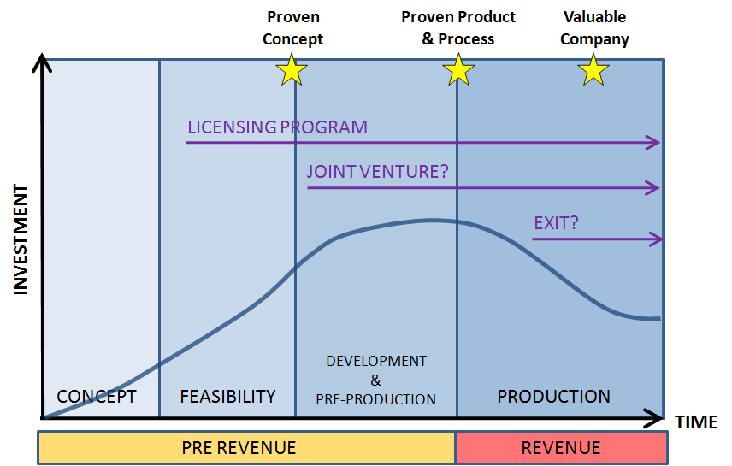
Company Lifecycle

Slide 7
Divergence
1
2
3
Company products & services
Company products & services
Company products & services
Patents
Patents
Patents
Company growth over time
With growth, patents may become less well aligned
License / sell original core patents?
Acquisition to realign with new company focus?

Slide 8
Google: Patent Filing Timeline
Developed data capture and scalability:
Filed patents on their own developments
Google enters a range of new markets including Telecoms and TV:
Patent filing and acquiring
1998
THE FUTURE
Start Up Search Company:
800 Patents
Advertising becomes core – Google achieves massive growth:
IP is aligned
$12.5 billion purchase of Motorola for its 17,000 patents and 7,500 patent applications
ALSO
Buys 1,023 IBM patents to bolster defence of Android

Slide 9
Tools to Help
Patent Landscaping
Innovation Capture
Patent Acquisition
IP Health Checks

Slide 10
Patent Landscaping
Understand the competition
Who are the strong/weak innovators?
Who are the new comers?
Who was there first with the broad/fundamental IP?
Who is partnering with who?
Who are the litigators?
Understand the technology
Get detailed insight into the state of the art
What are the current/past technology focuses?
What will be the features of tomorrow's products?

Slide 11
Patent Landscaping: Case Study
Wave energy technology:
Start Up Company
Patented Technology: Wave Energy generation solution
Find and assess companies: threat/collaborate?
Citation Analysis
Patent keyword searching – relevant terminology
Clustering and categorisation
Assignee searches

Slide 12
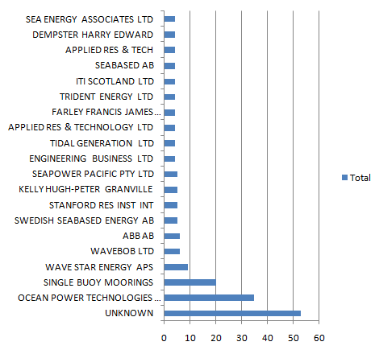
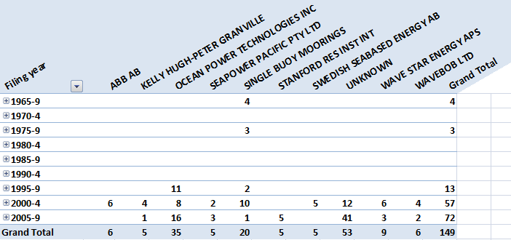
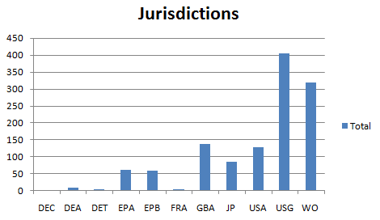
Patent Landscaping: Statistics
Statistical analysis of consolidated searches gives new perspective on target market:
Top patenting companies
Companies without patents
Patent timeline
Top cited patents/companies
New entrants …..

Slide 13
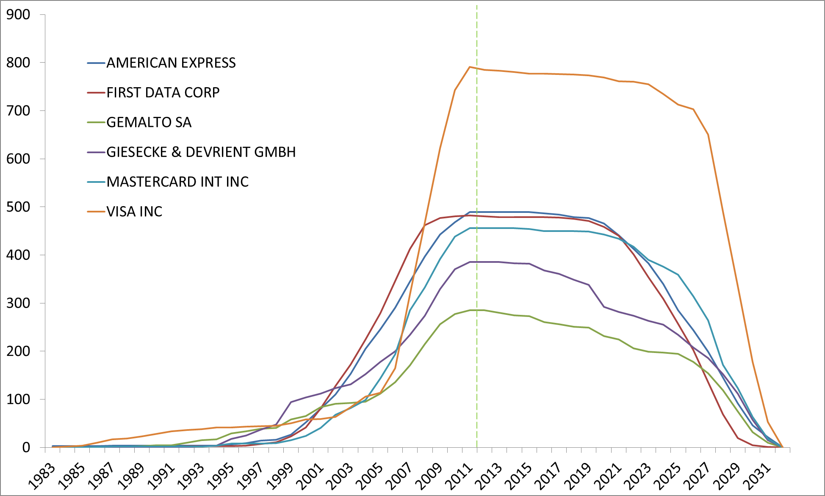
Patent Landscaping: Portfolio Life
Credit Cards

Slide 14
Patent Landscaping: Patent Uptake

Slide 15
Innovation Capture
Best in class internal and partner IP capture and processing
Market driven
Collaboration between engineers and marketing
Filter and focus on strategic direction

Slide 16
Patent Acquisition
Develop techniques to find patents
Filter patents according to criteria
Litigation ready
Support patents
Room for manoeuvre
Probability of purchase
Commercial knowledge
Discreet enquiries

Slide 17
IP Filing versus Acquisition?
 | Organic Filing | Acquisition
Per family Cost (5 countries+) | $100k+ | $50k-$500k Nominal ~$100k
Time to use | Grant takes 4-7 years | Acquisition takes 6-15 months
Certainty of being core | <30% | >75%
Resources | In house R&D with patent attorney support internal or external | External service helps retain distance and avoid price creep
Trends | Time to grant increasing, costs fairly flat | Price rises (100% over last year, starting to settle down now after Nortel / Google frenzy)
Litigation ready | Maybe after many years | Part of the research criteria, but may be expensive

Slide 18
IP Health Checks
Innovation
Do new developments match current business?
Is the business still aligned with early patents?
Revisit the landscape with focus on where actual business is now
Are you still in scope of original patents ?
Are any competitors ?
Do you need to buy ?
Any new threats ?

Slide 19
Where do threats come from ?
Funding and further funding:
Potentially threatening patent disclosed during public funding round
Effort to demonstrate no threat greater than quick/expensive settlement
Public funding raises the cash
All the attack patents appear - ability to pay
Expect a lot of attention from ‘Old Guard’

Slide 20
Patent Litigations: High Tech vs. Bio Tech
Plaintiff vs. Defendant
HIGH TECH |  | BIO TECH
Apple | 6 vs. 117 | Biomet | 2 vs. 8
Google | 8 vs. 52 | GlaxoSmithKline | 21 vs. 6
Microsoft | 13 vs. 152 | Johnson & Johnson | 31 vs. 126
Nokia | 7 vs. 71 | Roche | 37 vs. 19
Samsung | 19 vs. 141 | Smith and Nephew | 14 vs. 18
Sony | 18 vs. 172 | Zimmer | 8 vs. 10

Slide 21
What do VCs ask us to do?
Understand the:
Product or Service
Technology & Market
COMPANY IP PORTFOLIO & STRATEGY
IP OWNERSHIP
IP LANDSCAPE & FREEDOM TO USE
Do they all Stack Up? If we see a strategic weakness, can we see how to fix it?

Slide 22
Summary
What do you have to commercialise?
Innovation Capture
Do you know the risks in commercialising your IP?
Patent Landscape
How might you defend your Market position?
Patent Acquisition
Are you regularly monitoring your IP?
IP Health Checks

Slide 23
Contact
Colin Hunsley, Commercialisation Director
colin_hunsley@clearviewip.com
Tel: 0845 680 1953
www.clearviewip.com

