Slide 1

Intellectual Property at the Higher Education in Republic of Macedonia
Dr. Gligorche VRTANOSKI, Ph.D.
University Professor, WIPO IP Coordinator
Ss. Cyril and Methodius University of Skopje,
Faculty of Mechanical Engineering
Georgia, Tbilisi, April 11 and 12, 2012

Slide 2
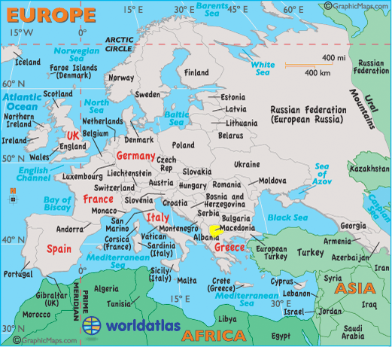
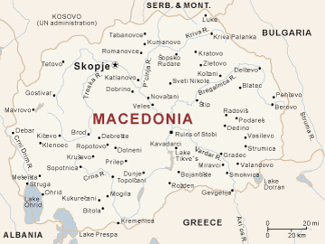
Republic of Macedonia

Slide 3
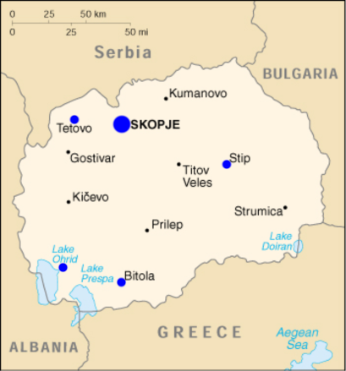
University Cities in Republic of Macedonia

Slide 4
Higher Education in Republic of Macedonia
The bearer of the Higher Education in Republic of Macedonia is Ministry of Education and Science.
    State Governmental Universities = 5
    Private Universities = 14
Academic Ranking of World Universities: Shanghai Ranking
  The ranking of Macedonian Higher Education Institutions (HEIs) was commissioned by Ministry of Education and Science of Republic of Macedonia in February, 2011 and released on February 16, 2012. Nineteen qualified HEIs were included in the ranking. The ranking used 19 indicators of academic performance and competitiveness, covering major mission aspects of HEIs such as teaching, research and social service. It is the first university ranking in Macedonia.

Slide 5
Macedonian HEIs Ranking 2011/12

Slide 6
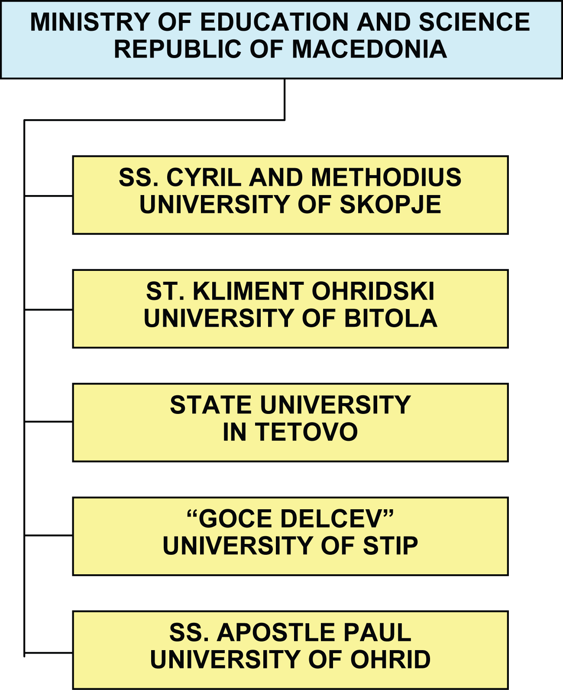

Slide 7
SS. Cyril and Methodius University v.s. Other
The oldest and biggest University in Republic of Macedonia is Ss Cyril and Methodius University of Skopje, where, study around 30000 students. (Integrated University from 2010)
    University Structure, compose of:
      23 Faculties => 9 Faculties from Engineering field, and
      9 Autonomus Public Scientific Institutes.
The second State University is Bitola.
The other State Universities are very new.
Private Universities do not have serious scientific R&D

Slide 8
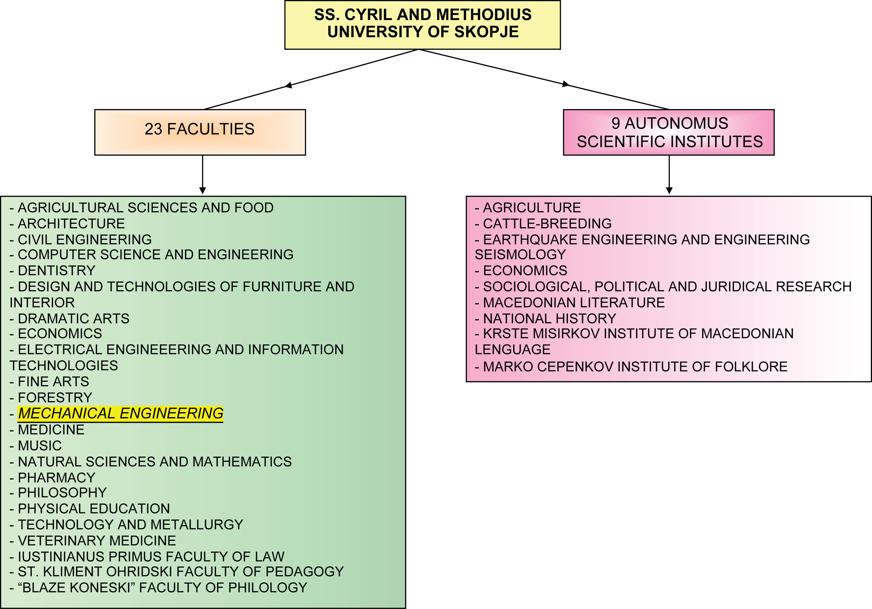

Slide 9
Education at UKIM - University of Skopje
At UKIM - University of Skopje we have established Bologna Process in 2004/05.
Faculty of Mechanical Engineering and Faculty of Low were pioneers in renewed curriculum with ECTS according to Bologna Process. (We are in the second process of renewing of curriculum, wait approval from accreditation board, starting from September 2012)

Slide 10
Education at FME
Faculty of Mechanical Engineering offers different study programs…
  Academic study with 4 years duration
  => 9 bachelor’s degree programs
  Professional study with 3 years duration
  => 5 bachelor’s degree programs

Slide 11
Important of IP
During the preparation of my doctoral dissertation (2000/03) I realized how important is the issue of protection of scientific research.
Result of protection of my scientific research&development work, I am owner of few patents (one of them granted with Golden Medal in Brussels, 2003).
From that experience, develop teaching subject: Management of New Product Development (8 EKTS) offered on three study programs (approx. 90 students):
  Academic study at Industrial Engineering and Management
  Professional studies: Production Informatics and Industrial Design

Slide 12
Creations of the Mind: IP Assets
Students obtain knowledge of the Intellectual Property Rights:
      1. Industrial Property:
        Patents (inventions)
        Utility Models
        Trade Secret
        Trademarks
        Industrial Designs
        Geographic Indications
        New Plant Varieties
      2. Copyright (author rights), related rights.
Students, have doing practical project.

Slide 13
IP Promoting Innovation and Technology Transfer
Many thanks to CARDS project: WIPO University Initiative start 2005, was established office for providing information to the University Researchers in protecting their researches and innovations.
By my experience and as a WIPO University Coordinator I have information that Universities in this region, West Balkan Countries and Turkey still they have not established University IP policy, what is the first important level for serious research and protecting Intellectual Property Rights.

Slide 14
National IP Strategy
Republic of Macedonia has implemented its National IP Strategy, under which diversified and comprehensive policy tools have been adopted to promote innovation and effective utilization of innovative achievements (2010)
Not Sufficient Commercialization and Technology Transfer
Among all utilized patents in Republic of Macedonia, 95% is self-utilized by the right owners, while the ratio of transferred and licensed is only below 5%.
Easier to file, harder to commercialize and transfer

Slide 15
Not Sufficient Interest for R&D Projects
Lack of Support (Government, Ministry University) and incentive
Lack of Strategic Research Planning
Gap between basic research and market needs
Lack of Funds for IP protection
Lack of IP Knowledge
Lack of expertise to Manage TT and Commercialization Process
Lack of Entrepreneurial Skills
Conflict of interest (University vs. Industry)

Slide 16
Major Problems in Technology Transfer
Imbalanced capacities and potentials for innovation
Complexity of technology transfer
No willing to transfer technology
Out of date technologies transferred
Hard to access to information & evaluation of technology
High cost for negotiations, signing and executing contract
IP abuse hindering technology transfer and innovation

Slide 17
Most Important Legal Sources
Industrial Property Law (21/2009 and 24/2011)
Law for Copyrights and Related Rights (15/2010 and 51/2011)
Law for Seed and Planting Material for Agricultural Plants (39/06)
Law for Topography of Integrated Circuits (5/98, 33/2006 and 136/2011)
Customs Law of Measures for the Protection of Intellectual Property Rights (38/2005, 107/2005 and 135/2011)
Obligations Law (18/2001, 4/2002, 5/2003 and 84/2008)
Law on Protection of Competition (145/2010)
Law on State Aid Control (145/2010)
Law against Unfair Competition (80/99)
Law on the Macedonian Academic and Research Network (124/2010, 47/2011)
Law on Scientific activity (46/2008, 103/2008 and 24/2011)

Slide 18
Most Important Legal Sources
Law to Encourage and Facilitate the Technological Development (41/2009)
Law on Technological Industrial Development Zones (14/2007, 103/2008, 130/2008, 139/2009 and 156/2010)
Labour Relations Law – Consolidation (158/2010)
Company Law (28/2004..... 24/2011)
Courts Law
Civil Procedure Law
Enforcement Law
Law on General Administrative Procedure
Law on Administrative Disputes
Law on Providing Claims
Criminal Code
Law on Criminal Procedure

Slide 19
International Resources – Ratified in RM
Convention Establishing the World Intellectual Property Organization;
Agreement on Trade-Related Aspects of Intellectual Property Rights (TRIPS Agreement);
Paris Convention for the Protection of Industrial Property;
Agreement on Cooperation in the Field of Patents;
European Patent Convention;
Treaty Patent;
Agreement of Trademarks Rights;
Madrid Agreement Concerning the International Registration of Trademarks;
Madrid Protocol for International Registration of Trademarks;
Hague Agreement Concerning the International Deposit of Industrial Designs;
Stabilisation and Association Republic of Macedonia and the European Communities and its Member States;

Slide 20
Spin-off Company - CIRKO
CIRKO – CENTER FOR RESEARCH, DEVELOPMENT AND CONTIUNOUS EDUCATION (estab. 2002) (profit-organiz.)
    Created by University;
    Technologies owned by University;
    Financed by University;
    Managed by University staff.
INTERNATIONAL SUPPORTED PROJECTS:
    Technology transfer – GTZ - 9 projects (Germany)
    Center for energy efficiency (Norway)
    Center for mechanical systems – Center for excellence (USAID)
    Johnson Control, Training room (USA)

Slide 21
Focus on Project
Science Projects
    Biomedical Materials, dental implants, medical prosthesis, etc.
    Substitution materials in machines
    Advance materials in military, railway vehicles (wagons, locos)
    Bioengineering and composite materials
Applied projects
    Research of patents in pharmaceuticals, generic drugs
    New products in cosmetics
    Medical haemodialysis solutions
    Organic herbs

Slide 22
Thank you for your attention
**********************************************************************************
Professor Gligorce Vrtanoski, Ph.D.
Head of the Division for Manufacturing Systems and Technologies
Ss. Cyril and Methodius University Skopje
Faculty of Mechanical Engineering
Institute for Production Engineering and Management
Karpos II b.b., or P.O.Box 464
MK-1000 Skopje,
Republic of Macedonia
Tel.: +389 2 3099 259
Fax.: +389 2 3099 298
Mob: +389 70 268 699
E-mail: gliso@mf.edu.mk
***********************************************************************************

