Slide 1


The Gathering of Evidence and Evidentiary Hurdles in the Judicial Process
WIPO seminar for judges and enforcement institutions
Sofia, 22 & 23 November 2012
Marius Schneider
Attorney-at-law
Eeman & Partners
EEMAN & PARTNERS
EEMAN & PARTNERS
EEMAN & PARTNERS
EEMAN & PARTNERS
EEMAN & PARTNERS
EEMAN & PARTNERS

Slide 2
Introduction
Disclosing evidence => an important tool that underpins the system for IP enforcement
Requirement to prove the infringements of IP Rights:
Identify individuals and entities responsible
Support claims
Prove elements of the claim for compensation

Slide 3
Introduction
Legal basis: The European directive (Directive 2004/48/EC) on the Civil Enforcement of Intellectual Property Rights.
New step in the harmonization: provide a high protection of the intellectual property rights
It requires Member State
The ability to apply for provisional measures to preserve evidence
The right to obtain information from the infringers and the third parties
Practice is different in from one Member States to another (ex: the right for information and the internet infringements )

Slide 4
Introduction
The scope is large, it concerns : most IPR’s (Cfr statement of the Commission 2005/295/EC)
The beneficiaries of these provisions are:
(a) the holders of intellectual property rights, in accordance with the provisions of the applicable law;
(b) all other persons authorized to use those rights, in particular licensees, in so far as permitted by and in accordance with the provisions of the applicable law;
(c) intellectual property collective rights-management bodies which are regularly recognised as having a right to represent holders of intellectual property rights, in so far as permitted by and in accordance with the provisions of the applicable law;
(d) professional defense bodies which are regularly recognised as having a right to represent holders of intellectual property rights, in so far as permitted by and in accordance with the provisions of the applicable law.

Slide 5
Production of Evidence
The Article 6 Directive n° 2004/48/EC of 29 April 2004 on the enforcement of intellectual property rights
“1. Member States shall ensure that, on application by a party which has presented reasonably available evidence sufficient to support its claims, and has, in substantiating those claims, specified evidence which lies in the control of the opposing party, the competent judicial authorities may order that such evidence be presented by the opposing party, subject to the protection of confidential information. For the purposes of this paragraph, Member States may provide that a reasonable sample of a substantial number of copies of a work or any other protected object be considered by the competent judicial authorities to constitute reasonable evidence.
2. Under the same conditions, in the case of an infringement committed on a commercial scale Member States shall take such measures as are necessary to enable the competent judicial authorities to order, where appropriate, on application by a party, the communication of banking, financial or commercial documents under the control of the opposing party, subject to the protection of confidential information.”

Slide 6
Production of Evidence
In Practice:
The infringer is often the one who has the relevant evidence. This is often the case with physical products. Consequently the right holder has no more than a few samples of the infringing product => Necessity to check documents and records on the infringers business premises to establish the quantities manufactured (if infringement concerns a large quantity it may be necessary to test a reasonable sample of products)
Necessity to obtain banking, financial and commercial documents. These documents should give as many information as possible on the quantities produced and distributed, the revenues of the infringement. => It gives an overview of the damages which could be claimed.
The ability of the court to grant orders. Penalties for non-compliance to incite the defendants to collaborate

Slide 7
Provisional measures for preserving evidence
Measures for preserving evidence
Detailed description, with or without the taking if samples
  The physical seizure of infringing goods
  The physical seizure of the materials and implements used in the production and/or distribution of these goods and the documents related thereto
  But also…
  Test purchase by a bailiff, control by market inspection authorities...
  Legal basis: Article 7 Directive n° 2004/48/EC of 29 April 2004 on the enforcement of intellectual property rights
EEMAN & PARTNERS
EEMAN & PARTNERS
EEMAN & PARTNERS
EEMAN & PARTNERS
EEMAN & PARTNERS
EEMAN & PARTNERS

Slide 8
Provisional measures for preserving evidence
Why? As documents are really important to establish the evidence, many infringers will be tempt to destruct or delete information => (digital evidence is easy to delete)
According to Article 7 the members States shall:
Provide the ability to apply for prompt and effective provisional measures to preserve relevant evidence which may include:
Description or seizure goods
Materials used in the production and/ or distribution of the good
Related documents
On the basis of the article 50 of TRIPs the article 7 provide that:
“The judicial authorities shall have the authority to adopt provisional measures inaudita altera parte ( ex parte ) where appropriate, in particular where any delay is likely to cause irreparable harm to the right holder, or where there is a demonstrable risk of evidence being destroyed.
Procedural protections for defendants
Also = > Protection of the witness identity

Slide 9
Legal remedies: civil remedies
Against intermediaries:
Right for information: on the origin and distribution networks of the goods to be provided by the infringer and/or other person who:
  was found in possession of the infringing goods on a commercial scale;
  was found to be provided on a commercial scale services used in infringing activities;
Legal basis: Article 8 Directive n° 2004/48/EC of 29 April 2004 on the enforcement of intellectual property rights
EEMAN & PARTNERS
EEMAN & PARTNERS
EEMAN & PARTNERS
EEMAN & PARTNERS
EEMAN & PARTNERS
EEMAN & PARTNERS

Slide 10
Legal remedies: civil remedies
Right for information:
Information on the origin and distribution networks of the goods to be provided by the infringer and/or other person who:
  was found in possession of the infringing goods on a commercial scale;
  was found to be using the infringing services on a commercial scale;
  was found to be provided on a commercial scale services used in infringing activities;
  was indicated by the person involved in the production, manufacture or distribution of the goods or the provision of the services.
  Legal basis: Article 8 Directive n° 2004/48/EC of 29 April 2004 on the enforcement of intellectual property rights
Cases:
Promusicae case fair balance between privacy law and right for information
Bonnier Audio AB case. No EU legislation would govern personal data in cases of violations of intellectual property rights.
EEMAN & PARTNERS
EEMAN & PARTNERS
EEMAN & PARTNERS
EEMAN & PARTNERS
EEMAN & PARTNERS
EEMAN & PARTNERS

Slide 11
Shortcoming in evidence and Right of information
Limitation of disclosure of financial documents to commercial scale documents (in some States => limit of disclose)
Search and seizure orders
Costs sometimes prohibitive
Lack of certainty regarding computer evidence
Right of information – implementation issues
Rights of information restricted by data retention and data protection laws
Sanctions not sufficiently deterrent

Slide 12
Corrective Measures in Civil Proceedings, including the Disposal of Infringing Goods
WIPO seminar for judges and enforcement institutions
Sofia, 22 & 23 November 2012
Marius Schneider
Attorney-at-law
Eeman & Partners
EEMAN & PARTNERS
EEMAN & PARTNERS
EEMAN & PARTNERS
EEMAN & PARTNERS
EEMAN & PARTNERS
EEMAN & PARTNERS

Slide 13
Introduction
  Legal basis : Directive n° 2004/48/EC of 29 April 2004 on the enforcement of intellectual property rights
Purposes of correctives measures:
To correct an infringement
To deter further infringements to occur
Destruction of infringing goods shall therefore be the general principle and there should be very few exceptions to this rule.
EEMAN & PARTNERS
EEMAN & PARTNERS
EEMAN & PARTNERS
EEMAN & PARTNERS
EEMAN & PARTNERS
EEMAN & PARTNERS

Slide 14
Legal remedies
Against economic operators involved in the sale, distribution, import, export ...
Provisional and precautionary measures
Corrective measures
Damages and legal costs
Publication of the judicial decision
EEMAN & PARTNERS
EEMAN & PARTNERS
EEMAN & PARTNERS
EEMAN & PARTNERS
EEMAN & PARTNERS
EEMAN & PARTNERS

Slide 15
Legal remedies: civil remedies
a) Provisional and precautionary measures:
  Interlocutory injunction intended to prevent any imminent infringement of an intellectual property right, or to forbid, on a provisional basis and subject to a recurring penalty payment the continuation of the alleged infringement
  Seizure or delivery up of the goods suspected of infringing an intellectual property right, blocking of the bank accounts and other assets (including the communication of bank, financial or commercial documents, or appropriate access to the relevant information)
  Legal basis: Article 9 Directive n° 2004/48/EC of 29 April 2004 on the enforcement of intellectual property rights
  Cases:
  L’Oréal v. eBay: - obligation to end infringements of identified users
          - obligation to prevent further infringements
  Scarlet v. SABAM & SABAM v. Netlog (filtering system may be possible if it respects (a) freedom of information, (b) freedom to conduct a business, (c) the right to protect users’ personal data.)
EEMAN & PARTNERS
EEMAN & PARTNERS
EEMAN & PARTNERS
EEMAN & PARTNERS
EEMAN & PARTNERS
EEMAN & PARTNERS

Slide 16
Legal remedies: civil remedies
b) Corrective measures
  Recall the infringing goods from the channels of commerce
  Injunction aimed at prohibiting the continuation of the infringement and subject to a recurring penalty payment
Legal basis: Article 10 Directive n° 2004/48/EC of 29 April 2004 on the enforcement of intellectual property rights
EEMAN & PARTNERS
EEMAN & PARTNERS
EEMAN & PARTNERS
EEMAN & PARTNERS
EEMAN & PARTNERS
EEMAN & PARTNERS

Slide 17
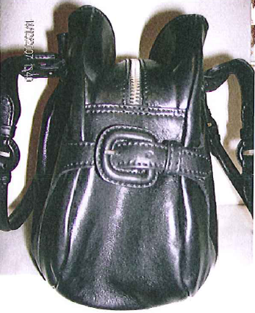
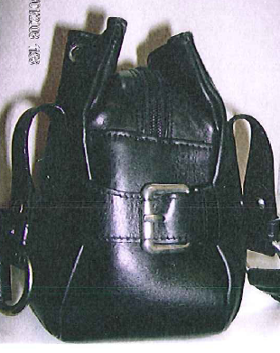
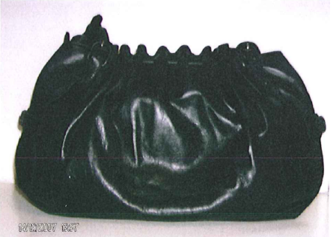
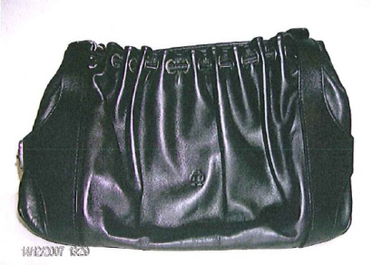
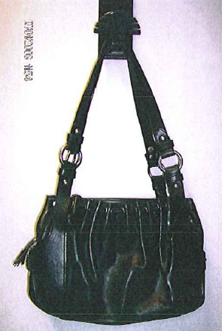
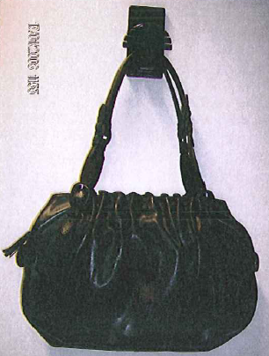

Slide 18
Legal remedies: civil remedies
c) Damages and legal costs (Article 13-14)
Infringer who acted knowingly :
  Pay the right-holder damages appropriate to the actual prejudice.
    Taking into account all appropriate aspects, such as the negative economic consequences, including lost profits, which the injured party has suffered, any unfair profits made by the infringer and, in appropriate cases, elements other than economic factors, such as the moral prejudice caused to the rightholder by the infringement;
    Set the damages as a lump sum on the basis of elements such as at least the amount of Royalties or fees which would have been due if the infringer had requested authorisation to use the intellectual property right in question
Infringer who did not act knowingly:
  recovery of profits or the payment of damages, which may be pre-established
Reasonable and proportionate legal costs and other expenses
EEMAN & PARTNERS
EEMAN & PARTNERS
EEMAN & PARTNERS
EEMAN & PARTNERS
EEMAN & PARTNERS
EEMAN & PARTNERS

Slide 19
Legal remedies: civil remedies
d) Publication of the decision (Article 15):
« La société ZIPPO MANUFACTURING COMPANY, relevant du droit des Etats-Unis d’Amérique et constituée selon les lois de l’Etat de Pennsylvanie, produit et commercialise le briquet « ZIPPO » mondialement connu. Elle est propriétaire des marques tridimensionnelles
pour des « briquets ». Elle est par ailleurs titulaire des droits d’auteur sur la forme du briquet « ZIPPO ». La société de droit belge XXXXX a été reconnue coupable de contrefaçon par un jugement du Tribunal correctionnel de Bruxelles datant du (date du jugement à intervenir) pour avoir porté atteinte à ces marques en important des briquets reproduisant à l’identique cette forme protégée par des droits exclusifs. »
EEMAN & PARTNERS
EEMAN & PARTNERS
EEMAN & PARTNERS
EEMAN & PARTNERS
EEMAN & PARTNERS
EEMAN & PARTNERS

Slide 20
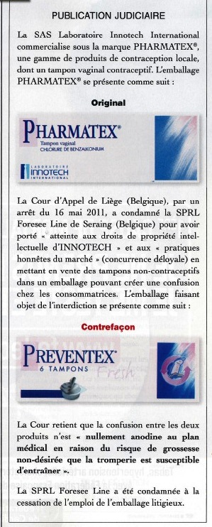

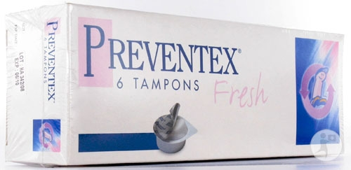

Slide 21
Shortcomings in the Directive’s Corrective Measures
A review of the implementation of the Enforcement Directive with regard to corrective measures is hindered by the lack or at least the scarcity of precedents/relevant court cases.
However it is clear that there are at least a number of problems in this specific field, which may undermine the achievement of the main objective of the Directive of ensuring an equivalent and homogeneous level of protection of IPRs in the Internal market. In particular the following seem to be of special relevance:
Destruction of infringing products is not the general principle in all Member States and secondary use admitted on different and even unclear grounds in the various Member States
Different prerequisites for the issue of the order of definitive removal from the channels of commerce and unclear distinction between recall and definitive removal from the channels of commerce
Costs of storage and destruction born by the IPRs’ holders
Insufficient expertise and consequent uncertainty on the principle of proportionality

Slide 22
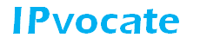

Conclusion
…and Questions ?
Marius Schneider
attorney-at-law
ms@edr.be
Bld de la Cambre, 33 bte 8
1000 Bruxelles
Tel. : +32 2 647 04 14
Fax : +32 2 647 04 13
Mob: +32 476 96 38 73
www.EemanPartners.com
EEMAN & PARTNERS
EEMAN & PARTNERS
EEMAN & PARTNERS
EEMAN & PARTNERS
EEMAN & PARTNERS
EEMAN & PARTNERS

