Slide 1
Border Measures
WIPO seminar for judges and enforcement institutions
Sofia, 22 & 23 November 2012
Marius Schneider Attorney-at-law Eeman & Partners
EEMAN & PARTNERS
EEMAN & PARTNERS
EEMAN & PARTNERS
EEMAN & PARTNERS
EEMAN & PARTNERS
EEMAN & PARTNERS

Slide 2
OUTLINE
Introduction
Subject matter and scope
Customs action
Right to information
Proceedings
Provisions applicable to infringing goods
Penalties
Conclusion
EEMAN & PARTNERS
EEMAN & PARTNERS
EEMAN & PARTNERS
EEMAN & PARTNERS
EEMAN & PARTNERS
EEMAN & PARTNERS

Slide 3
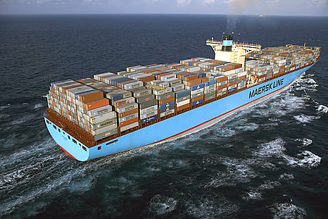

Slide 4
Border measures
Customs authorities can detain goods suspected of infringing an intellectual property right either on their own initiative or at the request of an intellectual property right-holder, in order to allow the right-holder to initiate proceedings aiming to determine whether an intellectual property right has been infringed or to settle the matter under a ‘simplified procedure’. The infringing goods will be destroyed.
Legal basis: Regulation (EC) n° 1383/2003 of 22 July 2003 concerning customs action against good suspected of infringing certain intellectual property rights and the measures to be taken against goods found to have infringed such rights
See also:
‘Implementing’ Commission Regulations
National measures ‘implementing’ the Regulation
Manual for right-holders – New trend and red alert forms
EEMAN & PARTNERS
EEMAN & PARTNERS
EEMAN & PARTNERS
EEMAN & PARTNERS
EEMAN & PARTNERS
EEMAN & PARTNERS

Slide 5
Border measures
Subject matter and scope
Customs situations in which the authorities may intervene:
release for free circulation, export, re-export, free zone or free warehouse
problem with suspensive procedures (eg external transit or customs warehousing cf. CJEU joined cases C-446/09 (Philips) and C-495/09 (Nokia) // see also C-405/03 Class International and C-281/05 Montex)
not internal transit (cf. CJEU case C-23/99 Commission v. France)
Intellectual Property Rights concerned:
“counterfeited goods”: certain trade mark infringements
“pirated goods”: certain copyright and design infringements
goods infringing other intellectual property rights: patent, SPC, plant variety right, GI
Exceptions:
Parallel imported goods and other infringements of a licence
Non-commercial items contained in travellers personal baggage

Slide 6
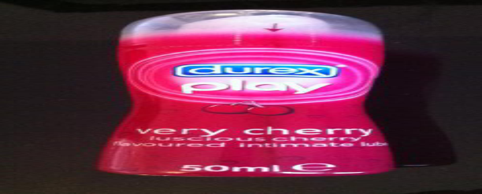
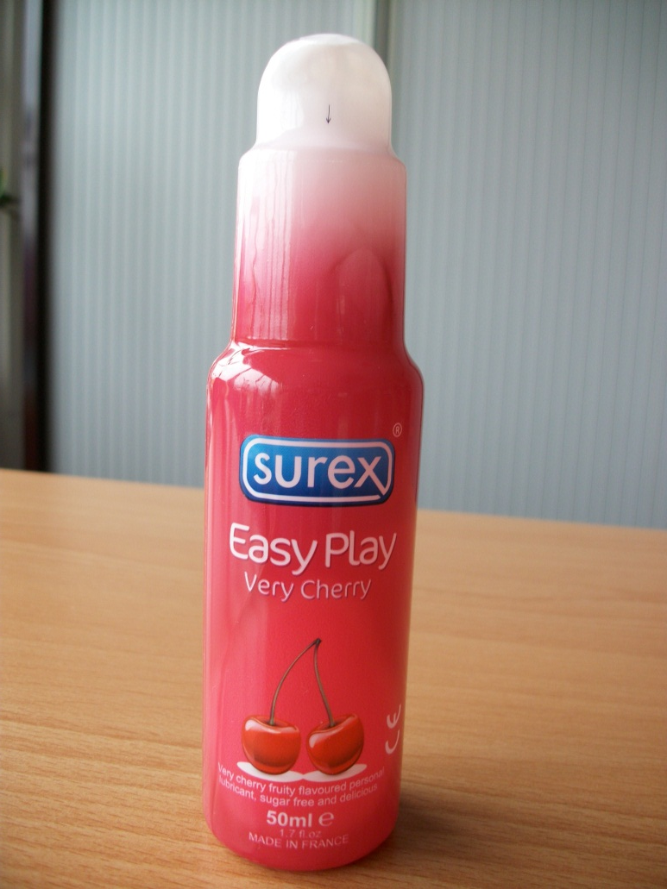

Slide 7
Border measures
The lodging and processing of applications for customs action
One customs department per Member State competent to receive and grant applications for action (list available in the « Implementing » Regulation and on the website of DG Taxud)
Form:
National application for customs action v. Community application for customs action
Mandatory information (description of the goods, type or pattern of fraud, name and address of administrative and technical contact person, declaration accepting liability, proof of IP right) v. additional information (the more the better cf. manual)
Decision within 30 working days: once accepted the information is spread out to all customs departments
Validity: one year, renewable
EEMAN & PARTNERS
EEMAN & PARTNERS
EEMAN & PARTNERS
EEMAN & PARTNERS
EEMAN & PARTNERS
EEMAN & PARTNERS

Slide 8
Border measures
Preventive application for action v. ex officio measures
Ex officio procedure: | Normal procedure:
In the absence of an application for action customs has sufficient ground of suspecting that goods infringe certain intellectual property rights; They suspend the release and allow the right-holder 3 working days to file an application for action: then normal procedure | Suspension of release of 10 working days (can be extended once) to allow the right-holder to initiate proceedings to determine whether an intellectual property right has been infringed or to settle the matter under the simplified procedure
EEMAN & PARTNERS
EEMAN & PARTNERS
EEMAN & PARTNERS
EEMAN & PARTNERS
EEMAN & PARTNERS
EEMAN & PARTNERS

Slide 9
Border measures
Right to information
Ex officio procedure: | Normal procedure:
Actual or supposed number of items and their nature | Actual or estimated quantities and nature of the goods: without being bound to notify the authority who has to take a substantive decision. In accordance with provisions on the protection of personal date, commercial and industrial secrecy and administrative confidentiality : name and address of the consignee, consignor, declarant or holder of the goods and the origin and provenance: in view of establishing whether an intellectual property right has been infringed Inspection of the goods, taking of samples, sending of digital pictures cf. CJEU cases C-408/01 Adidas
EEMAN & PARTNERS
EEMAN & PARTNERS
EEMAN & PARTNERS
EEMAN & PARTNERS
EEMAN & PARTNERS
EEMAN & PARTNERS

Slide 10
Border measures
Proceedings to determine whether an intellectual property right has been infringed v. simplified procedure
Proceedings:
proceedings on the merits
conservatory measures
interim measures (inter partes or ex partes)
criminal proceedings (criminal complaint ?)
applying the law of the Member State where the goods are placed in a customs situation
Simplified procedure
Destruction without the need to initiate proceedings, provided the parties (right-holder and declarant, holder, owner) agree within a certain term on the destruction and the destruction is carried out under the responsibility and at the expense of the right-holder
Implied consent
Settlement agreements
CJEU case C-93/08 Schenker
EEMAN & PARTNERS
EEMAN & PARTNERS
EEMAN & PARTNERS
EEMAN & PARTNERS
EEMAN & PARTNERS
EEMAN & PARTNERS

Slide 11
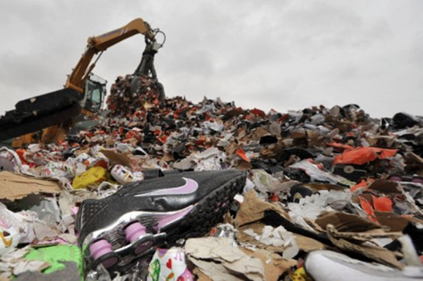
Border measures
Provisions applicable to goods found to infringe an intellectual property right
Destruction and effectively depriving the infringers of the goods (save in exceptional cases simply removing the trade marks is not sufficient)
EEMAN & PARTNERS
EEMAN & PARTNERS
EEMAN & PARTNERS
EEMAN & PARTNERS
EEMAN & PARTNERS
EEMAN & PARTNERS

Slide 12
Border measures
Penalties
Civil and criminal penalties (cf. CJEU case C-60/2002 Rolex)
Liability of customs authorities and right-holders
EEMAN & PARTNERS
EEMAN & PARTNERS
EEMAN & PARTNERS
EEMAN & PARTNERS
EEMAN & PARTNERS
EEMAN & PARTNERS

Slide 13
Border measures
also see : www.BorderMeasures.com
=> The Border Measures Regulation is under review !
http://ec.europa.eu/taxation_customs/resources/documents/customs/customs_controls/counterfeit_piracy/legislation/com285_en.pdf
EEMAN & PARTNERS
EEMAN & PARTNERS
EEMAN & PARTNERS
EEMAN & PARTNERS
EEMAN & PARTNERS
EEMAN & PARTNERS

Slide 14
Conclusion
…and Questions ?
Marius Schneider
attorney-at-law ms@edr.be
Bld de la Cambre, 33 bte 8
1000 Bruxelles Tel. : +32 2 647 04 14 Fax : +32 2 647 04 13
Mob: +32 476 96 38 73
www.EemanPartners.com
EEMAN & PARTNERS
EEMAN & PARTNERS
EEMAN & PARTNERS
EEMAN & PARTNERS
EEMAN & PARTNERS
EEMAN & PARTNERS

