Slide 1
WIPO-UKRAINE SUMMER SCHOOL ON INTELLECTUAL PROPERTY: JULY 2011
International and Regional Patent Systems

Slide 2
Outline
Reasons for international and regional patent systems
Examples of international and regional systems
The Patent Cooperation Treaty
The Eurasian Patent Organisation
The European Patent Organisation
European Community
African Regional Systems
The Future

Slide 3
Reasons for international and regional patent systems
Political
  Equal treatment
  Closer cooperation
Economic
  Lower costs
    For countries
    For applicants
Administrative
  Reduces backlogs
  Simplifies procedures

Slide 4
Examples of international and regional patent systems
The Patent Cooperation Treaty
The Eurasian Patent Organisation
The European Patent Organisation
European Community Developments
African Regional Systems
  African Regional Intellectual Property Organisation
  Organisation Africaine de la Propriete Intellectuelle

Slide 5
The Patent Cooperation Treaty; members - 1
Albania, Algeria, Angola, Antigua and Barbuda, Armenia, Australia, Austria, Azerbaijan
Bahrain, Barbados, Belarus, Belgium, Belize, Benin, Bosnia and Herzegovina , Botswana, Brazil, Bulgaria, Burkina Faso
Cameroon, Canada, Central African Republic, Chad, Chile, China, Colombia, Comoros, Congo, Costa Rica, Côte d'Ivoire, Croatia, Cuba, Cyprus, Czech Republic,
Democratic People's Republic of Korea, Denmark, Dominica, Dominican Republic
Ecuador, Egypt, El Salvador, Equatorial Guinea, Estonia

Slide 6
The Patent Cooperation Treaty; members - 2
Finland, France,
Gambia, Georgia, Germany, Ghana, Greece, Grenada, Guatemala, Guinea, Guinea-Bissau,
Honduras, Hungary
Iceland, India, Indonesia, Ireland, Israel, Italy
Japan
Kazakhstan, Kenya, Kyrgyzstan
Lao People’s Democratic Republic, Latvia, Lesotho, Liberia, Libyan Arab Jamahiriya, Liechtenstein, Lithuania, Luxembourg

Slide 7
The Patent Cooperation Treaty; members - 3
Madagascar, Malawi, Malaysia, Mali, Malta, Mauritania, Mexico, Monaco, Mongolia, Montenegro, Morocco, Mozambique
Namibia, Netherlands, New Zealand, Nicaragua, Niger, Nigeria, Norway
Oman
Papua New Guinea, Peru, Philippines, Poland, Portugal
Qatar
Republic of Korea, Republic of Moldova, Romania, Russian Federation, Rwanda

Slide 8
The Patent Cooperation Treaty; members - 4
Saint Kitts and Nevis Saint Lucia, Saint Vincent and the Grenadines, Sao Tome and Principe, Senegal, Serbia, Seychelles, Sierra Leone, Singapore, Slovakia, Slovenia, South Africa, Spain, Sri Lanka, Sudan, Swaziland, Sweden, Switzerland, Syrian Arab Republic
Tajikistan, Thailand, The former Yugoslav Republic of Macedonia, Togo, Trinidad and Tobago, Tunisia, Turkey, Turkmenistan
Uganda, Ukraine, United Arab Emirates, United Kingdom, United Republic of Tanzania, United States of America, Uzbekistan1
Viet Nam
Zambia, Zimbabwe

Slide 9
The Patent Cooperation Treaty; an outline
1144 Member States
International Phase
  International search
  International Publication
  International Preliminary Examination
National Phase
  Examination
  No examination
  Granted Patents

Slide 10
The Patent Cooperation Treaty; International Search and Preliminary Examination Authorities
Australia, Austria, Brazil, Canada, China, Egypt, Finland, India, Israel, Japan, the Republic of Korea, the Russian Federation, Spain, Sweden, the United States of America, the European Patent Office, and the Nordic Patent Institute.

Slide 11
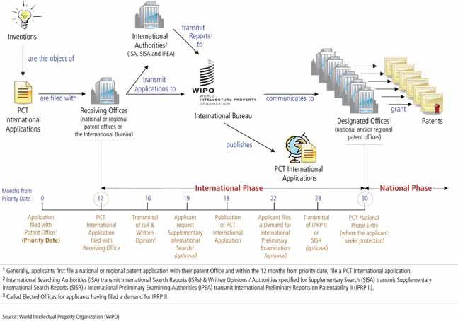
The Patent Cooperation Treaty – How it works

Slide 12
The Eurasian Patent Organisation; members
Kyrgyz Republic
Republic of Armenia
Republic of Azerbaijan
Republic of Belarus
Republic of Kazakhstan
Republic of Moldova
Republic of Tajikistan
Russian Federation
Turkmenistan

Slide 13
Eurasian Patent Organisation; how it works
Structure
  Administrative Council
  Eurasian Patent Office
Filing of Single application with Eurasian Patent Office
Initial search by Eurasian Patent Office
Substantive examination – requested 6 months after publication of search report
Grant
Designation of states in which patent is to be effective
Maintenance in members states individually

Slide 14
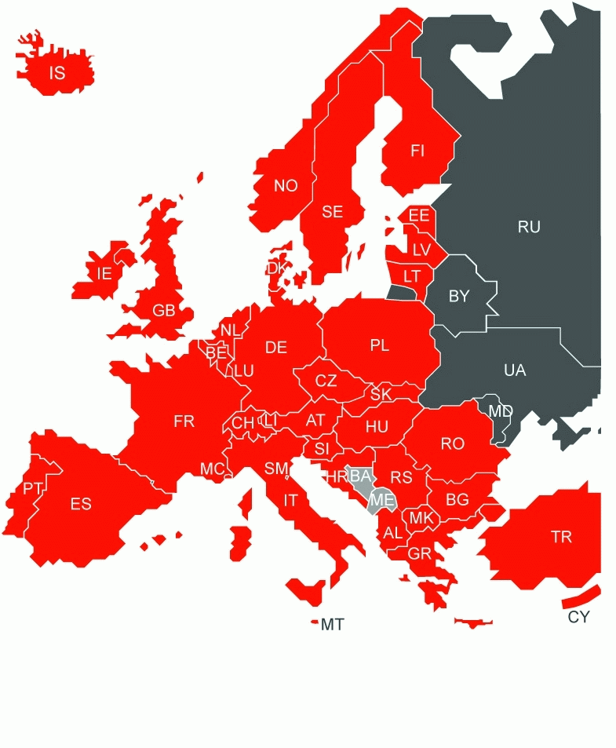
The European Patent Organisation; Member States

Slide 15
The European Patent Organisation; how it works
Structure
  Administrative Council
    Budget and Finance Committee
    Patent Law Committee
    Technical and operational support committee
  The European Patent Office
    Hague
    Berlin
    Vienna
    Munich

Slide 16
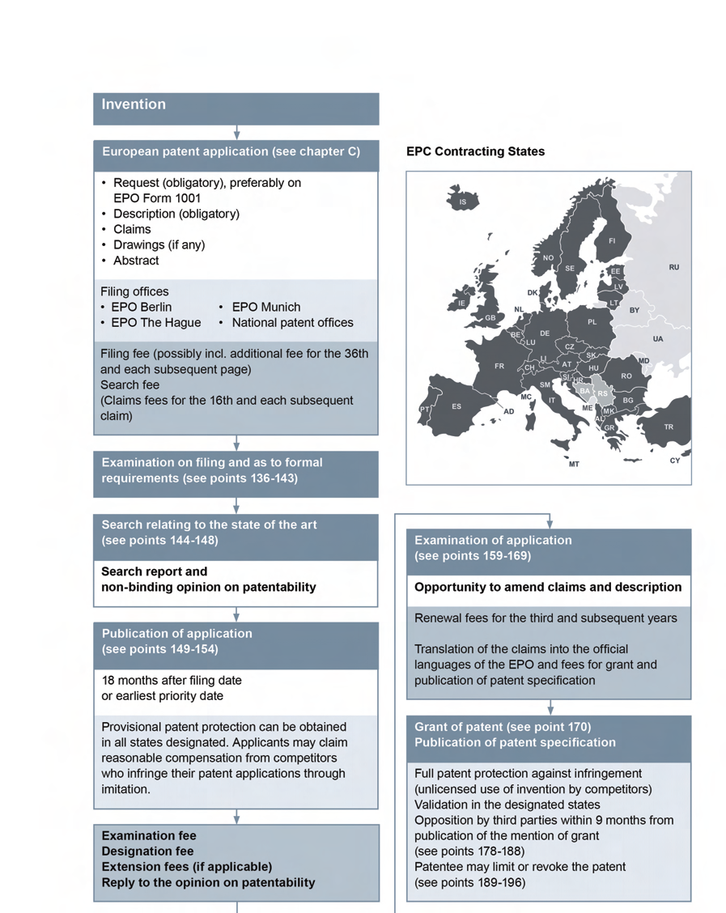
The European Patent Organisation; procedures

Slide 17
The European Community; member states

Slide 18
The European Union; regional IP systems
Office for the Harmonisation of the Internal Market
  Single European trade mark
  Single European design
Community patent
  Enhanced cooperation – not Italy and Spain
  Optional – national and European patents continue
  Single application made at EPO
    Examined under European patent Convention
    Made unitary patent at request of applicants
    EPO collects renewal fees and conducts other maintenance functions

Slide 19
European Community Patent; some issues
Translations
  Proceedings in EPO languages (English, French, German)
  No further translation at grant machine translation when needed
  Transitional period
    Translation into English or language of member state filed by applicant but reimbursed
Litigation
  European and EU Patents Court
  First Instance regional and central

Slide 20
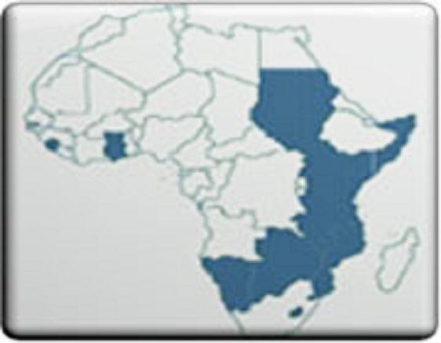
African Regional Intellectual Property Organisation

Slide 21
African Regional Intellectual Property Organisation; member states
    Botswana
    Gambia
    Ghana
    Kenya
    Lesotho
    Liberia
    Malawi
    Mozambique
Namibia
Sierra Leone
Somalia
Sudan (changes)
Swaziland
Tanzania
Uganda
Zambia
Zimbabwe

Slide 22
African Regional Intellectual Property Organisation; how it works
Structure
  Administrative Council
  ARIPO Office
  Training Centre
Process
  Trade marks, patents and designs
  Single application
  Search and substantive examination
  Grant
    National acceptance

Slide 23
Organisation Africaine de la Propriete Intellectuelle; member states
Benin
Burkino Faso
Cameroun
Centrafique
Congo
Cote d’Ivoire
Gabon
Guinee
Guinee Bissau
Mali
Mauritanie
Niger
Senegal
Tchad
Togo

Slide 24
Organisation Africaine de la Propriete Intellectuelle; how it works
Structure
  Administrative council
  Director general
  Board of appeals
Deals with all IP rights
Effective in all states
Decisions by court in one state apply to all

Slide 25
The Future
Strengthening of existing systems
Patent Prosecution Highway
  Work done once is used again
Mutual Recognition
  Grant by one leads to grant by others
The big 5
  State Intellectual Property Office (China), EPO, Korean Intellectual Property Office, Japan Patent Office, United States Patent and Trade Mark Office
An alternative to the PCT?

