Slide 1
The Past, Present and Future of Traditional Knowledge
Shubha Ghosh
Vilas Research Fellow & Professor of Law
University of Wisconsin Law School

Slide 2
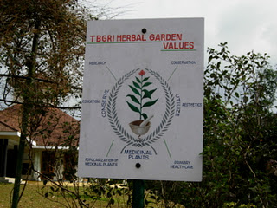
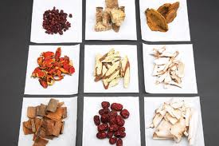
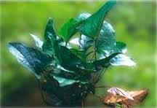
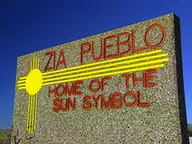
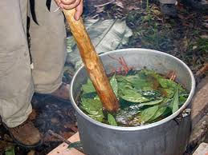
Varieties of TK

Slide 3
Issues
Commons
Distributive and Intergenerational Justice
Legal meets the Social

Slide 4
Commons
Economic
Political
Limited common property (LCP)

Slide 5
The devilish details
Representation
Governance
Commodification

Slide 6
After the commons
Commons of liberty
Commons of equality
Commons of justice

Slide 7
Justice informs the commons
Expertise
Civic Participation
Market Failure
Management

Slide 8
Distributive Justice
Dividing the spoils?
Benefit sharing
Social investment

Slide 9
Intergenerational Justice
Overlap with intellectual property
Multiple public domains
Institutions for preserving and transmitting knowledge
Tacit and codified knowledge
Bridging past, present, and future
Identifying constituencies

Slide 10
Constituencies
Beyond authors and inventors
Users
Preservers

Slide 11
Models
Cottier and traditional IP rights
Reichman and compensatory licensing regime
Unfair competition
NGO
National Botanical Research Institute
Society for Research and Initiatives for Sustainable Technologies and Institutions
Grassroots Innovation Augmentation Network
Honeybee Network

Slide 12
Implementation
No one sui generis regime
Medicine, folklore, performance
Formal or informal enforcement?
Governance and rule making?

Slide 13
Challenges
Legal meets the social
Modes of knowledge formation (Haverkort & Reijntjes)
Clash
Underground
Parallel
Selective inclusion
Paternalism
Romanticism
Co-evolution

Slide 14
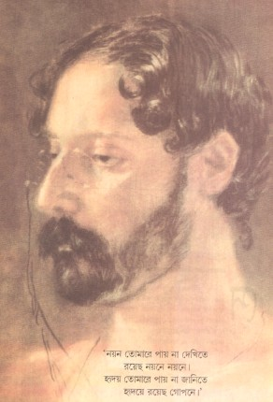
Where the mind is without fear and the head is held high Where knowledge is free Where the world has not been broken up into fragments By narrow domestic walls Where words come out from the depth of truth Where tireless striving stretches its arms towards perfection Where the clear stream of reason has not lost its way Into the dreary desert sand of dead habit Where the mind is led forward by thee Into ever-widening thought and action Into that heaven of freedom, my Father, let my country awake --Rabindranath Tagore

