Slide 1
TK and the Access to Knowledge Movement
nicholas.bramble@yale.edu
Information Society Project at Yale Law School

Slide 2
Justice Hugo Black, Associated Press v. United States, 326 U.S. 1 (1945)
The First Amendment “rests on the assumption that the widest possible dissemination of information from diverse and antagonistic sources is essential to the welfare of the public.”
Notes:
common understanding of a2k movement in 1st Am

Slide 3
Justice Hugo Black, Associated Press v. United States, 326 U.S. 1 (1945)
The First Amendment “rests on the assumption that the widest possible dissemination of information from diverse and antagonistic sources is essential to the welfare of the public.”
Notes:
but I want to draw out point that a2k’s focus on free flows of information (in other words, don’t focus on the substance of the info or its speakers/listeners, just focus on building efficient pipes through which it can travel) can distract from the question of the sources of information.

Slide 4
Problems of Access to Knowledge as applied to TK
History: indigenous people lost control over:
what kinds of knowledge were to be circulated
how third parties could make use of this information
Loss over knowledge management led to economic exploitation
e.g., Madagascar: rosy periwinkle and Eli Lilly
Notes:
facebook analogy

Slide 5
Problems of Access to Knowledge as applied to TK
The idea of the public domain – which is often held out as a necessary repository of cultural & scientific building blocks – was seen to feed into this kind of undervaluation.
Open access public domain composed of traditional knowledge serves as building blocks for expressions and inventions of western companies, which then control access to that knowledge.
Metaphors such as cultural environmentalism portray indigenous knowledge as part of nature – the raw materials from which others build inventions.
Separately, if A2K is framed as a blanket opposition to local control over knowledge production/management, then it may also sometimes be used to justify strong access claims made by intermediaries – in the context of privacy and Terms of Service agreements – that similarly inhibit the ability of users to govern and manage their identities.

Slide 6
Amy Kapczysnki
“The muted (or repressed) debate within the A2K movement over the proper status of traditional knowledge (is it rightfully the property of local communities, or part of the public domain open to all?), evinces the strains of this tension.”

Slide 7
Goals of Traditional Knowledge
Responsibility / custodianship over knowledge
Security / peace of mind re possible misuse of resources
Privacy / intimacy / solitude
Autonomy / freedom from dependence on others
Realization of community / project will into world through management of resources
Duty / take care of resources and deploy them carefully
Identity / stable and reliable relationships with particular objects and traditions over time

Slide 8
Goals of Traditional Knowledge
Responsibility
Security
Privacy
Autonomy
Realization of community
Duty
Identity
moral rights

Slide 9
Goals of Traditional Knowledge
Responsibility
Security
Privacy
Autonomy
Realization of community
Duty
Identity
How do the goals of TK differ from the goals of moral rights?
What sorts of remedies are appropriate to achieving these goals? Injunctive?
How do these goals fit with existing exceptions and limitations to rights, such as fair use? Parody, criticism, etc worse than mere unlicensed use? How to measure “effect on market”?

Slide 10
(Additional) Goals of TK
Recognition/apology for wrongful expropriation of knowledge in past
Equitable sharing of benefits of knowledge/innovation/practices, going forward – CBD 8(j)
Implementation of ethical standards for research
e.g., sharing of research derived from community’s knowledge
Respect for communities as sources of scientific and cultural expertise and innovation
Interest in not trivializing a community or its contributions
e.g., Lego & Maori names
Ensuring symbols, artifacts, designs not taken out of context
Notes:
to figure out how best to achieve these goals, it’s worth examining tensions w/i a2k movement

Slide 11
Tensions Within the A2K Movement
Distinction between:
interest in removing constraints on downstream uses of information
public domain
interest in placing affirmative obligations on downstream users to abide by terms set by local rightsholder
creative commons licenses
General Public License
Notes:
a productive tension?

Slide 12
Tensions Within the A2K Movement
TK problems w/ public domain
A2K problems w/ public domain
putting seeds into the public domain allows external actors to modify those seeds with genes that render them less useful to local farmers.
putting software code into the public domain allows external actors to implement that code in software and hardware that is no longer accessible to those who wrote the code.
Notes:
a productive tension?

Slide 13
Principles of Access to Knowledge that might be worth preserving
Whole > sum of parts.
Need to be attentive to dynamic routes by which creations evolve.
Difficult to isolate, catalogue, and quantify individual contributions to a larger creative endeavor.
Action spins out of interpersonal & intercommunity interactions.
Knowledge doesn’t arise out of thin air from single authors. People borrow from other sources and inspirations.
Knowledge isn’t always a discrete good.
Knowledge often only gains value insofar as it can be combined with other knowledge and other conceptual frameworks (one reason to emphasize “A” in A2K, not “K”).

Slide 14
Principles of Access to Knowledge that might be worth preserving
Skepticism re exclusive rights as the sole means of promoting innovation and scientific/cultural progress.
government funding of public goods / cross-licensing pools
incentives not always financial in nature – need to account for multiplicity of motivations
Methods for implementing local control can sometimes emerge from private ordering.
creative commons licenses, GPL
Difficult to set global rules as to different local needs.

Slide 15
Principles of Access to Knowledge that might be worth preserving
Important to distinguish rivalrous character of material goods from nonrivalrous character of information.
Networked information society can lower costs of production & distribution.
Innovation and expression that builds upon existing works cannot always be predicted by the owner of those existing works.
Design for innovation = design for unforeseen use.
Hierarchical management often not suited for cultivating challenging, unforeseen uses.
Process of allocating rights in a given expression/invention tends to provoke conflict.
Who got there first? Who contributed the most? Is locus of protection the individual, community, or nation?
International forums sometimes merely enhance trade imbalances.
Notes:
but most important…

Slide 16
Principles of Access to Knowledge that might be worth preserving
Important to pay attention not just to users but also to the intermediaries that build out access infrastructures.
(1) What sorts of intermediaries do different proposed forms of TK rights imply?

Slide 17
Principles of Access to Knowledge that might be worth preserving
Important to pay attention not just to users but also to the intermediaries that build out access infrastructures.
(1) What sorts of intermediaries do different proposed forms of TK rights imply?
collective licensing organizations similar to music copyright in US?
scanning organizations similar to search companies?
social organizations similar to social networks?
content management systems?

Slide 18
Principles of Access to Knowledge that might be worth preserving
E.g., Light Years IP:
“We assist producers, exporters, and governments in the developing world to analyse their export potential with respect to identifying the value of intangibles and then using IP tools, such as patents, trademarks and licenses, to secure more sustained and higher export income. The ownership of IP is secured in market countries through the existing legal frameworks of the developed world.”

Slide 19
Principles of Access to Knowledge that might be worth preserving
Important to pay attention not just to users but also to the intermediaries that build out access infrastructures.
(1) What sorts of intermediaries do different proposed forms of TK rights imply?
collective licensing organizations similar to music copyright in US?
scanning organizations similar to search companies?
social organizations similar to social networks?
content management systems?

Slide 20
Principles of Access to Knowledge that might be worth preserving
Important to pay attention not just to users but also to the intermediaries that build out access infrastructures.
(1) What sorts of intermediaries do different proposed forms of TK rights imply?
collective licensing organizations similar to music copyright in US?
scanning organizations similar to search companies?
social organizations similar to social networks?
content management systems?
(2) . . . or are TK rights more fractured/distributed/contextual and not liable to use by universalizing intermediaries?

Slide 21
Principles of Access to Knowledge that might be worth preserving
Important to pay attention not just to knowledge but also to the connective tissue and speech/network infrastructure that makes knowledge useful, generative, and comprehensible.
Often, that means turning to communications policy as much as intellectual property policy.
universal service
telecom regulation
interconnection
And as this infrastructure is built out, under-enforcement of laws regulating creative production and integrity of identity is sometimes necessary to promote greater user participation.

Slide 22
Principles of Access to Knowledge that might be worth preserving
copyrights and patents, at least in the US, are premised on a utilitarian bargain/exchange:
“securing for limited times” a monopolistic or exclusive right over an expression or invention
in exchange for the creation & publicization of that expression/invention (e.g., written description)
and eventual release into the public domain
. . . in order “to promote the progress of science and useful arts”
but the reasons for implementing this utilitarian bargain through the allocation of exclusive rights may not make sense in all contexts of knowledge production….

Slide 23
How to Square The Goals of TK with the Principles of A2K?
On one hand, we need to develop a better definition of A2K:
Recognize that the process of granting “access” is often accompanied by standardization and imposition of alien criteria.
“Knowledge” is about more than discrete individual goods – can also refer to practices and traditions to which large number of people have contributed.
When we talk about access to knowledge, important to talk about infrastructure-based barriers, and tie cultivation of knowledge to eroding of connectivity and access barriers.
On the other hand, these same critiques can be applied to some of the stronger suggested frameworks for TK protections.
Regulating the development of local knowledge through global norms and rights-based protection can impose unwelcome assumptions on how knowledge should be developed, constituted, and recorded.
As with A2K, important to recognize the inventive and dynamic character of knowledge rather than conserving access to a static good.

Slide 24
How to Square The Goals of TK with the Principles of A2K?
Develop better understanding of the way that universalized top-down protections might fail to represent the interests of indigenous communities, whether those protections come in the form of archives or of new universal rights.
Look beyond “knowledge” itself to the ways in which the legal system might better foster innovation and connectivity.

Slide 25
Sources of Traditional Knowledge
knowledge created or preserved in traditional context
knowledge recognized as belonging to a traditional group
knowledge integral to the cultural identity of a traditional group

Slide 26
Sources of Traditional Knowledge
knowledge created or preserved in traditional context
invented?
discovered?
naturally occurring?

Slide 27
Sources of Traditional Knowledge
knowledge recognized as belonging to a traditional group
algorithms for land management? e.g., Kayapo classifications of ecological zones in Amazon.

Slide 28
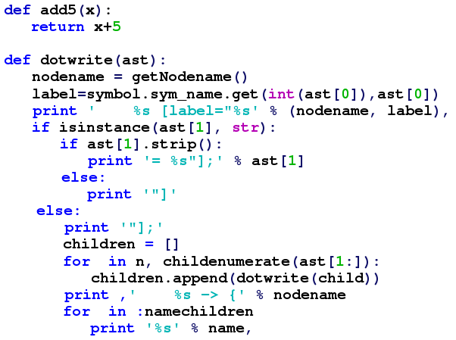
Sources of Traditional Knowledge
code?

Slide 29
Sources of Traditional Knowledge
code?
algorithms

Slide 30
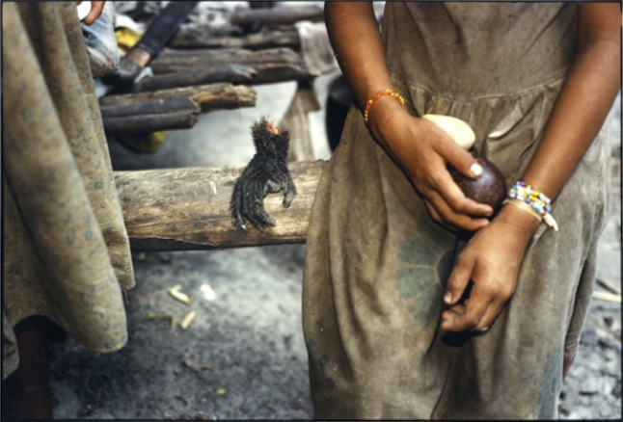
Sources of Traditional Knowledge
code?
algorithms
language
e.g., Pirahã in Brazil

Slide 31
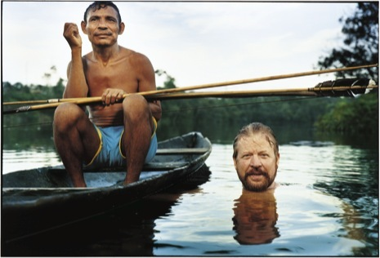
Sources of Traditional Knowledge
Pirahã language research
no numbers, quantifiers, conjunctions, dedicated color terms
no relative/subordinate clauses or other recursive constructions
challenge to Chomskyian theories of universal grammar
but research described as “having made the Pirahã sound like the mindless bearers of an almost subhumanly simple culture”

Slide 32
Sources of Traditional Knowledge
code?
algorithms
language
e.g., Pirahã in Brazil
software

Slide 33
Sources of Traditional Knowledge
once we understand TK as code, can think of its value deriving not from its essence (one component within a 30k-component system, one line within 300M lines of Linux), but from its combination with other components and its implementation in other systems.
but if we understand TK as code, how to isolate any individual contribution to that code within the bounds of a property right?
this framing leads us to shift focus away from preservation and towards downstream access & freedom.
code?
algorithms
language
e.g., Pirahã in Brazil
software

Slide 34
Different approaches to traditional knowledge
Defensive TK
Offensive TK
build registry of existing TK.
but how to set global parameters & archive standards?
before any “new” invention or expression is granted IP protection, must determine whether overlap (novelty/originality) with items in TK database.
-> simpler to determine prior art, who owns what, & what kind of licensing arrangements may be entered into.
grant exclusive right to TK.
allow owner of exclusive right to exercise IP-style control over uses of TK
right to exclude
right to license copies
right to license performances
right to manage creation of derivative works

Slide 35
Different approaches to traditional knowledge
Defensive TK
Offensive TK
see Brazil example:
Patent applicant must request info re origins of any TK associated with the invention.
Patent office then provides information on Internet regarding patent request and allows people to file objections based on existence of TK.

Slide 36
Different approaches to traditional knowledge
Defensive TK
Offensive TK
recognize
preserve
protect
promote
locate owners (cf. orphan works)
privilege local generics
incentivize
preserve

Slide 37
Some Concerns
Barriers to research
research exemption?
Upstream control: interference with innovation through overly rigid protectionism
Activities previously legal now deemed illegal
Golan v. Holder (US © law pegged to “traditional contours”)
Independent invention/discovery
Defining scope of ownership
Roadblock to publication and commercialization functions of IP

Slide 38
Some (Additional) Concerns
Construction of artificial exclusivity implies certain types of motivations and exploitation
recognition
appreciation
financial returns and monetary incentives
right to exclude
How to account for wide range of exceptions, limitations, loopholes? current length of US copyright statutes = 205 pages (100 pgs added in 1990s to close loopholes: DMCA, AHRA, etc)
could there be a DMCA for TK?
or can these issues be decided on a case-by-case basis, on a reasonableness standard?
Once you open door to increased extraction of commercial value, how do you close that door?
What happens to intermediaries? Secondary liab for archiving/displaying/linking TK’d works?
How to ensure free labor contract and unrestrained physical movement?

Slide 39
Some (Additional) Concerns
roadblock to publication and commercialization functions of IP
construction of artificial exclusivity implies certain types of motivations and exploitation
recognition
appreciation
financial returns and monetary incentives
right to exclude
perpetuates notion of “knowledge” as a discrete good arising from single authors
but knowledge often only gains value insofar as it can be combined with other knowledge and other conceptual frameworks (one reason to emphasize “A” in A2K, not “K”).
and knowledge doesn’t arise out of thin air; people borrow from other sources and inspirations.
once you open door to increased extraction of commercial value, how do you close that door?
how to account for wide range of exceptions, limitations, loopholes? current length of US copyright statutes = 205 pages (100 pgs added in 1990s to close loopholes: DMCA, AHRA, etc)
could there be a DMCA for TK?
or can these issues be decided on a case-by-case basis, on a reasonableness standard?
what happens to intermediaries? secondary liab for archiving/displaying/linking TK’d works?

Slide 40
Some (Additional) Concerns
roadblock to publication and commercialization functions of IP
construction of artificial exclusivity implies certain types of motivations and exploitation
recognition
appreciation
financial returns and monetary incentives
right to exclude
perpetuates notion of “knowledge” as a discrete good arising from single authors
but knowledge often only gains value insofar as it can be combined with other knowledge and other conceptual frameworks (one reason to emphasize “A” in A2K, not “K”).
and knowledge doesn’t arise out of thin air; people borrow from other sources and inspirations.
once you open door to increased extraction of commercial value, how do you close that door?
how to account for wide range of exceptions, limitations, loopholes? current length of US copyright statutes = 205 pages (100 pgs added in 1990s to close loopholes: DMCA, AHRA, etc)
could there be a DMCA for TK?
or can these issues be decided on a case-by-case basis, on a reasonableness standard?
what happens to intermediaries? secondary liab for archiving/displaying/linking TK’d works?
it’s complicated

Slide 41
Alternative Proposals
Compulsory License
if demonstrated that patented or copyrighted product/expression is derived from TK, then automatic licensing fee charged to holder.
Preclusion of Propertization
Prior Art & Defensive TK
Exceptions & Limitations
if indigenous people are not owners/authors of works that draw upon their expression, grant automatic license of these works within community.
Q: how far should this exception extend to commercial uses of those works?
Governmental Investments:
TK as a Public Good: emphasis on continued availability and wide access, rather than excludability
Preservation Efforts
basing preservation not on isolation but on openness and evolvability.
e.g., Makan: offer performances of traditional Egyptian music and recreate a place for it in the lives of everyday Egyptians, rather than relegating that music to an exotic curiosity.

Slide 42
Alternative Proposals
TK intermediaries
safe harbors for promoting growth of TK?
public domain not just about enabling users; also about enabling intermediaries (protections from secondary liability)
Commons-based licensing system for TK
Similar to GPL
Compulsory cross-license between the patented product and the TK component of that product? http://workingagenda.blogspot.com/2006/04/access-to-traditional-knowledge-and.html But where to set the price? Software development community emphasized access over cross-payments.

