Slide 1
General Directorate of Customs Czech Republic budějovická 7 Prague Lucie Bednářová IPR Unit Specialist

Slide 2
Organizational structure of the Czech Customs Administration
General Directorate of Customs with registered office in Prague
8 Customs Directorates with registered offices in Prague, Brno, České Budějovice, Hradec Králové, Plzeň, Olomouc, Ostrava and Ústí nad Labem
54 Customs Offices

Slide 3
Basic legislation
Council Regulation (EC) No 1383/2003
Commission Regulation (EC) No 1891/2004
Act No. 191/1999 Coll., on measures related to the import, export and re-import of goods infringing certain intellectual property rights
Act No. 634/1992 Coll., on protection of the consumer

Slide 4
Competences of the Czech Customs Administration in the area of IPR rights
General Directorate of Customs
Hradec Králové Customs Directorate
Customs Directorates
Customs offices

Slide 5
Measures adopted in relation to goods from third countries (1)
Pursuant to Regulation No 1383/2003 and Act No. 191/1999 Coll. the customs authorities are authorized
In the framework of performing supervision, to withhold goods suspected of infringing intellectual property rights
- ex officio, or - on the basis of a request received from the owner of the rights or decision of some other EU Member State on adoption of a measure
To make a decision in the framework of the so-called simplified procedure on destruction of goods infringing intellectual property rights

Slide 6
Measures adopted in relation to goods from third countries (2)
Pursuant to Regulation No 1383/2003 and Act No. 191/1999 Coll. the customs authorities are authorized
On the basis of a court decision, that the goods infringe intellectual property rights
- impose a fine and make a decision on forfeiture or confiscation of the goods - provide for destruction of the goods - make a decision on provision of the goods for humanitarian purposes with the consent of the owner of the rights

Slide 7
Measures adopted in relation to Community goods
Pursuant to Act No. 634/1992 Sb., the customs authorities are authorized
In the Community internal market, to perform supervision
To seize goods infringing intellectual property rights
To impose a fine and make a decision on forfeiture or confiscation of goods infringing intellectual property rights
On the basis of a decision on forfeiture or confiscation of goods, make a decision on their - destruction or - use for humanitarian purposes

Slide 8
Cooperation with other authorities in the area of IPR protection
Czech Trade Inspection
Police of the Czech Republic
Trade offices
Revenue authorities

Slide 9
Results of Customs control activities in the period 2008 - 2010
Year | Number of items | Value in CZK
2008 | 1,639,910 | 1,787,278,472
2009 | 2,722,366 | 2,545,214,239
2010 | 2,414,506 | 4,287,505,382

Slide 10
IPR Customs Database
Contains detailed information on seizures in IPR area (including photos )
Contains information on approved applications for action (national and Community)
Enables searching and browsing - suitable also for statistical and analytical purposes

Slide 11
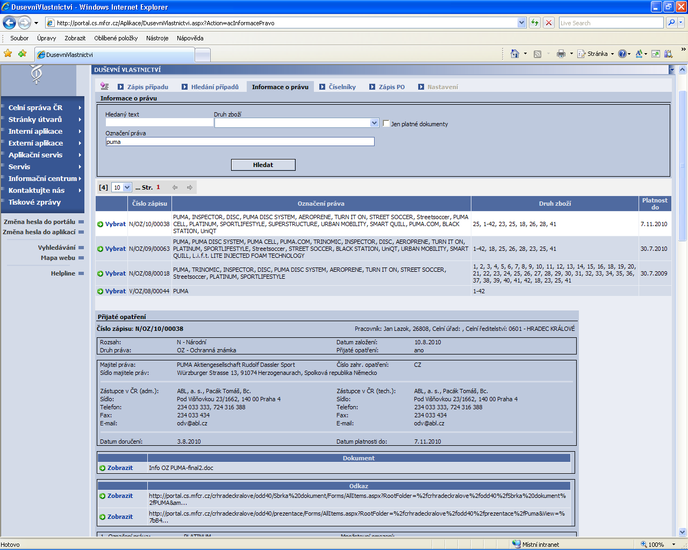
IPR Customs database – applications for action section

Slide 12
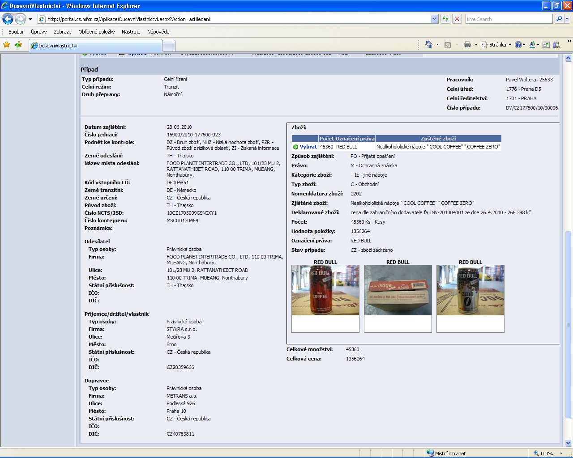
IPR Customs database – seizure section

Slide 13
Thank you for your kind attention!

