Slide 1
Can regulation keep up? Navigating the evolving regulatory landscape

Slide 2
State of the Federal Law
    The Blueprint for an AI Bill of Rights was issued by The White House Office of Science and Technology Policy (OSTP) in October 2022. It is non-regulatory and non-binding.
      It was intended to “help guide the design, use, and deployment of automated systems to protect the American Public.”
    The Artificial Intelligence Risk Management Framework (RMF) 1.0 was published by The National Institute of Standards and Technology (NIST) in January 2023.
      It was designed to help organizations of all sizes and across different sectors manage AI risks and promote trustworthy and responsible AI development and use.
    President Biden issued the Executive Order the Safe, Secure, and Trustworthy Development and Use of Artificial Intelligence on October 30, 2023.
      It requires certain federal agencies including the Departments of Commerce (through NIST), Energy, and Homeland Security to develop guidelines and standards for AI safety and security. It requires AI system developers to report their safety test results to the U.S. government if such results show that AI could pose a risk to national security.

Slide 3
State of the Federal Law
    The Federal Intelligence Risk Management Act was introduced in the Senate on November 2, 2023.
      If enacted, the bill would require federal agencies and vendors to follow the AI Risk Management Framework put forth by NIST.
    The AI Foundation Model Transparency Act of 2023 was introduced Dec. 22, 2023 by Reps. Anna Eshoo (D-CA) and Don Beyer (D-VA). It would direct the Federal Trade Commission (FTC) to work with NIST to establish rules for reporting training data transparency.
    The American Data Protection and Privacy Act (ADPPA) was introduced on June 21, 2022.
      The act regulates how organizations can keep and use consumer data.
      If enacted, the bill would require companies to conduct algorithmic impact assessments and submit those assessments to the Federal Trade Commission (FTC).

Slide 4
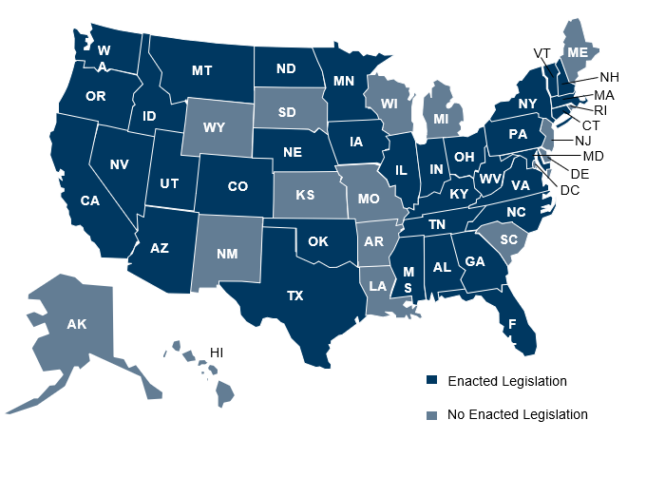
State-by-State AI Legislation Snapshot

Slide 5
The Role of Copyrights in Generative AI
  Copyrights
    The Copyright Act affords copyright protection to “original works of authorship.”
    The U.S. Copyright Office has recognized copyright only in works “created by a human being.”
  Risks
    Copyright Infringement
      Use of copyrighted materials to train AI Models might not be considered fair use, thereby infringing upon the copyright rights of the author of such materials
      Using AI to create content may run the risk of infringing another party’s copyright
        Example: DALL-E generates Super Mario Bros. image in response to an Italian cartoon
    Lack of copyright ownership in AI-generated content
      Works created by generative AI likely do not receive copyright protection, which means others can copy AI-generated work and use it for their benefit

