Slide 1
Training the Machines – Bytes, Rights and the Copyright Conundrum
Does litigation really solve everything – A UK perspective
13 March 2024 | Xuyang Zhu

Slide 2
GenAI and IP infringement – open questions
Trained model
Is the model once trained an infringing copy/ infringing article? (Relevant to whether models trained outside the UK can be provided into the UK)
Generated outputs
Who is liable for any infringement – the user, AI developer or both?
Remedies
Can an injunction prevent use of an existing model, or only prevent further use of works in training or use of infringing outputs?
Training process
Can copyright exceptions apply in relation to copies made while obtaining training works and during the training process? (E.g. temporary copying; no general commercial TDM exception in the UK)
How does the usual legal test for infringement apply to GenAI fact scenarios?
Do any defences apply?

Slide 3
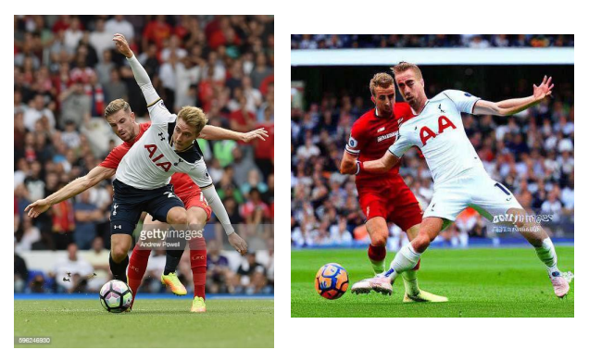
Getty v Stability AI – Getty's claims
Getty claiming copyright, database rights and trade mark infringement in the English High Court
Claims relate to
Use of images and captions in development and training of Stable Diffusion
Images generated by Stable Diffusion
Stable Diffusion itself being an infringing article, such that importing and dealing with the model in the UK is a secondary infringement
Seeking broad injunctions against the Stable Diffusion model

Slide 4
Getty v Stability AI – select defences
Trained model
Stable Diffusion is not a "copy" of any Getty works
Generated outputs
Any infringing outputs would be generated by the user, not Stability
Remedies
Injunctive relief claimed is excessively broad, unnecessary and disproportionate
Training process
No development and training in the UK so no infringement of UK copyright
Outputs are created from random noise without reproducing Getty image
Outputs including elements of Getty works amount to pastiche
Secondary infringement provisions relating to infringing articles only apply to tangible articles, not intangible information
(BUT in context of secondary infringement claim, Stability AI's position is that the making of Stable Diffusion in the UK would not have infringed copyright)
There is no communication to the public on the facts

Slide 5
Does litigation solve everything?
Trained model
Is the model once trained an infringing copy/ infringing article? (Relevant to whether models trained outside the UK can be provided into the UK)
Generated outputs
Who is liable for any infringement – the user, AI developer or both?
Remedies
Can an injunction prevent use of an existing model, or only prevent further use of works in training or use of infringing outputs?
Training process
Can copyright exceptions apply in relation to copies made while obtaining training works and during the training process? (E.g. temporary copying; no general commercial TDM exception in the UK)
How does the usual legal test for infringement apply to GenAI fact scenarios?
Do any defences apply?

